Slide 1

Home Learning
Monday 4th January 2021

Slide 2
Happy New Year, Year 6
Today we will be:
SPAG- Spelling- revising ‘ough’ words
English- Starting our new unit of work on Newspapers
Collective Worship- Feast of the Epiphany
Maths- Times Tables, revision of Area and finding the area of triangles.
Art- Observational drawing.

Slide 3
SPAG- ‘Ough’
Read this section of text and work out how many different ways we say the letter ‘ough’
I take it you already know Of tough and bough and cough and dough? Others may stumble, but not you, On hiccough, thorough, lough and through?

Slide 4
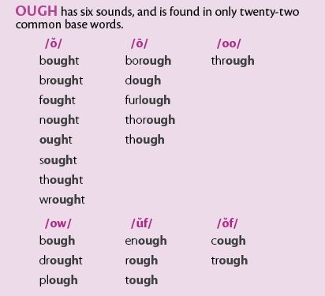
Practice time.
Task 1- Practice reading these>>>>>>>>
Task 2- Play this game to check your spellings.
(You do not need to send me these)

Slide 5
English- Newspapers.
How do we spread news and what is the purpose of a newspaper?
Task- Make a spider diagram to show why we have newspapers (online and in paper form) e.g.
Why I think we have newspapers…

Slide 6
All newspapers try to discuss the five ‘W’ questions that a news report tries to answer.
Who
What
When
Where
Why?

Slide 7
Task time…
Read these two articles…
https://www.bbc.co.uk/newsround/38518527
https://www.bbc.co.uk/news/uk-northern-ireland-55498775 (first half only)
Then for each of the articles work out the Who? What? Why? When? Where? That they talk about. You could set this out as a poster, as a grid or be creative!

Slide 8
Collective worship: Feast of the Epiphany
Read these two (Click the links)
Matthew 2: 1-12 The Wise Men visit Jesus
Isaiah 60: 1-6 Kings shall visit you.
THINK: What gift might you bring to Jesus today? Write it down and bring it back to school with you, on our return.
GO FORTH: After visiting Jesus, the Wise Men went home a different way. They changed direction. What changes will you make in your life today? On seesaw (ideally) write your own New Years resolution and find images from google to decorate it. I can then share this with the rest of the class (or keep it a secret if you wish)

Slide 9
Maths- Times tables!
Maths fitness (Like we do in class). If you have a smart device pick a number from 1-6, if not roll a dice or just guess!
1- 12 sit ups
2- 12 Press ups
3- 12 Lunges
4- 12 Dips
5- 30 second plank
6- Choose your own.
Select a times tables and practice the same times tables 3 times (or more if you wish). If you want to share a video on Seesaw then go for it! (You don’t have too!)

Slide 10
Area- What can you remember?
Clue- Length x Width= Area or L x W = A

Slide 11
Practice these
You can send me this on Seesaw if you wish/ if you need help!

Slide 12
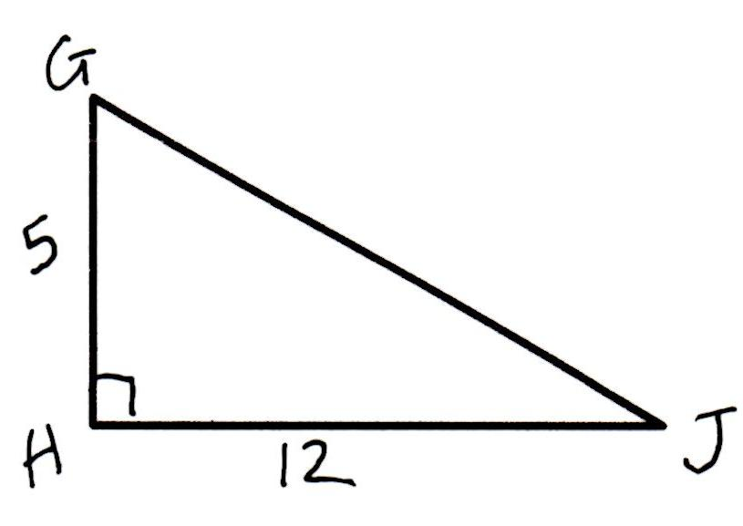
Finding the area of a right-Angled triangle…
Simple!
Rectangle = L x W = A
Triangle is just L x W then divide it by 2 = Area!
Here- would be 5 x 12= 60cm divided by 2= 30cm!

Slide 13
Your turn!- I have sent you this on seesaw to make it easier to edit! I will reveal the answers later!
If you get stuck visit:
https://garyhall.org.uk/Ultimate-KS2-Maths-SATs-Organiser-Y5-6-1.pdf

Slide 14
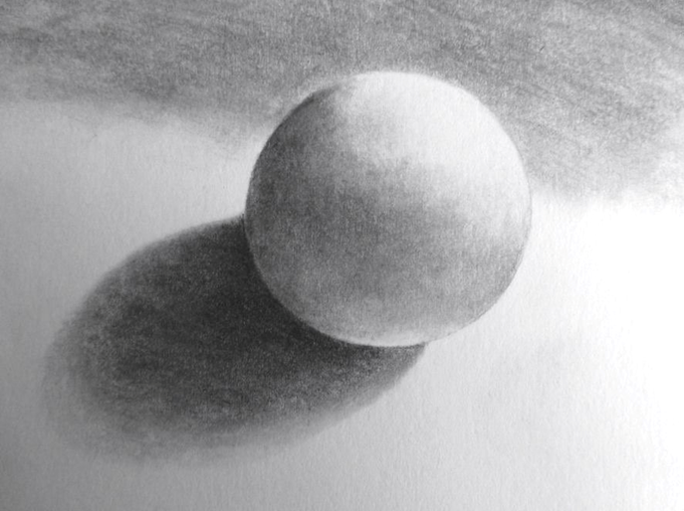
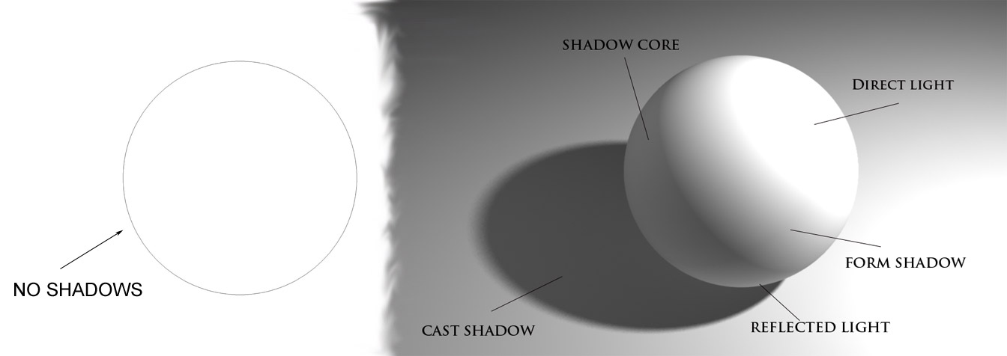
Art- Observational Drawing
Task-
Find any circular/round/ cylindrical objects from around your house e.g. small ball, water bottle, football, etc
Try to sketch 3 of these. Remember to use your pencil like a feather. Be gentle, long pencil strokes and shade them in in pencil. If you feel brave, then try to shade in coloured pencil but not felt tips!
This lesson we would have started our new learning around observational drawing. Your arts skills have improved hugely since September to keep up the good work!

