Slide 1
Design and Technology
You will need your parents permission and supervision during this lesson.

Slide 2
Remind yourself of the correct techniques to use when working in the kitchen.

Slide 3
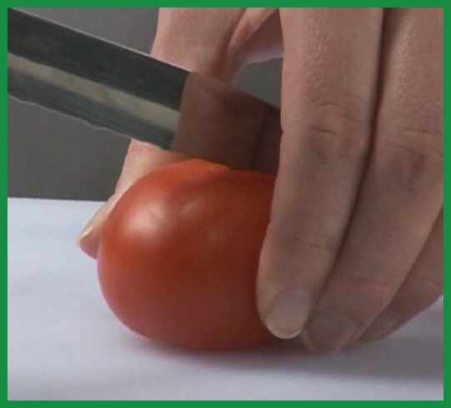
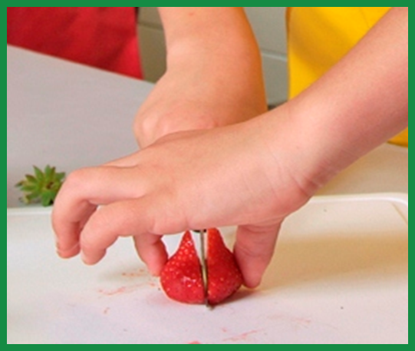
The Bridge hold
Method: Create a bridge over the food with your hand. The fingers should be on one side and the thumb should be on the other. Hold the food to be cut between the fingers and thumb creating a bridge. The knife should go through the bridge to cut the food.
Safety: This method ensures that fingers are out of the way as the knife cuts through the food.
Tips: To help children remember this method, they might like to think of the knife as a train which goes under the bridge and through the tunnel.
Use: This method is useful in lots of situations. It is especially useful for cutting circular items into halves and quarters, e.g. tomatoes, apples.

Slide 4
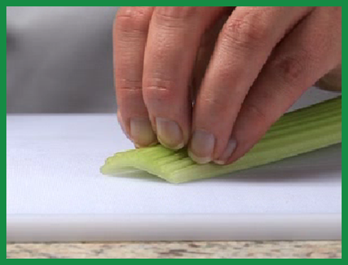
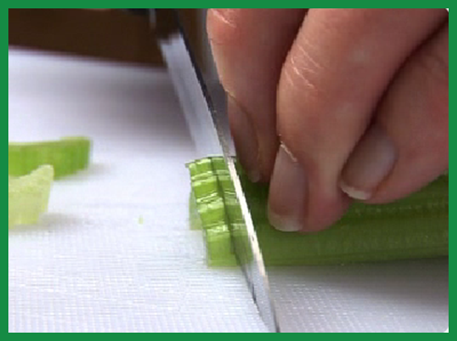
The Claw Grip
Method: Create a claw by partly curling your fingers together into a claw shape. Press the tips of your fingers (nails) against the food to be gripped and then lean your fingers slightly forward of your nails so that you can’t see your nails when you look down on your hand.
Safety: This method ensures that finger tips are tucked out of the way and will not get caught by the knife.
Tips: To help children remember this method emphasises creating a claw, gripping food and tipping the hand – claw, grip, tip, cut.
Use: This method is used to secure items so they can be cut safely. It is the best method to use when food needs to be cut into slices or diced.

Slide 5
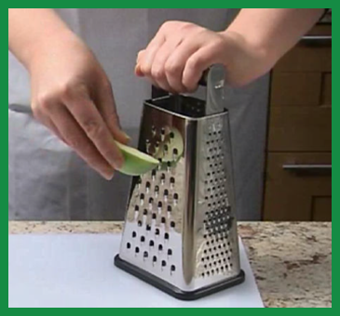
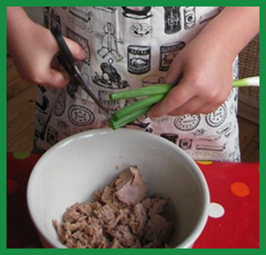
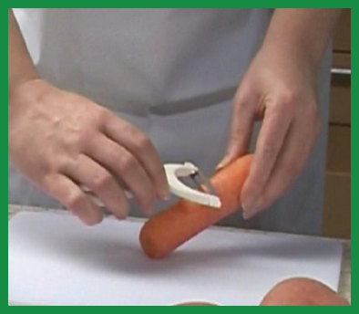
Grating – remember, you do not have to grate every bit of the food. It is best to leave a small chunk at the end to hang on to. This means that fingers are not pressed against the grater.
Kitchen scissors can sometimes be a useful alternative to a knife, especially if children are quite young. Scissors are good for snipping herbs and spring onions – even pepper slices!
Teach children to peel away from themselves while using a peeler. With long foods such as carrots they should hold one end and peel from the middle away from themselves and then hold the peeled end and repeat the same process

Slide 6
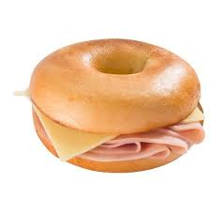
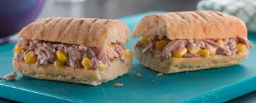
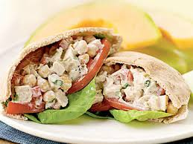
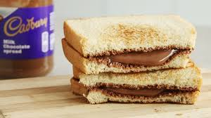
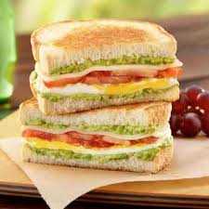
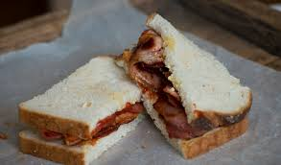

Slide 7
Can you remember the names of the different types of food groups and why it is important to eat a varied and balanced diet?

Slide 8
Name three types of food from each food group.

Slide 9
Last week you designed a sandwich for a specific purpose.

Slide 13
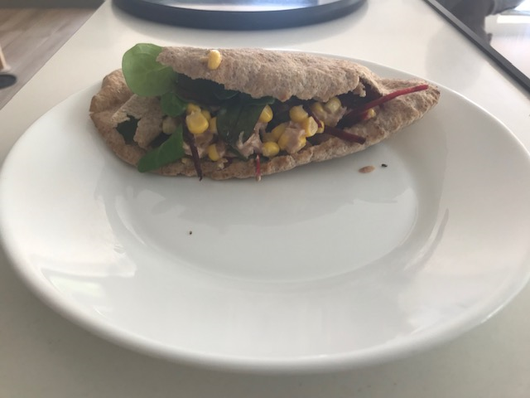
This is the sandwich that I made. It is on a brown pitta bread, has a tuna and sweetcorn filling, salad leaves, cucumber, tomato and a little salad cream. Do you think my sandwich is healthy? By the way it was really delicious!

Slide 14
Can you post me a picture of your healthy sandwich on dojo?

