Slide 1
Week beginning 27th April
This is your Maths work for this week. There are:
- 3 pieces of early bird work
3 pieces of Maths work
In addition to this, keep on with your Joe Wicks PE, learning your times tables and spelling work too.

Slide 2
This week, post at least two pieces of your work onto Class Dojo
For great work posted, there will be dojos given out!

Slide 3
Morning Work
Early Bird Time!

Slide 4
Early bird work 27.4.2020 Finish these sequences:
1. 22, 26, 30, __, __, | 6. -2, -4, -6, __, __,
2. 55, 44, 33, __, __, | 7. 20, 40, 60, __, __,
3. -1, -2, -3, __, __, | 8. 20, 10, 0, __, __,
4. 10, 5, 0, __, __, | 9. 101, 106, 111, __, __,
5. 6, 12, 18, __, __, | 10. 200, 195, 190, __, __,

Slide 5
Early Bird Work 28.4.2020
Multiplying by 10 and 100
Work these out
1. 33 x 10 = | 6. 33 x 100 =
2. 45 x 10 = | 7. 45 x 100 =
3. 27 x 10 = | 8. 27 x 100 =
4. 55 x 10 = | 9. 55 x 100 =
5. 491 x 10 = | 10. 491 x 100 =

Slide 6
Early Bird Work 29.4.2020
Dividing by 10
Find the answer to these:
1. 30 divided by 10 = | 6. 100 divided by 10 =
2. 40 divided by 10 = | 7. 300 divided by 10 =
3. 70 divided by 10 = | 8. 3000 divided by 10 =
4. 90 divided by 10 = | 9. 550 divided by 10 =
5. 10 divided by 10 = | 10. 380 divided by 10 =

Slide 7
Maths lesson 1

Slide 8
Warm up
8 x 3 = 8 x 4 =
8 x 12 = 8 x 8 =
8 x 1 = 8 x 9 =
8 x 7 = 8 x 6 =
8 x 5 = 8 x 11 =
8 x 10 = 8 x 2 =

Slide 9
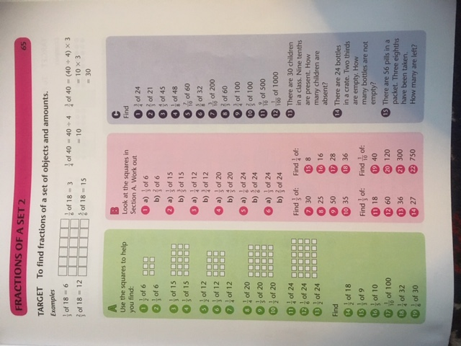
Complete section A and B.
Section C is a challenge!
Method:
To work out ¾ of 20 = ____
Step 1 - work out ¼ of 20 = 5
(This is the same as doing 20 ÷ 4)
Step 2 – Multiply the 5 by 3 = 15
…so ¾ of 20 = 15 !

Slide 10
Now try these!

Slide 11
If you have time...
Try a times tables game on this website.
https://www.topmarks.co.uk/maths-games/7-11-years/times-tables

Slide 12
Maths lesson 2

Slide 13
Warm up
1. 40 ÷ 8 = _____ 2. 24 ÷ 8 = _____ 3. 16 ÷ 8 = _____ 4. 88 ÷ 8 = _____ 5. 24 ÷ 8 = _____ 6. 64 ÷ 8 = _____
7. 56 ÷ 8 = _____ 8. 8 ÷ 8 = _____
9. 72 ÷ 8 = _____ 10. 32 ÷ 8 = _____ 11. 48 ÷ 8 = _____ 12. 96 ÷ 8 = _____

Slide 14
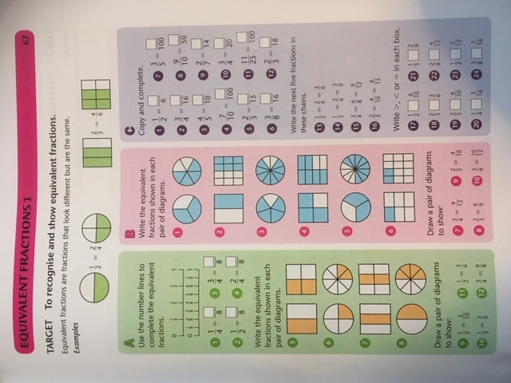
Complete section A and B.
Section C is a challenge!

Slide 15
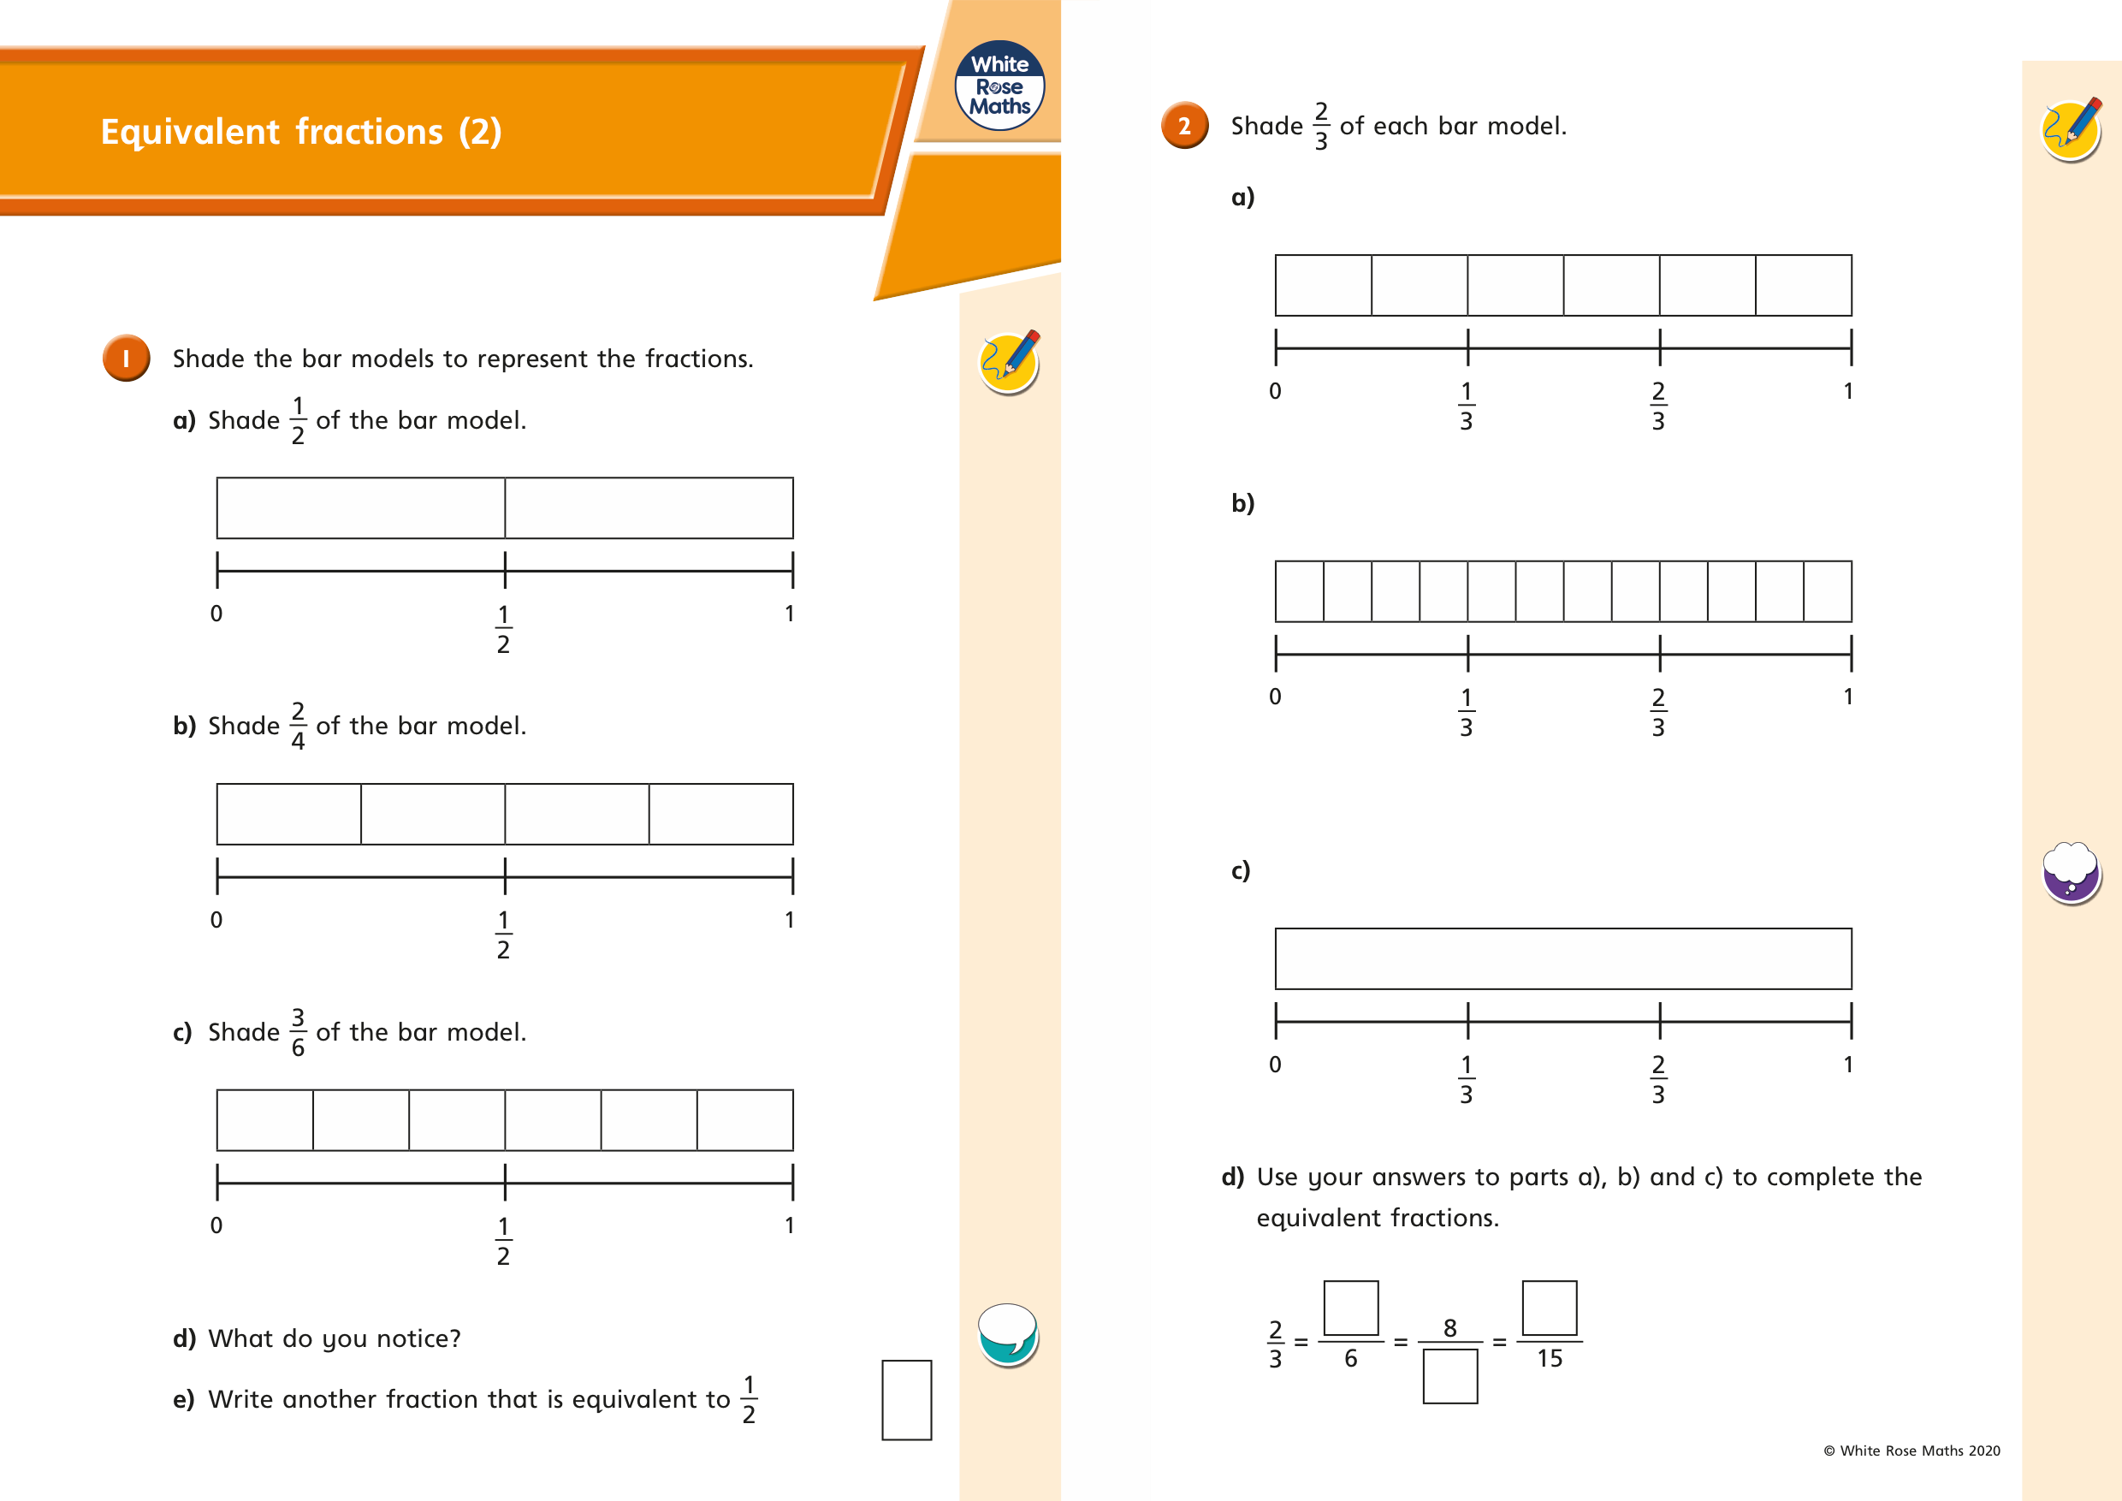

Slide 16
If you have time...
Try a times tables game on this website.
https://www.topmarks.co.uk/maths-games/7-11-years/times-tables

Slide 17
Maths lesson 3

Slide 18
Warm up
1. 1 x 4 =
2. 4 x 4 =
3. 6 x 4 =
4. 5 x 4 =
5. 2 x 4 =
6. 7 x 4 =
7. 3 x 4 =
8. 0 x 4 =
9. 9 x 4 =
10. 8 x 4 =
11. 11 x 4 =
12. 12 x 4 =

Slide 19
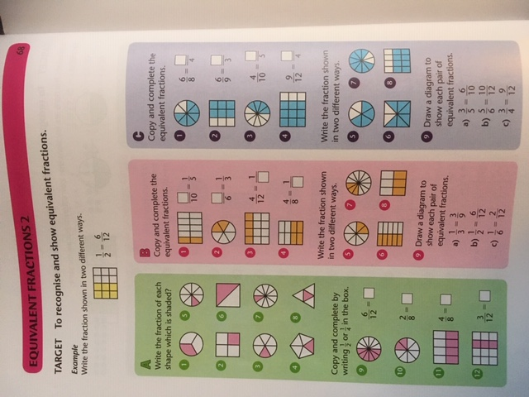
Complete section A and B.
Section C is a challenge!

Slide 20
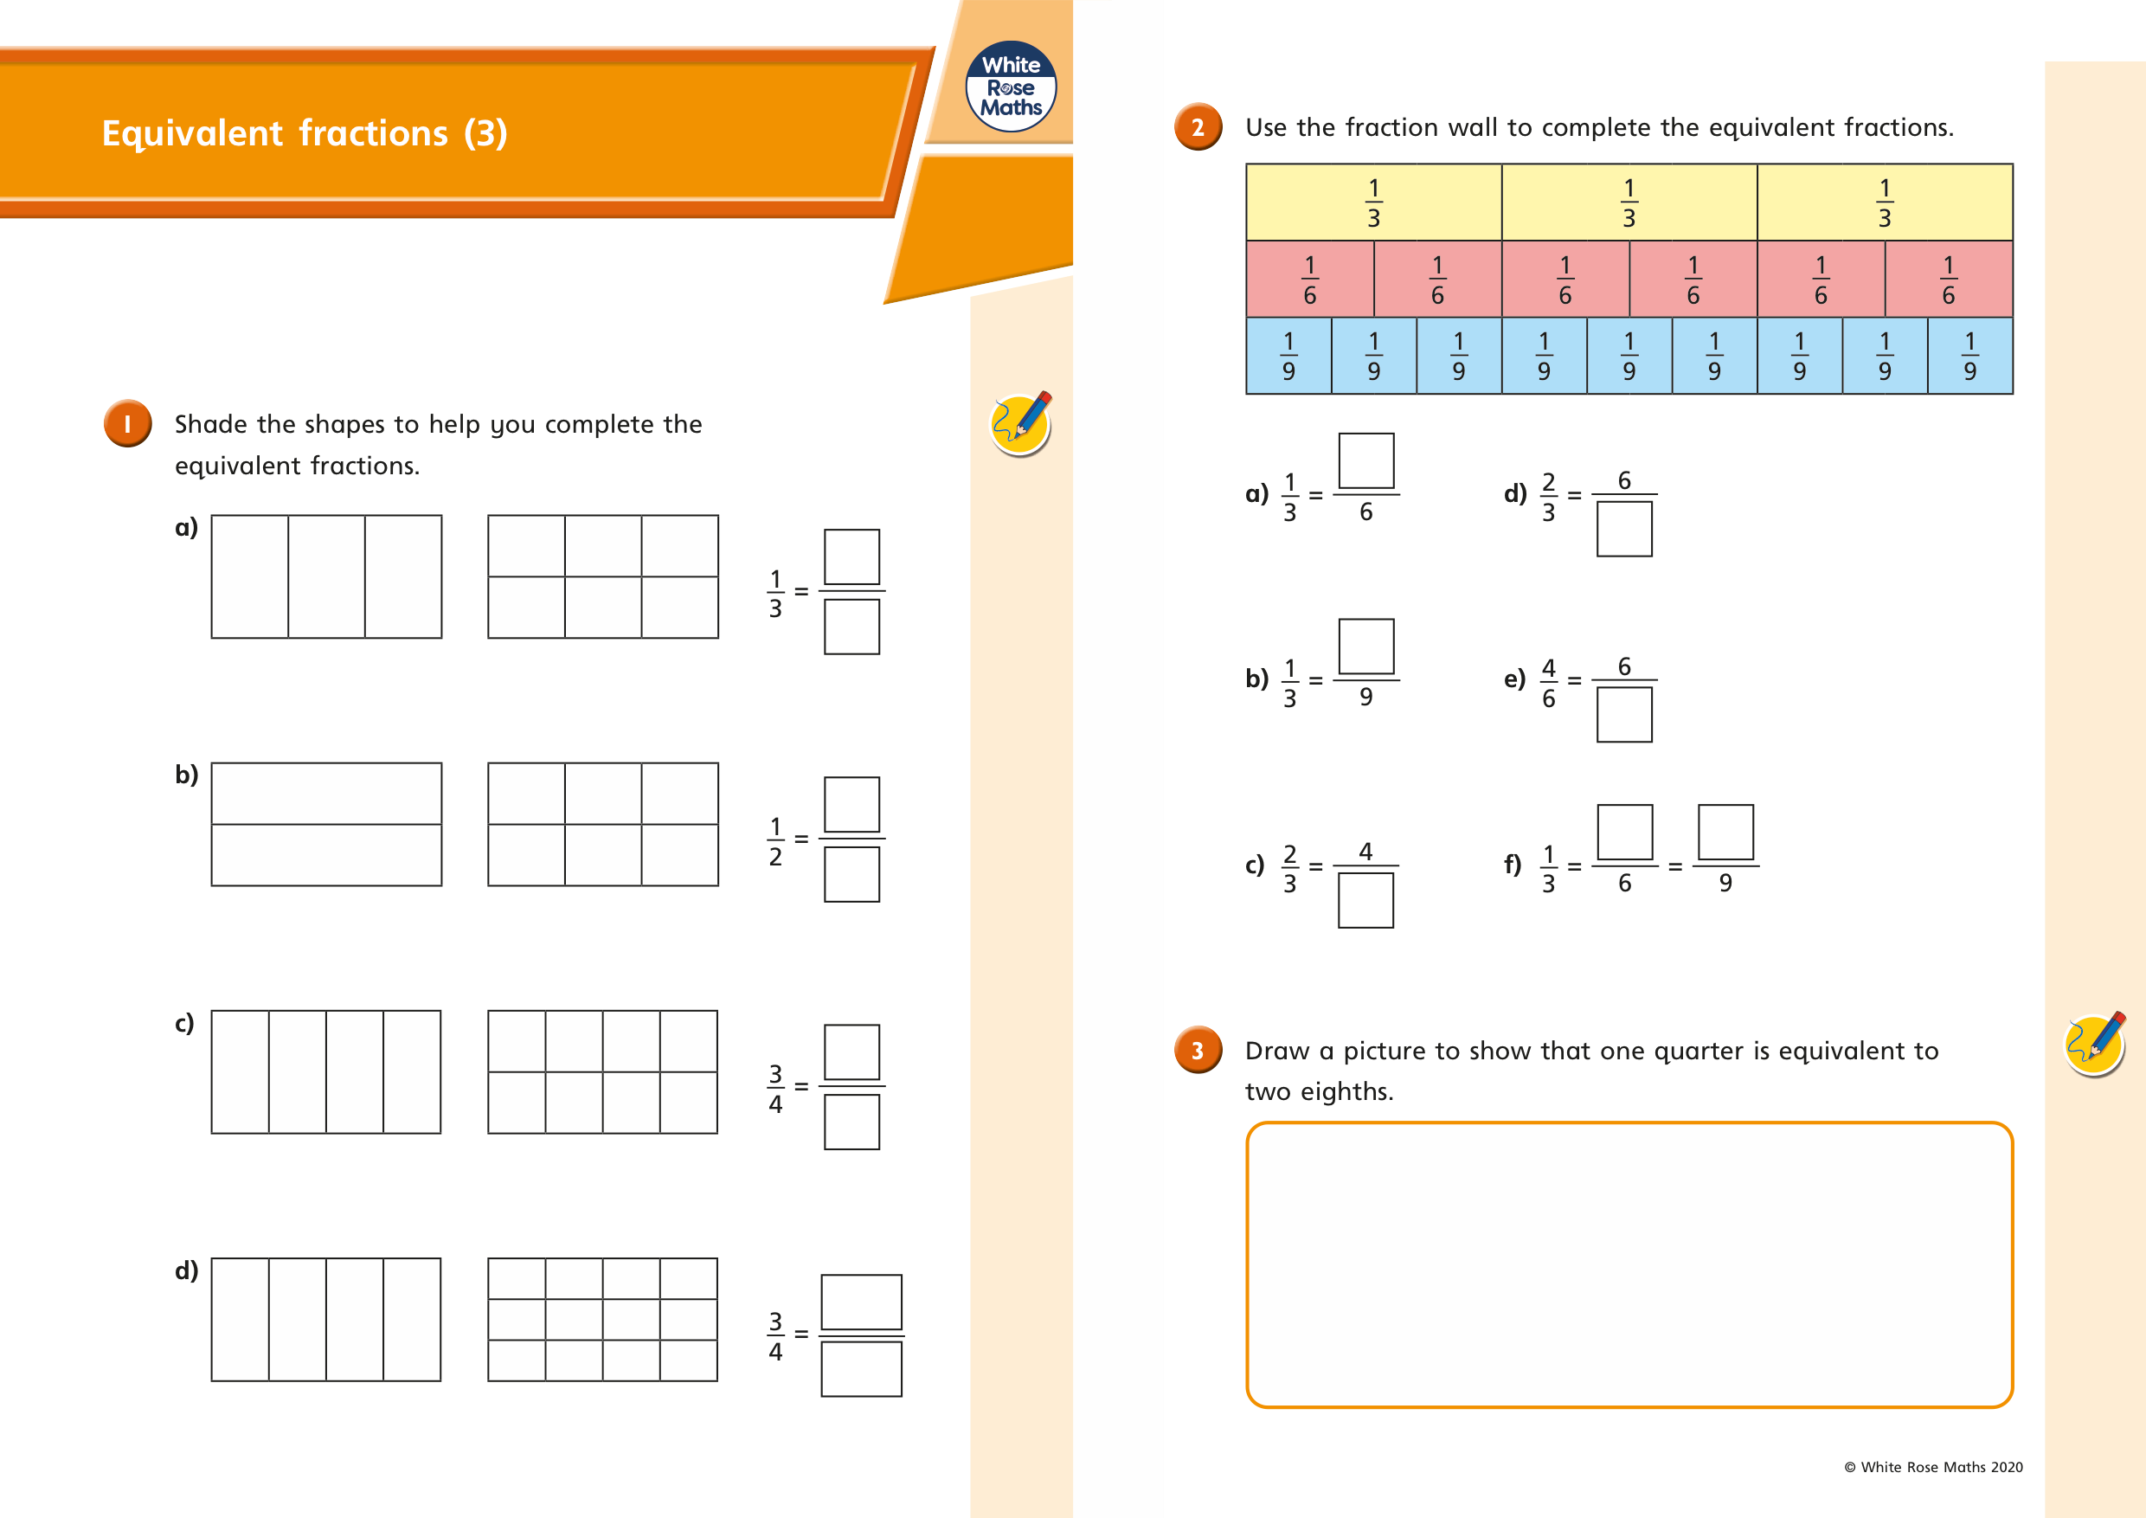

Slide 21
If you have time...
Try a times tables game on this website.
https://www.topmarks.co.uk/maths-games/7-11-years/times-tables

