Slide 1
English Lessons
15.6.2020
This powerpoint includes:
3 warm up activities
3 English lessons

Slide 2
English Lesson 1

Slide 3
Our New Class Read:
Ice Palace
By Robert Swindells

Slide 4
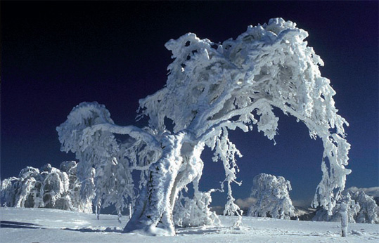
The book we’re going to study this half-term is set in a land where the intense cold is a matter of life and death.

Slide 5
The book is written for 7 to 9 year olds.
. . . it is really quite sinister.
A young boy cheats death several times thoughout the story.
Much of the story takes place in a landscape like this one.

Slide 6
Warm Up Activity Similes Similes are sentences where something is described as being like something else. Task: Write 4 similes to describe this landscape. E.g. The snow was as soft and fluffy as a pile of feathers. E.g. The trees stood straight and tall like soldiers.

Slide 7
Chapter One - story introduction
Turn your face into the East wind, and if you could see forever, you would see Ivan’s land. It is a land where summer is short and pale like a snowdrop; winter long and cold like an icicle. Ivan does not live there now for he grew old long ago, and is gone. But the people of the pine-woods remember him. They remember him all of the time, but most of all they remember him in winter because they are not afraid of winter any more. They have no need to be afraid, because of something Ivan did when he was very small.

Slide 8
Main Task 1: Answer these questions
What are we told about Ivan’s land in this opening paragraph?
The writer uses two similes in this paragraph. Which one do you think is most effective, and why?
How does the writer show us that Ivan’s story has already happened, and is being described afterwards?
The writer suggests that Ivan did something special. What do you think this might be?
The writer uses one word three times, close together, in this paragraph. What is the word, and why do you think the writer has repeated it?
NOW LET’S READ ON...

Slide 9
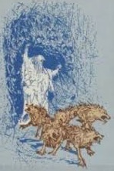
Ivan and his brother lived in the house of their father the blacksmith, in a village in the shadow of the great, dark forest. The people of the village were poor, but in the summertime they were mostly happy, so that the pale, warm air rang with their laughter and their singing as they worked.
But as the short summers gave way to autumn their songs became sad songs, and their laughter thin. For they knew that far away to the north, Starjik was greasing the runners of his sled and rounding up his wolves. Starjik! Whisper his name and it was winter in your heart.

Slide 10
Information:
This is a dog sled. It is used in cold parts of the world as a form of transportation. In the story, Starjik doesn’t use dogs to pull the sled, he uses wolves!
NOW LET’S READ ON...

Slide 11
Hissing over crisp white snow in the black of night came Starjik behind his hungry team. Their eyes were yellow and their fangs were white. When Starjik was in a village the people lay very still behind their shutters but always, in the morning, a child was gone. For Starjik was known in every pine-woods village as the child-taker, and those he took were never seen again.

Slide 12
One night when an icy wind whined through the black trees, and powdery snow sifted under everybody’s doors, Starjik came to Ivan’s house, and when Ivan awoke in the morning his little brother was gone.
All the village wept for the blacksmith and his wife, and for little Ivan who must now play alone. And little Ivan walked in Starjik’s sled-tracks to the end of the village and stood there a long time, gazing into the north.

Slide 13
That evening, at suppertime, while his mother and father were not looking, Ivan took some of the dark bread from the wooden board on the table, and slipped it into his pocket. Then he said,
“Mother, I am very tired. I will go to sleep now.” His mother lighted a candle for him and he carried the lottle flame into his room.
For a long time he sat on his bed, listening to the small noises his parents made beyond the door of his room, and to the wind outside. The wind made a sad, lonely sound, and as he listened it seemed to Ivan that something was crying out there in the night; something small and frightened that touched his window and moved away along the wall. And he lifted a corner of the window-curtain and pressed his face to the cold glass and whispered,
“Wait, little brother. I will not leave you. I am coming.” His breath made a cloud on the glass, and there was only the wind. He let the curtain fall, blew put the candle, and climbed into bed without taking off his clothes.

Slide 14
Main Task 2: Answer these questions ….
Who is Ivan?
Where does he live?
What sort of person is Ivan?
Where is the story set?
Why does the village not like winter?
Who is Starjik?
What do you predict will happen next?
Why do you think the story is called; Ice Palace?

Slide 15
English Lesson 2

Slide 16
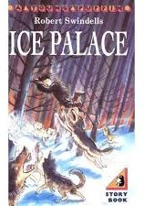
Warm Up
Read the next section of the story.
As you read it, look out for evidence for how Ivan or his parents are feeling.
Find at least 6 words or phrases.

Slide 17
Ice Palace by Robert Swindells
After a while, the door of his room was opened quietly and Ivan pretended to be sleeping while his mother smoothed his quilt, kissed him and went out, closing the door behind her. Soon after that the unhappy couple went to their room and the house was still.
Ivan slipped out of bed and pulled on his boots. Then he took his fur parker and moved quietly to the door. Moments later he was across the warm, dark kitchen and out into the freezing wind.
Next morning the people were awakened by a terrible cry from the blacksmith’s house. The blacksmith’s wife had crept early into Ivan’s room and found his bed empty. All that day the people stood about the village in groups, talking, but nobody had heard Starjik come again, and nobody could remember having known anyone as unlucky as the blacksmith and his wife.

Slide 18
Ice Palace by Robert Swindells
And far away, through the forest and over the hill walked Ivan. He wore his fur parker, and between his teeth he held a squirrel tail, for if he had not, the wind would have frozen his breath into a mask of ice on his face.
Ivan was afraid. He was more afraid than he had ever been, for nobody had ever seen Starjik’s land, and lived to return home. His head was bowed and he cried a little as he went along, and his tears became pips of ice before they touched the snow.

Slide 19
Ice Palace by Robert Swindells
He was afraid, and sometimes he almost turned around, to follow his footprints back to his father’s house. But then he would see in his mind a picture of his brother, holding out his arms and crying, in a place that was cold beyond imagining. And then Ivan would brush away his tears and go on.
On and on he went, and when it began to grow dark he found a snowdrift and tunnelled into it as his father had taught him. Outside, the screaming wind drove blizzards of snow across the darkness, but Ivan slept safe and warm in his shelter. When morning came he dug himself out, ate a little food from his pocket and looked all around. His footprints were gone and the wind had shifted the snowdrifts into a new pattern so that he could not tell which way he had come. He sighed, turned his face into the wind, and walked on.

Slide 20
Ice Palace by Robert Swindells
The snow was deeper now, and Ivan’s feet sank far beneath its surface with every step. He began to feel tired, and to wonder if he would ever see his home again. He was thinking longingly about his chair by the big, hot stove, when there came a sound that felt like an icicle in his heart. It was the long, thin cry a hungry wolf makes when it scents its prey. The cry was answered by another, and soon the pinewoods echoed with the howls of the hunting pack.
Ivan tried to go faster but the snow sucked at his boots, making him stumble. He looked back, sobbing. His footprints wound away between the trees, and somewhere back there, he knew, the wolves were running in his tracks with their noses down to smell him out.

Slide 21
Ice Palace by Robert Swindells
A tree: he must find a tree to climb. Wolves can outrun any living thing but they cannot climb trees. He stumbled on, looking wildly around him, but the trees just here were all pines with smooth icy trunks. The wolf-cries drew nearer. He looked back. Dim shapes moved in the dark beneath the trees. He plunged forward, gasping. They had seen him now. A few seconds more and they would be upon him. He glanced all about and ploughed through the snow, the wolves at his heels. He leapt; his hands closed around the lowest branch and he swung his legs clear of the ground as the first wolf lunged in a fluffy of snow.
Painfully, Ivan hauled himself up into the ice-lacquered branches and sat, gazing down. The wolves milled, snarling, around the foot of the tree. Their slavering jaws were upturned and their breath rose in plumes around him. Now and then a wolf would leap, its jaws snapping within inches of his feet.

Slide 22
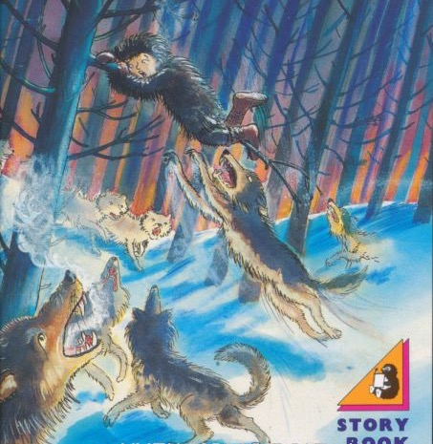
These are the ones I found:
Warm Up Answers:
Did you find any words or phrases to describe how they are feeling?
the unhappy couple
a terrible cry from the blacksmith’s house
Ivan was afraid… more afraid than he had ever been
he cried a little as he went along
He was afraid, and sometimes he almost turned around
He sighed,
He began to feel tired
He looked back, sobbing.
looking wildly around him

Slide 23
Main Task:
Look back at the story so far. Search for effective words and phrases in the text that describe the characters and the setting.
Look for how they are feeling and what things look like
Characters | Setting

Slide 24
English Lesson 3

Slide 25
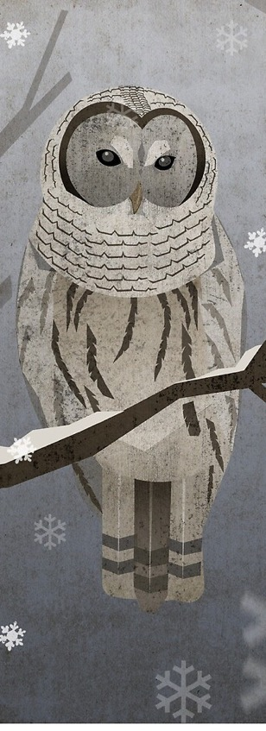
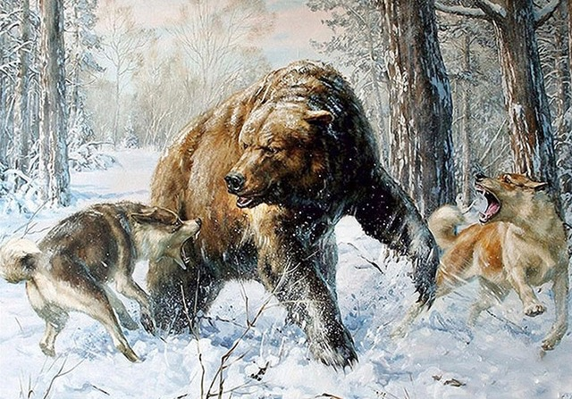
Warm Up Task:
In today’s part of the story, there is a bear, a snowy owl and some wolves.
Think of words or phrases to describe how each animal moves or the sound it makes. You could use a simile.
Examples:
The owl flew as silent as the wind through the forest.
The wolves leapt and snapped their slavering jaws just inches from his feet.

Slide 26
Can you remember the speech punctuation rules?
Today’s task:
To practise writing speech using the correct speech punctuation.
First: We will read the next part of the story.
During the story, look at how the author has used speech puncuation.

Slide 27
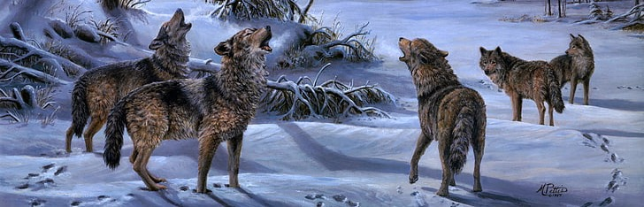
Soon Ivan began to feel cold. The wind whipped through the bare branches and his dangling legs became numb. Soon he knew the frost would be in his fingers. It would spread through his hands until they could no longer grip, and he would fall into that whirling mass of fur and fangs.
“Go away!” he cried. “Oh go away and find someone else to kill!” But the wolves gazed at him with their cruel eyes and their jaws seemed to grin. “They know,” sobbed Ivan. “They know that I am freezing. They’re waiting for me to fall.”
He clung desperately to his perch. The cold began to seep through his hands. He cried softly, and his tears froze on his cheeks. “Farewell little brother,” he whispered. “I can never save you now.” His eyes felt heavy, and his head sank slowly until his chin rested on his chest. He was going to sleep.

Slide 28
The cold was going away. He smiled a little. He had only to let go now, and he could sleep and sleep until the end of the world…
A startled yelp roused him. He shook his head and looked down. The wolves were scattering in all directions and in their midst, rearing on its hind legs, was a huge bear. Its terrible claws hissed through the air and the wolves fell back, snapping. The bear lunged at them and they turned tail, slipping away between the frozen trees.
Ivan cried out joyfully, then gaped with horror. Bears kill people. And bears can climb! He pulled up his feet, trying to move higher. The bear dropped onto all its four feet and stood a moment, snarling into the forest. Then, with only an upward glance at the boy, it loped off, melting soon among the shadows of the pines.
Stiffly, Ivan climbed down. He peered fearfully all around but the wolves were gone, and there was no sign of the bear.

Slide 29
All that day, little Ivan walked on. Now and then he would break off a little of the bread in his pocket and chew it as he walked. And when it began to grow dark he found another snowdrift and made a cave inside it. He ate more of the bread and snuggled down to sleep.
At midnight he awoke, and it seemed to him that he had heard a voice. He listened. Outside, the wind was howling. After a moment he closed his eyes again.
“It must have been the wind,” he said to himself. “Only the wind.” But no sooner had he closed his eyes then he seemed to hear the voice again. He got up, knelt by the hole, and stuck his head out. The cold made him gasp. Ivan screwed up his eyes and peered into the darkness. There was nothing. Only the tossing of the pines and clouds of windblown snow. Then, just as he was about to draw his head back inside, he thought he saw a movement under the trees.

Slide 30
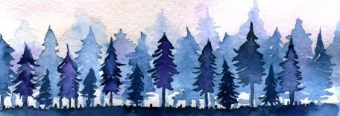
A small figure flitting across a paler patch between the shadows. Ivan cried out, clambering from the snowdrift. The figure; it seemed impossible, but from here it had looked like – “Little brother!” he cried. “Wait!”
He was stumbling through deep snow. As he drew near, the small figure seemed to move back, so that he was always the same distance away from it. “Wait!” he cried again, “Oh don’t run away. It is Ivan, come to take you home.” But the figure was only a smudge now; a shadow in the shadows, and as he watched it faded and was gone. And he heard laughter in the wind and whirled around, but no-one was there.
The cold was like knives in his feet and he looked down at himself through his tears. “My boots!” he gasped. “I left them in the snowdrift, and my mittens too.” He turned. “I must go back at once or I will die!” He knew now that the figure in the trees had been Starjik’s cruel trick, and that the laughter in the wind had been Starjik’s laughter. But when he looked around, he could not tell which way he had come.

Slide 31

He ran, fist this way, then that; stumbling in the snow but no way seemed to be the right way. The voice laughed more loudly in the wind.
Ivan stopped. He was lost, and knew that very soon he would fall into a sleep from which he would never awaken. He closed his eyes and was about to sink down on the snow when he heard a shrill scream. He jerked his head around and saw a white shape that flew soundlessly between the trees. As he watched, it settled on a branch and stared at him with great yellow eyes. “Go away snowy owl,” he whispered. “Go away and find a mouse to eat. I am no use to you. I am no use to anyone.”
The owl leapt from its perch with a scream, circled his head on velvet wings, and made off through the forest. After a moment it came back and flew round his head again. “Perhaps,” though Ivan, “it wants me to follow it.” He was becoming very weary, but when the great white bird flew away again he followed. In a few moments, he saw the snowdrift in which he had made his shelter. He fell to his knees by the entrance and crawled inside with the last of his strength. The snowy owl circled the snowdrift once and was gone.

Slide 32
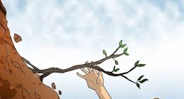
When dawn came, Ivan wrapped himself up in his warm clothing and set out again. There was only a little bread left now in his pocket and he knew he must save it, for he still had far to go.
The wind was strong and the snow was deep, and Ivan went very slowly, with his head down. All at once he felt the snow shift, and he cried out. Beneath his feet, a great crack opened up, and lumps of snow as big as houses fell into it with a hissing roar. He flung himself forward, trying to reach the other side. His mittens grabbed at the lip of the crack but it crumbled and he was falling. Desperately he clutched at a tiny fir tree that grew outward from the side of the crack. It was so small that he knew it would never hold him; his weight would pull it out by the root and he would fall, down, down with the tumbling snow blocks to be buried forever in the bottom of the crack.

Slide 33
Reflection/Discussion: What do you think is going to happen next?

Slide 34
Task: Correct the sentences below. Where should the speech punctuation go?
My boots! he gasped. I left them in the snowdrift, and my mittens too. He turned. I must go back at once or I will die!
Go away! he cried. Oh go away and find someone else to kill!
They know, sobbed Ivan. They know that I am freezing. They’re waiting for me to fall.
He cried softly, and his tears froze on his cheeks. Farewell little brother, he whispered. I can never save you now.
Go away snowy owl he whispered. Go away and find a mouse to eat. I am no use to you. I am no use to anyone.

Slide 35
Answers: Where should the speech punctuation go?
“My boots!” he gasped. “I left them in the snowdrift, and my mittens too.” He turned. “I must go back at once or I will die!”
“Go away!” he cried. “Oh go away and find someone else to kill!”
“They know,” sobbed Ivan. “They know that I am freezing. They’re waiting for me to fall.”
He cried softly, and his tears froze on his cheeks. “Farewell little brother,” he whispered. “I can never save you now.”
“Go away snowy owl,” he whispered. “Go away and find a mouse to eat. I am no use to you. I am no use to anyone.”

Slide 36
Don’t forget to post pictures of your work on Class Dojo!

