Slide 1
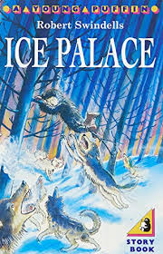
English Lessons
Monday 22nd June
This powerpoint includes:
3 warm up activities
3 lessons about the story: Ice Palace

Slide 2
Ice Palace
Can you remember what has happened so far in the story?
The story so far...
Ivan lived in a village with his father, the blacksmith. At night, his brother was kidnapped by Starjik on his sledge pulled by wolves. Ivan packed his bag, and sneaked off into the winter forest to rescue him. He was chased by wolves and climbed a tree. A bear chased the wolves away. It was very cold, so Ivan slept in a snow cave. Ivan became lost, but was helped by a snowy owl. Suddenly, he fell down a hole, but grabbed a branch...

Slide 3
English Lesson 1

Slide 4
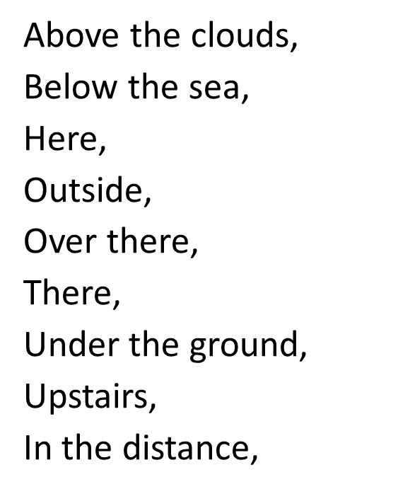
Warm up task:
To read the next part of the story and spot the prepositions for where.
Examples
Between the …,
Everywhere he looked,
Around the outside,
Back in the village,
Nearby,
Down the road,
Behind the tree,
In the wooden box,
Over the top of the …,
On the snow,…
Beyond the trees,
Somewhere near by,
Far away,
Next to …,
Wherever he went,
North of the tree,
Along the…
Beside the…
Inside the…
Close to…
From far away,…
At the far end of the…,

Slide 5
Desperately he clutched at a tiny fir tree that grew outward from the side of the crack. It was so small that he knew it would never hold him; his weight would pull it out by the root and he would fall, down, down with the tumbling snow blocks to be buried forever in the bottom of the crack.
But the little fir tree held. It jerked him to a stop, and held. Dangling over the deep drop, he watched an avalanche of snow hurtle down into the dark depths.
Afterwards, he could never tell how long he hung there. He only knew that at last the avalanche stopped, and he scrambled his way somehow out of that ghastly crack.
On the snow, he lay down and sobbed with fright at the horrible fate he had escaped. Then, wearily, he got to his feet and brushed the snow from his clothes with his mittened hands. His heart was heavy, and if it had not been for the crack that now blocked the way, he might have given up and returned to his distant home. As it was he sighed, turned his face into the north wind, and went on.

Slide 6
Presently it began to grow dark.
“I must find another snowdrift,” said Ivan to himself. He sighed. Long ago, when his father had taught him to make a snow-den, it had been fun. Now it just seemed like hard work. “Snow-dens are quite warm,” he thought, “but they are not like my little bed at home.” The sky was a deep grey, turning black, when Ivan found his snowdrift. He fell to his knees and began to scrape out a tunnel with his mittened hands.
After a moment he stopped, his head tilted to one side. From far away, carried on the wind, he thought he heard music. He listened. The pine trees creaked and sighed, and snow-powder hissed over the snowy crust. Then he heard it again. It was the sound of a fiddle. Ivan screwed up his eyes and shook his head fiercely. No! It was not real. It could not be real. It was another cruel trick to hurt him, to keep him from doing what he must do.

Slide 7
Crouching by the snow drift, he began once more to scrape at the snow, whistling a little between his teeth to blot out the sound of the fiddle. But when he stopped, there it was, rising and falling in the wind. He got to his feet and gazed towards the sound, biting his lip. Beyond the pines, there was a faint glow in the sky. And now he was sure there were voices too, mixed in with the fiddle. He looked down at his unfinished den, then out again towards the glow. It seemed real; all of it. The fiddle, the voices and the glow. In his mind, he saw a picture of people; happy people who laughed and shouted and danced to a fiddle, and suddenly he was overcome with loneliness. He left the snowdrift and began hurrying through the trees, his eyes fixed on that warm, hypnotic glow.
He came out of the trees on to a long slope and there below him lay a village. In the windows, lamplight glowed warmly and spilled out of open doorways onto a crowded street.

Slide 8
Everyone in the village seemed to be out of doors and when Ivan looked down the street he could see why. At the far end of the street, someone had built an enormous fire. Its flames rose high in the air and the snow all around was pink with its glow.
And the music! It wafted in great clouds up the slope and Ivan had never heard such music. He was weary but he wanted to dance. He was far from his home yet he felt like shouting. Towards him, their laughter spangling the night, came children; a long ribbon of children hand-in-hand, running up the hill. When they drew near they stopped, and their leader smiled, holding out his hand to Ivan.
“Come,” he said. “Tonight is a feast, and you are welcome here.” And though it was winter, and though the night was a cold one, these children had on summer clothes, and all the girls wore flowers in their hair.

Slide 9
In the village below, the fiddles began a fresh tune. The line of children stirred, restlessly, like a string of spirited ponies. The boy beckoned, his smile inviting.
“Come,” he said once more. “Come and dance.” And stepping forward, Ivan slipped off a mitten and gave his hand. At once they went whirling away, across the slopes and down; down to where the people danced through pools of lamplight on the snow. Ivan, skipping, threw back his head and laughed. The line had reversed itself so that now the last child had become the first and was leading them onto the street.
On the streets of the village, the line began to thread itself like a many coloured serpent to and fro between the houses. The music grew louder.
Around the corner of a house, Ivan soon saw that they were close to the great fire.

Slide 10
Which prepositions for where did you find?
On the snow…
From far away…
In the window…
At the far end of the street…
In the village below…
Around the corner of the house…
On the streets of the village…
Did you spot these ones?

Slide 11
Main task: Write two sentences about each of the next slides using a where preposition. Underline all of the prepositions for where that you use.
Example:
The wolves sped towards the fleeing reindeer. Their paws left deep prints on the crisp white snow.

Slide 12
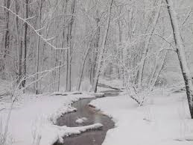

Slide 13
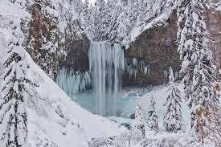

Slide 17
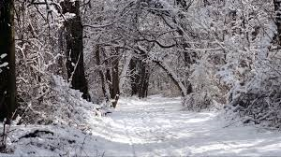

Slide 18
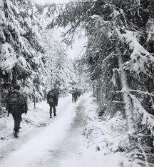

Slide 20
English Lesson 2

Slide 21
Warm Up Activity - Adjectives
Task: Rewrite these sentences.
Make them more exciting by replacing the boring adjective with a better one.
In the forest stood a big tree.
The river ran down the big mountain.
A nice fish splashed its tail in the water.
A small spider spun a web.
A nice looking flower grew at the edge of the lake.

Slide 22
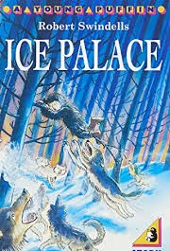
Task: Read the next part of the story.

Slide 23
The music grew louder, and as he came round a corner of a house, he saw lots of villagers close to the great fire. In the flames, an ox was roasting and nearby, on upturned barrels, sat the fiddlers. Their bows flashed back and forth across the strings of their fiddles, and they tapped their feet in time upon the beaten snow.
The line of children circled, forming a ring with the fiddlers in the middle. Round and round they whirled, the firelight dancing in their eyes. Then the circle broke, and the child who had led them was thrust into the centre. The tune changed, and she danced a special dance for them while they went round and round. When her dance was finished the girl re-joined the circle, the next child was pushed forward and the tune changed again. Ivan watched through tears of joy. The cold was gone, and the loneliness. What would be the tune, when his turn came, and what steps would he dance?

Slide 24
Round, and round, and round. The people of the village had stopped their dancing now, and were crowding forward to watch the children. And as they watched, they clapped their hands to the fast, clever rhythm.
The boy beside Ivan grinned, winked at him, and leapt into the centre. The child whose dance was done took Ivan’s hand. The circle never stopped spinning.
“My dance next!” cried Ivan. ”A few more moments, and I will show you dancing!”
They whirled on; Ivan gasped as a volley of wind whipped about his legs, unimaginably cold. It scooped up a twist of crystals and spun them about his body. In an instant he was blinded as the stinging powder lashed his eyes. He tore his hands from those of his friends and fell to the ground clawing at his face.

Slide 25
The crystals turned to water and he blinked them from his eyes. He had broken the circle; he must get up and take his place or the dance would be spoiled. Already the fiddlers had stopped playing…
He scrambled to his knees and cried out in pain and disbelief. The fire was gone. There was no ring of children, nor any mark upon the snow where they had been. There were no villagers. The houses lay cold and broken along the empty street. Snow sifted through saggingdoors and the wind moaned in sightless windows, stirring here and there a rag of ancient curtain.
He knelt there in the snow and wept for the pretty phantoms of the dance; his tears becoming ice upon his cheek. And when at last the crying stopped, so that he could see again, he saw before him a great black hole in the place where the fiddlers hd been. A well: a deep, deep well with smooth sides and black, icy water far down in the bottom of it. And he knew that if his turn had come to dance, then that black water would have closed forever over his head.

Slide 26
He got to his feet, shuddering; backing away from the well. Was it possible? They had been so beautiful; they had befriended him and made him one of them. Would they have led him to the brink of the well? Would they have let him fall? He stood there; forlorn in the broken village. The wind blew round him and there was laughter in it, and he knew.
He turned and ran, along the silent street that had no footprint on it but his own. Past the last house and out on to the moon-washed slope. His feet sank into the snow and his lungs were bursting, but he did not stop until he topped the slope and plunged deep among the black pines. There he found a snowdrift, burrowed into it, and cried softly till sleep came.
He set out the next morning, weary and sad. He felt even more lonely than before. It seemed to him that he had no friend in the world. There was only enemies out here in the wilderness. His bread was almost gone. There was one piece left but he dared not eat it, for he did not know how much further he had to go.

Slide 27
He had not walked far when, turning to look back, he saw something moving, far away between the snow-laden trees. At first it looked like a whirl of snow crystals whipped by the wind, but as it came closer he saw that it was an old woman in a grey sparkling shawl which flapped about her as she came. He waited. The old woman came slowly, bending down now and then to pick something from the snow. When she came near she straightened up, gazing at Ivan. Strands of her hair whipped across her face like sleet, but she was smiling.
Ivan took off his mitten, put it in his pocket and pulled out a crust of bread. He held it out to her.
“Old woman,” he said, “it is cold, and you must be very far from your home. Share my bread. It will warm you a little, perhaps.”
The old woman shook her head.
“You are kind,” she said gently, “but I do not need your bread.”
Ivan did not understand.

Slide 28
“Old woman,” he said, “what did you do when it was night and the wind howled like a hungry wolf?”
The old woman smiled. “You are a good boy to care about an old woman like me. But I am not an old woman always. Sometimes I am an icicle, or a bear, or a spruce tree. Sometimes I am a twist of windblown snow, colder than the night.” Her eyes twinkled at him. “One night,” she said, “I was a snowy-owl.”
Ivan stared, remembering how he had been lost and freezing in the night.
“Were you,” he said, “the owl who showed me the way? And the bear who drove off the wolves? And the little fir tree in the crack?”
The old woman smiled. “It may well be so, “ she said, “for lovers find small miracles, no matter what men say, and no-one ever loved better than you love your brother.”
“How do you know of this?” cried Ivan, “and what do you pick from the snow?”

Slide 29
The old woman held out her hand to him. Pips of ice lay like diamonds in her palm.
“These are the tears that you cried for your brother,” she said. “I have followed you, gathering them from the snow because you will need them soon.”
Ivan frowned. “What would I do with tears?” he said. “Why will I need them soon?”
“To soften Starjik’s heart,” replied the old woman. “Here, take them.” and she tipped the icy pips into Ivan’s hand.
Ivan gazed at them. “I do not understand,” he said. “What am I to do with these tears?”
The woman became grave. “At the moment of your greatest danger,” she said, “you must fling the tears into Starjik’s face and say: “Brothers never more shall part, melt the winter in his heart.”
Ivan said the words softly to himself so that he would remember, and the old woman nodded.
“That is right,” she said. “And now go, for I can help you no more.”

Slide 30
Task: Answer these questions
What kind of food was roasting on the fire?
What did the fiddlers sit on?
What went into Ivan’s eyes?
Were the dancing children ever there? What happened to them?
What terrible thing almost happened to Ivan?
Where did he go to sleep?
What was the old lady wearing?
Why do you think he offered the old lady some bread?
How had the old lady helped Ivan in the past?
How do you know that the old lady is magical?
Why did the old lady give Ivan his frozen tears?

Slide 31
Lesson 3

Slide 32
Warm Up - Verbs
Rewrite the sentences and replace the verbs with more interesting ones.
The wolves ran across the field.
”Where is our son?” said the blacksmith’s wife.
The bear walked into the clearing.
The snowy path went through the wood.
”I’m so tired and scared,” said Ivan.

Slide 33
Task: Read the next part of the story.

Slide 34
The woman became grave. “At the moment of your greatest danger,” she said, “you must fling the tears into Starjik’s face and say: “Brothers never more shall part, melt the winter in his heart.”
Ivan said the words softly to himself so that he would remember, and the old woman nodded.
“That is right,” she said. “And now go, for I can help you no more.”
When he had gone a little way, Ivan turned to wave farewell but there was only a little spruce-tree that quivered in the wind. He turned and walked on, and after a long time he came to a mountain. It was a hard, white mountain and as he drew near the air grew colder still. At the foot of the mountain was a great high cave with the wind booming in its mouth. Ivan shuddered, because he knew that he had come at last to Starjik’s land.
Inside the cave it was utterly black. The roar of the wind was deafening, and it was deadly cold. Ivan stopped. The darkness filled him with dread. He looked back to where the grey light spilled a little way into the entrance. He could go no further; must get outside where he could see the sky and the snow and the trees. But his brother must have passed this way.

Slide 35
Somewhere in this terrible place, his brother was waiting; waiting for Ivan to come and take him home. He set his lips in a thin, firm line and moved into the blackness, holding out his arms before him and going very slowly. The wind howled in his ears and he hear again the laughing voice in it. Something fluttered in his face. He struck at it with his hand and it slid up over his forehead and became tangled in his parka, dragging the hood from his head. At once something else hit him, flapping coldly in his hair. Ivan cried out, clawing the thing from his head. It sank needle-teeth into his finger and whirled away on the wind.
Another one, this time on his chest. He threw up his arms to protect his face.
Whatever the things were, they were all around him. He felt the small collisions, felt them cling, fluttering to his clothing. He screamed, but the wind drowned the cry. He whirled round and round, beating himself to knock them off, and for every one he brushed away there was another one to take its place.

Slide 36
He knew that it was hopeless. He put his head down, wrapped his arms around it and went through them, and after a time the collisions stopped.
For a long time Ivan moved onwards through the cold darkness. The sound of the wind began to fade and when he looked back he could no longer see the light.
As he walked he noticed that the tunnel was becoming higher and wider, and he seemed to be moving towards a lighted place. Presently he stopped, listening intently. Somewhere in front of him he heard a laugh. It was not a pleasant laugh, like the laugh of someone who is enjoying a good joke. It was a cold, flat laugh, and when it came again Ivan found himself thinking about the laughter he had heard in the wind, last night when he was lost and freezing.
As he moved on, the laughter grew louder and he could hear other sounds too; a swishing noise, and now and then a thin, high scream.

Slide 37
The tunnel, which be now was wide and very high, took a sudden turn. The sounds seemed to be coming from just beyond the turn. Ivan flattened himself against the wall, peered cautiously round, and almost cried out.
He was looking into a great, glittering cavern. The floor was blue ice and enormous icicles hung in thousands from the roof. Hard blue light glowed and flickered like cold fire and the wind from the passage moaned around the walls.
In the centre of the cavern, its back towards the boy, stood a hideous figure. It was stooped and crooked, and its white robe hung in folds from a bony frame. In one hand it gripped a thin, springy rod, of the kind which Ivan’s people used to fish for trout in the river. As Ivan watched, the figure turned, pulling on the rod and watching something that fluttered and squealed far up near the roof, among the icicles.

Slide 38
It was then that Ivan saw what the man was doing, and his heart turned cold. Fishing! The creature was fishing, but not in the water, and not for fish. He was fishing in the air, and his victim was a tiny bat that whirled and tugged frantically as the man began to wind in the thin line. But struggle as it might, the poor creature was pulled closer and closer to its monstrous captor, and soon Ivan could see a streak of blood at its mouth from the cruel hook. When the terrified creature was close enough, the man clawed it out of the air, crushed it and dropped it on to the ice, where the broken bodies of several others lay. Then he threw back his head and laughed horribly.
Ivan drew back into the passage. The man’s cruelty had sickened him, and the laughter turned his blood cold. He tried to tell himself that it didn’t matter. The man had not seen him, so he could just turn round and run away and never see the creature again.
But deep within himself he knew the name of this monster. No other man could possibly behave with such cruelty. This man was Starjik and Ivan knew that if he fell into those awful hands, he need expect no more mercy than the poor, broken bat. And somewhere not far away, this creature had his brother.

Slide 39
Task: Write a paragraph to predict what you think will happen next.
Include in your paragraph:
What happens to Ivan.
What happens to his brother.
What happens to Starjik.

