Slide 1
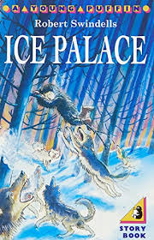
English Lessons
Monday 29th June
This powerpoint includes:
3 warm up activities
3 lessons about the story: Ice Palace

Slide 2
Ice Palace
Can you remember what has happened so far in the story?
The story so far...
Starjik steals his brother.
Ivan prepares for his journey.
Ivan sneaks off on his own.
Ivan is chased by wolves.
Ivan gets lost but is helped by an owl.
Ivan almost falls down a deep crack.
Ivan is tricked by Starjik’s vision of a village.
Ivan almost falls down a well.
Ivan is helped by an old woman.
Ivan arrives at Starjik’s cave.
Ivan fights off bats.

Slide 3
English Lesson 1

Slide 4
What are Adverbs?
Today we are going to be learning about adverbs.

Slide 5
Example Adverbs:
Adverbs often end in –ly…
…but not every time!

Slide 6
Warm Up: Adverbs
Can you spot the adverb in these sentences?
Task: Underline the adverbs in these sentences.
Ivan quickly scrambled up the tree.
Quietly, Ivan packed his bags and tiptoed out of the house.
The wolves snarled viciously while snapping at his legs that were dangling from the tree.
Silently, the owl swooped down towards a snow covered branch.
Ivan desperately clung on to the small branch and tried to pull himself back up to solid ground.
Answers on the next slide…

Slide 7
Warm Up: Adverbs – Answers!
Can you spot the adverb in these sentences?
Task: Underline the adverbs in these sentences.
Ivan quickly scrambled up the tree.
Quietly, Ivan packed his bags and tiptoed out of the house.
The wolves snarled viciously while snapping at his legs that were dangling from the tree.
Silently, the owl swooped down towards a snow covered branch.
Ivan desperately clung on to the small branch and tried to pull himself back up to solid ground.
Note:
What punctuation has been added when the sentence is started with an adverb?

Slide 8
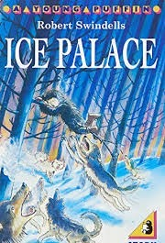
Task: Read the next part of the story. Look out for adverbs.

Slide 9
This man was Starjik and Ivan knew that if he fell into those awful hands, he need expect no more mercy than the poor, broken bat. And somewhere not far away, this creature had his brother.
The thought of his little brother in the hands of such a man filled Ivan with rage. He was so angry that his fear left him. He would fling himself on Starjik, quickly snatch the rod from his hand and beat him with it until he screamed like the bat had screamed. He clenched his fists and stepped into the open.
Instantly he froze. It was as though his arms and legs had become ice. Try as he might, he could not move.

Slide 10
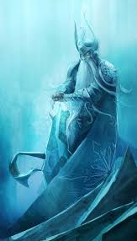
Starjik no longer fished. He sat now in the middle of the cavern, on a throne of deep blue ice, and his stare held held Ivan rigid. He moved a hand; beckoning with one grey finger. The pale eyes now seemed to draw Ivan across the icy floor until he stood trembling before the throne. Starjik stared down at him, his hands firmly gripping the arms of the chair. His grey beard was stiff with ice and his hair fell in frozen strands about his thin shoulders.

Slide 11
After a long time he spoke, and his voice was like walking on crisp snow.
“Who are you?”
Ivan stood up very straight. He hoped that Starjik could not see him trembling.
“I am Ivan,” he said. “The blacksmith is my father.”
Starjik’s lips twitched cruelly.
“Why do you come here?” he hissed. “Do you not know that all who enter Starjik’s land are dead?”
“I have come for my brother,” said Ivan.
“Your brother is dead,” replied Starjik. Ivan desperately shook his head.
“No, he is not dead, I can feel him in here,” Ivan touched his chest with a mittened hand.
“That is not possible!” snapped Starjik. “People cannot feel other people. They can only see them or hear them!” He flung out a hand.

Slide 12
“Do you see your brother here? Do you hear him?”
Ivan shook his head. “No. But he is nearby.”
Starjik gripped the arm of his throne and rose to his feet. “Very well,” he said softly. “You are right, little Ivan, your brother is close by.” He turned, beckoning. ”Come, and I will show you.”
Ivan’s heart leapt. He did not see the smile on Starjik’s lips as he turned and shuffled across the floor. Ivan followed.

Slide 13
To one side of the cavern and ice-curtain hung from roof to floor. Starjik went behind this curtain and Ivan was close on his heels. The man turned with a leer, pointing.
“Well, Ivan, here he is. Was it worth all the hardships of your journey?”
Ivan clapped a hand to his mouth, stifling a cry. He was looking at a great block of ice. It was higher than three houses and as long as the cavern. The ice was a clear as a crystal pool and inside he saw children. Many children, trapped in the solid ice.

Slide 14
Did you spot any adverbs in this part of the story?
These ones were in the story and all end in –ly.
Did you spot any adverbs that didn’t end in –ly?
Here is an adverb phrase that was used in the story. It shows how Starjik turned around.
What do you think; ‘turned with a leer.’ means?
Quickly
Instantly
Firmly
Cruelly
Desperately
Softly
Starjik turned with a leer.
Verb
Adverb phrase
Challenge: If you are not sure, use a dictionary or ask an adult!

Slide 15
Task: Add an adverb to each sentence to describe the verb. Remember, adverbs show how, where or when something happens.
Ivan crept into the cave.
Starjik grabbed a bat and ate it!
Ivan froze. He couldn’t move!
Starjik laughed as he told Ivan about his brother.
“Your brother is dead,” replied Starjik. Ivan shook his head.
Ivan cried out at the sight of his brother trapped in the ice.
Look on the next page for ideas if you get stuck.

Slide 16
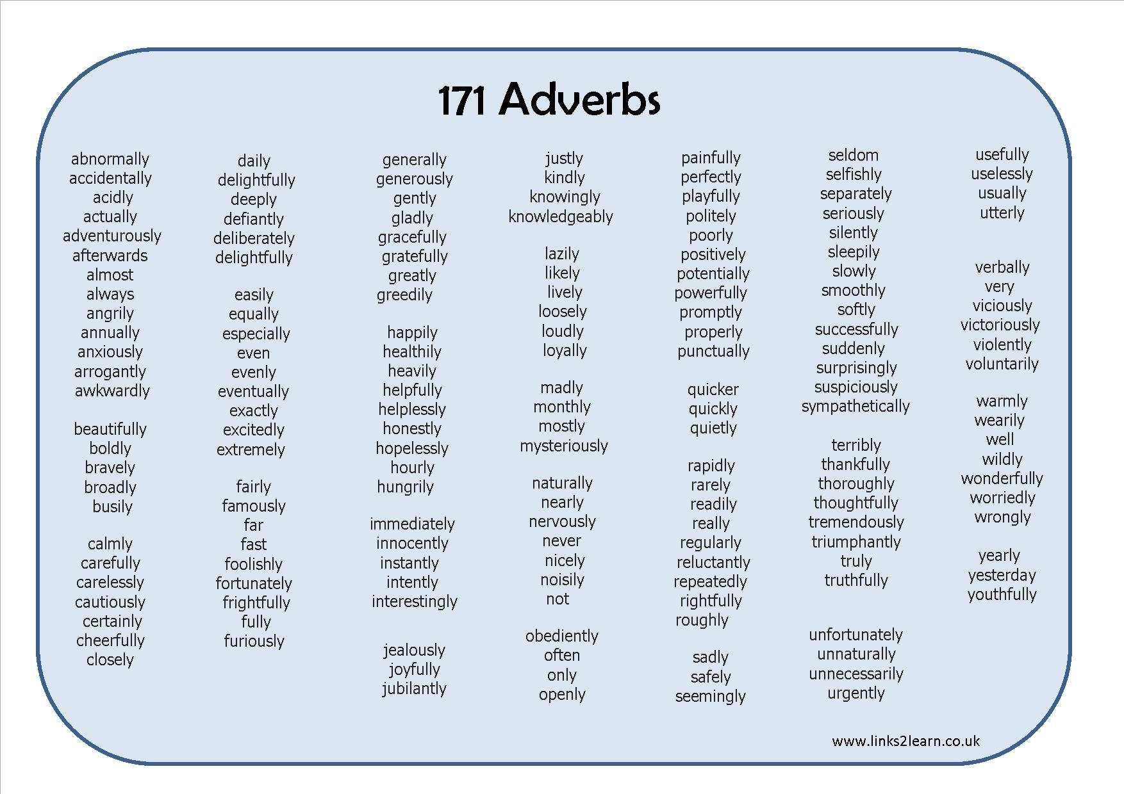

Slide 17
English Lesson 2

Slide 18
Warm Up Activity
Revision: Can you remember what these are?
Adjectives
Nouns
Verbs
Adverbs

Slide 19
Warm Up Activity
Revision: Can you remember what these are?
Adjectives
Nouns
Verbs
Adverbs

Slide 20
Warm Up Activity
Task: Put these words into the correct part of the table
Tree
Jumped
Desperately
Sad
Happily
Vicious
Shouted
Ran
cold
Quickly
Snatched
Sadly
sat
Hungrily
Icy
Adjectives | Nouns | Verbs | Adverbs

Slide 21
Task: Read the next part of the story.

Slide 22
Some looked as though they had been running, others seemed to have been skipping. Some sat and some stood. There were frozen smiles and frozen frowns, and there, right at the front, gazing out from his icy prison, was Ivan’s brother.
Starjik laughed cruelly. “Such pretty children,” he said, “and mine, for ever.”
Ivan looked into the twisted face and his eyes were filled with tears.
”But these children do not move,” he cried. “You cannot play with them or hear them laugh. You could make such children from painted wood.”

Slide 23
Starjik shook his head. “Ah no! The finest wood-carver could not do that. And besides, I take the children to punish those who sent me away.” He laughed again. “Once I was a child like these,” he said, “but the other children would not play with me. They said my heart was cold, and they sent me away.”
He turned to the ice-prison, resting his hands on it, looking in.
“Now I have friends, and every one a pretty one, for I have chosen them myself.”

Slide 24
He turned, smiling coldly down at Ivan. “You, also, are a pretty child,” he hissed. “You would not be out of place at all. They are happy, you know with me, for they have forgotten their homes. And now it is time for you to join them.” He reached up and snapped an icicle from the curtain. Ivan backed away. Starjik laughed. “It is no use, Ivan. You cannot escape. I have only to touch you with this icicle and you are mine for ever.”
Think about/Discuss…
What could happen next?
Will Ivan save his brother?
How will Ivan get out of this tricky situation?

Slide 25
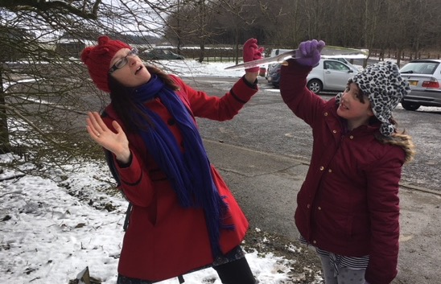
This is a picture of myself and my daughter acting out part of the story.
You could act it out too!
Think about how Ivan might feel.
How might he get out of this tricky situation?

Slide 26
Review of the story so far:
Starjik steals his brother.
Ivan prepares for his journey.
Ivan sneaks off on his own.
Ivan is chased by wolves.
Ivan gets lost but is helped by an owl.
Ivan almost falls down a deep crack.
Ivan is tricked by Starjik’s vision of a village.
Ivan almost falls down a well.
Ivan is helped by an old woman.
Ivan arrives at Starjik’s cave.
Ivan fights off bats.
Starjik shows him the frozen children.
Starjik attacks Ivan with an icicle!

Slide 27

Task: Think of two different ways this story could end. Draw a picture and write about your ideas for two possible endings to this story.
Ending 1
Ending 2

Slide 28
Lesson 3

Slide 29
Warm Up
Task: Correct the punctuation in these sentences.
1. ivan gasped when he saw the frozen children
2. starjik laughed cruelly Such pretty children he said
3. ivan looked at starjik’s twisted face and his eyes were filled with tears
4. But these children do not move he cried
5. starjik lifted an icicle above his head ready to strike at ivan
Answers on the next slide. No peeking!

Slide 30
Warm Up
Answers
1. Ivan gasped when he saw the frozen children.
2. Starjik laughed cruelly. “Such pretty children,” he said.
3. Ivan looked at Starjik’s twisted face and his eyes were filled with tears.
4. “But these children do not move,” he cried.
5. Starjik lifted an icicle above his head ready to strike at Ivan.

Slide 31
Task: Read the next part of the story.

Slide 32
He turned, smiling coldly down at Ivan. “You, also, are a pretty child,” he hissed. “You would not be out of place at all. They are happy, you know with me, for they have forgotten their homes. And now it is time for you to join them.” He reached up and snapped an icicle from the curtain. Ivan backed away. Starjik laughed. “It is no use, Ivan. You cannot escape. I have only to touch you with this icicle and you are mine for ever.”

Slide 33
Ivan felt the ice-prison at his back. He could go no further. Starjik grinned and came on, the icicle held out before him. Ivan bit his lip. The ice-point was inches from his head. As Starjik stooped for the final lunge, the boy whipped off his mitten and flung the ice-pips into the evil face. His voice echoed shrill through the cavern:
“Brothers never more shall part;
Melt the winter in his heart!”
At once there came a rumbling sound and the cavern floor quivered. Starjik staggered back with an awful cry, his hands clawing at his face.

Slide 34
Ivan was flung to the floor. Behind him, the ice-prison heaved, split, and shivered into fragments. He scrabbled at the slippery floor, trying to get up. Then something struck him on the head and he felt himself falling, falling…
After a long time Ivan opened his eyes, and cried out. Starjik was bending over him. He rolled away, trying to get up. Starjik watched him. Ivan scrambled to his feet and backed off, eyeing the old man warily. Starjik made no attempt to follow, but stood, gazing at him across the shattered ice. Then the corner of his mouth twitched, so that he seemed almost to smile. Ivan screwed up his eyes, shook his head, and looked again. Starjik was smiling. There was no cruelty now in his smile. There was something in his hand, and he held it out towards Ivan.
“Soup,” he said, “hot soup.”
Ivan took a step forward. Something grabbed at his waist and clung there, very tightly. He looked down and saw his brother’s head pressed against him.

Slide 35
All around children were awakening; rubbing their eyes and gazing about them. Starjik came closer, offering the soup. He seemed straighter now; less twisted. Ivan took the bowl and backed away, drinking the hot soup and watching Starjik through the steam.
“There are furs,” said Starjik. “In my store-room; many furs. I will fetch them.” He shuffled away through the splintered ice. Ivan gazed at him, wonderingly, passing the soup-bowl to his brother.
Starjik went several times back and forth with his shuffling gait until a heap of warm furs lay on the floor.

Slide 36
“You ought to be going,” he said. “There is no wind now and you have a long journey.’ And he began to go round from child to child, wrapping the furs about their shoulders; smiling. And when they began to move out through the passage in twos, holding hands behind Ivan, starjik led the way. There was no wind, and no fluttering things now in the quiet darkness, and they came at last to the end of the cave, where their eyes danced to see the snow-flakes falling through the pure light.

Slide 37
“You will never see me again,” said Starjik, “but I shall see you. And when winter comes again you will have reason to remember how Starjik’s heart was warmed.”
And so they left Starjik’s land, and Ivan took them home. And at every village he strode along the street crying, “Here are your children, home again from far away!” And the people cheered, and brought them food, and heaped gifts upon them, and stood waving as the line of children marched away. With each village the line became a little shorter, until at last only Ivan and his brother were left.
And so they came home. And the fear melted in the hearts of the people they were happy.

Slide 38
And when winter came again, Starjik remembered his promise. No-one heard him come, for the howling wolves were gone and his sled was pulled now by silent deer. But when the people awoke at dawn there were sled tracks in the snow, and shining gifts by all the children’s beds.

Slide 39
Think about/Discuss:
Did you enjoy this story?
Did it end the way you expected?
What would you have done in Ivan’s situation?
How did Starjik change?
What did he start to do to put things right?

Slide 40
Your task:
Create a story map of what has happened in the story.
It could look like one of these.
Or you can use the template on the next slide if you want to.

Slide 42
Now post your work onto Class Dojo

