Slide 1
Friday 27th March
Read chapter 6 of Cliffhanger and complete the task.
Complete the Maths work on place value.
Carry on learning your times tables and spellings. Practise your dis prefix words today.

Slide 2

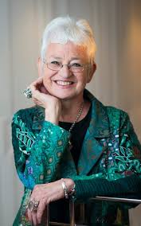
Read chapter 6 of Cliffhanger. Discuss the questions I have put on the pages.

Slide 3
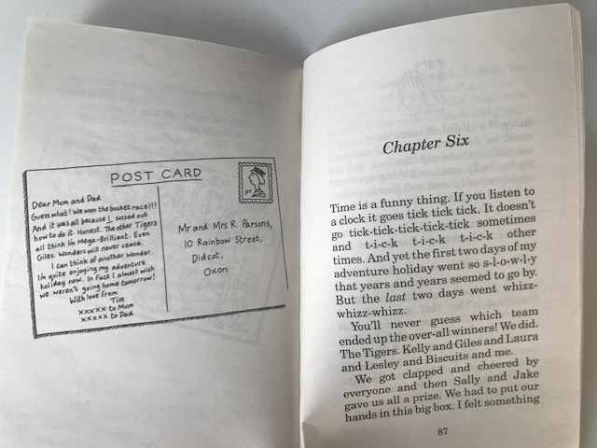

Slide 4
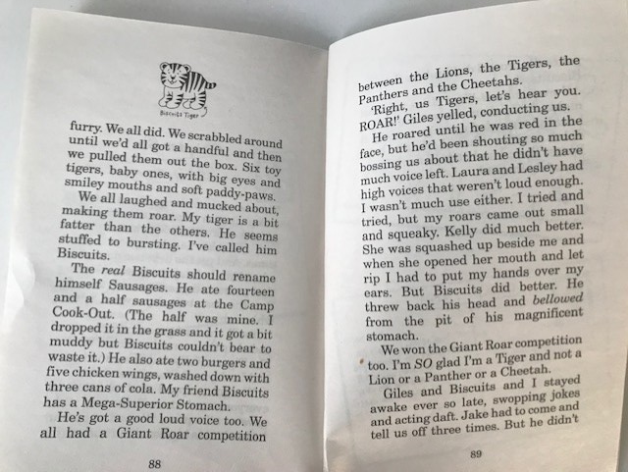

Slide 5
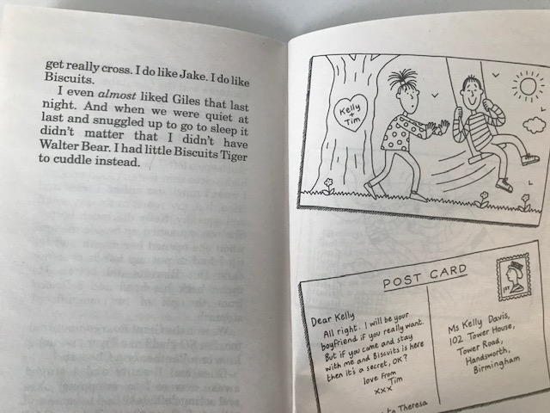

Slide 6
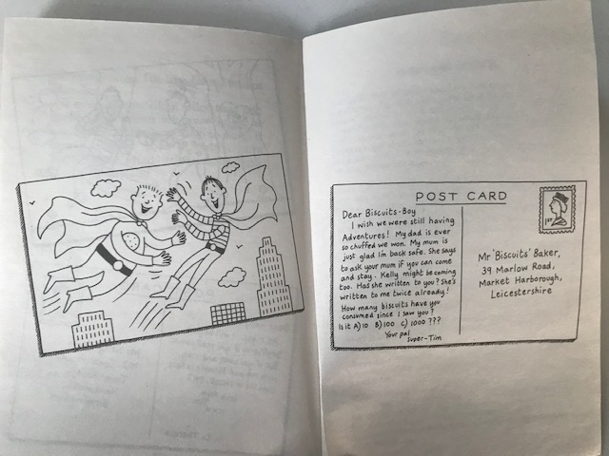

Slide 7
Cliffhanger – Chapter 6
Answer these questions in full sentences in your book.
1) Which team ended up the overall winners?
2) What did Tim call his baby tiger cub toy? Why?
3) Why didn’t Giles have much of a roar left when they were having a competition?
4) Who was good at roaring? Why?
5) Do you think Tim has changed during this holiday? How has he changed?
6) What did the boys do on their last night?
7) Do you think Tim, Biscuits and Kelly will stay friends? Why?
8) Which was your favourite part of the story?

Slide 8
Write a diary entry, as Tim, about his time at the adventure holiday. A diary contains your thoughts, feelings and experiences. You might want to do just one diary entry or a diary over a couple of days. Remember to try and use a range of sentence openers to make your writing more exciting. There is a checklist of features on the next slide.

Slide 10
Design a poster to advertise the adventure centre that Tim went to. You could make up a name for the centre and the activities that are available.

Slide 11
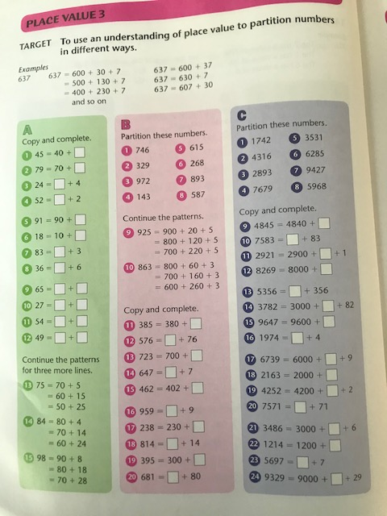
Section A and B to be completed by everyone.
Section C is a challenge
There are a few more challenges on the next few slides.

Slide 14
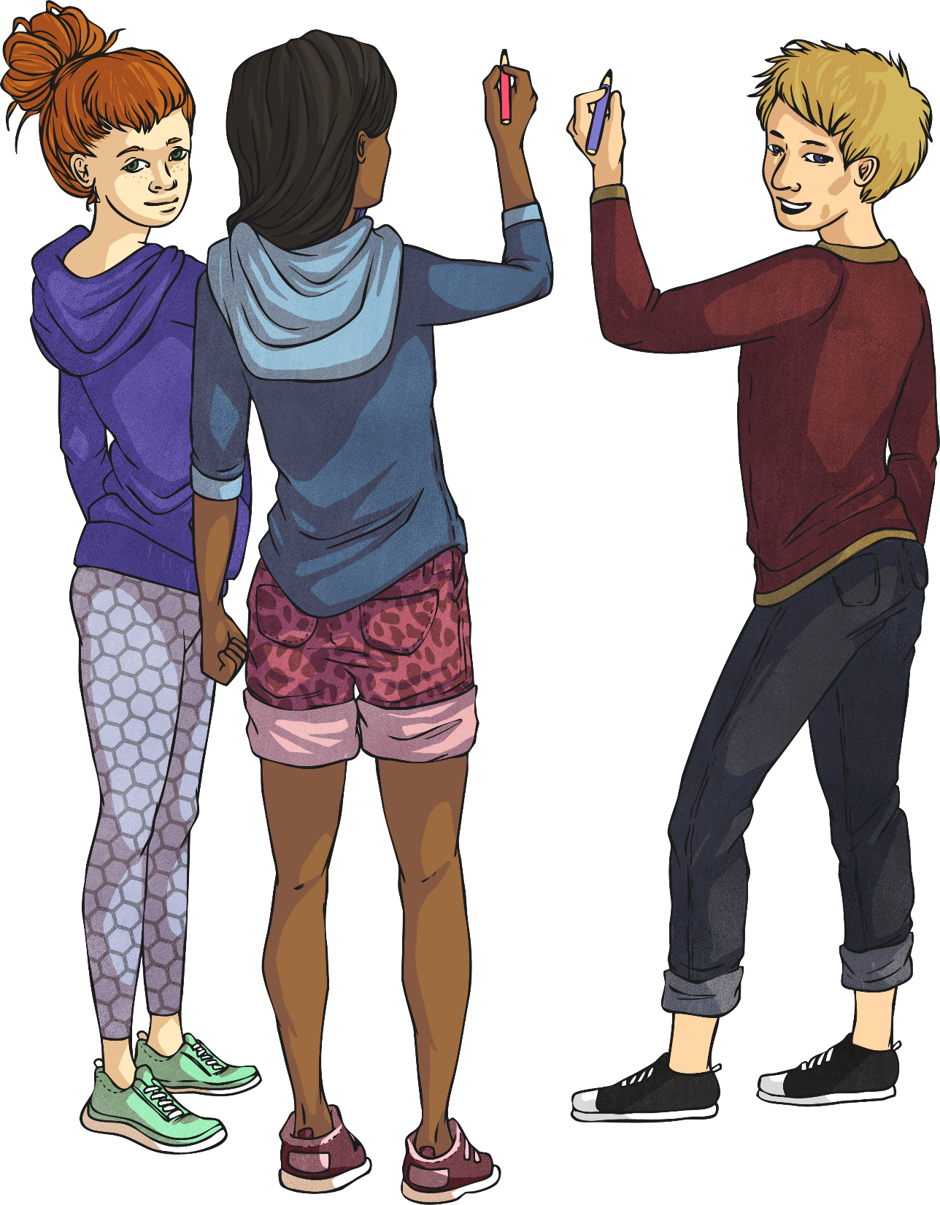
Last week, we began looking at adding a particular prefix to lots of different root words.
Can you remember
what a prefix is and where it goes?
A prefix is a letter or group of letters added at the beginning of a root word that creates a new word with a different meaning.
Which prefix were we looking at?
dis-

Slide 15
Which dis word goes in these sentences?
Most people ______________ going to the dentists.
The teacher asked the children not to _____________ her instructions.
When I washed my t-shirt, it came out all ________________.
The explorer wanted to be the first to ___________ the treasure.
The magician made the lady _____________ in one of his tricks.
The footballer was off-side so the referee had to ___________ the goal.
I ________________ every word that you say.
The lady said that the girl was ____________ because she had told a lie.
He knew his father would ___________ of his behaviour.
They decided to ____________ that style of dress.

Slide 16
Which dis word goes in these sentences?
Most people dislike going to the dentists.
The teacher asked the children not to disobey her instructions.
When I washed my t-shirt, it came out all discoloured.
The explorer wanted to be the first to discover the treasure.
The magician made the lady disappear in one of his tricks.
The footballer was off-side so the referee had to disallow the goal.
I disbelieve every word that you say.
The lady said that the girl was dishonest because she had told a lie.
He knew his father would disapprove of his behaviour.
They decided to discontinue that style of dress.

Slide 17
To have a negative opinion about something.
_ _ _ _ _ _ _ _ _ _
Disapprove

Slide 18
To find something or someone
_ _ _ _ _ _ _ _
Discover

Slide 19
To refuse or reject something
_ _ _ _ _ _ _ _
Disallow

Slide 20
To change the colour of something
_ _ _ _ _ _ _ _ _
Discolour

Slide 21
To not be truthful
_ _ _ _ _ _ _ _ _
Dishonest

Slide 22
To go against the rules
_ _ _ _ _ _ _
Disobey

Slide 23
To doubt something is true
_ _ _ _ _ _ _ _ _ _
Disbelieve

