Slide 1
History Lesson
25.5.2020
Ancient Roman Roads, Forts and Towns

Slide 2

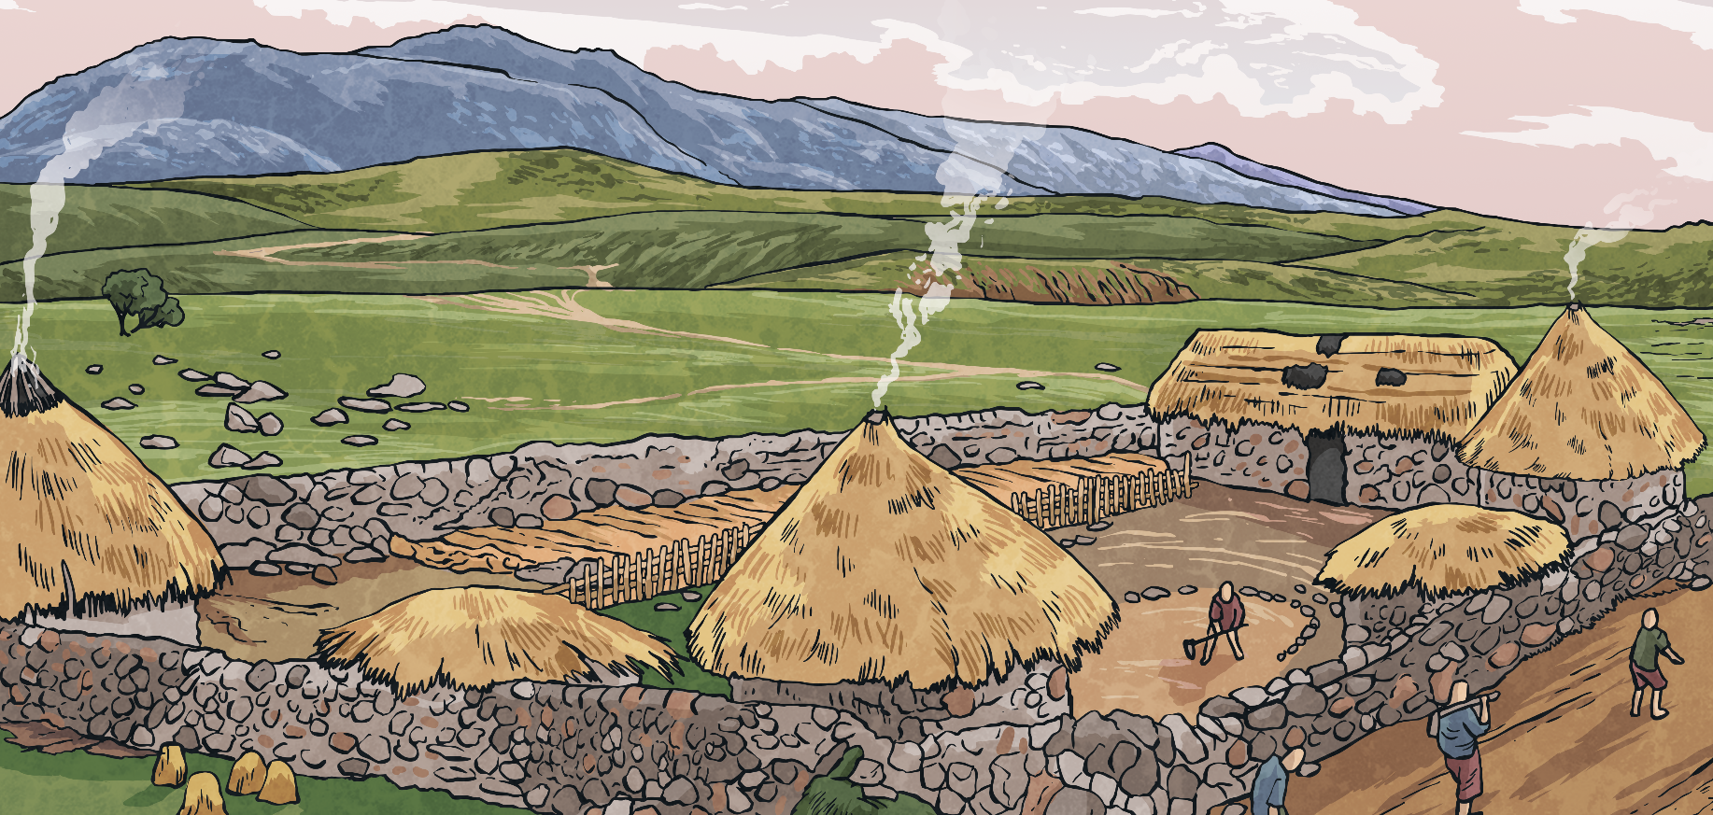
Before the Ancient Romans came to Britain…
Before the Romans arrived, Britain had no proper roads and no large towns.
The Celts rode horses, walked and travelled in carts pulled by oxen along paths and tracks. These paths and tracks connected local farms, small villages, and hill forts.
There were some longer tracks for trade. These tracks were often in very poor condition.
Question:
Why do you think the Romans wanted to build new roads?
Can you think of three possible reasons?
Celtic Village and mud track for travelling along.

Slide 3
Question:
Why do you think the Romans wanted to build new roads?
Can you think of three possible reasons?
Better links between places was good for trading.
Supplies could be sent to different areas of the country.
Answers:
Troops could be quickly moved from one place to another.
The Emperor had more control if messages could be sent quickly.
Now watch this video: https://www.bbc.co.uk/bitesize/clips/zdgrkqt

Slide 4
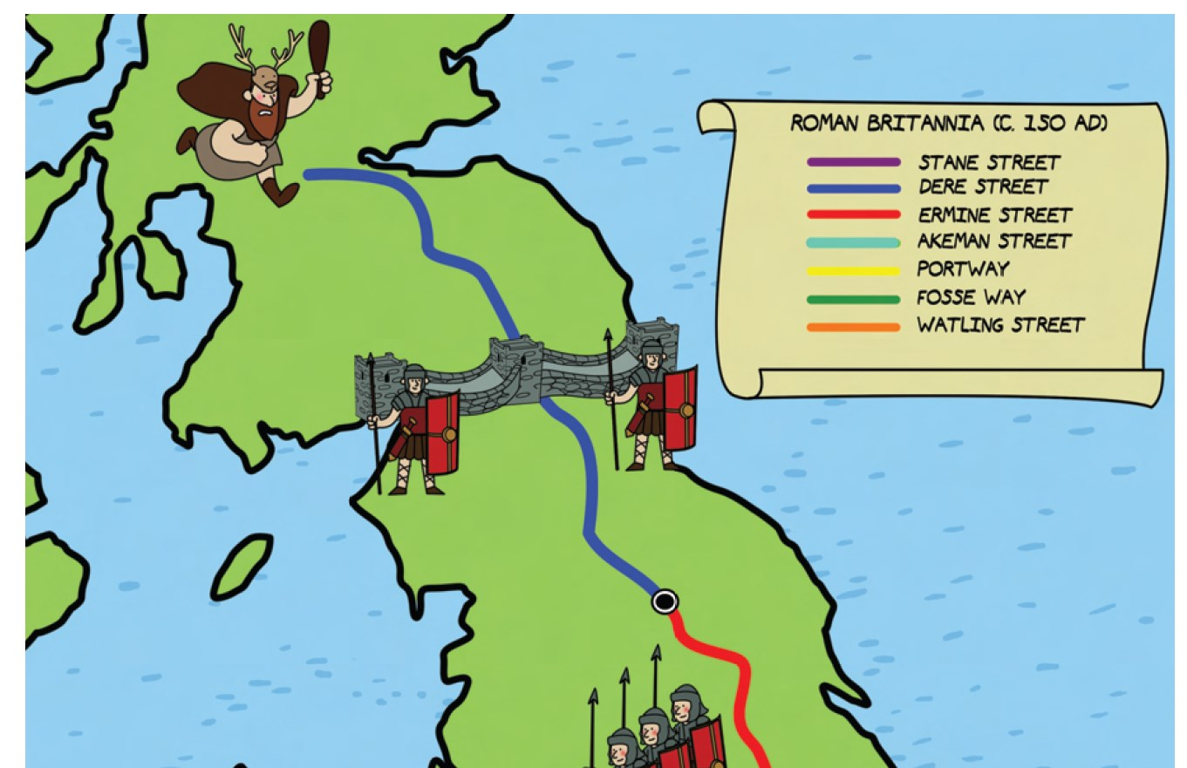
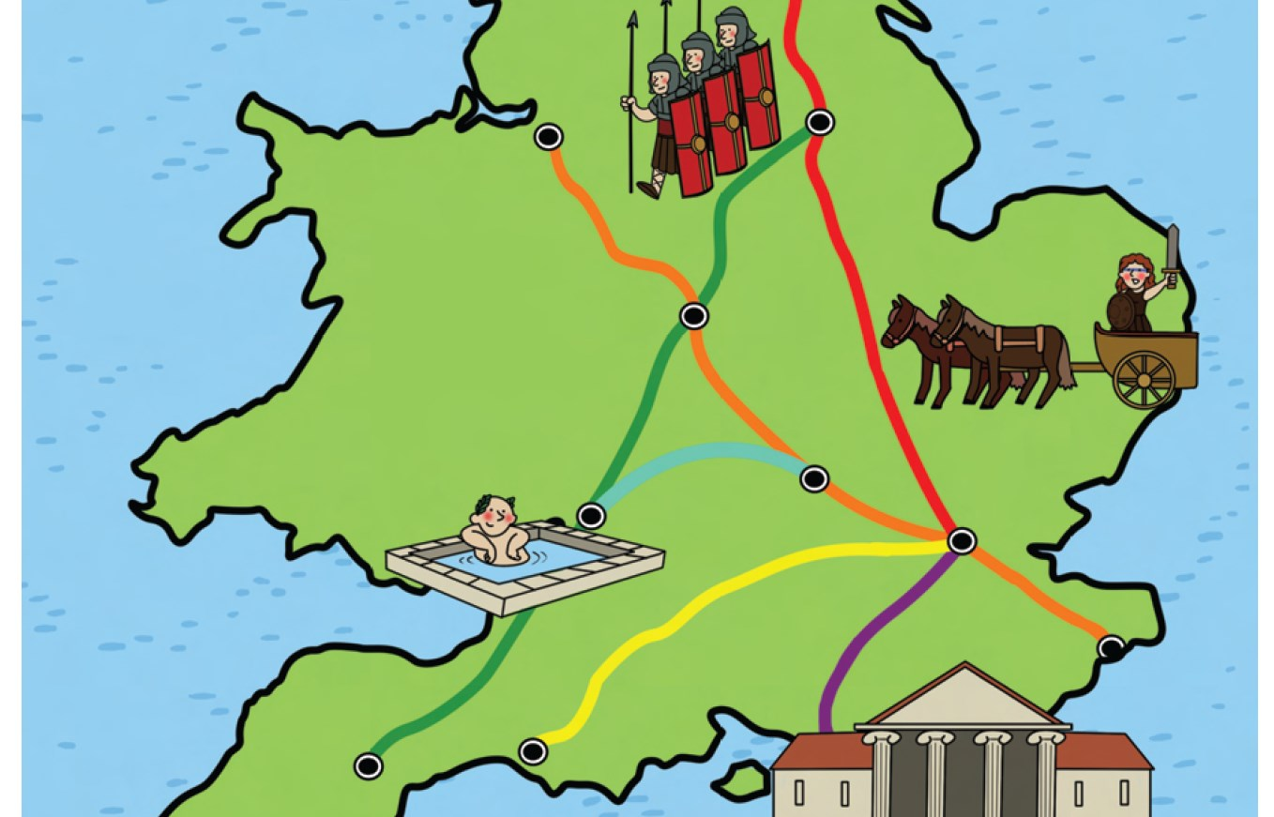
The Roman army needed a way to get from one end of the country to the other as fast as possible. So, part of the army’s job, was to build high quality roads. Many of these roads can still be seen today!
Now watch this video:
https://www.bbc.co.uk/teach/class-clips-video/history-ks1--ks2-explain-this-roman-roads/z7c8wty

Slide 5
How Roman roads were made
Task 1: Answer these questions.
Along the Roman road would be mile stones placed at regular intervals.
What do you think the ditches on either side of the road were for?
Why were they important?
The roads were curved with the highest point being in the middle. Why do you think the roads were made this way?
Why do you think the Romans placed milestones along the sides of the roads?
Below is a photo of the remains of a Roman road. It is about 1000 years old. Why do you think it has lasted so long?

Slide 6
How Roman roads were made
Task 1: Answers
The ditches were drainage ditches.
They channelled the water, so that the roads wouldn’t become too muddy.
The curved shape of the road surface meant that the water ran off to the ditches instead of forming puddles.
The mile stones helped travellers know how far they had to travel to their destination.
They Roman roads were well made with good drainage and had lots of layers to keep them level. They were made of long lasting materials such as stones, gravel and pebbles.
What do you think the ditches on either side of the road were for?
Why were they important?
The roads were curved with the highest point being in the middle. Why do you think the roads were made this way?
Why do you think the Romans placed milestones along the sides of the roads?
Below is a photo of the remains of a Roman road. It is about 1000 years old. Why do you think it has lasted so long?

Slide 7
As well as roads, the Romans built lots of forts around the country so that armies would have somewhere to live and so that they could trade and collect taxes from the Celtic people more easily. Towns often built up around these forts.
The things they traded and the money they collected in taxes would be sent along the roman roads and rivers, then eventually be put on ships and taken back to other parts of the Roman Empire such as Rome.

Slide 8
The Beginnings of Roman Towns
Some towns and cities grew up outside of army camps, to provide the soldiers with shopping, taverns, and women. Soldiers were not supposed to marry and have children but many did, and this was accepted. The children were allowed to become Roman citizens - if they joined the army!
Colchester was Britain’s first city.
This is what Historians think it might have looked like.

Slide 9
Task 2: Look at the map showing ancient Roman towns. Use a map of England or search on the internet to find out the modern names of the ancient Roman towns. Write the modern names below.
Eboracum ____________
Lindum ____________
Deva ____________
Aquae Sulis ____________
Venonis ____________
Verulamium ____________
Londinium ____________
Dubris ____________
Durnovaria ____________
Isca ____________
Eboracum
Lindum
Deva
Venonis
Aquae Sulis
Verulamium
Londinium
Durnovaria
Dubris
Isca

Slide 10
Task 3: Roman place names
In Britain, lots of places have Roman endings. E.g. caster, cester and chester.
These place name endings indicate that there was a Roman fortification or a roman town or fort there.
Use a map of Great Britain or go online. List all of the places that you can find that end in caster, cester or chester. I have put into the table 3 examples.
Caster | Cester | Chester
Lancaster | Leicester | Manchester

Slide 11
The Romans built towns throughout their enormous empire, and all were built to a similar design. Not all were the same shape, but nearly all had the same sort of layout - a grid pattern like a chessboard. And they all had the same sorts of buildings - temples, theatres, baths, forums, and amphitheatres.
Watch this video about Roman Towns:
https://www.bbc.co.uk/bitesize/clips/zp8v87h

Slide 12
What were Roman Towns Like?
Roman towns were planned by expert town planners. Streets crossed each other and made lots of blocks known as 'insulae'. Houses, shops and so on lined these streets. In the centre were the most important buildings - the basilica (town hall) and forum (market place). In most towns there were also temples to Roman gods and outside the town an amphitheatre for entertainment. Some towns also had theatres.
When Roman towns were first built there was usually only an earth ramp and wooden fence to protect the town, as with Celtic hill forts. In the 3rd century stone walls, towers, and gates were built for better defence.

Slide 13
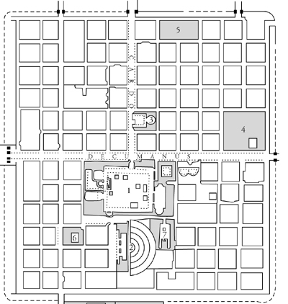
Task 4: Design an Ancient Roman Town
This is the outline of a real Roman Town, however the buildings don’t have names: they are just empty boxes.
Your job is to act as town planner, and label the town map to show which buildings are going to be:
The Forum: market place
Basilica: town hall
A Theatre: a semi-circular building
Baths: a large building with many sections
Temples: these don’t need to be big.
Barracks: a building where the soldiers live
Shops: these would be best on a main road and could be for food, clothes, shoes, etc.
Houses: the rich would live in the the city
Roads: the main roads have been given names
Gateways into the city

