Slide 1
History Lesson
11th May 2020
Roman Soldiers v Celtic warriors

Slide 2
In this History lesson we will try to answer these questions:
What were Celtic warriors like?
What were Roman soldiers like?
Why were the Roman soldiers able to defeat the Celts and invade and settle in Britain?

Slide 3
Celtic Warriors
Celtic warriors went into battle with a sword and a shield. The most important warriors had the biggest and best swords. Most of the time they were farmers but during the times of the year when the farms were less busy they would practice using their swords and shields.
They wanted to make themselves look scary so they spent quite a lot of time putting on their scary make-up. They used the dye from the woad plant to paint blue patterns on their face and all over their body. Then they used lime to dye their hair white and make it spiky.
The Celts wore trousers. They were good weavers and made
good cloth. But in battle they often took all their clothes off. Why
did they do this? Maybe it was to show that they were not scared
and they thought armour was just for softies? Maybe it was to make them look really mad? Maybe they really were a bit barmy!
The most important celtic warriors had chariots. These were small carts pulled along by horses. They went much fast-
er than people could run. Some-
times three people would ride on
the chariot. Two would carry spears. They would ride up to the enemy sideways, quickly throw their spears and then run off. Sometimes two soldiers would run alongside the chariots to defend them.
Sometimes Celts liked to drink
some beer before they went into
battle to make them even more mad and frightening.
When Celts beat an enemy they liked to keep their heads as souvenirs and carry them around with them to show off. They soaked them in cedar oil to stop them going rotten. Sometimes they hung them over their front doors.

Slide 4
How to be a Celt warrior:
What you need
1.
2.
3.
4.
5.
How to get ready for a battle:
Firstly, _____________________________________________________________________________________ ______________________________________________________________________________________________
Secondly, ___________________________________________________________________________________ ______________________________________________________________________________________________
Thirdly, ____________________________________________________________________________________ ______________________________________________________________________________________________
After that, __________________________________________________________________________________ _____________________________________________________________________________________________
Finally, ____________________________________________________________________________________ _____________________________________________________________________________________________
After the battle, ____________________________________________________________________________ _____________________________________________________________________________________________ ______________________________________________________________________________________________
Task:
Fill in these instructions on how to be a Celtic Warrior

Slide 5
So, how were the Roman Army different to the Celtic warriors?
Task: Read this fact sheet to find out.

Slide 6
Task: Fill in the empty parts of the tables

Slide 7
Visit some of these websites to find out more about the lives of Roman soldiers and Celtic warriors
(Make sure you get permission to go on the internet first!)
https://www.bbc.co.uk/bitesize/topics/zwmpfg8/articles/zqbnfg8
https://www.bbc.co.uk/bitesize/clips/zf98q6f
https://www.bbc.co.uk/bitesize/clips/zn2mhyc
http://www.bbc.co.uk/wales/celts/factfile/warriors.shtml
http://www.primaryhomeworkhelp.co.uk/celts/shields.html

Slide 8
A Celtic warrior
Task: Label the Celtic warrior and Roman soldier
What can you tell me about them?

Slide 9
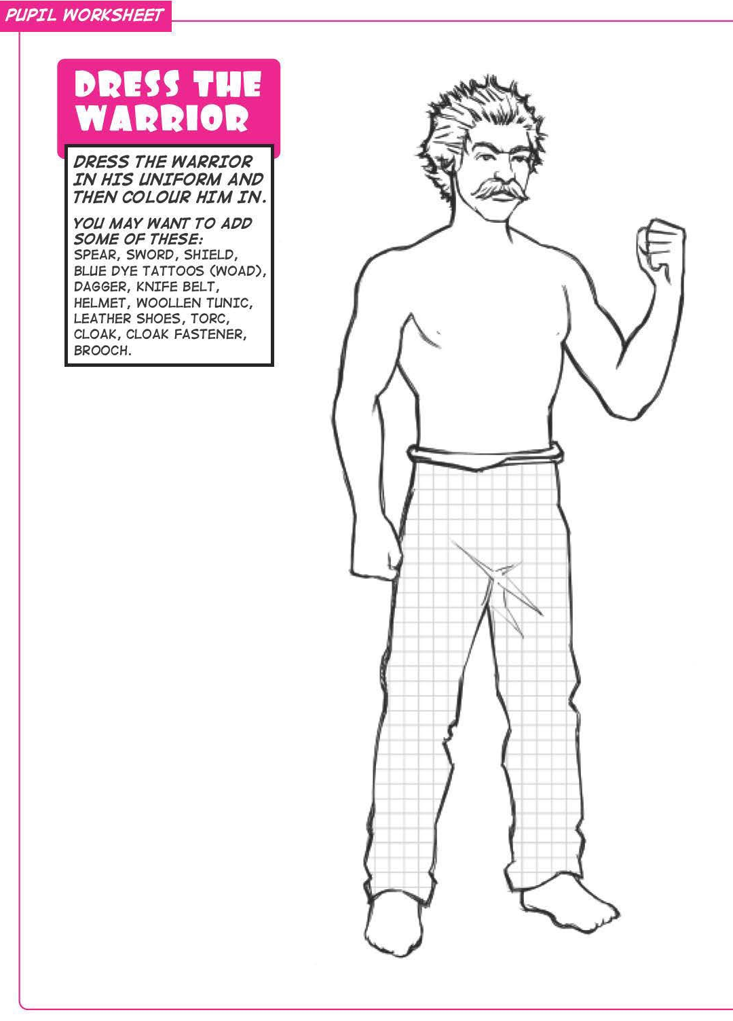
If you have time!
Task:
Draw on the missing clothing and equipment

Slide 10
Plenary
What have you found out?
Why were the Roman soldiers able to defeat the Celts and invade and settle in Britain?
Which would you rather be? A Celtic warrior or a Roman soldier?

