Slide 1
History Lesson
^{13th} July 2020
In today’s lesson we will be learning about:
How the Ancient Romans changed Britain
Look at a timeline of the Ancient Romans in Britain
Find out why the Ancient Romans left Britain
Find out how we know about the Ancient Romans

Slide 2
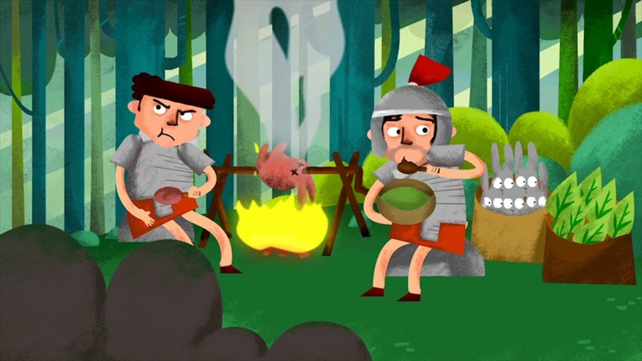
Watch these videos
First – How did the Ancient Roman’s change Britain?
https://www.bbc.co.uk/bitesize/clips/zwjhfrd
https://www.youtube.com/watch?v=SajyHgJTy3E
Task 1: Now read the next 2 slides and fill in the worksheet that follows.

Slide 3
How did the Ancient Roman’s change Britain?

Slide 4

What else?

Slide 5

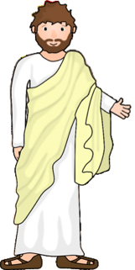
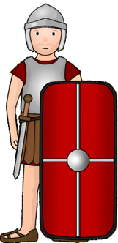
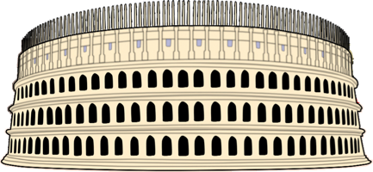
Task 1: Write a paragraph explaining how the Ancient romans changed Britain.

Slide 6
The Ancient Romans – A Timeline of Events
(Not to scale)
306 AD
The Emperor Constantine the Great is declared emperor in York. Having fought a successful war, he believed God aided him and becomes a Christian.
43 AD
The Emperor Claudius invades Britain. The Romans establish a capital city at Colchester.
122 AD
Hadrian’s Wall is built to control the movement of people and keep the Picts out.
735 BC
The Founding of Rome.
Rome is built.
4 BC
When historians suggest Jesus was born.
0
55 – 54 BC
Britain is invaded by Caesar and his Armies. They did not stay.
73 AD
Wales is conquered.
300 AD
Every Roman town had its own Roman bath. The Romans loved them so much that by AD 300, they had built over 300 of them.
410 – 455 AD
The Fall of the Roman empire. The Romans soldiers had to leave Britain to protect Italy which was under attack.
Task 2: Look at this timeline carefully and then answer the questions on the next slide.

Slide 7
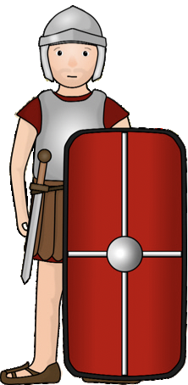

Task 2: Answer these questions about the timeline on the previous slide.
When was the city of Rome first founded?
When was Britain first invaded by the Romans?
Which Emperor was the second one to invade Britain?
What was the name of the capital city that they built?
When was Hadrian’s wall built?
How many Roman Baths had been built by AD 300?
Which emperor was the first to become a Christian?
Where was the Emperor crowned as emperor?
When did the Roman soldiers leave Britain?
Why were the soldiers told to leave Britain?

Slide 8
More about the Romans leaving Britain
The Roman Empire begins to fail
After AD 200, Roman generals began fighting between themselves over who was to be the next emperor.
Tribes outside the empire saw it weakening and attacked. Roman armies had to go home to defend Rome.
By AD 410, all Roman soldiers had left Britain. Angles, Saxons and Jutes started to settle here. Sometimes there was fighting with the newcomers and sometimes they settle peacefully.
A gradual decay set in. Evidence that Norfolk had ever been part of the Roman empire slowly crumbled into the earth.

Slide 9
Here are even more things that added to the Roman Empire collapse.
Task 3:

Slide 10
How do we know so much about the Ancient Romans in Britain?
Archaeology
As you dig in the ground you generally go further back in time. You can find:
• parts of buildings (tiles, floors, etc) • statues • pots
• coins • armour • metal buckles, brooches, etc
Where they are tells you that there was a settlement. What they are tells you what went on there. How deep they are tells you their age. Coins are brilliant because they are easy to date. In the time of the Roman empire more and more money factories (mints) had to be set up because: • emperors changed (their name and portrait had to be shown on the coins) • there were more wars (wars cost a lot)
there was an increase in building and trade.
Some writing about Roman Britain by Tacitus, Dio Cassius and Julius Caesar has also survived.

Slide 11
Activity – What is it?
(Not to scale)
C
Task 4: Look at these artefacts that archaeologists have found in the ground that belong to Ancient Romans. What do you think they are?
A
D
E
Archaeologists may be unsure about some of the objects which they find. They have to look very hard and guess what they might have been used for.
B
F

Slide 12
G
J
L
H
M
N
K
I

Slide 13
Answers
A – Bead
B – Brooch
C – Needle
D – Ear wax remover
E – Hair pin
F – Knife
G – Spoon
H – Comb
I – Bracelet
J – Ring
K – Coin
L – Oil lamp
M – Metal tray
N – Unknown
O – Jug
P – Glass container
Q – Drinking beaker
R - Mosaic
O
Q
R
P

Slide 14
Task 5:
What have you enjoyed the most about the Romans topic? Tell me your favourite bit here.

Slide 15
Now upload your work onto Class Dojo

