Slide 1
History Lesson
18th May 2020
Boudicca Fights back!

Slide 2
Lesson aim – to investigate what happened to an important historical figure - Boudicca
In this lesson we will try to answer the following questions
Who was Boudicca?
Where did she come from?
Why did she fight the Romans?
How do we know about her?

Slide 3
Watch the video using the link below.
This video tells the story of Boudicca in a short cartoon.
https://www.bbc.co.uk/teach/class-clips-video/story-of-britain-boudica-and-the-roman-invasion/zmyhf4j

Slide 4
Who was Boudicca?
Boudicca was a queen of the British Celtic Iceni tribe. She was married to the King of the Iceni tribe, Prasutagus.
Boudicca led led an uprising against the Roman army in Britain in AD 60 or 61.

Slide 5
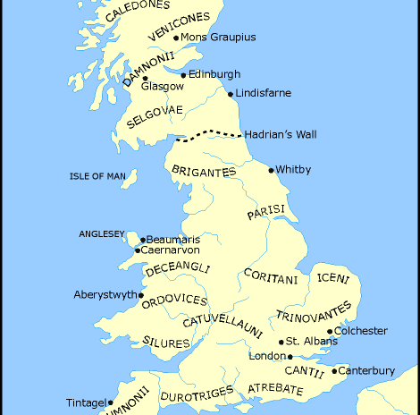
Where did Boudicca come from?
When the Romans invaded Britain, it was split up into lots of small tribes. Each tribe had their own ruler.
Boudicca and her husband, Prasutagus were the rulers of the Iceni tribe.
Read the next 4 slides which tell you about her story.

Slide 6
The story of Boudicca
When the Romans invaded Britain, the tribal leaders were allowed to stay in charge of their people, but they had to pay money to the Roman Emperor.
One tribe was called the Iceni, who ruled over the flat marshland in the East of England. When the Iceni King Prasutagus died, he left his people in the care of his widow, Queen Boudicca. The Celts respected male and female leaders alike, but the Romans did not. The Roman’s wanted her land and wanted her to give up her throne.
Boudicca was a fearsome warrior and an inspiring leader, who would charge into battle on her chariot and armed with a spear. She was tall and beautiful, and had flaming red hair that flowed down to her waist. However, the Roman soldiers ruling Britain refused to recognise Boudicca as a Queen. They stole Iceni land, burnt down their houses, and publicly beat Boudicca in front of her people. They even attacked Boudicca’s daughters.

Slide 7
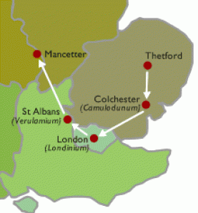
The story of Boudicca
Boudicca was furious. She was not going to let the Romans get away with humiliating her, so she led her people in a rebellion. The Iceni warriors attacked the nearest Roman city they could find, called Colchester. They killed the Roman inhabitants, and destroyed the Roman buildings. They did the same in the Roman town of St Albans.
From there, they carried on to a Roman town on the banks of the Thames called Londinuim, modern day London. Here, the Iceni burnt the city to the ground, and killed the people who lived there. Skulls of Roman soldiers who had their heads chopped off by the Iceni have be found in London.

Slide 8
The story of Boudicca
The Roman governor heard about what was happening so decided to return from a mission in Wales to fight Boudicca.
Boudicca gave a speech to her army. She told her troops that the battle would mean the end of Roman rule in Britain.
They carried on to a Roman town on the banks of the Thames called Londinuim, modern day London. Here, the Iceni burnt the city to the ground, and killed the people who lived there. Skulls of Roman soldiers who had their heads chopped off by the Iceni have be found in London.

Slide 9
The story of Boudicca
Tribes from all over Britain heard about Boudicca’s amazing victories, and joined her army. From London, Boudicca’s enormous army moved north. In the middle of England, they were met by a small but well-organised Roman army.
Despite outnumbering the Romans, Boudicca’s forces were heavily defeated. Some say 80,000 British tribespeople died, compared with only 400 Romans. Many of the women and children who had come to watch, were killed also.

Slide 10
The story of Boudicca
Boudicca knew that if she was captured, she would be tortured by the Romans. So she and her daughters took poison and killed themselves. The Romans continued to occupy England and Wales until the fifth century AD.
Today, a statue of this inspiring Queen stands next to Parliament in the centre of London—the same city that she burnt down 2,000 years ago.

Slide 11

Task: read through these events and place them in the correct order to create a story-board about what happened to Boudicca
The Roman governor returned to fight Boudicca. She told her troops that the battle would mean the end of Roman rule in Britain. | They marched towards the nearest Roman town of Colchester and other tribes joined them. They easily defeated the Romans in Colchester. | Boudicca escaped. No one is certain what happened to Boudicca next but many believe that she drank poison so that the Romans couldn’t capture her. | When she refused they tied her and her daughters up and beat them. This made Boudicca and her tribe very angry, and they decided to fight the Romans.
The new Roman army was outnumbered but won. Many of the soldiers, and women and children who had come to watch, were killed. | The Romans continued to occupy England and Wales until the fifth century AD. | When Boudicca’s husband died, the Romans wanted her land. They wanted her to give up her throne. | They continued to St Albans and London. The Romans sent more soldiers but they were easily defeated. Many Romans were killed.

Slide 12
How do we know about Boudicca’s story?
The Celts did not write anything down in this period that is available to us today and so no information from them concerning this event is left for historians to look at.
The first historian to leave us a record, Tacitus, was a young Roman boy at the time of Boudicca’s rebellion. His father-in-law was a governor in Britannia after the rebellion was crushed so would have had knowledge of the events and have been able to inform Tacitus of what happened.
Tacitus

Slide 13
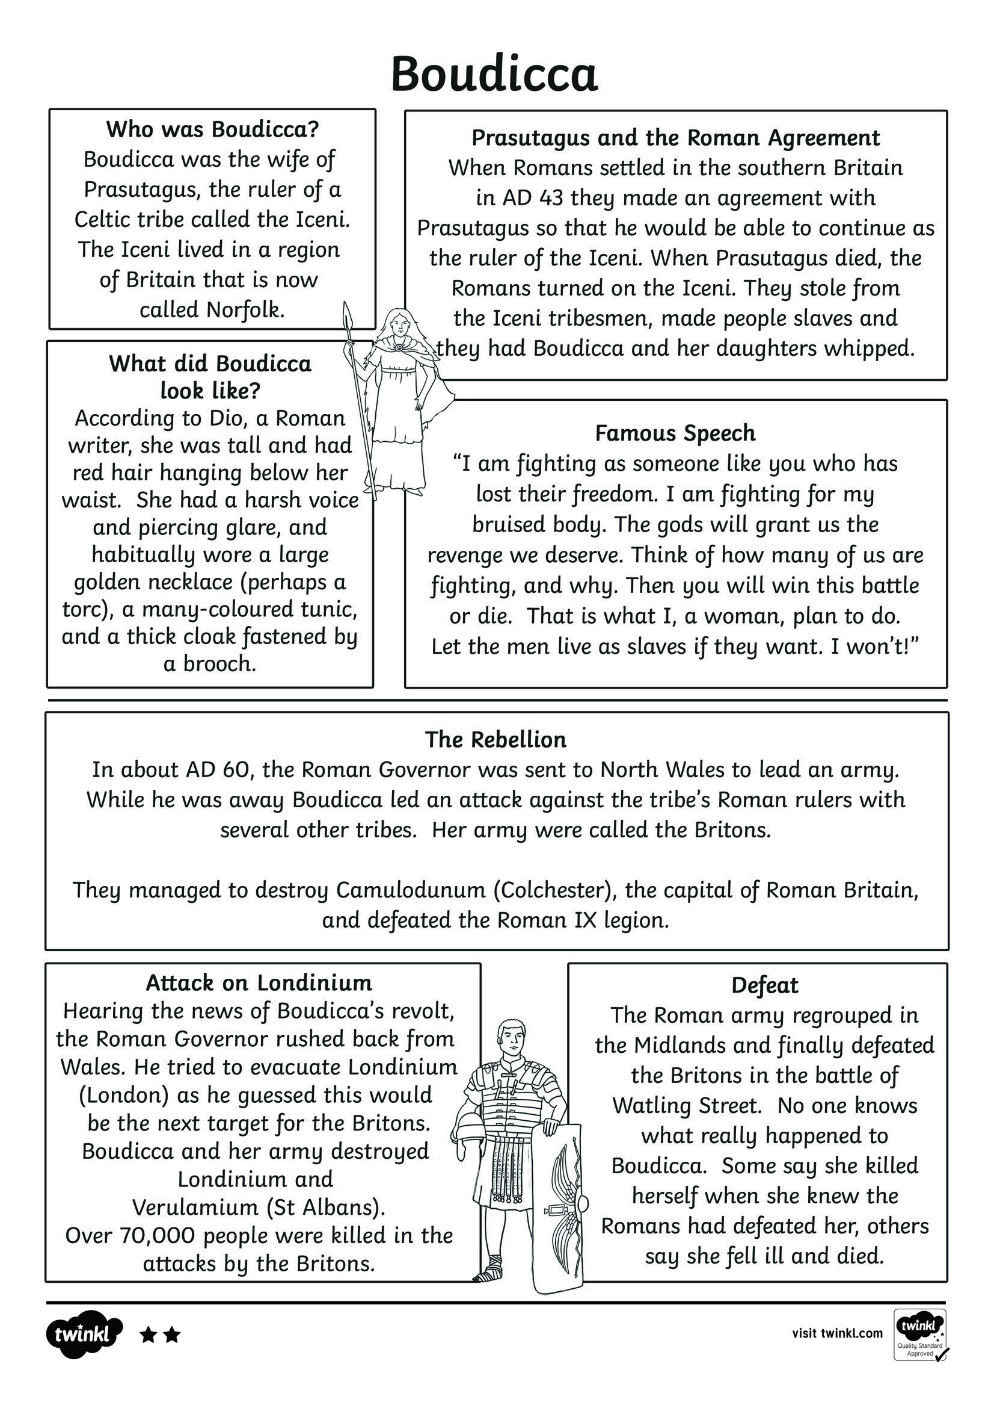
Task: Read through this information, then answer the questions on the next slide.

Slide 14
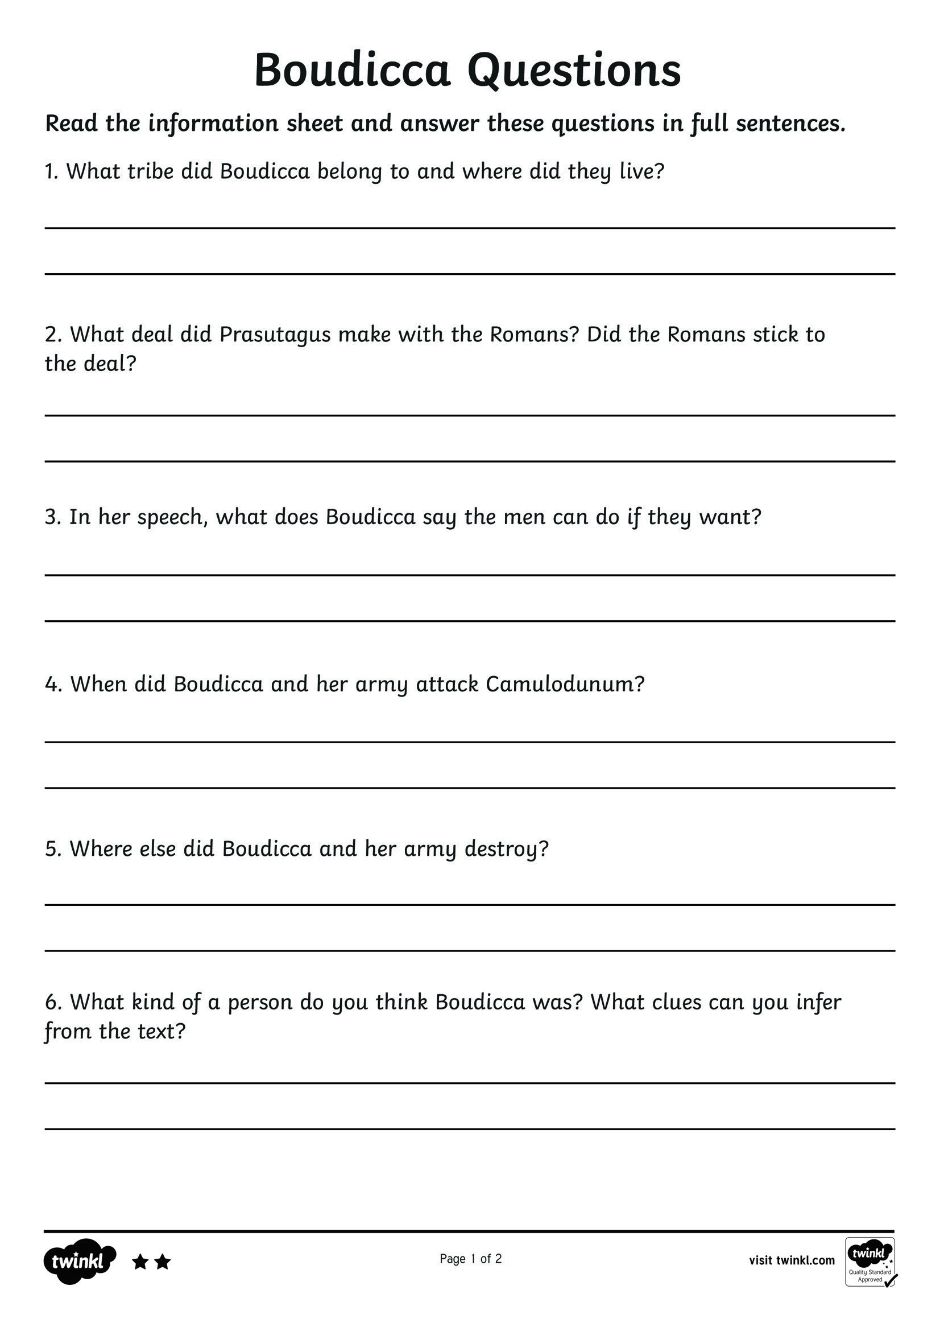
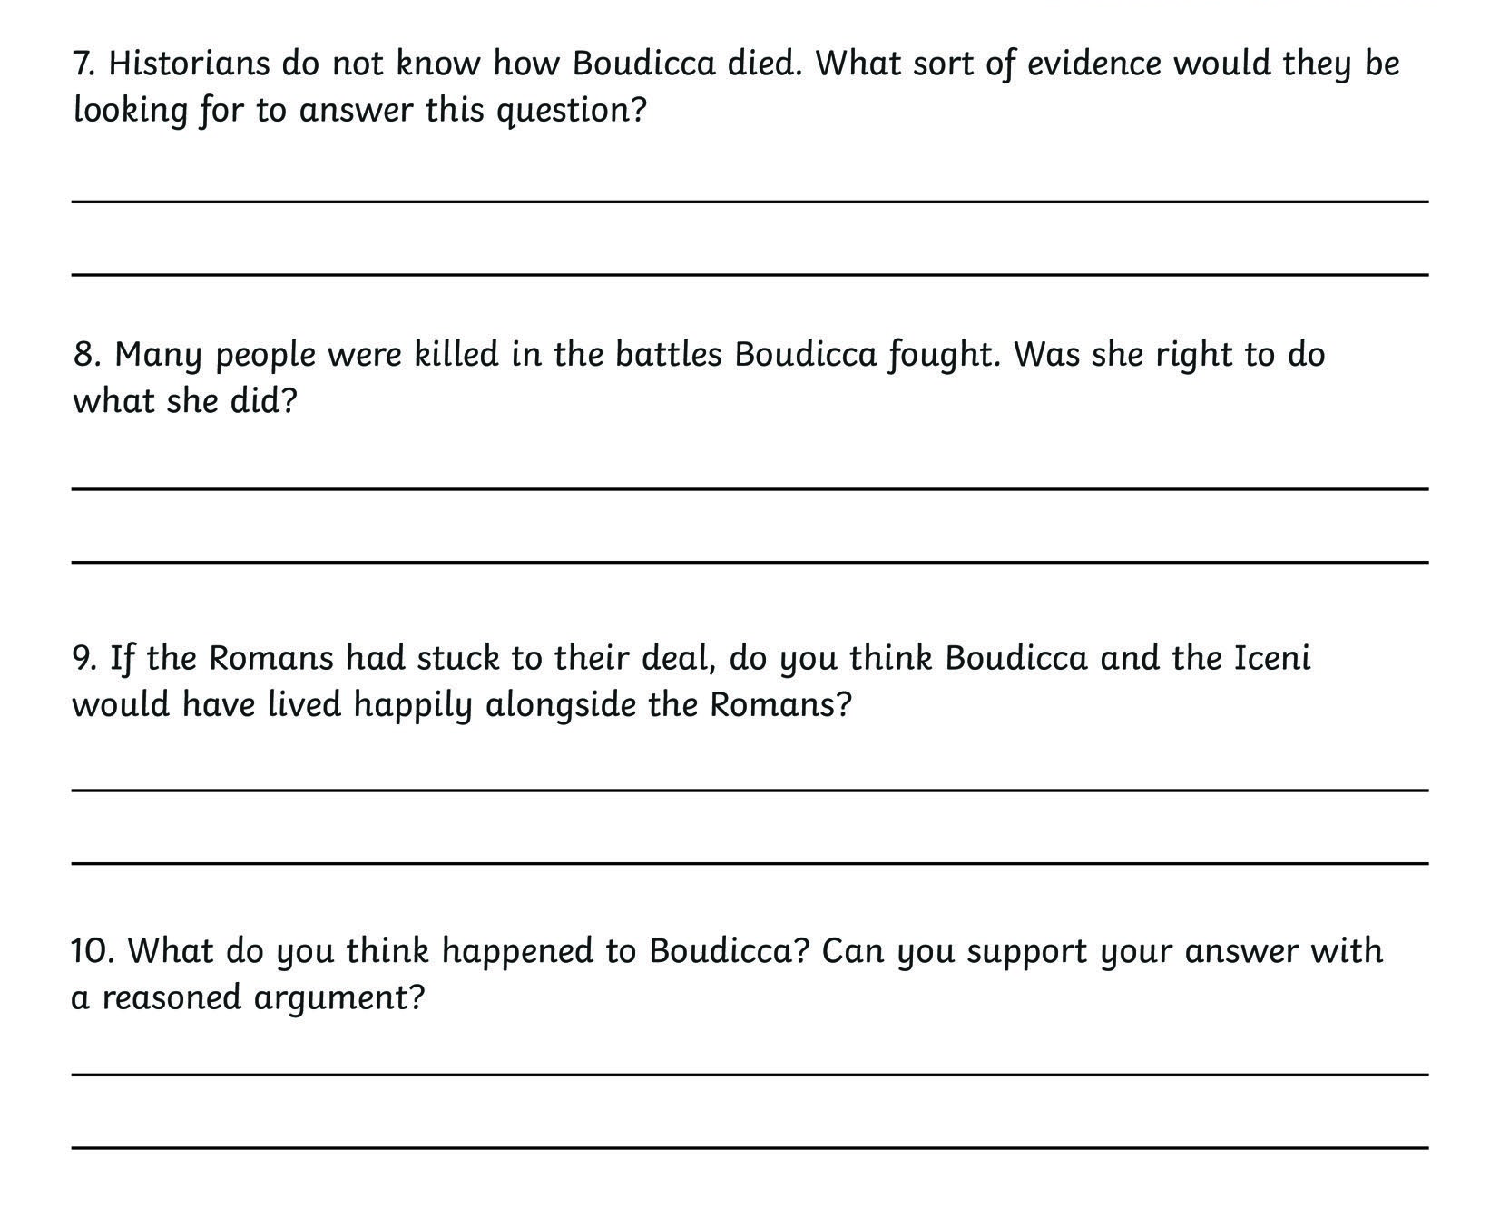

Slide 15
Plenary
What have you found out about Boudicca?
Who was Boudicca?
Where did she come from?
Why did she fight the Romans?
How do we know about her?

