Slide 1
History Lesson
22nd June 2020
In today’s lesson we will be learning about:
The life of Children in Ancient Roman times
Ancient Roman Numbers
Ancient Roman Writing

Slide 2
Introduction: Watch these videos about Ancient Roman children
Video 1
Remember:
Get your parents permission first!
https://www.youtube.com/watch?v=D-VmbxpEFAA
Video 2
https://www.youtube.com/watch?v=3xbgvnz8eJA&list=TLPQMTgwNjIwMjBykIEDS8mqMg&index=1
Task 1: Read the next 6 information slides, then answer the questions about them.

Slide 3
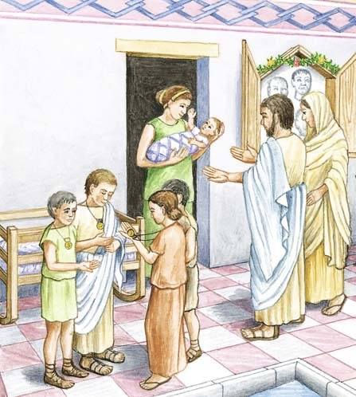
A Bulla
Bulla: Both boys and girls wore a special locket, given to them at birth, called a bulla. A bulla was an amulet, a protective charm against evil. Girls wore their bulla until their wedding night, when it was set aside with other childhood things, like her toys. Boys wore their bulla every day until they were 16 or 17 and became full Roman citizens, with the right to vote and hold office and marry.

Slide 4
Clothing and Bathing
Clothing: Both boys and girls wore tunics. Boys wore tunics down to their knees. Girls usually wore a tunic that reached their feet.
Bathing: Children were not allowed to use the public baths. They bathed at home or in the river.

Slide 5
Ancient Roman Toys
Both boys and girls played with toys. Boys played war games, and had wooden swords, little soldiers, and chariots with wheels.
Girls played with dolls, and dollhouses, and tiny sets of dishes.
Both boys and girls played board and ball games, like tic-tac-toe and knuckleball (jacks).
Note: there was no electricity, so they there were no computers, phones, playstations etc!

Slide 6
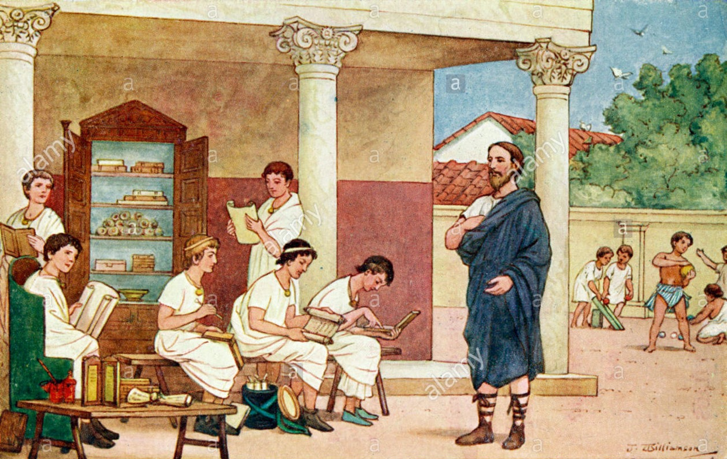
What would children do all day?
Today almost everyone goes to school, but in Ancient Rome that was definitely not the case. Only the sons of rich parents could go to school, while most other children would have to work in the fields or in blacksmiths or bakeries. Poor children would learn their parents’ craft, but they would never see a classroom. And almost no girls, not even the rich ones, would go to school.

Slide 7
Ancient Roman Education
If the family could afford it, boys might attend school and study reading, writing, math, oration, and how to be a good Roman citizen. Educated slaves were often their teachers. Greek slaves especially were in high demand as teachers for Roman children.

Slide 8
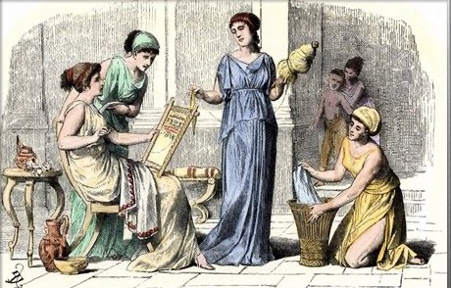
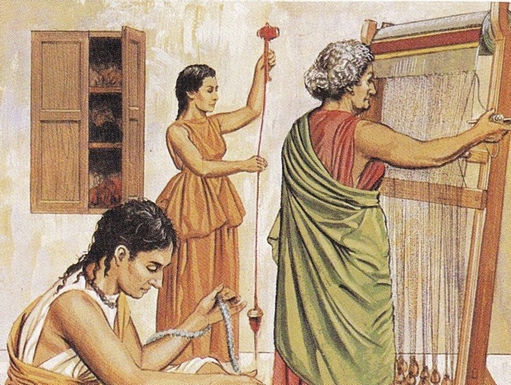
What about Girls?
Girls usually had to stay at home and learn to cook, to sew, weave cloth and clean the house.
If they were rich, they would supervise slaves while they did many of these jobs.
If the girl’s mother could read and write, then they would teach any daughters how to read and write at home.
Girls were allowed to get married at 12 years old and many became mothers at 15.

Slide 9
What have you learnt so far?
Task: Answer these questions about Ancient Roman Children
What did Ancient Roman children wear around their necks and why?
What did Ancient Roman children wear?
What kind of games did Roman children play?
What did Rich Ancient Roman boys learn at school?
What would poor Ancient Roman boys learn instead?
What did Ancient Roman girls do all day?
Would you like to be an Ancient Roman boy or girl and why?

Slide 10

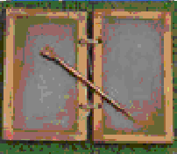
Ancient Roman Writing
The Ancient Roman people spoke and wrote in Latin. They used the same alphabet that we now use today. They usually wrote just in capital letters.
What did the Ancient Romans write on?
The Ancient Romans didn’t have books like we do today.
This is a Roman wax tablet that children would write onto with a metal or wooden stylus.
Longer and more official pieces of writing would be put onto a scroll like this one.

Slide 11
Ancient Roman Numerals
Task: Work out these calculations using the table to help you.
Roman numbers are very different to to the ones we use.
They are called Roman numerals.
I + II = ___________
V+V= ____________
V+IV=__________
X+V=__________
IV + VIII = __________
X + XII = ___________
XX + VIII = __________
IX + IX = __________
1 = I 2 = II 3 = III 4 = IV 5 = V 6 = VI 7 = VII | 8 = VIII 9 = IX 10 = X 20 = XX 30 = XXX 40 = XL 50 = L | 60 = LX 70 = LXX 80 = LXXX 90 = XC 100 = C 500 = D 1000 = M

Slide 12
Now upload your work onto Class Dojo

