Slide 1
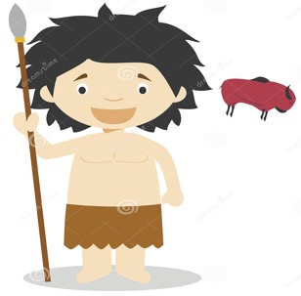
Lesson Objective: To understand what life was like in Stone Age Britain.
History Lesson 1
Year 3
Lesson 1 – Stone age to Iron age Britain Topic – January 2021

Slide 2

We are starting a new History Topic
We are going to be learning about the Stone Age
3. What people ate in Stone Age Britain

Slide 3
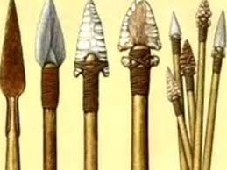
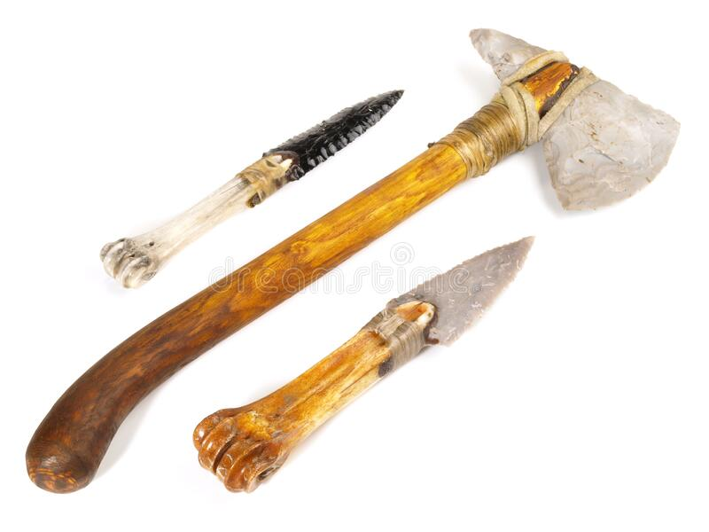
Why is it called the Stone Age?
Because people used tools made out of Stone!
Metal had not been invented yet!

Slide 4
Watch this video – click on the link.
https://www.bbc.co.uk/teach/class-clips-video/history-ks2-discovering-stone-age-tools-made-of-flint/zjtjmfr
This is a BBC educational video about the Stone Age

Slide 6
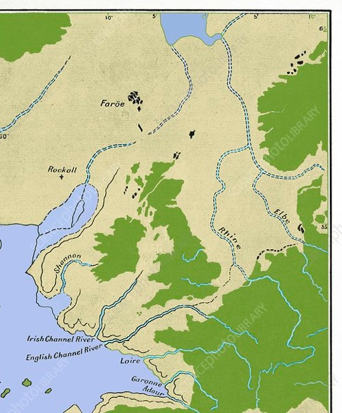
How has Britain changed over time? 1. What do you notice about these maps? 2. Look at how Britain used to be connected to the rest of Europe when the sea was lower. 3. Look at how much of Britain was covered by an ice sheet.
60,000 years ago
26,000 years ago
10,000 years ago
Today
Ice sheet

Slide 7
Task 1 – Read this text and answer these questions.

Slide 8
How do we know when the first humans arrived in Britain?
Evidence from animal and plant fossils, tools and other artefacts, have been found. This means we are able to build quite a detailed picture of the lives of the early Britons and the conditions they faced.
Excavations at Happisburgh in Norfolk, site of the oldest evidence for humans in Britain.

Slide 9
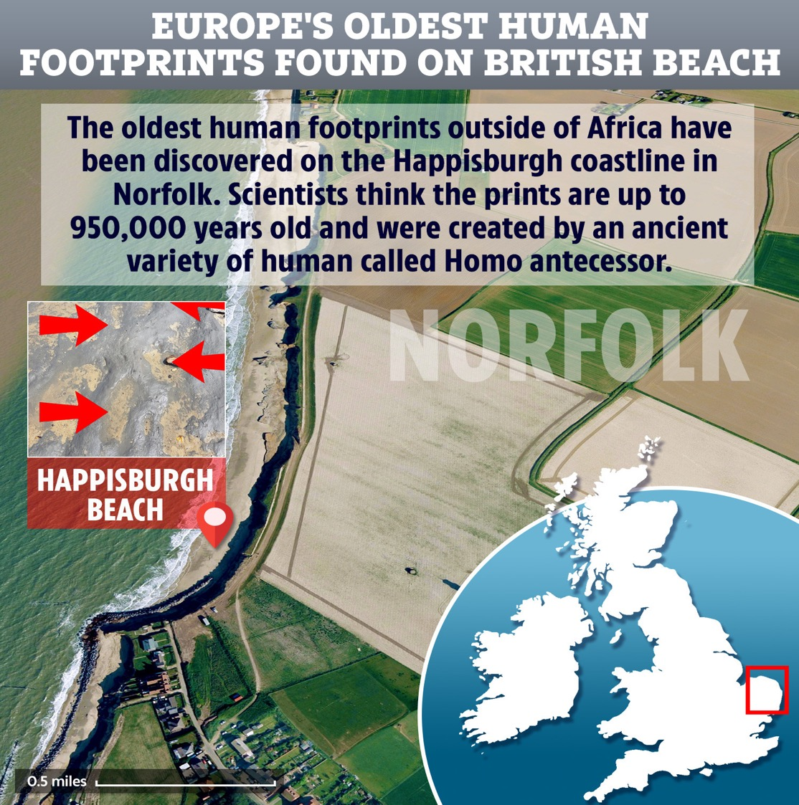
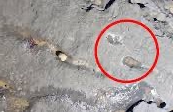

Slide 10
The identity of the very first people to come to Britain is still a mystery.
Stone tools discovered in Norfolk and in Suffolk show Stone Age people were there between 950,000 and 700,000 years ago. Scientists have even discovered a preserved trail of footprints left by a small group of these people as they walked along mudflats by the sea.

Slide 11
When did Modern Humans first arrive in Britain?
The earliest humans arrived in Britain nearly one million years ago.
Our own species of human (Called Homo Sapiens) is a relative newcomer.
The earliest direct evidence is a jaw fragment found in a cave in Devon. Scientists estimate it to be at least 40,000 years old.

Slide 12
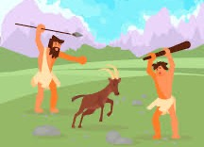
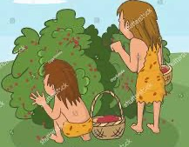
What did they eat in stone age Britain?
This depended on the time period.
For some of the Stone Age, Britain was hot.
For some of the Stone Age, Britain was cold.
People in the Early and Middle Stone Age were Hunters and Gatherers.
Hunters
Hunted down animals to cook and eat.
…and…
Gatherers
Would gather plants, nuts and berries to eat.

Slide 13
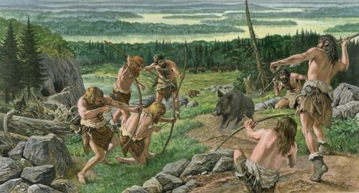
What are they hunting? How are they hunting?

Slide 14
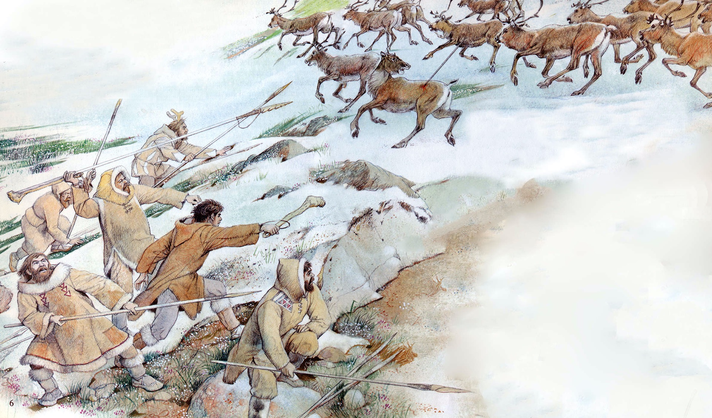
What are they hunting?
How are they hunting?

Slide 15
What are they hunting? How are they hunting?

Slide 16
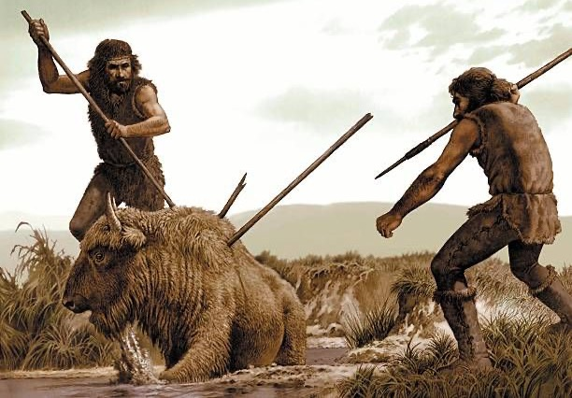
What are they hunting? How are they hunting?

Slide 17
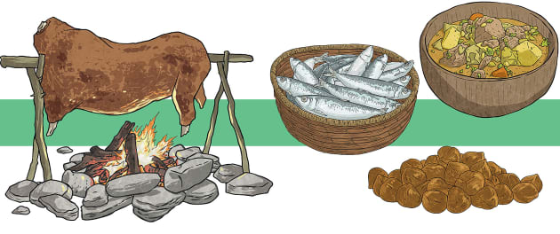
Task 2: Research and make a list of what Stone Age people might eat.
Meat | Plants, nuts and berries

Slide 18
Task 3: Read the text and answer the questions

