Slide 1

Lent Liturgy Week five

Slide 2
Opening Hymn
Listen to a couple of minutes of the song by clicking on the link below
As you listen, reflect on your Lenten promises.
How are you getting on?
Have you been wonderful with all your heart?
Have you shown how God’s love makes you beautiful?
Have you tried to make the world a fairer place?
Do you know how much God loves you?
https://www.youtube.com/watch?v=MvpjxfWrjzY

Slide 3
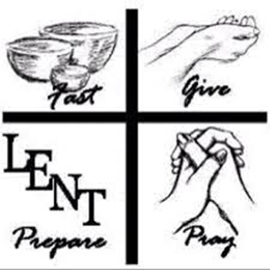
Opening Prayer ( we make the sign of the cross)
Let us pray. God our Father,
through our prayers, fasting and acts of kindness this Lent,
help us to grow closer to you.
Help us always to stay close to you by leading lives of love and service.
We make this prayer through Jesus Christ, our Lord. Amen.

Slide 4
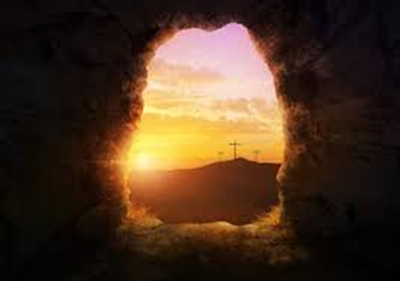
Introduction (Reader)
During Lent we prepare for Easter. In Lent we remember how Jesus suffered and died for us. When Jesus rose from the tomb on Easter Sunday, he showed us that death is not the end.
God, our Father, wants us all to live with him in a new life of peace and joy in heaven.
During Lent, we prepare for Easter in three ways: we pray, fast and do acts of kindness.
By doing these things we grow in love of God and other people.

Slide 5
Today’s Bible reading is taken from the Gospel of John ( 12:20-33)
The Gospel reading for the fifth Sunday of Lent is when Jesus tells us that death is not the end.
Jesus said to his disciples, Andrew and Phillip, “The hour has come for the Son of Man to be glorified. In truth, I tell you, unless a grain of wheat falls into the earth and dies, it remains just a single grain, but if it dies, it bears much fruit.”
The Gospel of the Lord. R/Praise to you, Lord Jesus Christ.

Slide 6
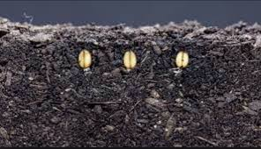
Bible Reflection
In the Gospel we heard, Jesus predicted that very soon he would die and rise from the dead.
This is what he meant when he said that he would be ‘glorified’. His death would not be the end, but rather the beginning of a new life with God our Father in heaven. To help his disciples understand, he sked them to think about a wheat seed.
Have you seen a seed?
What is it like?
What would happen if you left the seed in its packet?
Think about what happens when you plant a seed.
It is hidden away in the silence and darkness of the earth.
Then, when the time is right, it bursts out of the ground into a wonderful display of beauty and joy.

Slide 7
Bible Reflection
Jesus was saying that his death would be like this – he was going to die and be buried in the silence and darkness of the tomb. But then, he would be brought into a new life and everlasting life with God the Father.
This is exactly what happened to Jesus on Easter Sunday and it is this everlasting life with him that God wants for all of us.
Think about how you can love God and serve others. Isn’t it wonderful that you follow Jesus too?
What have you been doing during Lent to follow Jesus and serve other people. It is never too late to start.

Slide 8
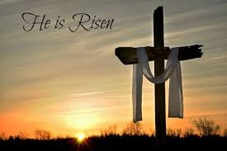
Prayers of intercession
Reader: The response to our prayer is: Lord, hear us.
Reader: Heavenly Father, we give thanks for all the people who serve you by sharing your love with the world. We think of our teachers, doctors, nurses, priests and nuns. Help us to serve you be sharing your love too. We pray to the Lord. R/Lord hear us.
Reader: We ask for forgiveness for the times we have failed to share your love with others, when we have been selfish, mean or rude. Help us to be more generous and kind. We pray to the Lord. R/Lord hear us.

Slide 9
Reader: Heavenly Father, we pray for all those who have died, for their families and friends. May the promise of everlasting life with you bring them comfort and hope. We pray to the Lord. R/Lord, hear us.
Reader: Heavenly Father, we pray for the children, families and staff in our school. May we live lives of joy and hope, knowing that your love us greater than death.
We pray to the lord. R/Lord, hear us.
Reader: We pray for children overseas whom Mission Together helps: those who are scared, sad or lonely, who are homeless, sick, hungry or who are refugees. May they find hope in your love and may we always be ready to help them. We pray to the Lord. R/Lord, hear us.

Slide 10
Reader: We end our prayers by saying together the Mission Together Prayer.
May all children
In the world
Share love
Share friendship and live
in the peace
Of God’s love,
Now and forever. Amen

Slide 11
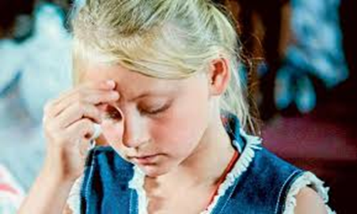

We close our Liturgy by making the sign of the Cross.
In the name of the Father and of the Son and of the Holy Spirit. Amen
Now go forth with today’s message and spread the good news, just as Jesus did.
https://www.youtube.com/watch?v=CWhrzbcHcnI

