Slide 1

Lent Liturgy Week one

Slide 2
Find a quiet place, away from any distractions and spend 10 minutes reflecting on the first week of Lent. You may want to ask an adult to help you read some of the readings and prayers.

Slide 3
Opening Hymn
Listen to a couple of minutes if the song by clicking on the link below (remember to ask an adult first)
As you listen, reflect on what Mrs Charnley said last week.
Have you been wonderful and kind from the bottom of your heart?
https://www.youtube.com/watch?v=G2o27qpvfUc

Slide 4
Opening Prayer
Let us pray. God our Father,
through our prayers, fasting and acts of kindness this Lent,
help us to grow closer to you.
Teach us how to bring the good news of your love to everyone, everywhere.
We make this prayer through Jesus Christ, our Lord
Amen.

Slide 5
Introduction (Reader)
During Lent we prepare for Easter. Lent begins on Ash Wednesday and it lasts for 40 days. In Lent we remember how Jesus suffered and died for us. When Jesus rose from the tomb on Easter Sunday, he showed us that death is not the end.
God, our Father, wants us all to live with him in a new life of peace and joy in heaven.
During Lent, we prepare for Easter in three ways: we pray, fast and do acts of kindness.
By doing these things we grow in love of God and other people.

Slide 6
Bible reading : From the Gospel of Mark (1:12-15)
The Holy Spirit sent Jesus out into the desert. He was there for 40 days and was tempted by the devil. He was with the wild animals, and the angels looked after him. Then Jesus went into Galilee, proclaiming the good news of God. He said, “Repent! The kingdom of God is near. Believe the Good News!”
The Gospel of the Lord – R/ Praise to you Lord Jesus Christ.

Slide 7
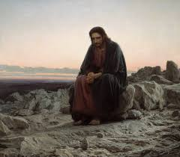
Bible reflection
Can you remember how many days Jesus spent in the desert?
What else have we heard about today that lasts 40 days?
What was the good news that Jesus was proclaiming?
What else did Jesus tell the people in Galilee to do?

Slide 8
Prayers of Intercession
Reader: The response to our prayer is :Lord, hear us.
Reader: Heavenly Father, help us to grow closer to you this Lent. May we do our best to spend more time with you in prayer and follow the example of your Son, Jesus, so that we might share your love with everyone, everywhere. We pray to the Lord. R/ Lord hear us.
Reader: Heavenly Father, we ask for forgiveness for the times we have put ourselves before other people. May our prayers and sacrifices this Lent help us to be forgiving like you. We pray to the Lord. R/ Lord hear us.

Slide 9
Reader: Heavenly Father, we pray that we may be kind with our time and our gifts during Lent, knowing that even small things can make a bid difference. We pray to the Lord. R/ Lord hear us.
Reader: Heavenly Father, we pray for the children, families and staff in our school. May we always see in each other the love you have for us.
Reader: Heavenly Father, we pray for children overseas whom Mission together helps: those who are scared, sad or lonely and those who are homeless, sick or who are refugees. May they find hope in your love and may we always be ready to help them. We pray to the Lord. R/ Lord, hear us.

Slide 10
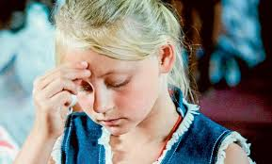
We close our Liturgy today by making the sign of the cross.
Now go forth with today’s message and spread the good news, just as Jesus did.
https://www.youtube.com/watch?v=s7GexIvX8HU
There are a few additional activities attached to the end of this power point that can be done at home.
God Bless.

Slide 12
We would love to see some of you prayers posted on dojo.

