Slide 1
Can I plan my own Three Wishes folk story?
Wednesday 14th October

Slide 2
Green Pen Time!

Slide 3

Warm Up Activity – Conjunctions
(On your wipe-boards.)
A wood nymph appeared.
The woodcutter started to chop down his tree.
…while…
…after…
…because…
…when…
…if…
…although…
Join these sentences with a conjunction.
Choose one from the conjunction cloud.
Which one is best?

Slide 4
Warm Up Activity – Conjunctions
(On your wipe-boards.)
The woodcutter was granted three wishes.
He didn’t cut down the tree.
…while…
…after…
…because…
…when…
…if…
…although…
Join these sentences with a conjunction.
Choose one from the conjunction cloud.
Which one is best?

Slide 5
Warm Up Activity – Conjunctions
(On your wipe-boards.)
Sausages appeared on the plate.
The woodcutter wished for them accidentally.
…while…
…after…
…because…
…when…
…if…
…although…
Join these sentences with a conjunction.
Choose one from the conjunction cloud.
Which one is best?

Slide 6
Warm Up Activity – Conjunctions
(On your wipe-boards.)
The king pulled and tugged at his beard.
He wished that he had never grown one.
…while…
…after…
…because…
…when…
…if…
…although…
Join these sentences with a conjunction.
Choose one from the conjunction cloud.
Which one is best?
You may need to change some of the words so that the sentence makes sense.

Slide 7
Warm Up Activity – Conjunctions
(On your wipe-boards.)
You can go down to the dungeons.
You can make a wish.
Join these sentences with a conjunction.
Put it at the start of the sentence.
Choose one from the conjunction cloud.
Which one is best?
You may need to change some of the words in the sentence so that it makes sense! Add a comma too!
…while…
…after…
…because…
…when…
…if…
…although…

Slide 8
Warm Up Activity – Conjunctions
(On your wipe-boards.)
The traveller entered the dungeons.
He shouted, “Gold!”
Join these sentences with a conjunction.
Put it at the start of the sentence.
Choose one from the conjunction cloud.
Which one is best?
You may need to change some of the words in the sentence so that it makes sense! Add a comma too!
…while…
…after…
…because…
…when…
…if…
…although…

Slide 9
The 3 Wishes Story Plot
Someone gets three wishes
The first wish is used to satisfy a desire without much real thought.
The wish is granted but the wisher realizes that the result is not what he or she really wants.
The wisher uses the second wish to change that result but, when it is granted, the wisher is unhappy with this result.
The wisher uses the third wish to go back to normal.

Slide 10
The 3 Wishes Story Plot
Someone gets three wishes
The first wish is used to satisfy a desire without much real thought.
The wish is granted but the wisher realizes that the result is not what he or she really wants.
The wisher uses the second wish to change that result but, when it is granted, the wisher is unhappy with this result.
The wisher uses the third wish to go back to normal.
Today you are going to plan your own
3 wishes story based on the same plot.

Slide 11
Can I plan my own Three Wishes folk story?
Monday 12th October
1. Main character:
Copy this into your book.

Slide 12
Can I plan my own Three Wishes folk story?
Monday 12th October
1. Main character: Fisherman
Copy this into your book.
Your story is going to be about a fisherman.

Slide 13
Can I plan my own Three Wishes folk story?
Monday 12th October
1. Main character: Fisherman
Copy this into your book.
2. Main settings:

Slide 14
Can I plan my own Three Wishes folk story?
Monday 12th October
Copy this into your book.
Your story is going to be set in a cottage by a lake.
1. Main character: Fisherman
2. Main settings: his cottage and a lake

Slide 15
Can I plan my own Three Wishes folk story?
Monday 12th October
Copy this into your book.
1. Main character: Fisherman
2. Main settings: his cottage and a lake
3. Opening sentence:

Slide 16
Can I plan my own Three Wishes folk story?
Monday 12th October
Copy this into your book. Finish off the sentence.
1. Main character: Fisherman
2. Main settings: his cottage and a lake.
3. Opening sentence: Once there lived a poor fisherman who lived …
4. Who gives the wishes:

Slide 17
Can I plan my own Three Wishes folk story?
Monday 12th October
1. Main character: Fisherman
2. Main settings: his hut and a lake.
3. Opening sentence: Once there lived a poor fisherman who lived …
4. Who gives the wishes: A huge snapper fish.
Describe the fish.

Slide 18
5. The first wish:
Greedy Wish
6. The second wish:
Accidental Wish!
7. The third wish:
Wish that put things right again
8. How the story ends:
What does the main character learn?
Decide what the characters might wish for. Write down your ideas in your books.

Slide 19
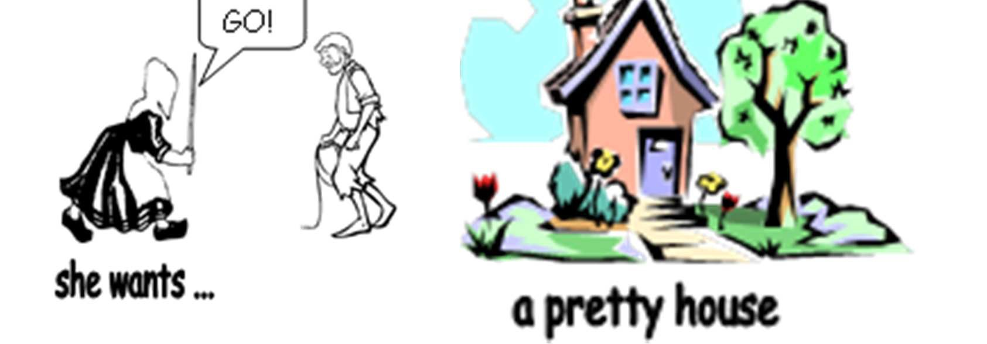
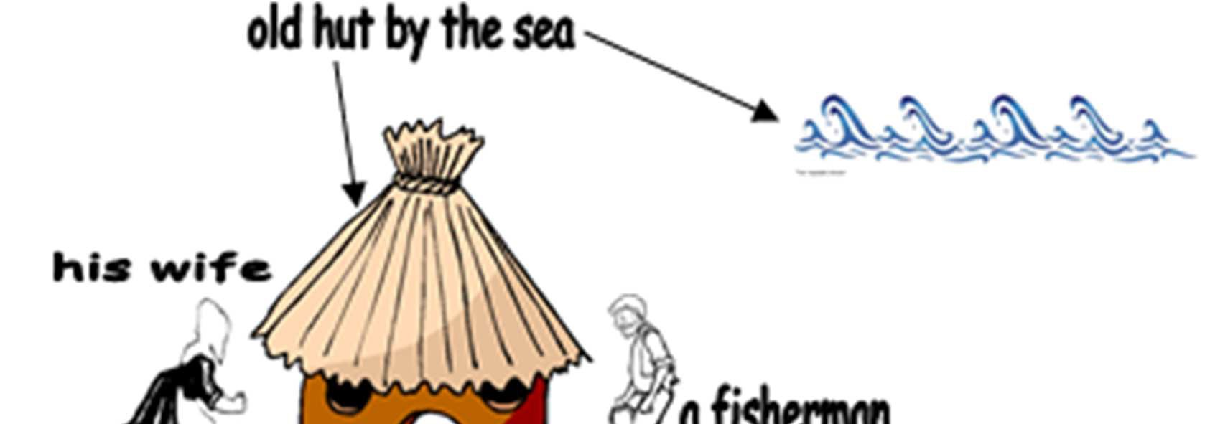
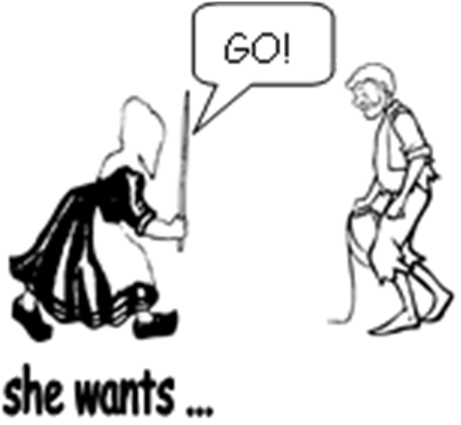

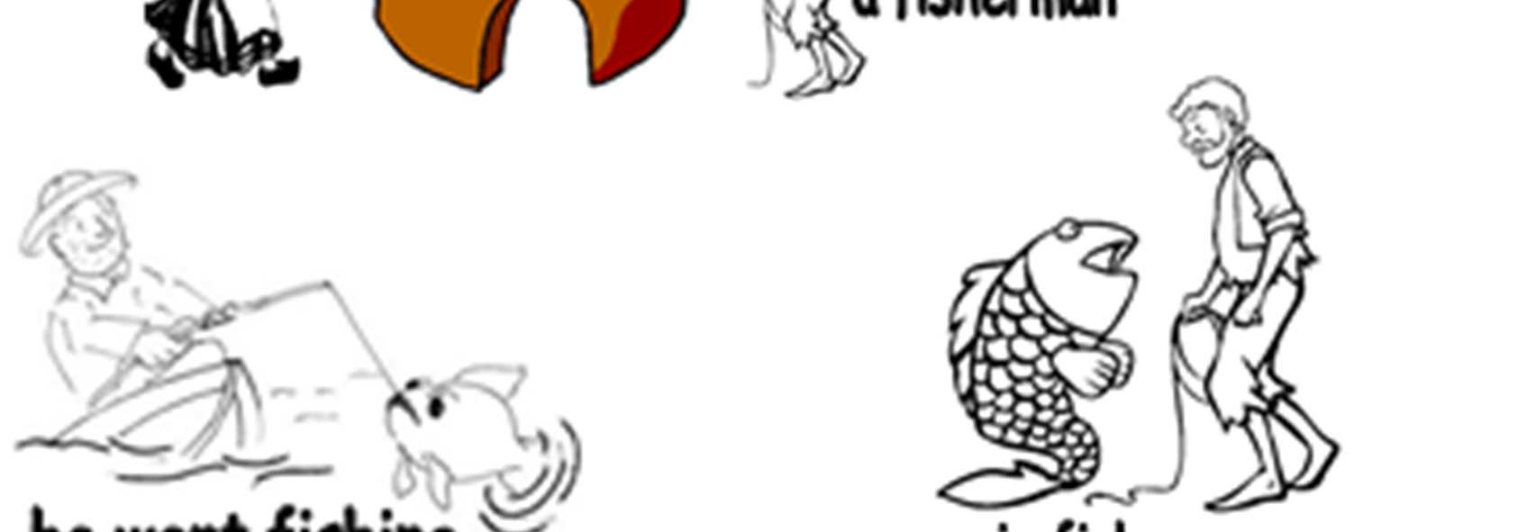
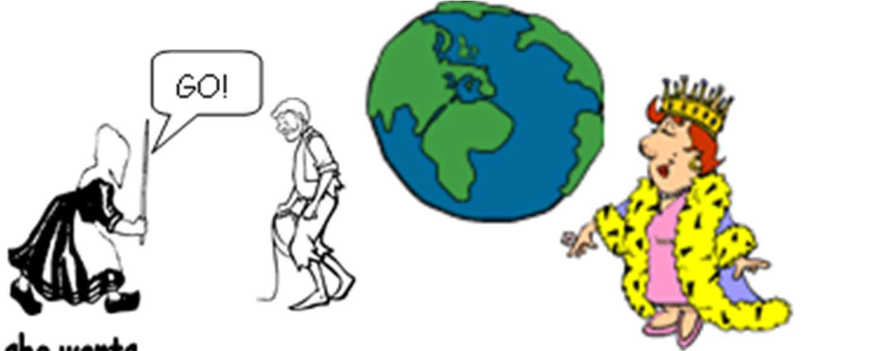
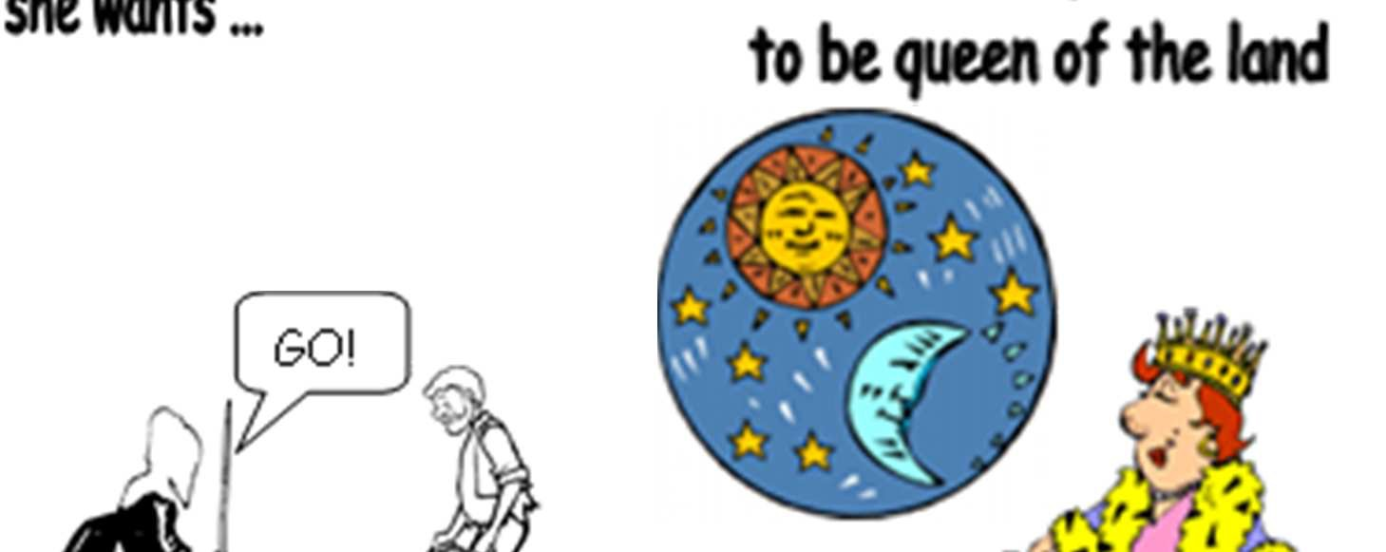
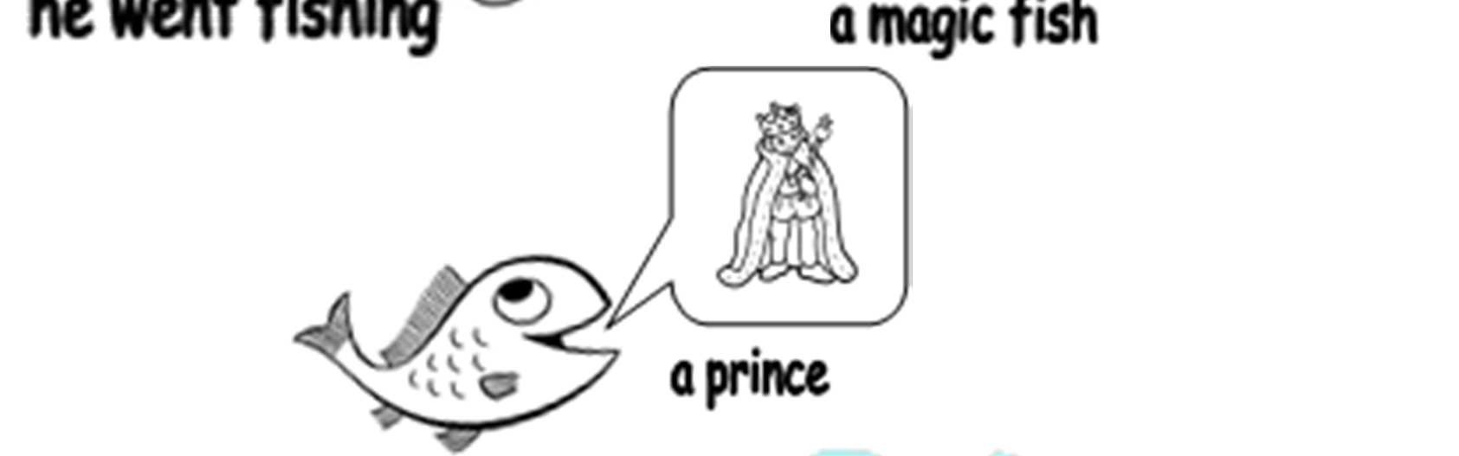
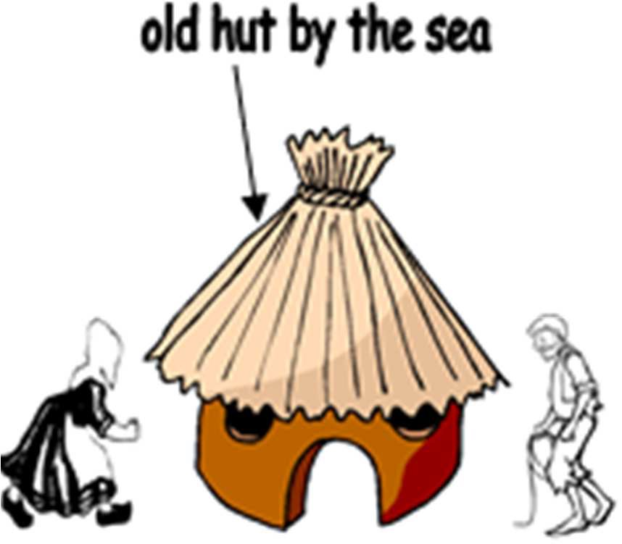
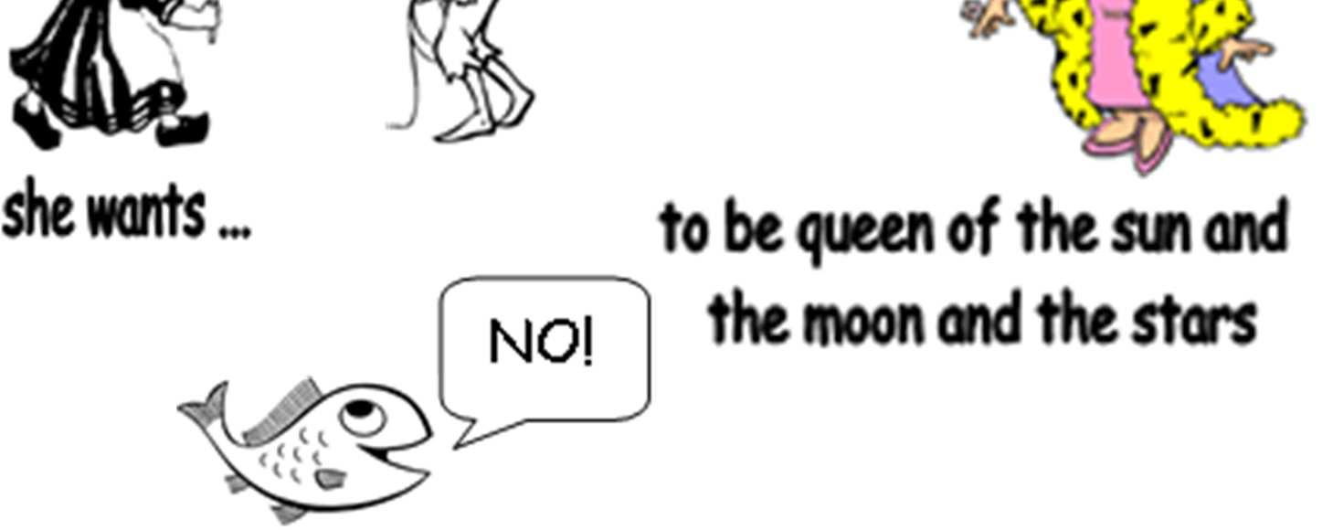
3.
1.
1st wish
4.
2nd wish
5.
a castle
2.
3rd wish
7.
3 Wishes
6.
…if you let me go!
Story Plan - The fish and the Three Wishes!
SEN help sheet

Slide 20
The 3 Wishes Story Plot
Someone gets three wishes
The first wish is used to satisfy a desire without much real thought.
The wish is granted but the wisher realizes that the result is not what he or she really wants.
The wisher uses the second wish to change that result but, when it is granted, the wisher is unhappy with this result.
The wisher uses the third wish to go back to normal.

Slide 21
Plenary
Let’s share our ideas.

