Slide 1
This week, post at least two pieces of your work onto Class Dojo
For great work posted, there will be dojos given out!

Slide 2
Literacy Lesson 1

Slide 3
What are Adverbs?
Remind yourself of the work you did on adverbs last week.

Slide 4
Example Adverbs:
Adverbs often end in –ly…
…but not every time!

Slide 5
Warm Up: Adverbs
Can you spot the adverb in these sentences?
Task: Underline the adverbs in these sentences.
Jane carefully opened the door to the washing machine.
Cautiously, Jane held out her hand and felt cool water between her fingers.
Immediately, Jane gulped a gallon of air and entered the washing machine.
Jane quickly followed the glowing light.
Hungrily, the shark was circling Jane’s body.
Answers on the next slide…

Slide 6
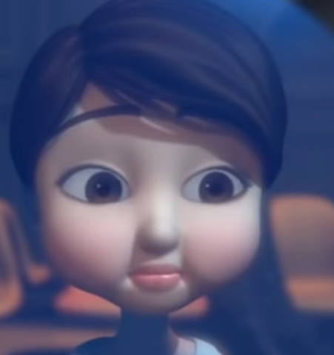
Warm Up: Adverbs – Answers!
Can you spot the adverb in these sentences?
Task: Underline the adverbs in these sentences.
Jane carefully opened the door to the washing machine.
Cautiously, Jane held out her hand and felt cool water between her fingers.
Immediately, Jane gulped a gallon of air and entered the washing machine.
Jane quickly followed the glowing light.
Hungrily, the shark was circling Jane’s body.
Note:
What punctuation has been added when the sentence is started with an adverb?

Slide 7
This week you ae going to write a fantasy story/story set in an imaginary world based on the following video clip.
https://www.literacyshed.com/something-fishy.html
You can write it as if you are the girl (first person) or give the girl a name
Spend some time watching the video clip. Watch it a couple of times because you might miss something!
Think about the story in three parts.
An opening – Describing the setting and character
Middle – Where does she go? What is it like? What happens to her?
Ending – How does she return? How will you leave you reader feeling at the end?

Slide 8
Today you are going to write the opening to your story. Remember to think about setting and character. Try to include the following features.
Describe the setting and introduce the character
Use sentences beginning with verbs and adverbs.
e.g. Confused, Jane crept towards the glowing washing machine.
Carefully, she prized open the door and peered inside.
Use a range of adjectives .
e.g. After a while, her eyes became heavy and she felt tired and sleepy.
Leave the reader thinking what is going to happen next?
e.g. “Is anyone there?” shouted Laura into the machine
“Come inside!” a voice echoed back.
Make it a super opening! Don’t go into the machine yet, that comes next!

Slide 9
Example opening – Written by Finley Milne aged 8
One sunny evening, Laura was sat all alone in the laundrette reading her favourite book. After a while, she began to feel tired and sleepy so she stretched out her arms, yawned and closed her eyes. Suddenly, she was awoken by a bright light that filled the whole room and it was coming from the washing machine. Confused, Laura crept towards the glowing machine and carefully peered inside.
“Hello. Is anyone there?” shouted Laura, into the machine.
“Come inside!” an eerie voice called back.

Slide 10
Literacy Lesson 2

Slide 11
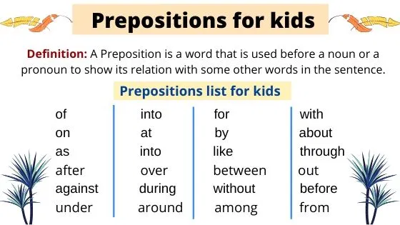
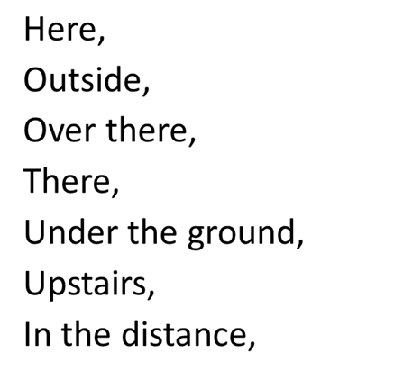
Warm up task:
Using prepositions for where at the beginning of our sentences. Think of prepositions to use in your story.
Examples
,

Slide 12
Remind yourself of the video clip from yesterday. Watch the part where the girl enters the washing machine. Make a list of adjectives you could use to describe the world she is in?
Today you are going to write the middle part of your story, when your character enters the washing machine.
Middle – Where does she go? What is it like? What happens to her?
https://www.literacyshed.com/something-fishy.html

Slide 13
Example middle part – Written by Finley Milne aged 8
Immediately, Laura gulped a gallon of air and dived inside, following a quickly moving light. Gliding through the water, she saw a beautiful underwater world of pink dancing coral and groups of yellow sock fish zooming around. She felt wonderful as she felt the cool water on her body. Then, Laura followed a stray sock fish into the deep, dark water. Suddenly, out of the shadows, a pant shark with sharp, gleaming teeth appeared. Menacingly, he began to circle Laura’s shivering body. Panicking and swimming for her life, Laura swam towards the distant shining light for safety.

Slide 14
Literacy Lesson 3

Slide 15
Warm Up - Verbs
Rewrite the sentences and replace the verbs with more interesting ones.
The yellow sock fish swam.
Jane opened the door and looked inside.
The shark pant fish circled a frightened Jane.
Jane landed on the laundrette floor and sighed with relief.

Slide 16
Remind yourself of the video clip from yesterday. Watch the part where the girl is swimming away from the shark, towards the door and back into the laundrette.
Today you are going to write the end part of your story.
Ending – How does she return? How will you leave you reader feeling at the end?
https://www.literacyshed.com/something-fishy.html

Slide 17
Example ending- Written by Finley Milne aged 8
Hungrily, the sharp was biting and chomping at her feet. All of a sudden, Laura reached the door and dived through. Her heart was pounding that much she thought it would come through her chest. Breathing heavily, she reached out to touch the soaking wet jeans on the floor beside her. Had she imagined what had just happened to her? She steadied herself ready to get up when, she felt a presence behind her.
“I think they are mine.”
Slowly, Laura turned around……..

