Slide 1

Let’s remind ourselves of what we have covered so far in our discussion text unit.

Slide 2
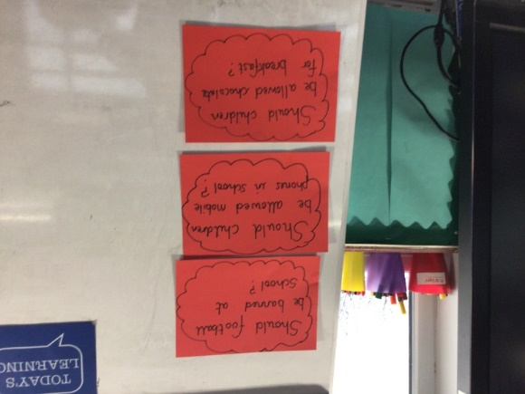
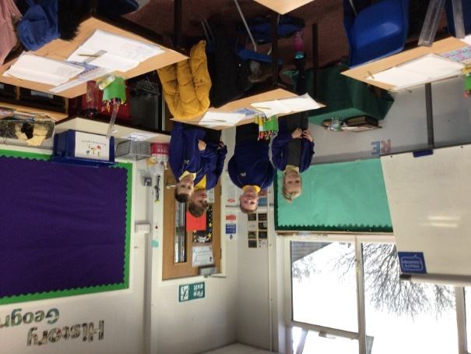
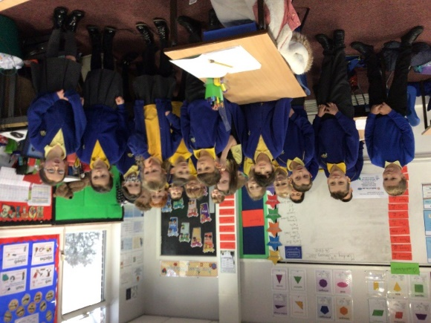
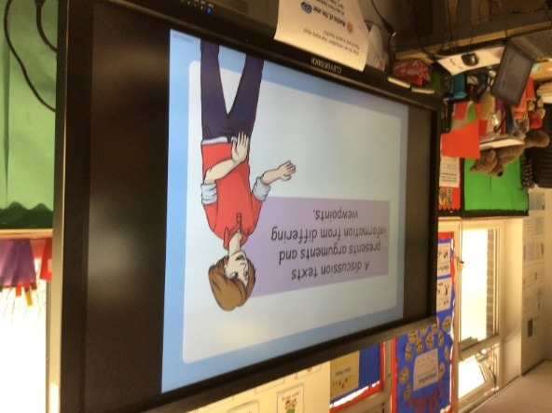
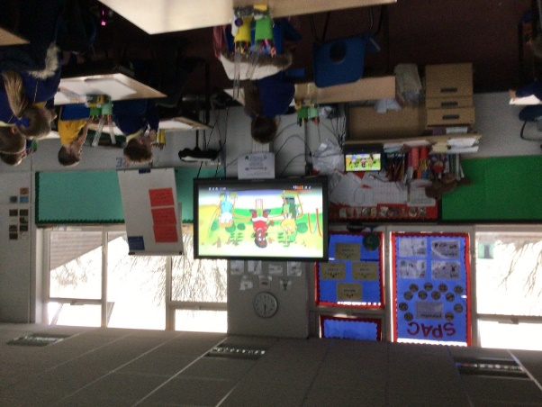
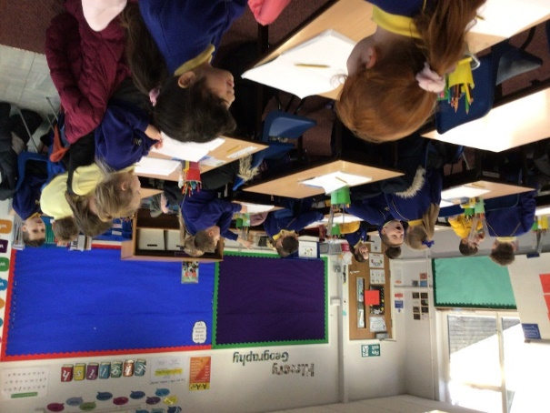
Creating interest in our discussion texts unit. We discussed differing viewpoints on some topics and gave reasons for our opinions. We were really good at using the language of discussion.
For
Against

Slide 3
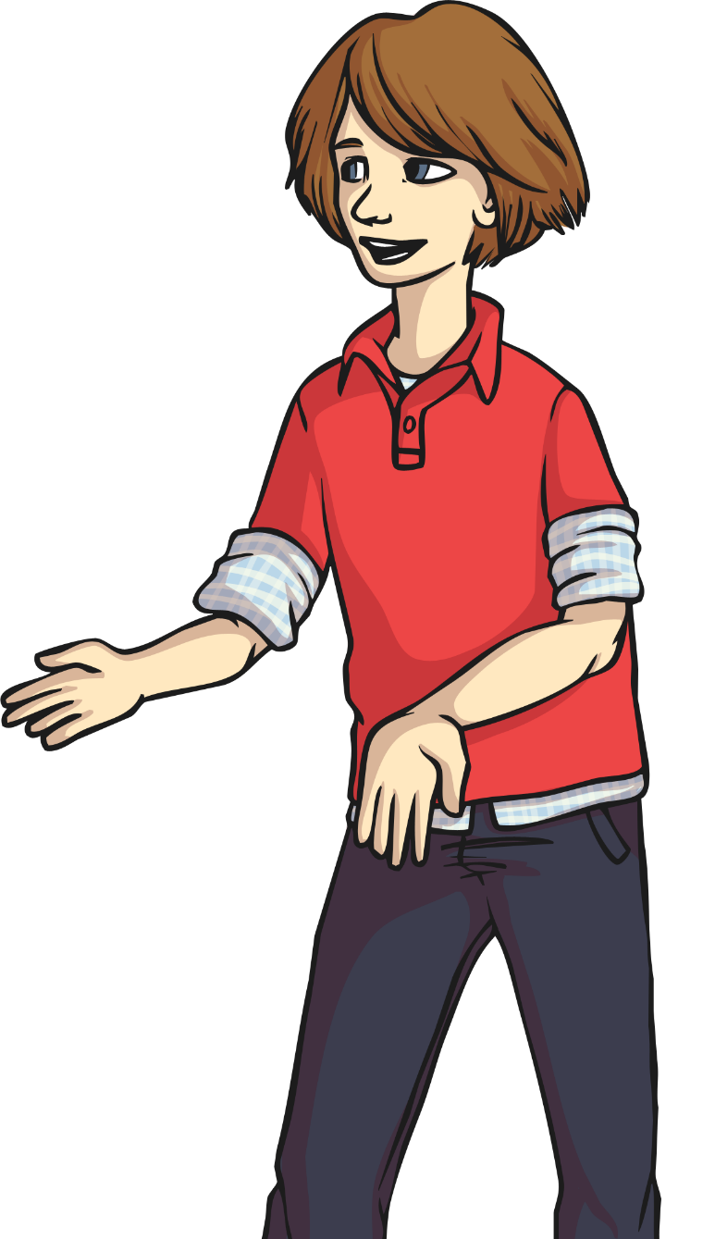

A discussion texts presents arguments and information from differing viewpoints.
It gives reasons for and against an argument.

Slide 4
Let’s take a look at an example of a question that we can discuss. We will then think about the reasons for and against what is being said.

Slide 5
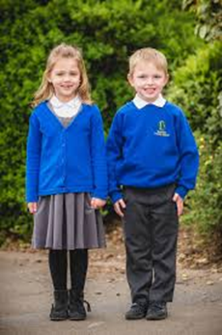
Should children wear school uniform?
Arguments for why they should?
Do you agree? Yes or No
Why?
Arguments for why they should NOT?

Slide 6

Watch the following clip where some children are discussing whether we should wear a school uniform or not.
Listen to the reasons for wearing a school uniform
Listen to the reasons against wearing a school uniform
https://www.bbc.co.uk/bitesize/clips/z2ftsbk
How do they back up their opinions?
What arguments for and against did the children give?

Slide 7
For school uniform
Against school uniform
You should take pride in your appearance for school
It is important to look smart for school and not scruffy
Identify children on school trips. Stops them from getting lost and keeps them safe.
Stops children competing to wear the nicest clothes.
School uniform is expensive and children grow out of it quickly
Teacher’s don’t have to wear uniform so why should children. It should be the same rules for both.
It is boring because you can’t choose what you want to wear.

Slide 8
Let’s now have a go at saying some sentences to present different points of view.
Use the sentence starters on the following slide to help you.

Slide 9
I believe children should wear school uniform because________________
I think that children should not wear school uniform because _____________
Wearing school uniform is a good idea because _____________
Wearing school uniform is not a good idea because ______________
Although some people think that school uniform is a good idea, I think that ___
Although some people think that wearing school uniform is a bad idea, I think that__
Children should wear school uniform because _____________________
Children should not wear school uniform because __________________

Slide 10
Take a look at the following pictures and decide whether the jobs you see are for males or females.

Slide 11
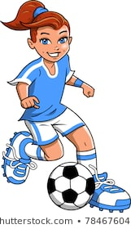
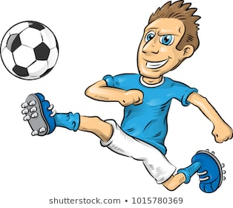
Footballer

Slide 12
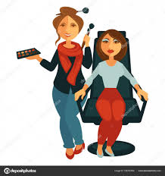
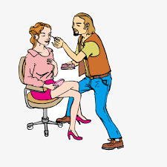
Beautician

Slide 13
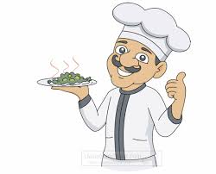

Chef

Slide 14
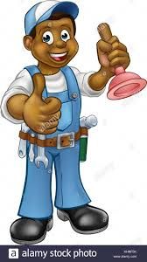

Plumber

Slide 15
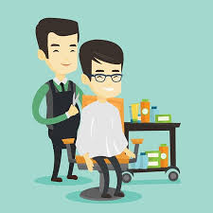
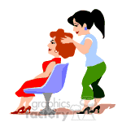
Hairdresser

Slide 16
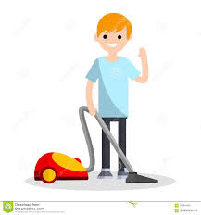
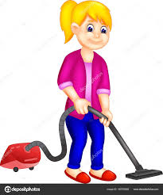
Cleaner

Slide 17

Should boys learn cookery?
Arguments For why they should?
Do you agree? Yes or No
Why?
Arguments For why they should NOT?

Slide 18
Should boys learn cookery?
In our class we have been discussing whether or not boys as well as girls should have to learn cookery.
Some of the class believe that all children should have to learn cookery. They have a number of reasons for suggesting this. Their first reason is that when you leave home, you have to be able to look after yourself, and this involves cooking. Another reason is that many girls do not enjoy cooking and would not want to cook for their husbands. Furthermore, it is not fair that a man should be able to sit and watch television while their girlfriend is cooking. These people argue that everyone should learn to cook because they will need this skill in life and because people should help each other and take turns.
On the other hand, there are quite a few people in our class who believe that boys should not bother with cookery. They argue that boys could easily buy a take-away or use a microwave meal. They believe that if they do not enjoy cooking then they should not have to do it. Some people just say that cooking is a job for girls. They think that boys’ time would be better spent if they learned how to mend a car or build things.
Finally, having listened to all arguments that people have suggested I have made my own mind up. I believe that girls and boys should learn subjects that will help them with everyday living. This means that everyone should learn cookery as well as how to mend a car. This would mean that people could choose what to do depending on what they like and what they are good at.
What is the question being discussed?
What are the reasons for?
What are the reasons against?
What is the person’s final opinion? Why?

Slide 19
Should boys learn cookery?
Reasons For:
Reasons Against:
Need to look after yourself when you leave home.
Boys can easily buy a take away or use a microwave meal.
People should help each other and take turns.
If they do not enjoy cooking they should not have to do it.
Some girls do not enjoy cooking and do not want to spend their time cooking.
It is a job for girls.
What is your opinion on this subject?
Unfair if a man has time to relax and watch TV while a girl has to cook.
Boys should be fixing cars or building things.

Slide 20
Yesterday you read the discussion text ‘Do Cats Make Good Pets?’ and you had to find the arguments for and against and write them in a table. See how you got on, on the next slide.

Slide 21
Do cats make good pets?
Reasons For:
Reasons Against:
They are very clean as they look after their coats.
They always go to the toilet outside or in a litter tray.
Cats are cuddly and beautiful.
Cats do not need a lot of food.
Cats like to be stroked and make a purring noise.
Cats kill birds and small animals.
You can’t take a cat for a walk and they hate riding in cars.
Cats scratch and spit when they are angry.
They do not protect their house like a dog.
What is your opinion on this subject?

Slide 22
Write today’s date and objective in your home learning book.
Thursday 8th January 2021
Can I answer questions about a discussion text?
Remember to be proud of your work and use your best presentation and handwriting

Slide 23
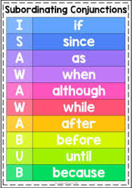
Warm up
Using conjunctions to create complex sentences.
Write these sentences out in your home learning book and underline the conjunction.
If children do not wear a school uniform, they will look scruffy and untidy.
Children need to be recognised easily while they are on a school trip.
Although some children feel uncomfortable in a school uniform, it makes them look smart and respectable.
Children can wear their own clothes after they have finished school.

Slide 24
Warm up
Let’s see if you got them correct.
If children do not wear a school uniform, they will look scruffy and untidy.
Children need to be recognised easily while they are on a school trip.
Although some children feel uncomfortable in a school uniform, it makes them look smart and respectable.
Children can wear their own clothes after they have finished school.

Slide 25


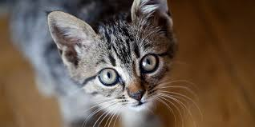
So far we have read a discussion text on the following topics.
Should children wear a school uniform?
Should boys learn cookery?
Do cats make good pets?

Slide 26
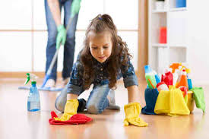
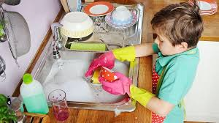
Today we are going to be answering questions about a discussion text. We will read a different one together and look at the strategies for how we can answer the questions.
Before we begin, the discussion text is called, ‘Should children do housework?’
What are your thoughts? What do you think some of the points for children doing housework will be? What do you think some of the points against will be?

Slide 27
What is the title of the discussion text?
Give two reasons for children doing housework.
Give two reasons against children doing housework.
Find a different word for ‘job’ in the text.
What is your opinion about children doing housework? Why?
Answers on the next slide.
Find one word that means the same as working in a better way.

Slide 28
The title of the discussion text is ‘Should children do housework’.
Two reasons for children doing housework are that it is unfair if the adult in every house has to do all the work and that when children ware older they have to look after themselves and this is good preparation.
Two reasons against children doing housework are that when you are a child you should be free to do watch TV, play computer games and read comics and that household jobs are boring.
The word that means job is chores
I think children should be responsible for helping at home especially with cleaning and tidying their own bedrooms.
The word efficient means working in a better way.

Slide 29
Task
Read the discussion text through carefully. There is an easier one (Do cats make better pets? and a harder one Should children do homework?) Now answer the questions about the text in full sentences in your home learning book. You can do both if you wish!
When you write your answer, remember to use the question to help you write your sentence.
Example
Question - What is the title of the discussion text?
Answer- The title of the discussion text is ‘Should children do housework?’
Be proud of your work and earn extra dojos!

Slide 30
Do Cats Make Good Pets
Answer these questions in full sentences in your book.
What is the title of the discussion text?
Why is this class discussing this topic?
Write 2 reasons why cats make good pets.
Write 2 reasons why cats do not make good pets.
What do cats do when they are angry?
What do cats do when they are stoked?
Find the word that means the same as guard.
In your opinion which is the best pet to have? Give three reasons. Start your answer with: I think the best pet to have is………
Can you think of three reasons for having a dog as a pet and three reasons against? Set it out in a table – for/against

Slide 31
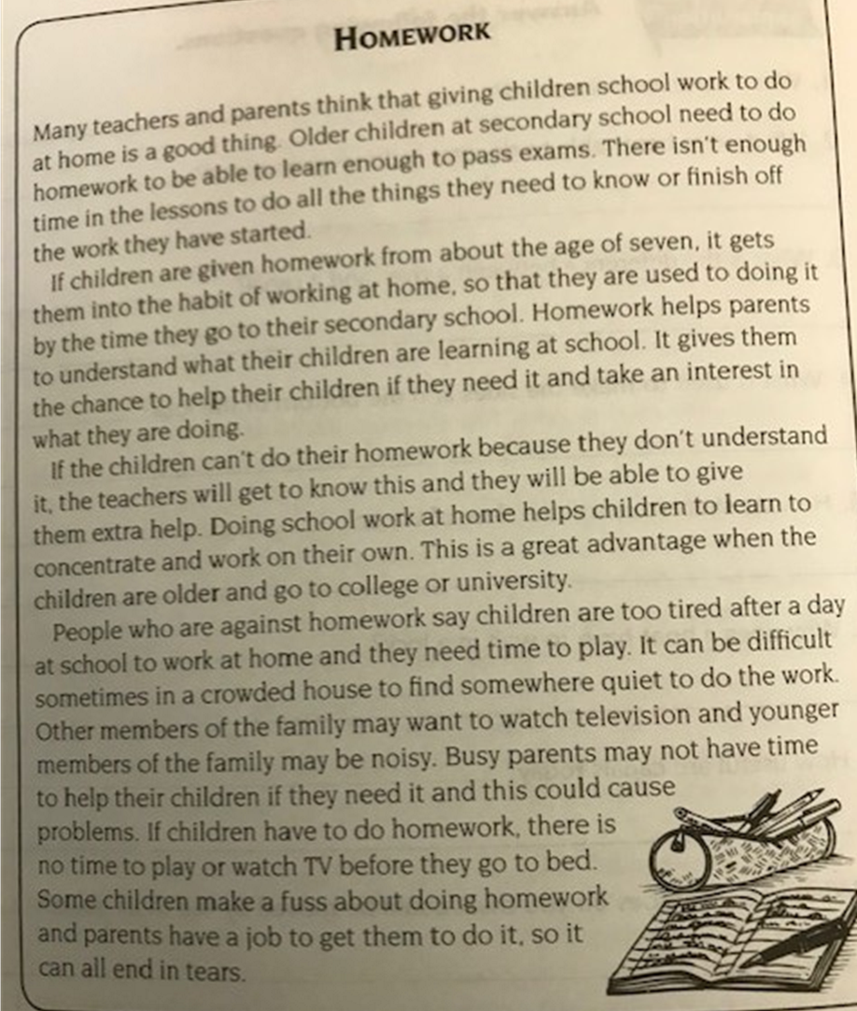

Slide 32
Don’t forget to make us smile and post work onto Class Dojo!
For great work posted, there will be dojos given out!

