Slide 1
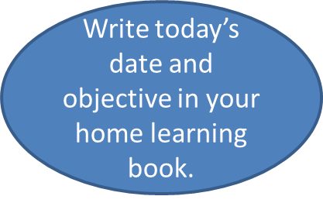
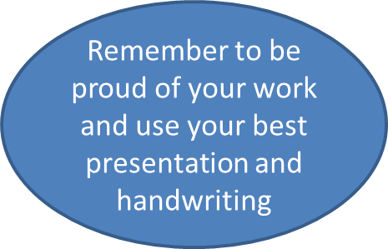

Friday 9th January 2021
Can I identify the structure of a discussion text?

Slide 2
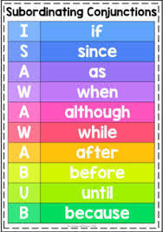
Warm up
Using conjunctions to create complex sentences.
Can you add a conjunction to these complex sentences?
Boys should learn cookery ___________ they need to be able to look after themselves.
Children need to have homework _________ they are at school __________ parents need to know what they have been learning.
___children do not wear a school uniform, then they will look scruffy and untidy.
Homework is essential for children ______ they are at school.

Slide 3
Warm up
Using conjunctions to create complex sentences.
How did you get on?
Boys should learn cookery because they need to be able to look after themselves.
Children need to have homework while they are at school because parents need to know what they have been learning.
If children do not wear a school uniform, then they will look scruffy and untidy.
Homework is essential for children when they are at school.

Slide 4
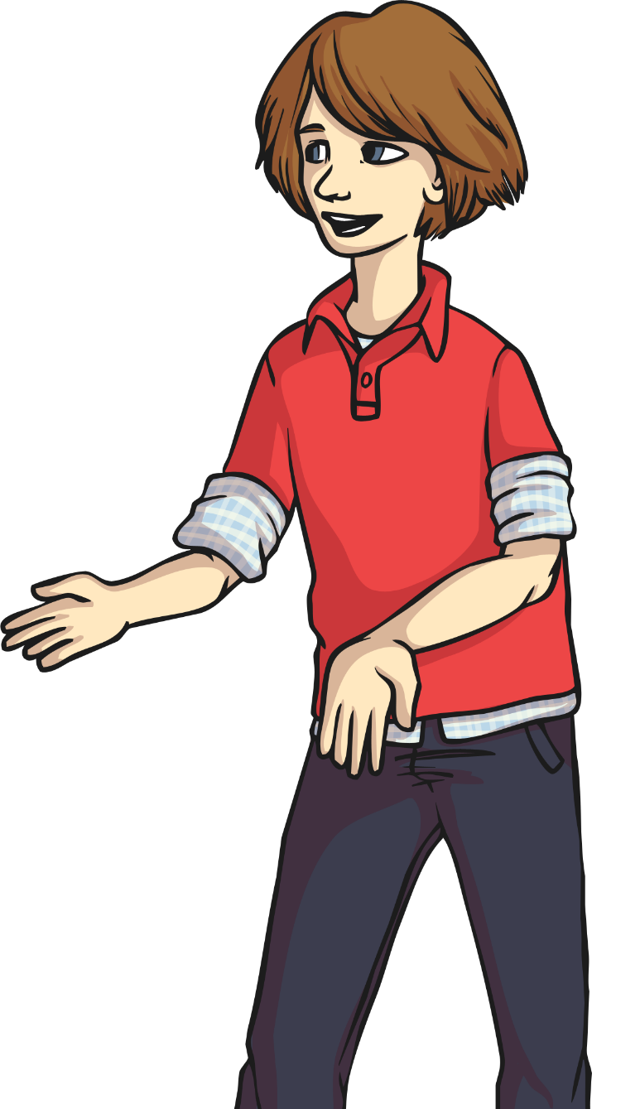
A discussion texts presents arguments and information from differing viewpoints.
It gives reasons for and against an argument.

Slide 5
Yesterday we were looking at different discussion texts and answering questions about what we had read. Check on the next slides to see how you got on.

Slide 6
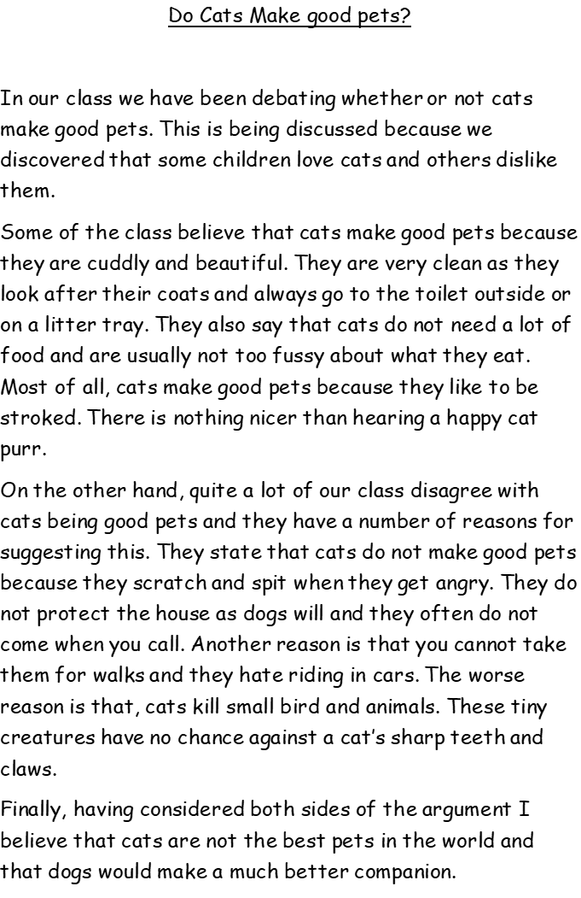
The title of the discussion text is ‘Do cats make good pets?’
The class are discussing this because they discovered that some children love cats and others dislike them.
Two reasons why cats make good pets are they are beautiful and cuddly and like to be stroked (other answers from the for cats section would be adequate)
Two reasons against why cats don’t make good pets is because they scratch and spit and they do not protect the house like a dog (other answers from the against cats section will be adequate)
Cats scratch and spit when they get angry.
Cats purr when they are stroked.
The word that means the same as guard is protect.
I think the best pet to have is……..
Three reasons for having a dog are – they are very loyal, you can take them on walks and they can protect your property
Three reasons against having a dog are – you have to clean up their mess, they can get muddy on walks and they can chew your things

Slide 7
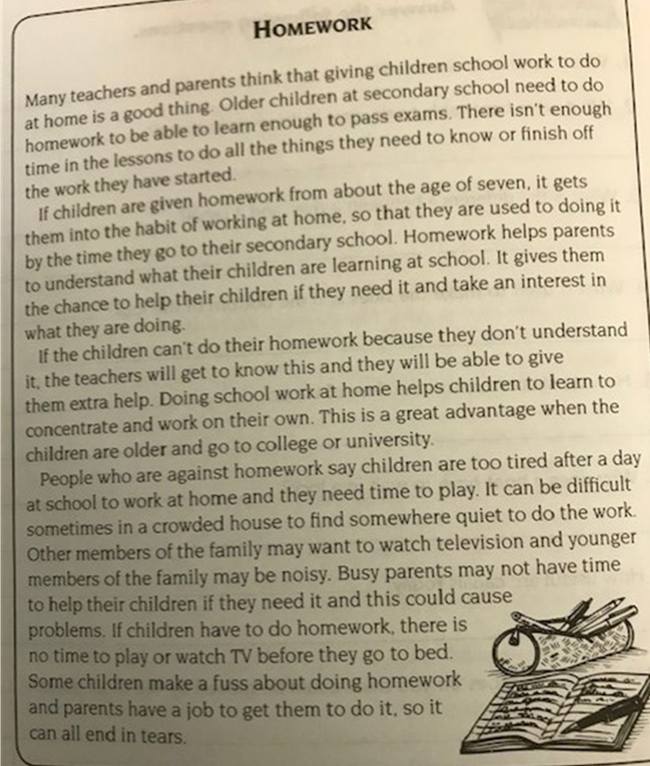
Older children need to do school work at home because they need to learn enough to be able to pass exams.
Three reasons for homework are homework helps parents to understand what their children are learning and to help them at home, it gets them into good habits and it helps them to concentrate on their own.
Three reasons against homework are that people say that children are too tired after a day at school. It can also be too crowded in some houses to find a quiet place to work and busy parents might not have the time to help their children and this could cause problems.
It could be difficult to find a quiet place to work if you live in a crowded house.
Children might fuss about homework because they don’t want to do it and parents have a job to make them do it so it all ends in tears.
Younger children are given homework because it gets them into the habit of working at home.
My opinion on homework is……..
3 reasons for banning playtimes – some children play in a rough way and hurt others, it is also a big chunk of learning time lost and break time interrupts valuable learning time.
3 reasons against banning playtimes – children need to exercise and run around, children need to eat toast and fruit to give them energy and children need to have time to go to the toilet.

Slide 8
Today we are going to look at how a discussion text is organised.
Look at the discussion text about whether boys should learn cookery and see if you can spot anything that is wrong with it.

Slide 9
Finally, having listened to all arguments that people have suggested I have made my own mind up. I believe that girls and boys should learn subjects that will help them with everyday living. This means that everyone should learn cookery as well as how to mend a car. This would mean that people could choose what to do depending on what they like and what they are good at.
Some of the class believe that all children should have to learn cookery. They have a number of reasons for suggesting this. Their first reason is that when you leave home, you have to be able to look after yourself, and this involves cooking. Another reason is that many girls do not enjoy cooking and would not want to cook for their husbands. Furthermore, it is not fair that a man should be able to sit and watch television while their girlfriend is cooking. These people argue that everyone should learn to cook because they will need this skill in life and because people should help each other and take turns.
Should boys learn cookery?
On the other hand, there are quite a few people in our class who believe that boys should not bother with cookery. They argue that boys could easily buy a take-away or use a microwave meal. They believe that if they do not enjoy cooking then they should not have to do it. Some people just say that cooking is a job for girls. They think that boys’ time would be better spent if they learned how to mend a car or build things.
In our class we have been discussing whether or not boys as well as girls should have to learn cookery.
Can you tell me what is wrong with this discussion text?

Slide 10
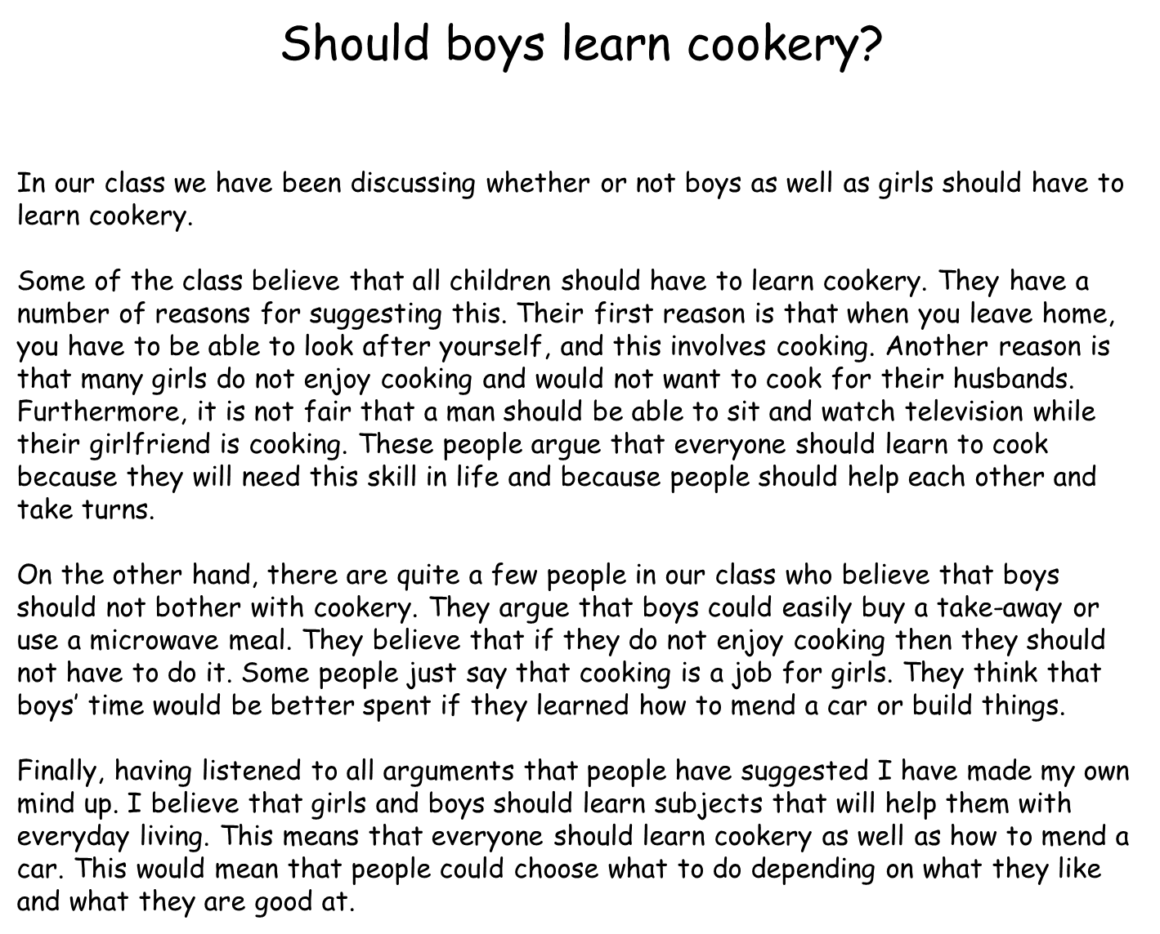
It was written in the wrong order! It is really important that a discussion text follows the following structure. When we have identified them we will add them to our working wall.

Slide 11
Should boys learn cookery?
In our class we have been discussing whether or not boys as well as girls should have to learn cookery.
Some of the class believe that all children should have to learn cookery. They have a number of reasons for suggesting this. Their first reason is that when you leave home, you have to be able to look after yourself, and this involves cooking. Another reason is that many girls do not enjoy cooking and would not want to cook for their husbands. Furthermore, it is not fair that a man should be able to sit and watch television while their girlfriend is cooking. These people argue that everyone should learn to cook because they will need this skill in life and because people should help each other and take turns.
On the other hand, there are quite a few people in our class who believe that boys should not bother with cookery. They argue that boys could easily buy a take-away or use a microwave meal. They believe that if they do not enjoy cooking then they should not have to do it. Some people just say that cooking is a job for girls. They think that boys’ time would be better spent if they learned how to mend a car or build things.
Finally, having listened to all arguments that people have suggested I have made my own mind up. I believe that girls and boys should learn subjects that will help them with everyday living. This means that everyone should learn cookery as well as how to mend a car. This would mean that people could choose what to do depending on what they like and what they are good at.
A title- what is being discussed. This is normally a question.
An opening paragraph which states what is being discussed (introduction)
The reasons for
The reasons against
A final paragraph stating your opinion

Slide 12
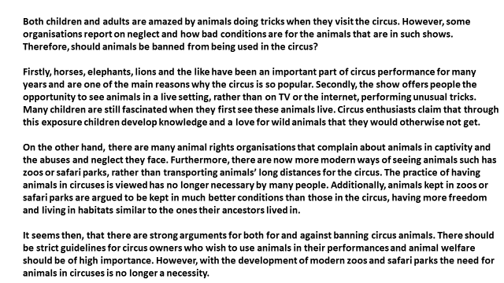
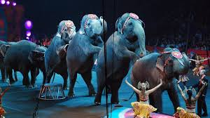
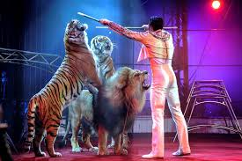
Let’s take a look at one more example. See if you can spot the features that we have just looked at together.

Slide 13

The reasons for
What is missing from this discussion text?
An opening paragraph/
introduction
Should animals perform in circuses?
A final paragraph stating your opinion
The reasons against

Slide 14
Checklist for the structure of a discussion text
Clear title that shows what is being discussed
Opening paragraph/introduction – states what is being discussed and why
Paragraph with reasons for.
Paragraph with reasons against
Final paragraph stating your views and provide reasons

Slide 15
Checklist for the structure of a discussion text
Clear title that shows what is being discussed
Opening paragraph/introduction – states what is being discussed and why
Paragraph with reasons for.
Paragraph with reasons against
Final paragraph stating your views and provide reasons

Slide 16
Task
If you can, print of the discussion text that is on the next slide. Stick it in your home learning book and find the features (slide 15) by drawing a line to this part and labelling it.
If you can not print the discussion text of, then in home learning book copy neatly the checklist for a discussion text (slide 15) You will need this for next week’s learning.

Slide 17
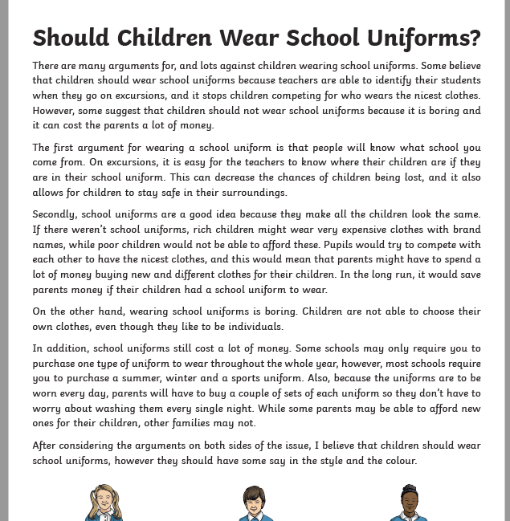

Slide 18
Don’t forget to make us smile and post work onto Class Dojo!
For great work posted, there will be dojos given out!

