Slide 1

On Monday we began our new unit on discussion texts.
Remind yourself of what a discussion text is by reading the next few slides.

Slide 2
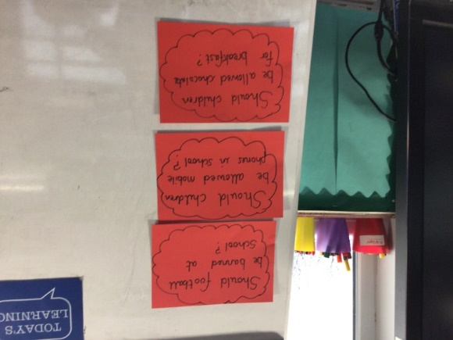
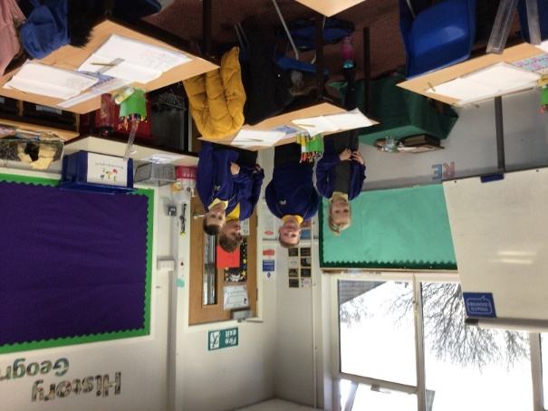
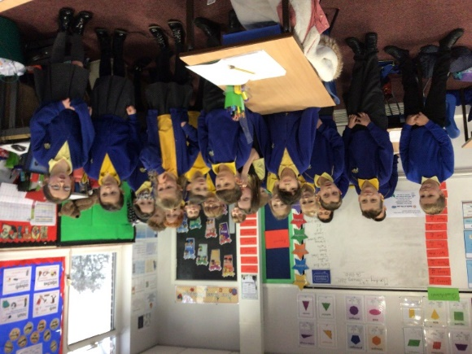
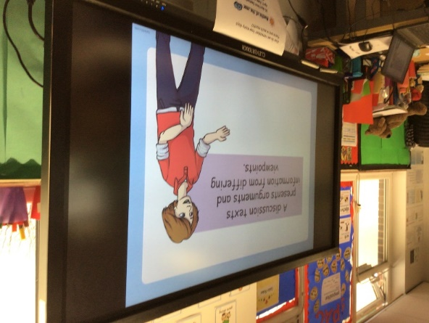
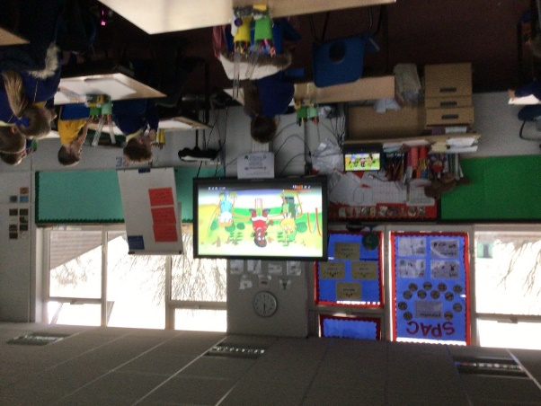
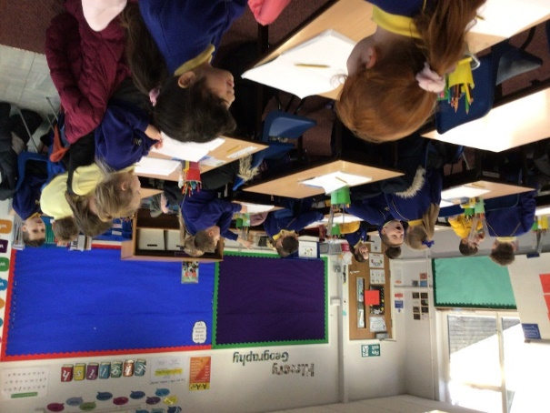
Creating interest in our discussion texts unit. We discussed differing viewpoints on some topics and gave reasons for our opinions. We were really good at using the language of discussion.
For
Against

Slide 3
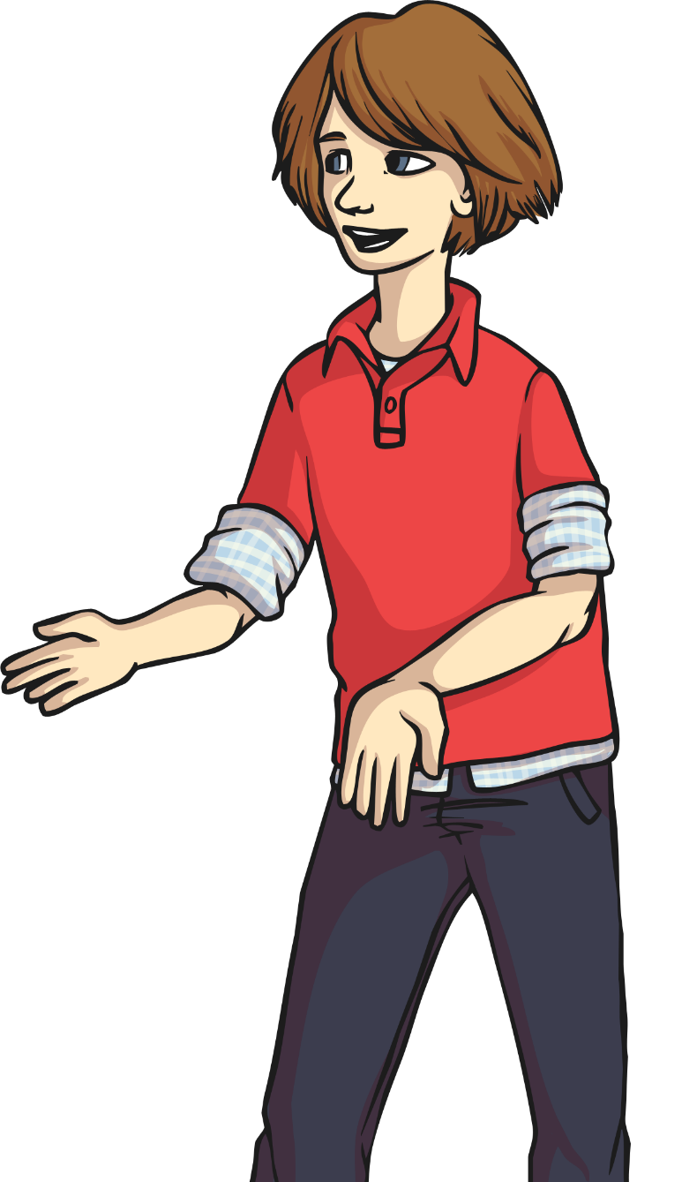

A discussion texts presents arguments and information from differing viewpoints.
It gives reasons for and against an argument.

Slide 4
Let’s take a look at an example of a question that we can discuss. We will then think about the reasons for and against what is being said.

Slide 5

Should children wear school uniform?
Arguments for why they should?
Do you agree? Yes or No
Why?
Arguments for why they should NOT?

Slide 6
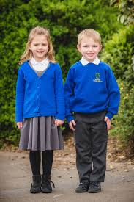
Watch the following clip where some children are discussing whether we should wear a school uniform or not.
Listen to the reasons for wearing a school uniform
Listen to the reasons against wearing a school uniform
https://www.bbc.co.uk/bitesize/clips/z2ftsbk
How do they back up their opinions?
What arguments for and against did the children give?

Slide 7
For school uniform
Against school uniform
You should take pride in your appearance for school
It is important to look smart for school and not scruffy
Identify children on school trips. Stops them from getting lost and keeps them safe.
Stops children competing to wear the nicest clothes.
School uniform is expensive and children grow out of it quickly
Teacher’s don’t have to wear uniform so why should children. It should be the same rules for both.
It is boring because you can’t choose what you want to wear.

Slide 8
Let’s now have a go at saying some sentences to present different points of view.
Use the sentence starters on the following slide to help you.

Slide 9
I believe children should wear school uniform because________________
I think that children should not wear school uniform because _____________
Wearing school uniform is a good idea because _____________
Wearing school uniform is not a good idea because ______________
Although some people think that school uniform is a good idea, I think that ___
Although some people think that wearing school uniform is a bad idea, I think that__
Children should wear school uniform because _____________________
Children should not wear school uniform because __________________

Slide 10
Write today’s date and the objective in your home learning book
Wednesday 6th January 2021
Can identify the arguments for and against in a discussion text?
Be proud of your work. Use your best handwriting and presentation and earn extra dojos!

Slide 11
Warm-up: Main and Subordinate clauses
The MAIN clause in a sentence contains the main idea or action : Sam went to bed
The SUBORDINATE clause in a sentence contains another idea or action: because she was tired.
Sam went to bed because she was tired.
Could we make this a complex sentence?

Slide 12
Write out these sentences in your home learning book and identify the main clause and the subordinate clause in these sentences
Children should not be allowed chocolate because there is too much sugar in it.
Children should be allowed to eat ice cream if they eat all their lunch.
Grandma said I could go out to play if I finished my homework.
Cats do make good pets even though they like to catch mice.
Homework should not be banned even if children do not like doing it.
Notes:
Because there is too much sugar in it, children should not be allowed chocolate.

Slide 13
How did you get on?
The main clause is underlined and the subordinate clause is in red.
Children should not be allowed chocolate because there is too much sugar in it.
Children should be allowed to eat ice cream if they eat all their lunch.
Grandma said I could go out to play if I finished my homework.
Cats do make good pets even though they like to catch mice.
Homework should not be banned even if children do not like doing it.
Remember you can use the subordinate clause at the beginning of your sentence to make complex sentences. But do not forget your comma!
Because there is too much sugar in it, children should not be allowed chocolate.
Notes:
Because there is too much sugar in it, children should not be allowed chocolate.

Slide 14
Take a look at the following pictures and decide whether the jobs you see are for males or females.

Slide 15
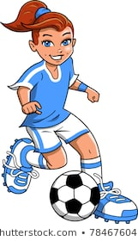
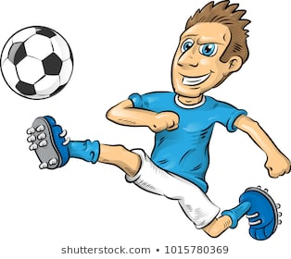
Footballer

Slide 16
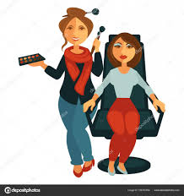
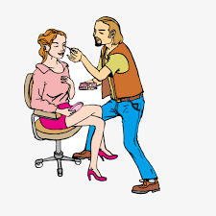
Beautician

Slide 17
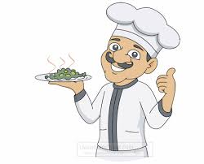

Chef

Slide 18


Plumber

Slide 19
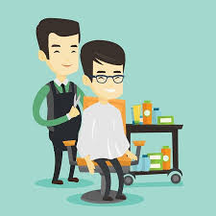
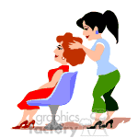
Hairdresser

Slide 20
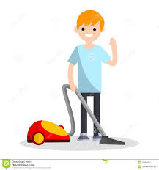
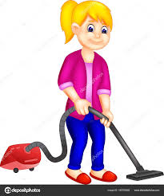
Cleaner

Slide 21

Should boys learn cookery?
Arguments For why they should?
Do you agree? Yes or No
Why?
Arguments For why they should NOT?

Slide 22
Should boys learn cookery?
In our class we have been discussing whether or not boys as well as girls should have to learn cookery.
Some of the class believe that all children should have to learn cookery. They have a number of reasons for suggesting this. Their first reason is that when you leave home, you have to be able to look after yourself, and this involves cooking. Another reason is that many girls do not enjoy cooking and would not want to cook for their husbands. Furthermore, it is not fair that a man should be able to sit and watch television while their girlfriend is cooking. These people argue that everyone should learn to cook because they will need this skill in life and because people should help each other and take turns.
On the other hand, there are quite a few people in our class who believe that boys should not bother with cookery. They argue that boys could easily buy a take-away or use a microwave meal. They believe that if they do not enjoy cooking then they should not have to do it. Some people just say that cooking is a job for girls. They think that boys’ time would be better spent if they learned how to mend a car or build things.
Finally, having listened to all arguments that people have suggested I have made my own mind up. I believe that girls and boys should learn subjects that will help them with everyday living. This means that everyone should learn cookery as well as how to mend a car. This would mean that people could choose what to do depending on what they like and what they are good at.
What is the question being discussed?
What are the reasons for?
What are the reasons against?
What is the person’s final opinion? Why?

Slide 23
Should boys learn cookery?
Reasons For:
Reasons Against:
Need to look after yourself when you leave home.
Boys can easily buy a take away or use a microwave meal.
People should help each other and take turns.
If they do not enjoy cooking they should not have to do it.
Some girls do not enjoy cooking and do not want to spend their time cooking.
It is a job for girls.
What is your opinion on this subject?
Unfair if a man has time to relax and watch TV while a girl has to cook.
Boys should be fixing cars or building things.

Slide 24
Task
Read the discussion text on the next slide and find the reasons for and against for ‘Do cats make good pets?’
Now split your page in two (home learning book) and write for in one column and against in the other (see example on the next slide) Now write the reasons under the correct column.
Challenge
Write three sentences using a conjunction that could be added to the discussion text.
e.g. I believe cats make good pets because they are really cute and cuddly.

Slide 25
For | Against

Slide 27
Don’t forget to make us smile and post work onto Class Dojo!
For great work posted, there will be dojos given out!

