Slide 1
This week, post at least two pieces of your work onto Class Dojo
For great work posted, there will be dojos given out!

Slide 2
Literacy Lesson 1

Slide 3
Starter activity

Slide 4
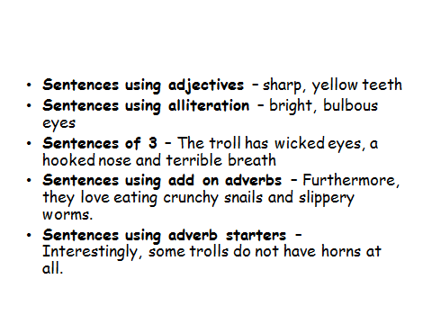
Improve these sentences in as many different ways as you can. Remember you can use:
-
The troll is ugly.
The troll lives in a cave.
The troll eats snails.
The troll is hairy.

Slide 5
Main activity

Slide 6
Read the information on the next few slides.

Slide 10
Task 1
Create an information poster/leaflet all about Iceland. You could include the following information:
Flag
Location
Capital city
Population
-Languages spoken
Climate
Foods eaten
Geographical features
Make your poster as colourful and informative as you can and remember to post a picture of it on dojo.

Slide 11
Literacy Lesson 2

Slide 12
Main activity

Slide 13
Today we are going to read a story called The Stone Trolls.

Slide 17
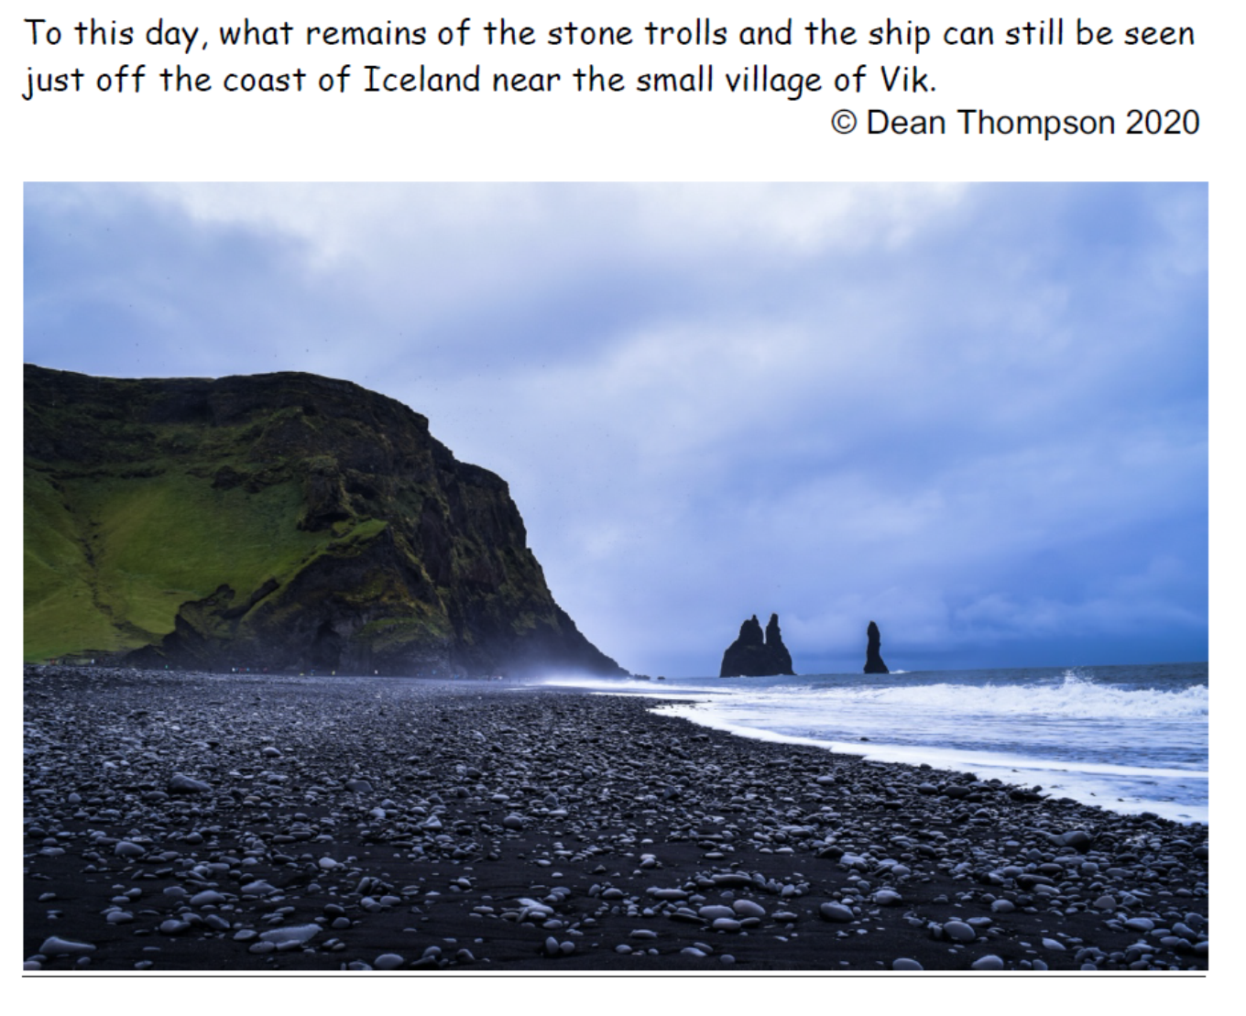

Slide 19
Task one

Slide 21
Task two

Slide 23
Literacy Lesson 3

Slide 24
Re-read the story The Stone Trolls from yesterday (go back and read the previous slides)
Task one

Slide 27
Task two

