Slide 1
This week, post at least two pieces of your work onto Class Dojo
For great work posted, there will be dojos given out!

Slide 2
Literacy Lesson 1

Slide 3
Remind yourself of the story The Stone Trolls from last week

Slide 6
Last week you worked on :
Using adjectives to describe nouns.
Using our senses when using adjectives.

Slide 7
In today’s lesson we are going to look at using prepositions and prepositional phrases to improve our sentences.

Slide 8
Task one

Slide 9
Task two

Slide 10
Literacy Lesson 2

Slide 11
Today we are going to look at the plot of the story. Read the story again before you begin.

Slide 14
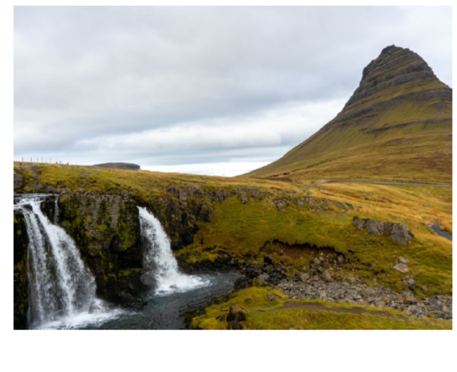

Slide 17
Now plan out your ideas for your new story.

Slide 18
Literacy Lesson 3

Slide 21

Remember to post a copy of your story on class dojo.

