Slide 1
Week beginning 13th July
This is your Maths work for this week. There are:
- 3 pieces of early bird work
3 pieces of Maths work
In addition to this, keep on with your Joe Wicks PE and spelling work too.

Slide 2
This week, post at least two pieces of your work onto Class Dojo
For great work posted, there will be dojos given out!

Slide 3
This week we will be revising our times tables in lots of different ways

Slide 4
Morning Work
Early Bird Time!

Slide 5
Early Bird Work 1
1. 4 x 3 = | 7. 4 x 6 =
2. 4 x 5 = | 8. 4 x 10 =
3. 4 x 4 = | 9. 4 x 9 =
4. 4 x 2 = | 10. 4 x 7 =
5. 4 x 0 = | 11. 4 x 8 =
6. 4 x 1 = | 12. 4 x 11 =

Slide 6
Early Bird Work 2
1. 3 x 3 = | 7. 3 x 6 =
2. 3 x 5 = | 8. 3 x 10 =
3. 3 x 4 = | 9. 3 x 9 =
4. 3 x 2 = | 10. 3 x 7 =
5. 3 x 0 = | 11. 3 x 8 =
6. 3 x 1 = | 12. 3 x 11 =

Slide 7
Early Bird Work 3
1. 6 x 3 = | 7. 6 x 6 =
2. 6 x 5 = | 8. 6 x 10 =
3. 6 x 4 = | 9. 6 x 9 =
4. 6 x 2 = | 10. 6 x 7 =
5. 6 x 0 = | 11. 6 x 8 =
6. 6 x 1 = | 12. 6 x 11 =

Slide 8
Maths lesson 1

Slide 9
Task 1 - Practise your x2 and x5 times tables with these reveal the picture puzzles.

Slide 10
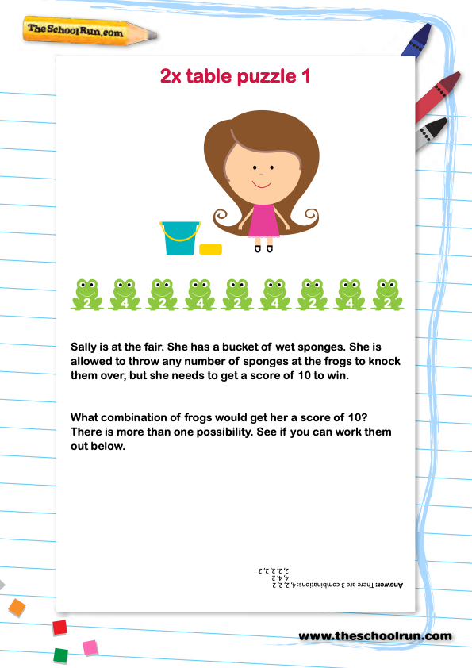
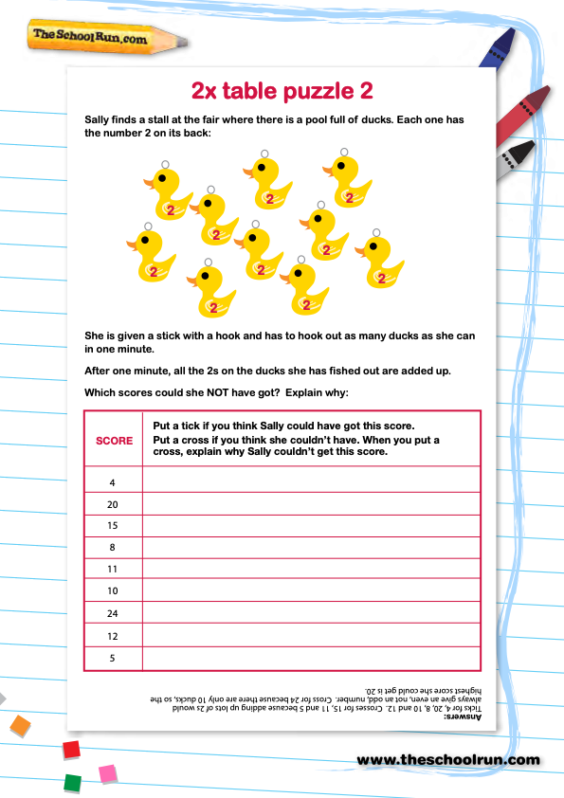
Task 2 – Now use your 2 x tables to solve these puzzles.
Answers on the next slide – no peeking!

Slide 11
Answers
2 times tables frogs puzzle
2 times tables puzzle - ducks

Slide 12
If you have time...
Try these times tables games:
https://www.topmarks.co.uk/maths-games/7-11-years/times-tables

Slide 13
Maths lesson 2

Slide 14
Task 1:
Practise your times tables by filling in this multiplication grid.

Slide 15
Task 2 - Practise your 3 times tables and dividing by 3 with this reveal the picture puzzle.

Slide 16
Task 3 - Practise your 4 times tables and dividing by 4 with this reveal the picture puzzle.

Slide 17
If you have time...
Try these times tables games:
https://www.topmarks.co.uk/maths-games/7-11-years/times-tables

Slide 18
Maths lesson 3

Slide 19
Task 1: Pretend you are the teacher and mark this work. How many answers are right?

Slide 20
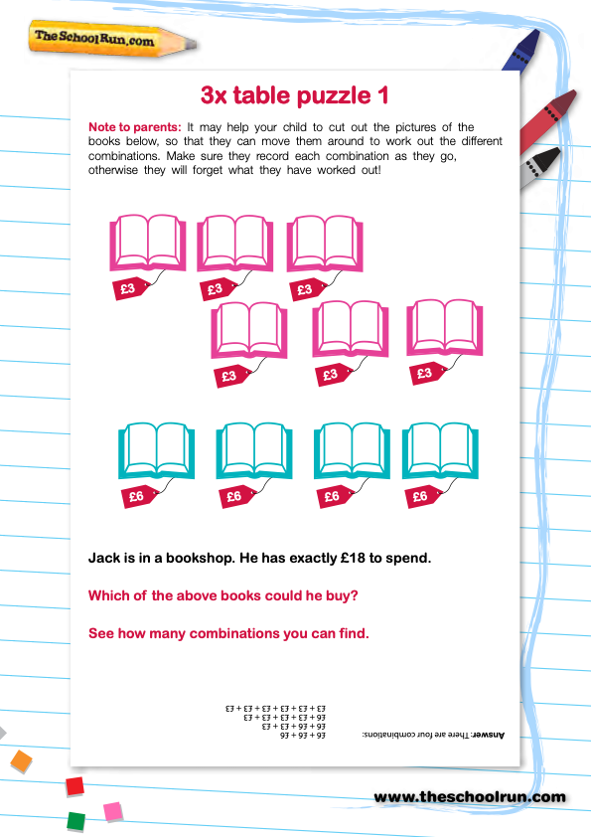
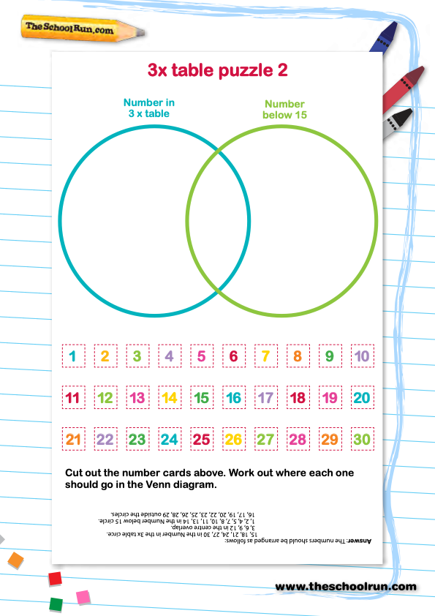
(You can write them in the circles instead if you want.)
Answers on the next slide – no peeking!

Slide 21
Answers
Books problem
Venn diagram

Slide 22
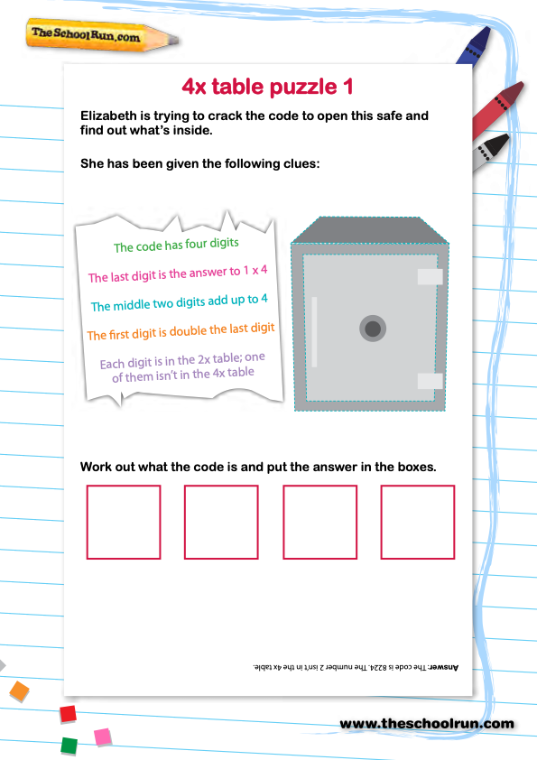
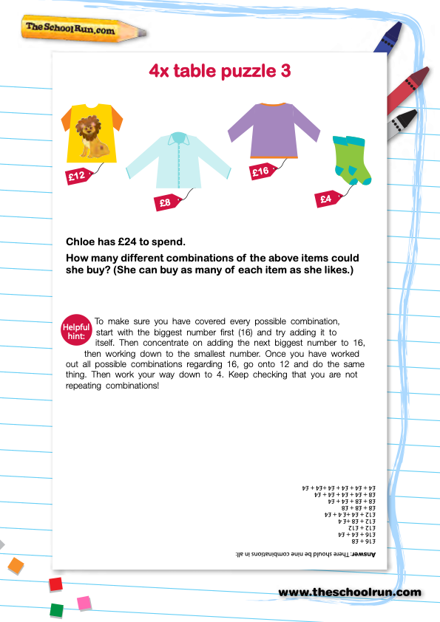
2
Answers on the next slide – no peeking!

Slide 23
Answers
Number safe puzzle
Clothes shop puzzle

Slide 24
Challenge Questions!
Multiplication and Division
Problem solving and reasoning questions
Always true, sometimes true or never true?
6 x 8 is the same as 4 x 12.
Dividing a number by 3 gives an odd answer.
Even numbers divide by 8 to leave no remainder.
Answers on the next slide – no peeking!

Slide 25
Answers
Always true, sometimes true or never true?
6 x 8 is the same as 4 x 12. True, both equal 48.
Dividing a number by 3 gives an odd answer. Sometimes,
e.g. 9 ÷ 3 = 3 but 12 ÷3 = 4. (Children should give examples).
Even numbers divide by 8 to leave no remainder. Sometimes, e.g. multiples of 8 such as 16, 24 or 32; but other even numbers will leave a remainder, e.g. 12, 20, or 22

Slide 26
If you have time...
Try these times tables games:
https://www.topmarks.co.uk/maths-games/7-11-years/times-tables

