Slide 1
23.03.21
Can I measure the perimeter of 2D shapes?

Slide 2

Warm Up Activity
Double these numbers
Mild
Hot
Double 3 =
Double 5 =
Double 7 =
Double 10 =
Double 8 =
Double 12 =
Double 16 =
Double 22=
Double 25 =
Double 33 =
Double 12 =
Double 18 =
Double 19 =
Double 23 =
Double 45 =
Double 51 =
Double 67 =
Double 83 =
Double 98 =
Double 99 =

Slide 3
Warm Up Activity
How did you get on?
Mild
Hot
Double 3 = 6
Double 5 = 10
Double 7 = 14
Double 10 = 20
Double 8 = 16
Double 12 =24
Double 16 = 32
Double 22= 44
Double 25 = 50
Double 33 = 66
Double 12 = 24
Double 18 = 36
Double 19 = 38
Double 23 = 43
Double 45 = 90
Double 51 = 102
Double 67 = 134
Double 83 = 166
Double 98 = 196
Double 99 = 198

Slide 4

Calculate
10 $+$ 20 $+$ 15 $+$ 20 $=$
2) What is double 100 $+$ double 50?
3) How would you work out 7 $+$ 5 $+$ 7 $+$ 5?

Slide 5


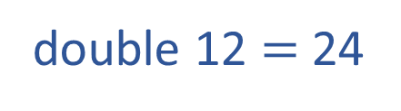

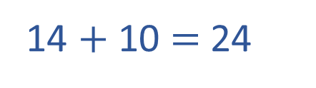
Calculate
10 $+$ 20 $+$ 15 $+$ 20 $=$
2) What is double 100 $+$ double 50?
3) How would you calculate 7 $+$ 5 $+$ 7 $+$ 5?
65
300
double 7 $=$ 14
12
12
double 5 $=$ 10
double 12 $=$ 24
14 $+$ 10 $=$ 24

Slide 6
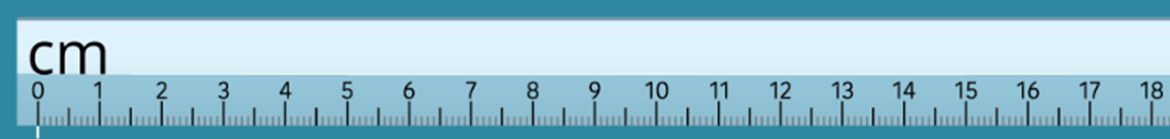
_____________________________
7cm = 70mm
_________________
4cm = 40mm
____________
3cm = 30mm

Slide 7


Click here to listen to a short song about the perimeter of a shape.
Copyright 2015 Online Teaching Resources Ltd www.Teacher-of-Primary.co.uk

Slide 8
What is the perimeter?
The perimeter is the total length around the outside of a 2-D shape.
Click here
Copyright 2015 Online Teaching Resources Ltd www.Teacher-of-Primary.co.uk

Slide 9
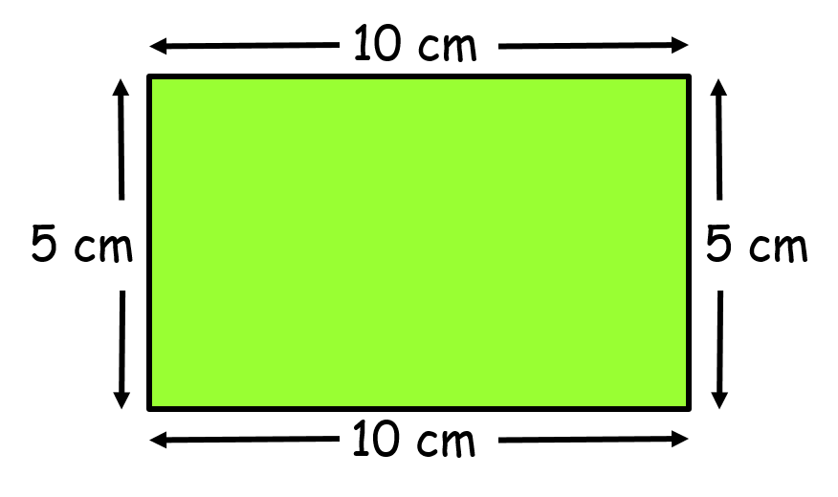
How to find the perimeter
Begin by measuring the length of each side
Add together the lengths of each side
The total is the perimeter
10 + 5 + 10 + 5 = 30 cm
Copyright 2015 Online Teaching Resources Ltd www.Teacher-of-Primary.co.uk

Slide 10
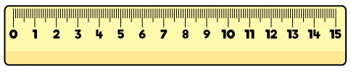
9 cm
13 cm
13 cm
9 cm
9 cm + 13 cm + 9 cm + 13 cm =
44 cm
22 cm
22 cm

Slide 11

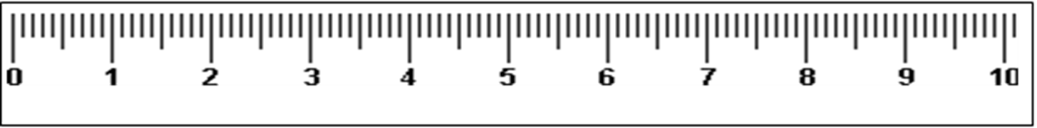
Here we are using a ruler to measure the length of each side.
6cm
6cm

Slide 12
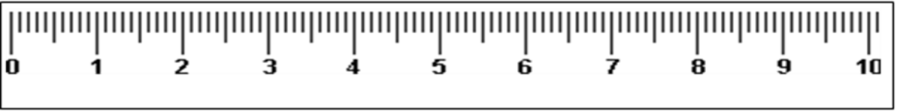
Next, we measure the length of the other side.
6cm
3cm
3cm
6cm
6cm+6cm+3cm+3cm = 18cm

Slide 13
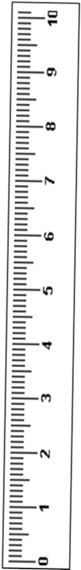


9cm
4cm
4cm
9cm
9cm+9cm+4cm+4cm = 26cm

Slide 14

What type of triangle is this?
4 cm
4 cm
This is an equilateral triangle.
4cm
4cm+4cm+4cm = 12cm

Slide 15


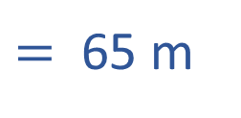

Mr Rose wants to put up a new fence around the perimeter of his garden.
10 m $+$ 20 m $+$ 15 m $+$ 20 m
How many metres of fencing does he need to buy?
10 m
20 m
20 m
15 m
$=$ 65 m
Mr Rose will need to buy 65 metres of fencing.

Slide 16




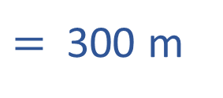
The children are running around the perimeter of the playground.
100 m $+$ 50 m $+$ 100 m $+$ 50 m
How far do they run on each lap?
100 m
50 m
50 m
100 m
$=$ 300 m
Each lap is 300 metres.

Slide 17
What is the perimeter of the rectangle?
1 cm
1 cm
24 cm

Slide 18
What is the perimeter of these shapes?
1 cm
1 cm
12 cm
14 cm
14 cm

Slide 19

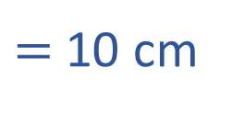

Annie has a 3 cm by 2 cm rectangular tile.
What is the perimeter of Annie’s tile?
1 cm
1 cm
3 cm $+$ 2 cm $+$ 3 cm $+$ 2 cm
$=$ 10 cm

Slide 20


Annie joins 2 tiles together
1 cm
1 cm
6 cm
2 cm
2 cm
6 cm
If one tile has a perimeter of 10 cm, two tiles must have a perimeter of 20 cm.
6 cm $+$ 2 cm $+$ 6 cm $+$ 2 cm $=$ 16 cm

Slide 21

Annie joins 2 tiles together
1 cm
1 cm
3 cm
4 cm
4 cm
3 cm
3 cm $+$ 4 cm $+$ 3 cm $+$ 4 cm $=$ 14 cm

Slide 22

How many different perimeters can you make using 3 of Annie’s tiles?
What is the longest possible perimeter?
What is the shortest?
What if you used 4 tiles?
3 cm
2 cm
Have a think

Slide 23
Using 3 tiles
1 cm
1 cm
22 cm
18 cm
20 cm

Slide 24
Using 4 tiles
28 cm
22 cm
20 cm
24 cm
26 cm
26 cm

