Slide 1
Week beginning 29th June
This is your Maths work for this week. There are:
- 3 pieces of early bird work
3 pieces of Maths work
In addition to this, keep on with your Joe Wicks PE, learning your times tables and spelling work too.

Slide 2
This week, post at least two pieces of your work onto Class Dojo
For great work posted, there will be dojos given out!

Slide 3
Morning Work
Early Bird Time!

Slide 5
Learn to spell these words and use your best handwriting. Can you use these words in your own exciting sentences?

Slide 6
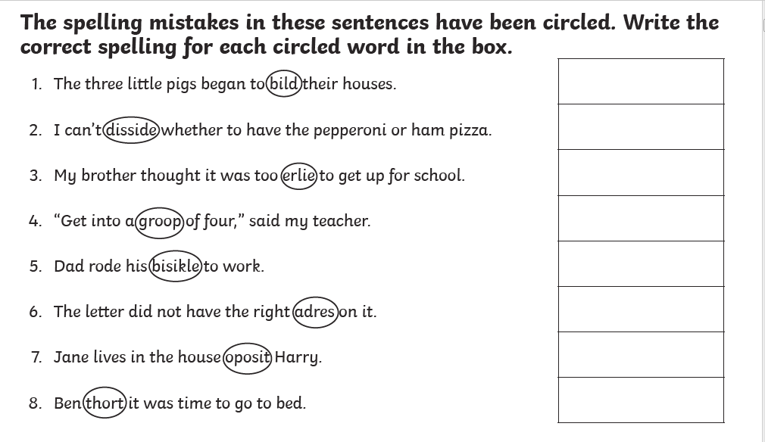
Correct the spelling mistakes! Spell it correctly.

Slide 7
Maths lesson 1

Slide 8
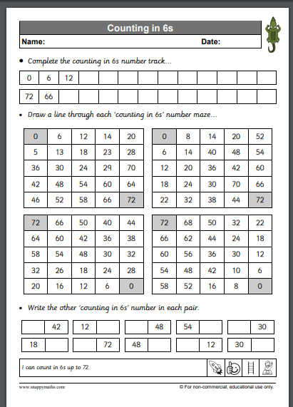
Warm up
Count in steps of 6 to help you practice your times tables

Slide 9
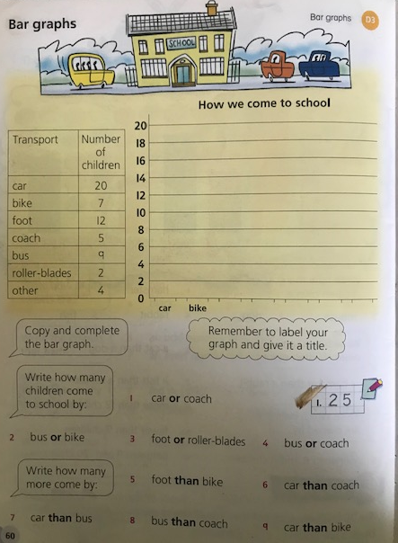
Complete this bar chart

Slide 10
Now try these

Slide 11
If you have time...
http://www.wldps.com/gordons/Bar_Chart.swf

Slide 12
Maths lesson 2

Slide 13
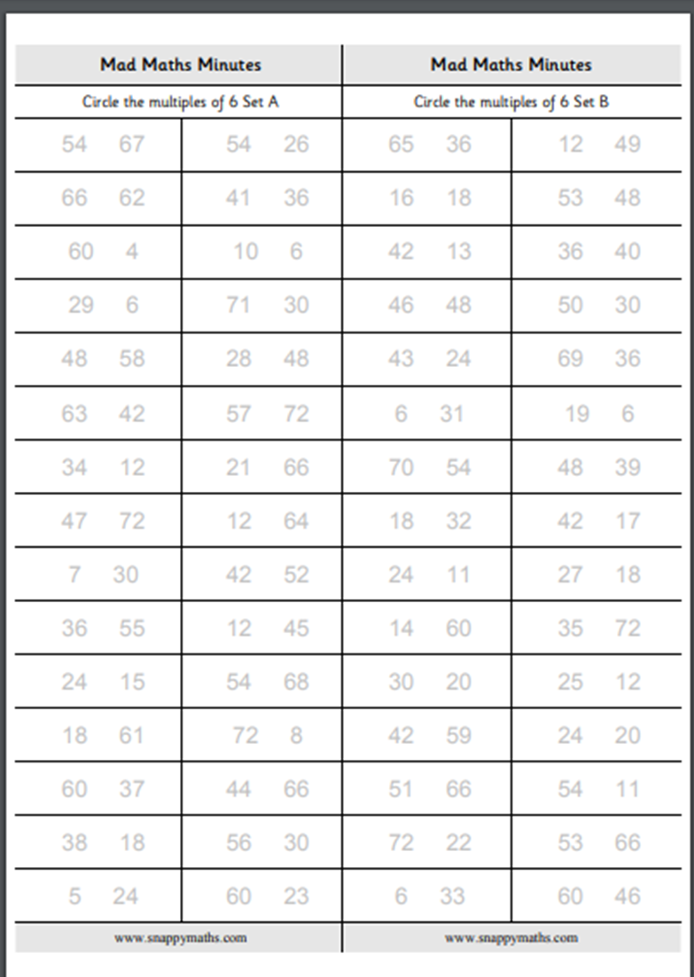
Warm up
Circle the multiple of 6 in each pair of numbers

Slide 14
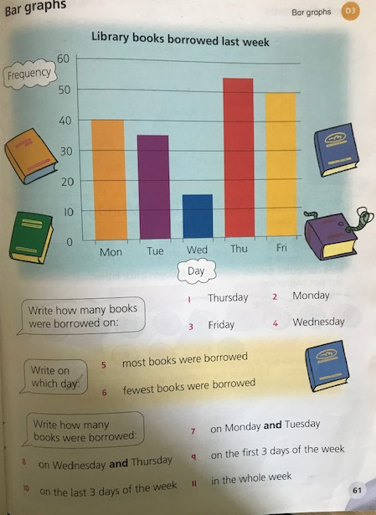
Answer the questions on the bar chart

Slide 15
Now try these

Slide 16
If you have time...
Try a game of time match up.
http://www.wldps.com/gordons/Bar_Chart.swf

Slide 17
Maths lesson 3

Slide 18
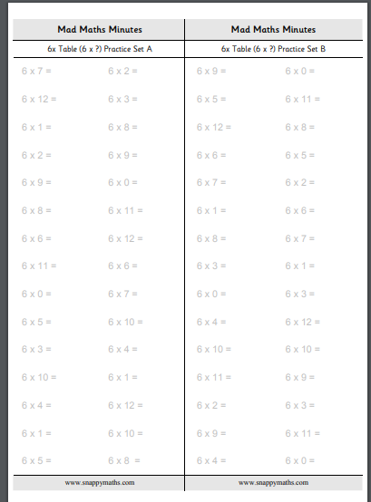
Warm up
Complete the x6 questions

Slide 19
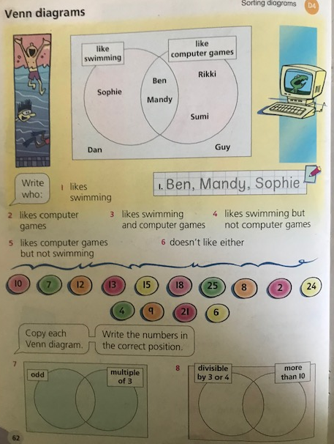
Complete the questions on the venn diagram

Slide 20
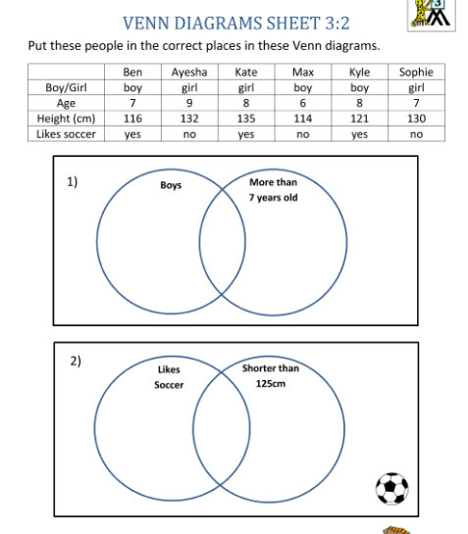
Now try this

