Slide 1
Week beginning 6th July
This is your Maths work for this week. There are:
- 3 pieces of early bird work
3 pieces of Maths work
In addition to this, keep on with your Joe Wicks PE, learning your times tables and spelling work too.

Slide 2
This week, post at least two pieces of your work onto Class Dojo
For great work posted, there will be dojos given out!

Slide 3
Morning Work
Early Bird Time!

Slide 5
Learn to spell these words and use your best handwriting. Can you use these words in your own exciting sentences?

Slide 6
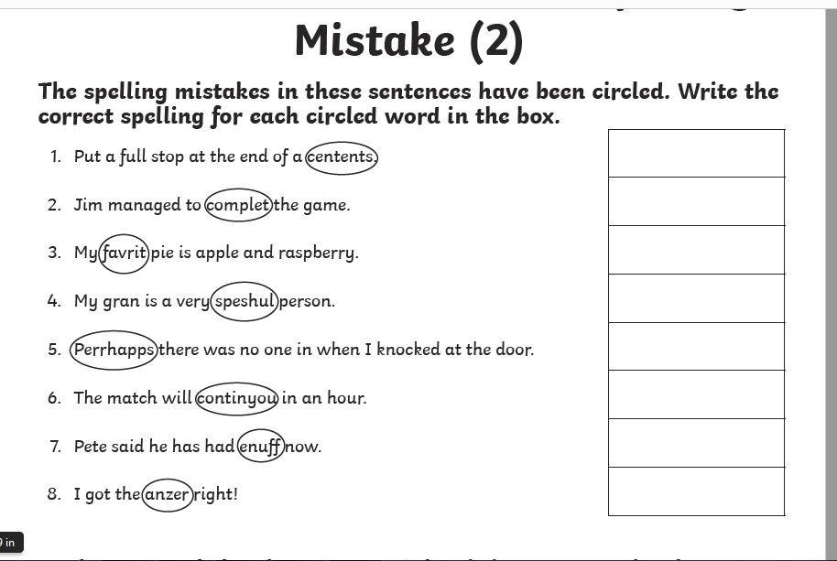
Correct the spelling mistakes! Spell it correctly.

Slide 7
Maths lesson 1

Slide 8
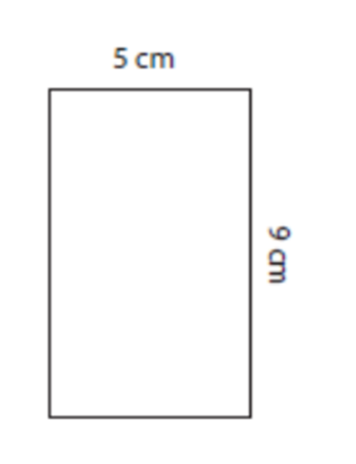
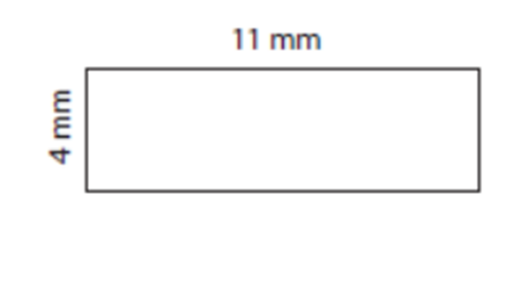
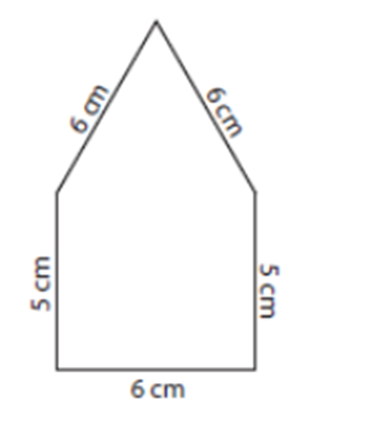
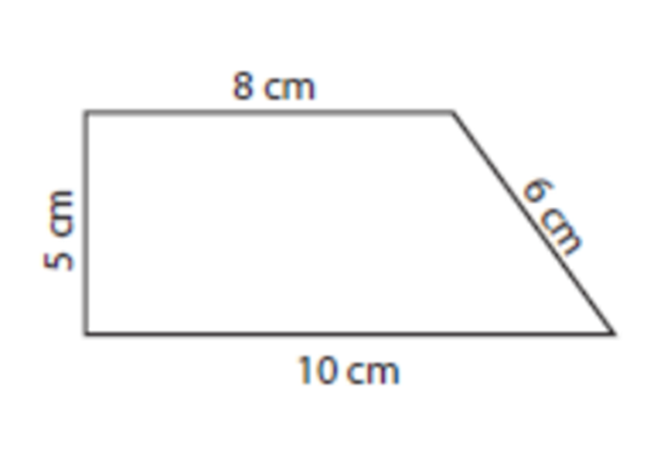
Warm up – Calculate the perimeter of the shapes (remember to add up the length of each of the sides)

Slide 9
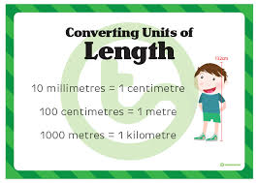

Slide 10
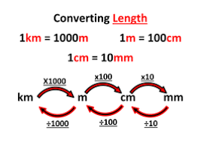
Over the next few lessons we are going to be looking at length. Here is a chart to show you how to convert between different units of length.

Slide 11
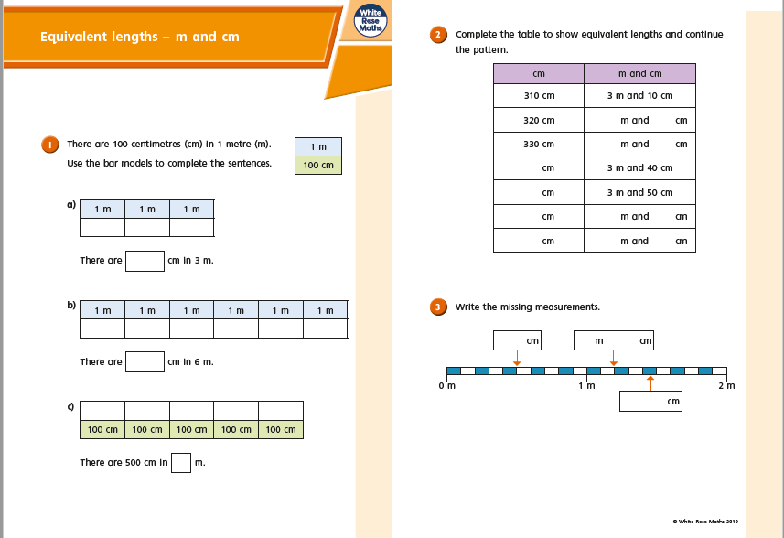

Slide 12
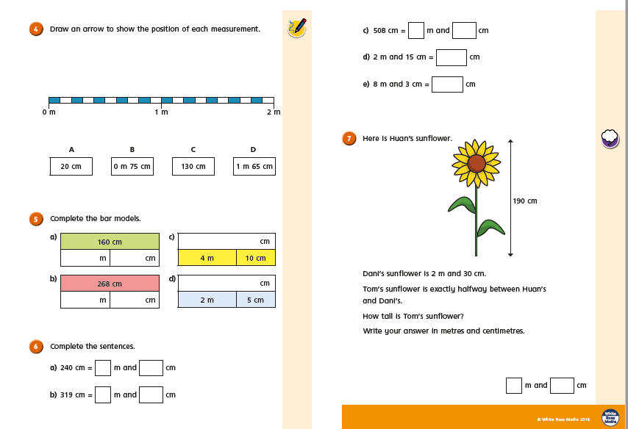

Slide 13
Now try these

Slide 15
If you have time...
Try these length activities:
http://www.wldps.com/gordons/Bingo_-_measures.swf

Slide 16
Maths lesson 2

Slide 17
Warm up

Slide 18
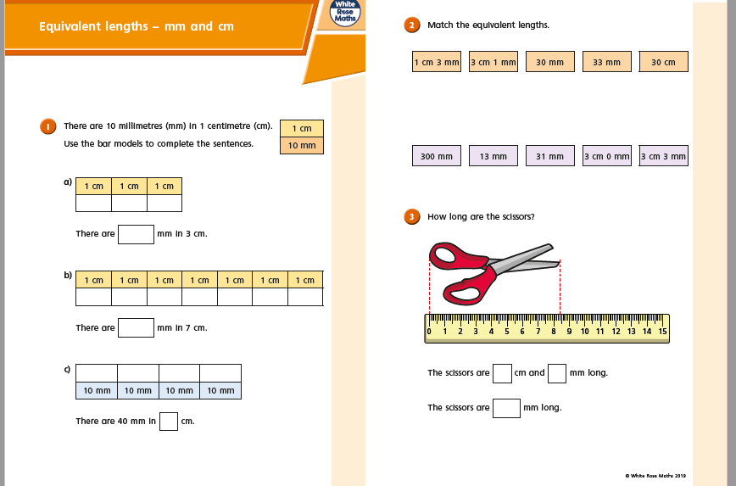

Slide 19
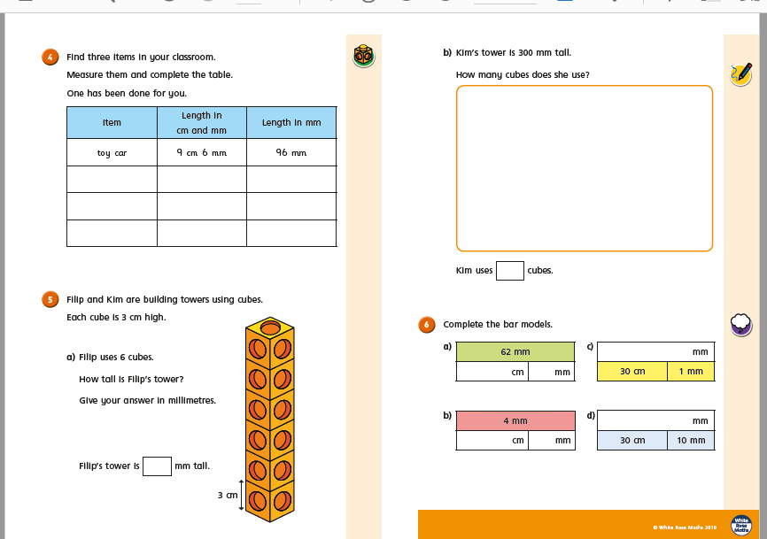

Slide 20
Now try these

Slide 23
If you have time...
Try these length activities:
http://www.wldps.com/gordons/Bingo_-_measures.swf

Slide 24
Maths lesson 3

Slide 25
Warm up - Convert these cm to mm
3 cm
5 cm
8 cm
12 cm
25 cm
76 cm
89 cm
8. 2.5 cm
9. 4.7cm
10. 13. 6cm
11. 34.7cm
12. 24. 9cm
13. 65.2cm
14. 89.6cm
Convert these m to cm
1 m 8. 2.5m
6m 9. 4.6m
7m 10. 7.9m
9m 11. 12.6m
10m 12. 17.9m
12m 13. 20.7m
23m 14. 23.7m

Slide 26
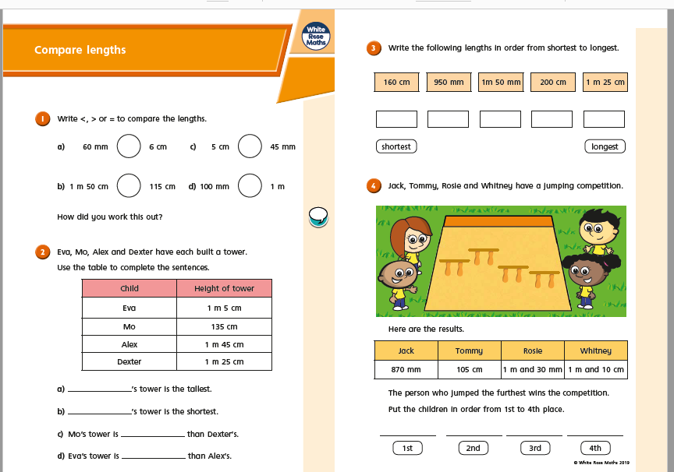

Slide 27
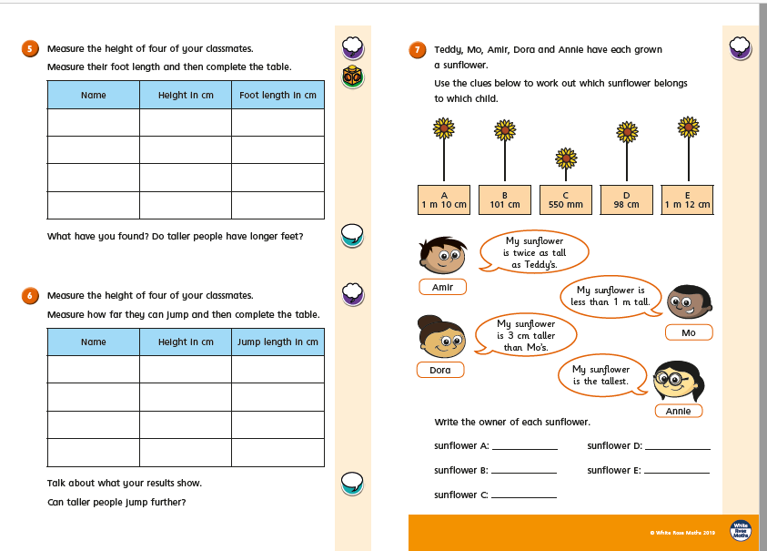

Slide 28
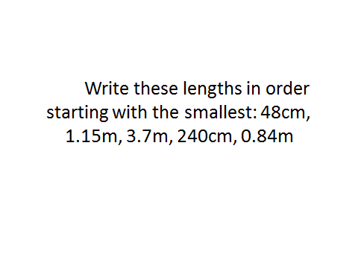
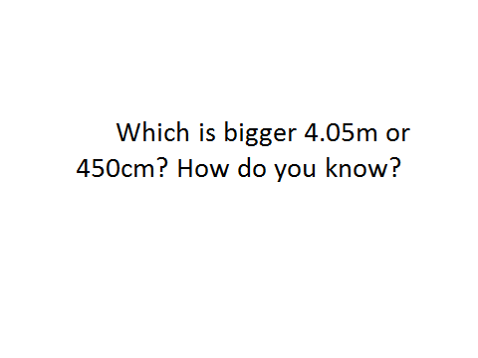
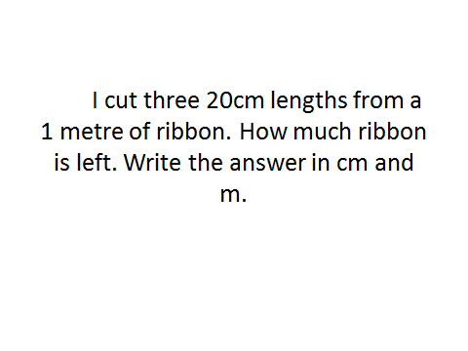
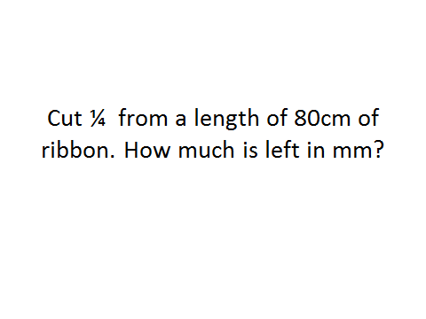
Now try these challenge questions

Slide 29
