Slide 1
Week beginning 11th May
This is your Maths work for this week. There are:
- 3 pieces of early bird work
3 pieces of Maths work
In addition to this, keep on with your Joe Wicks PE, learning your times tables and spelling work too.

Slide 2
This week, post at least two pieces of your work onto Class Dojo
For great work posted, there will be dojos given out!

Slide 3
Morning Work
Early Bird Time!

Slide 4
Early bird work
1. 1/10 of 60 = | 6. 1/6 of 6 =
2. ½ of 40 = | 7. ¼ of 8 =
3. ¼ of 24 = | 8. 1/3 of 9 =
4. 1/3 of 15 = | 9. ½ of 16 =
5. 1/10 of 20 = | 10. 1/10 of 50 =

Slide 5
Early Bird Work
Half of … | Division
1. Half of 80 = | 6. 26 2 =
2. Half of 42 = | 7. 28 2 =
3. Half of 22 = | 8. 38 2 =
4. Half of 24 = | 9. 53 2 =
5. Half of 40 = | 10. 93 2 =

Slide 6
Early Bird Work
Round these numbers to the nearest 10. Example:
1. 29 30 | 6. 44 ?
2. 42 ? | 7. 35 ?
3. 37 ? | 8. 68 ?
4. 21 ? | 9. 55 ?
5. 89 ? | 10. 91 ?

Slide 7
Maths lesson 1

Slide 8
Warm up
6 x 3 = 6 x 4 =
6 x 12 = 6 x 8 =
6 x 1 = 6 x 9 =
6 x 7 = 6 x 6 =
6 x 5 = 6 x 11 =
6 x 10 = 6 x 2 =

Slide 9
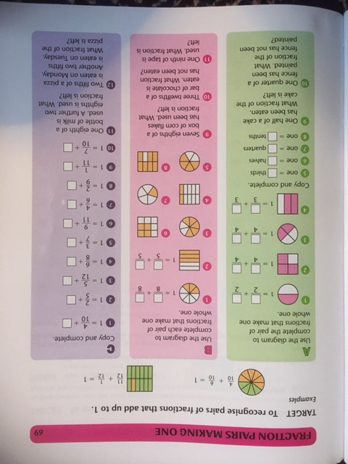
Complete section A and B.
Section C is a challenge!

Slide 10
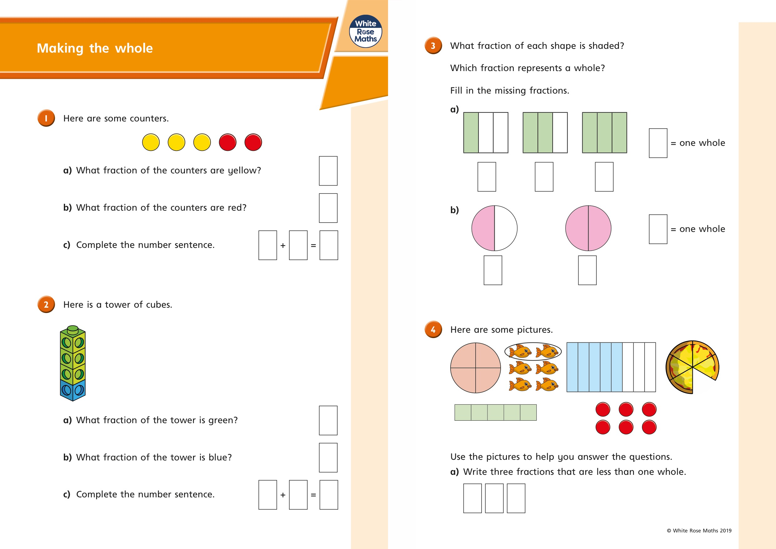
Now try these!

Slide 11
If you have time...
Try a times tables game on this website.
https://www.topmarks.co.uk/maths-games/7-11-years/times-tables

Slide 12
Maths lesson 2

Slide 13
Warm up
1. 12 ÷ 6 = _____ 2. 30 ÷ 6 = _____ 3. 18 ÷ 6 = _____ 4. 36 ÷ 6 = _____ 5. 24 ÷ 6 = _____ 6. 42 ÷ 6 = _____
7. 48 ÷ 6 = _____ 8. 6 ÷ 6 = _____
9. 54 ÷ 6 = _____ 10. 66 ÷ 6 = _____ 11. 60 ÷ 6 = _____ 12. 72 ÷ 6 = _____

Slide 14
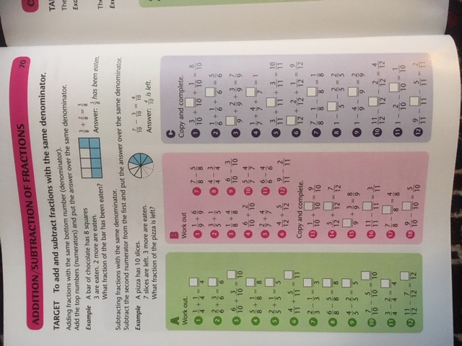
Complete section A and B.
Section C is a challenge!

Slide 15
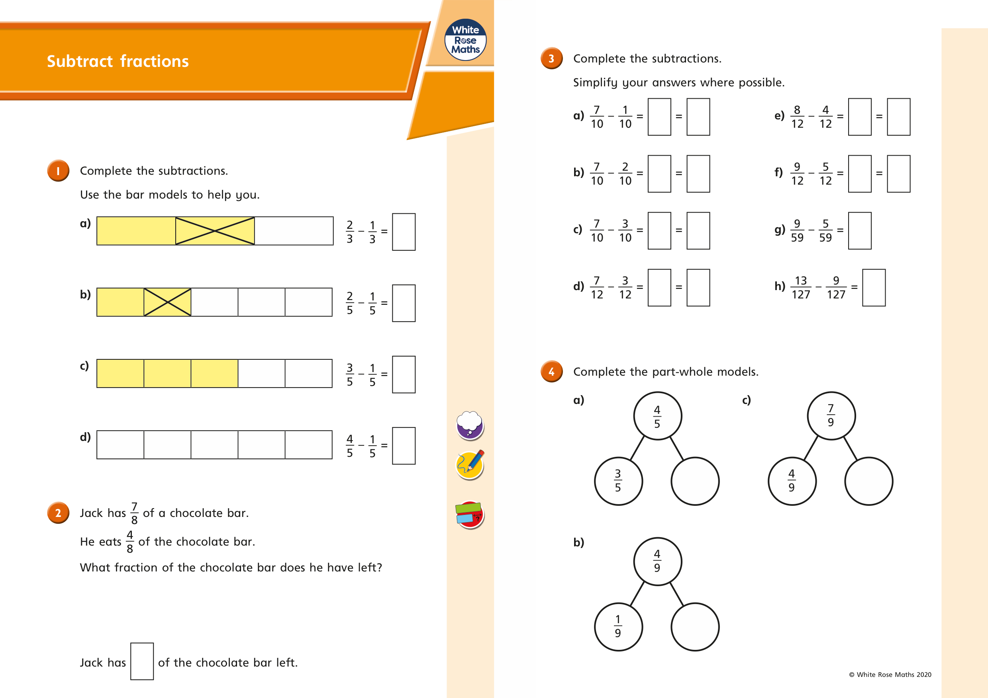

Slide 16
If you have time...
Try a times tables game on this website.
https://www.topmarks.co.uk/maths-games/7-11-years/times-tables

Slide 17
Maths lesson 3

Slide 18
Warm up
1. 1 x 3 =
2. 4 x 3 =
3. 6 x 3 =
4. 5 x 3 =
5. 2 x 3 =
6. 7 x 3 =
7. 3 x 3 =
8. 0 x 3 =
9. 9 x 3 =
10. 8 x 3 =
11. 11 x 3 =
12. 12 x 3 =

Slide 19
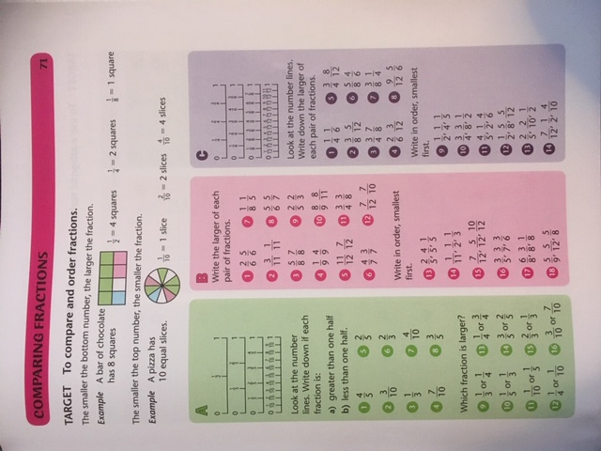
Complete section A and B.
Section C is a challenge!

Slide 20
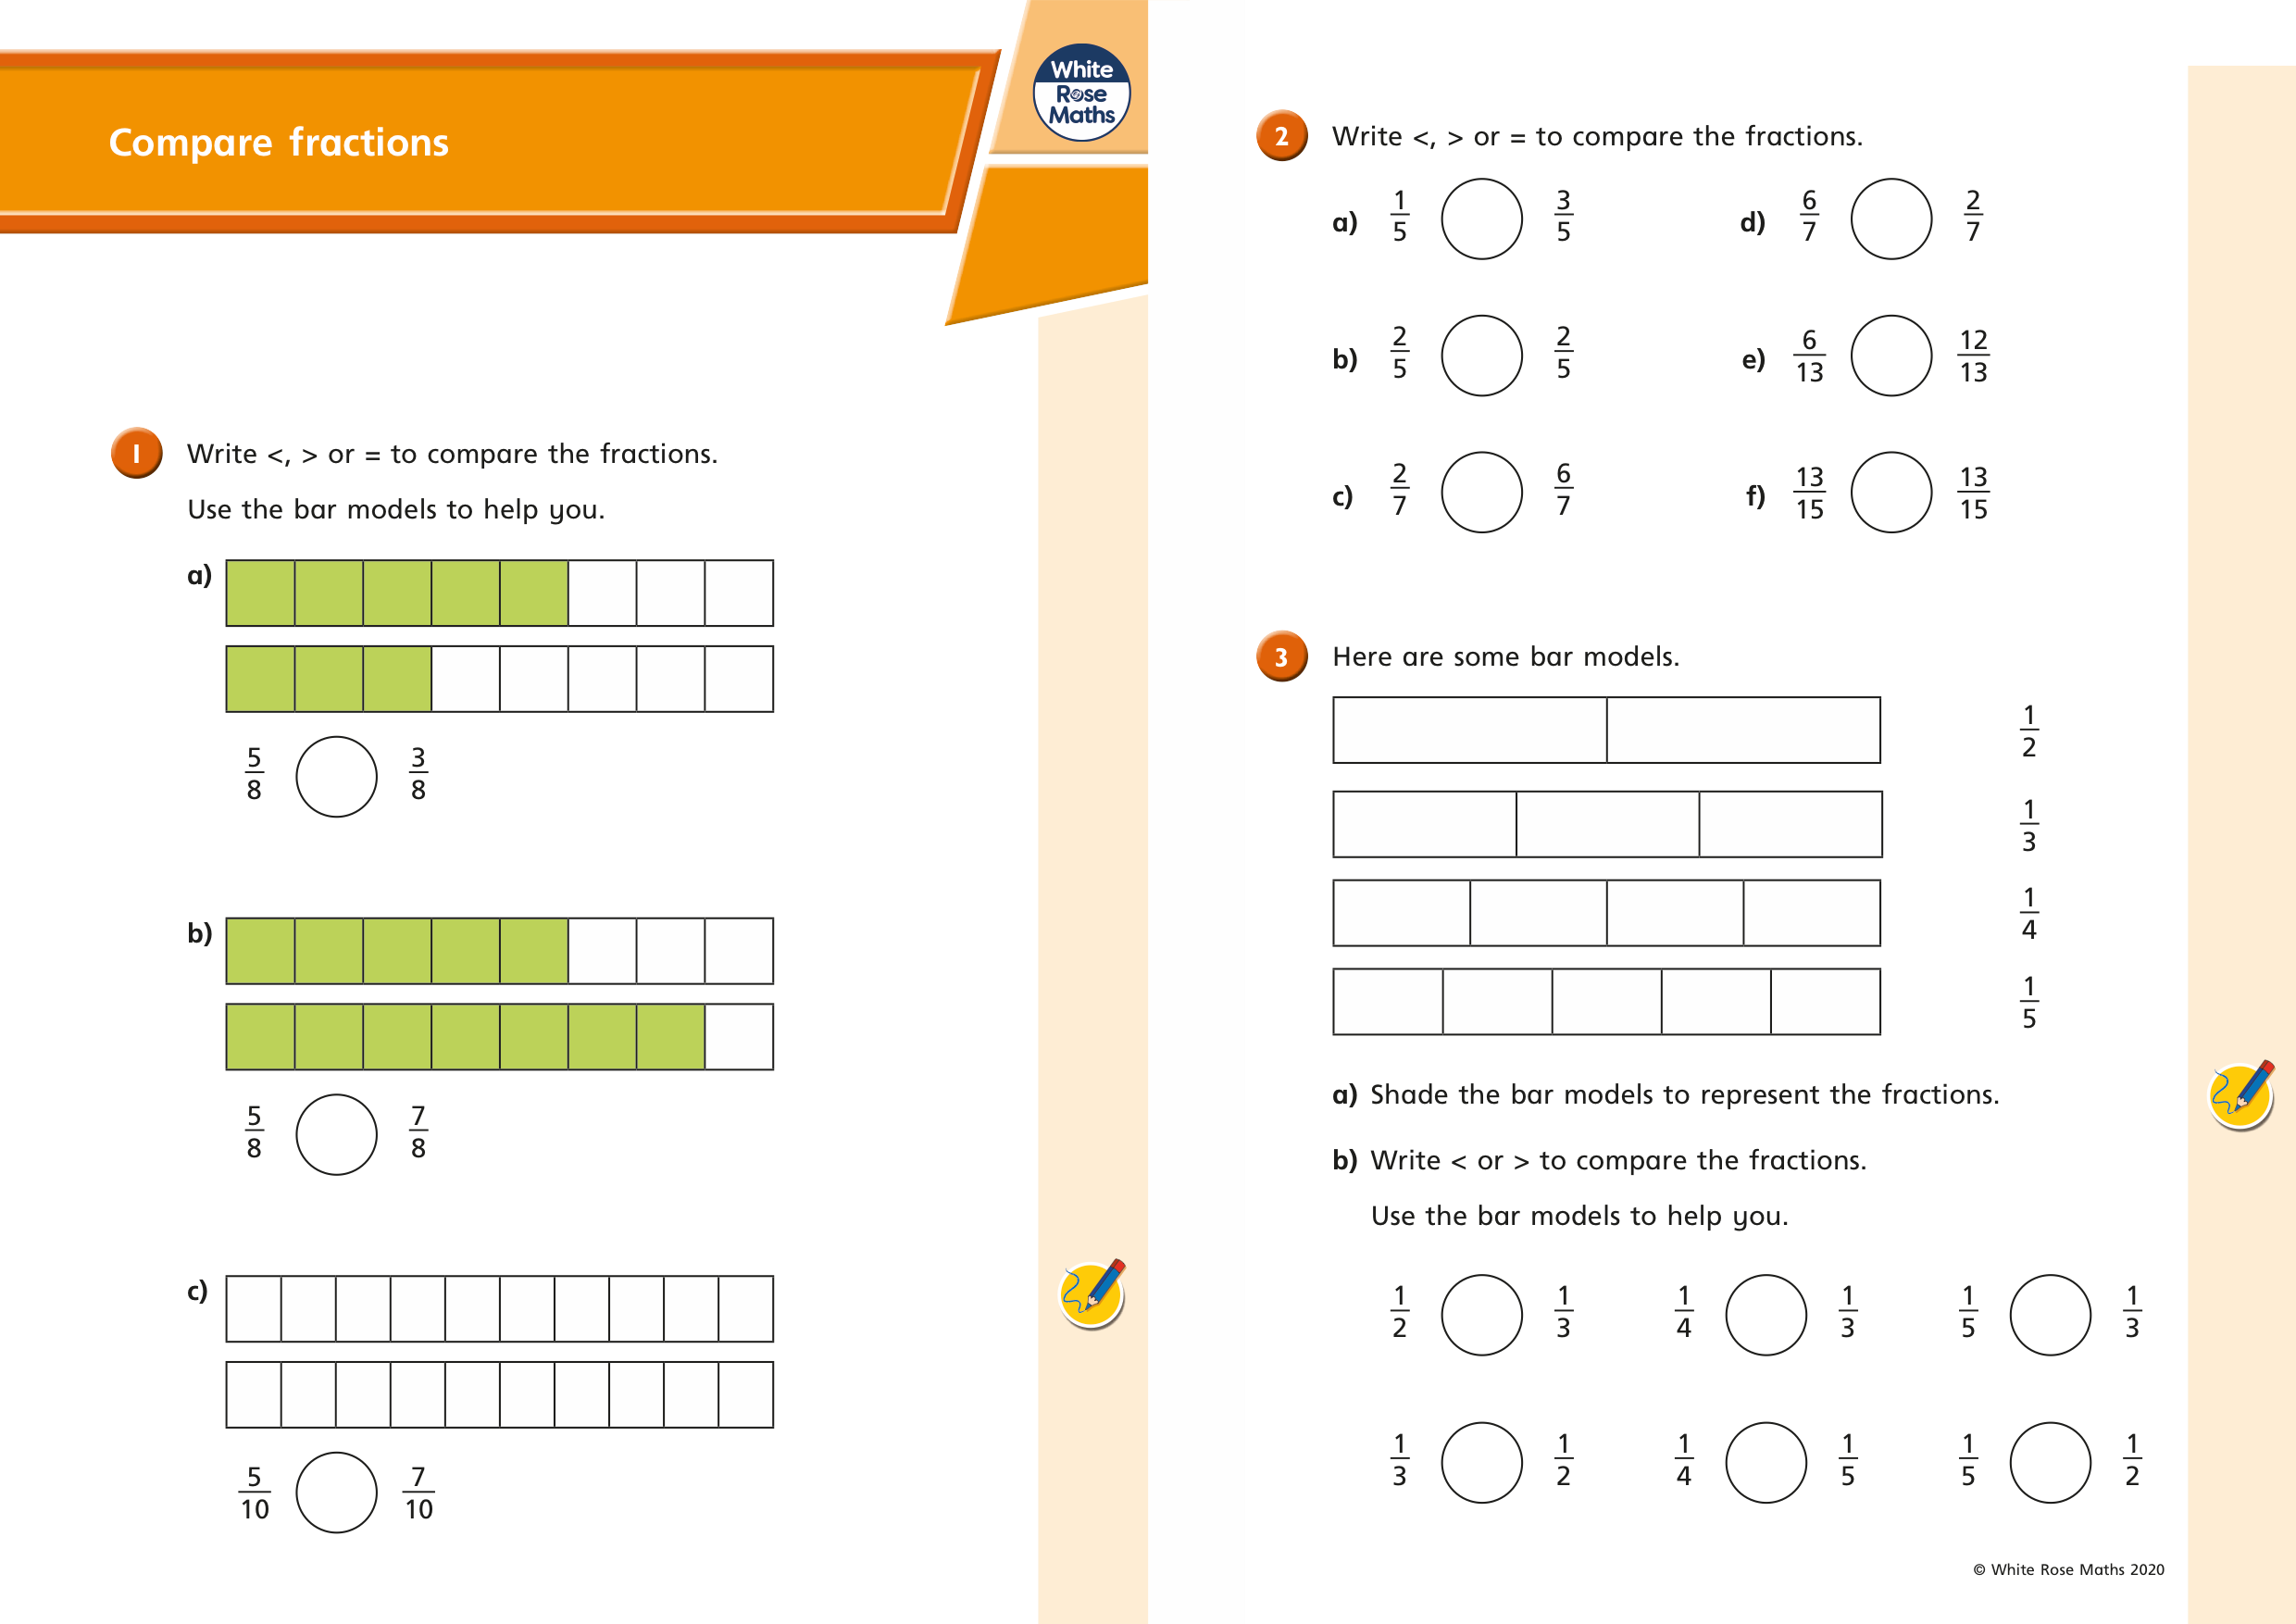

Slide 21
If you have time...
Try a times tables game on this website.
https://www.topmarks.co.uk/maths-games/7-11-years/times-tables

