Slide 1
Week beginning 25th May
This is your Maths work for this week. There are:
- 3 pieces of early bird work
3 pieces of Maths work
In addition to this, keep on with your Joe Wicks PE, learning your times tables and spelling work too.

Slide 2
This week, post at least two pieces of your work onto Class Dojo
For great work posted, there will be dojos given out!

Slide 3
Morning Work
Early Bird Time!

Slide 4
Early bird work 25.5.2020
Add or Subtract? Solve these:
1. 44 subtract 10 = | 6. I had 31 sweets and bought 20 more =
2. 61 plus 10 = | 7. I had 66 sweets and gave away 40 =
3. 10 fewer than 31 = | 8. What is the difference between 34 and 50 ?
4. 28 increased by 20 = | 9. What is 30 more than 21 ?
5. Remove 20 from 44 = | 10. What is 50 less than 150 ?

Slide 5
Early bird work 26.5.2020
Add or Subtract? Solve these:
1. 500 subtract 50 = | 6. I had 50 sweets and bought 150 more =
2. 50 plus 300 = | 7. I had 80 sweets and gave away 30 =
3. 400 take away 90 = | 8. What is the difference between 250 and 850 ?
4. 60 increased by 400 = | 9. What is 300 more than 50 ?
5. Remove 50 from 300 = | 10. What is 50 less than 550 ?

Slide 6
Early bird work 27.5.12020
Add or Subtract? Solve these:
1. 100 subtract 50 = | 6. I had 60 sweets and bought 150 more =
2. 100 plus 300 = | 7. I had 100 sweets and gave away 30 =
3. 100 take away 90 = | 8. What is the difference between 1000 and 850 ?
4. 100 increased by 40 = | 9. What is 300 more than 1000 ?
5. Remove 50 from 1000 = | 10. What is 90 less than 1000 ?

Slide 7
Maths lesson 1

Slide 8
Warm up
4 x 3 = 4 x 4 =
4 x 12 = 4 x 8 =
4 x 1 = 4 x 9 =
4 x 7 = 4 x 6 =
4 x 5 = 4 x 11 =
4 x 10 = 4 x 2 =

Slide 9
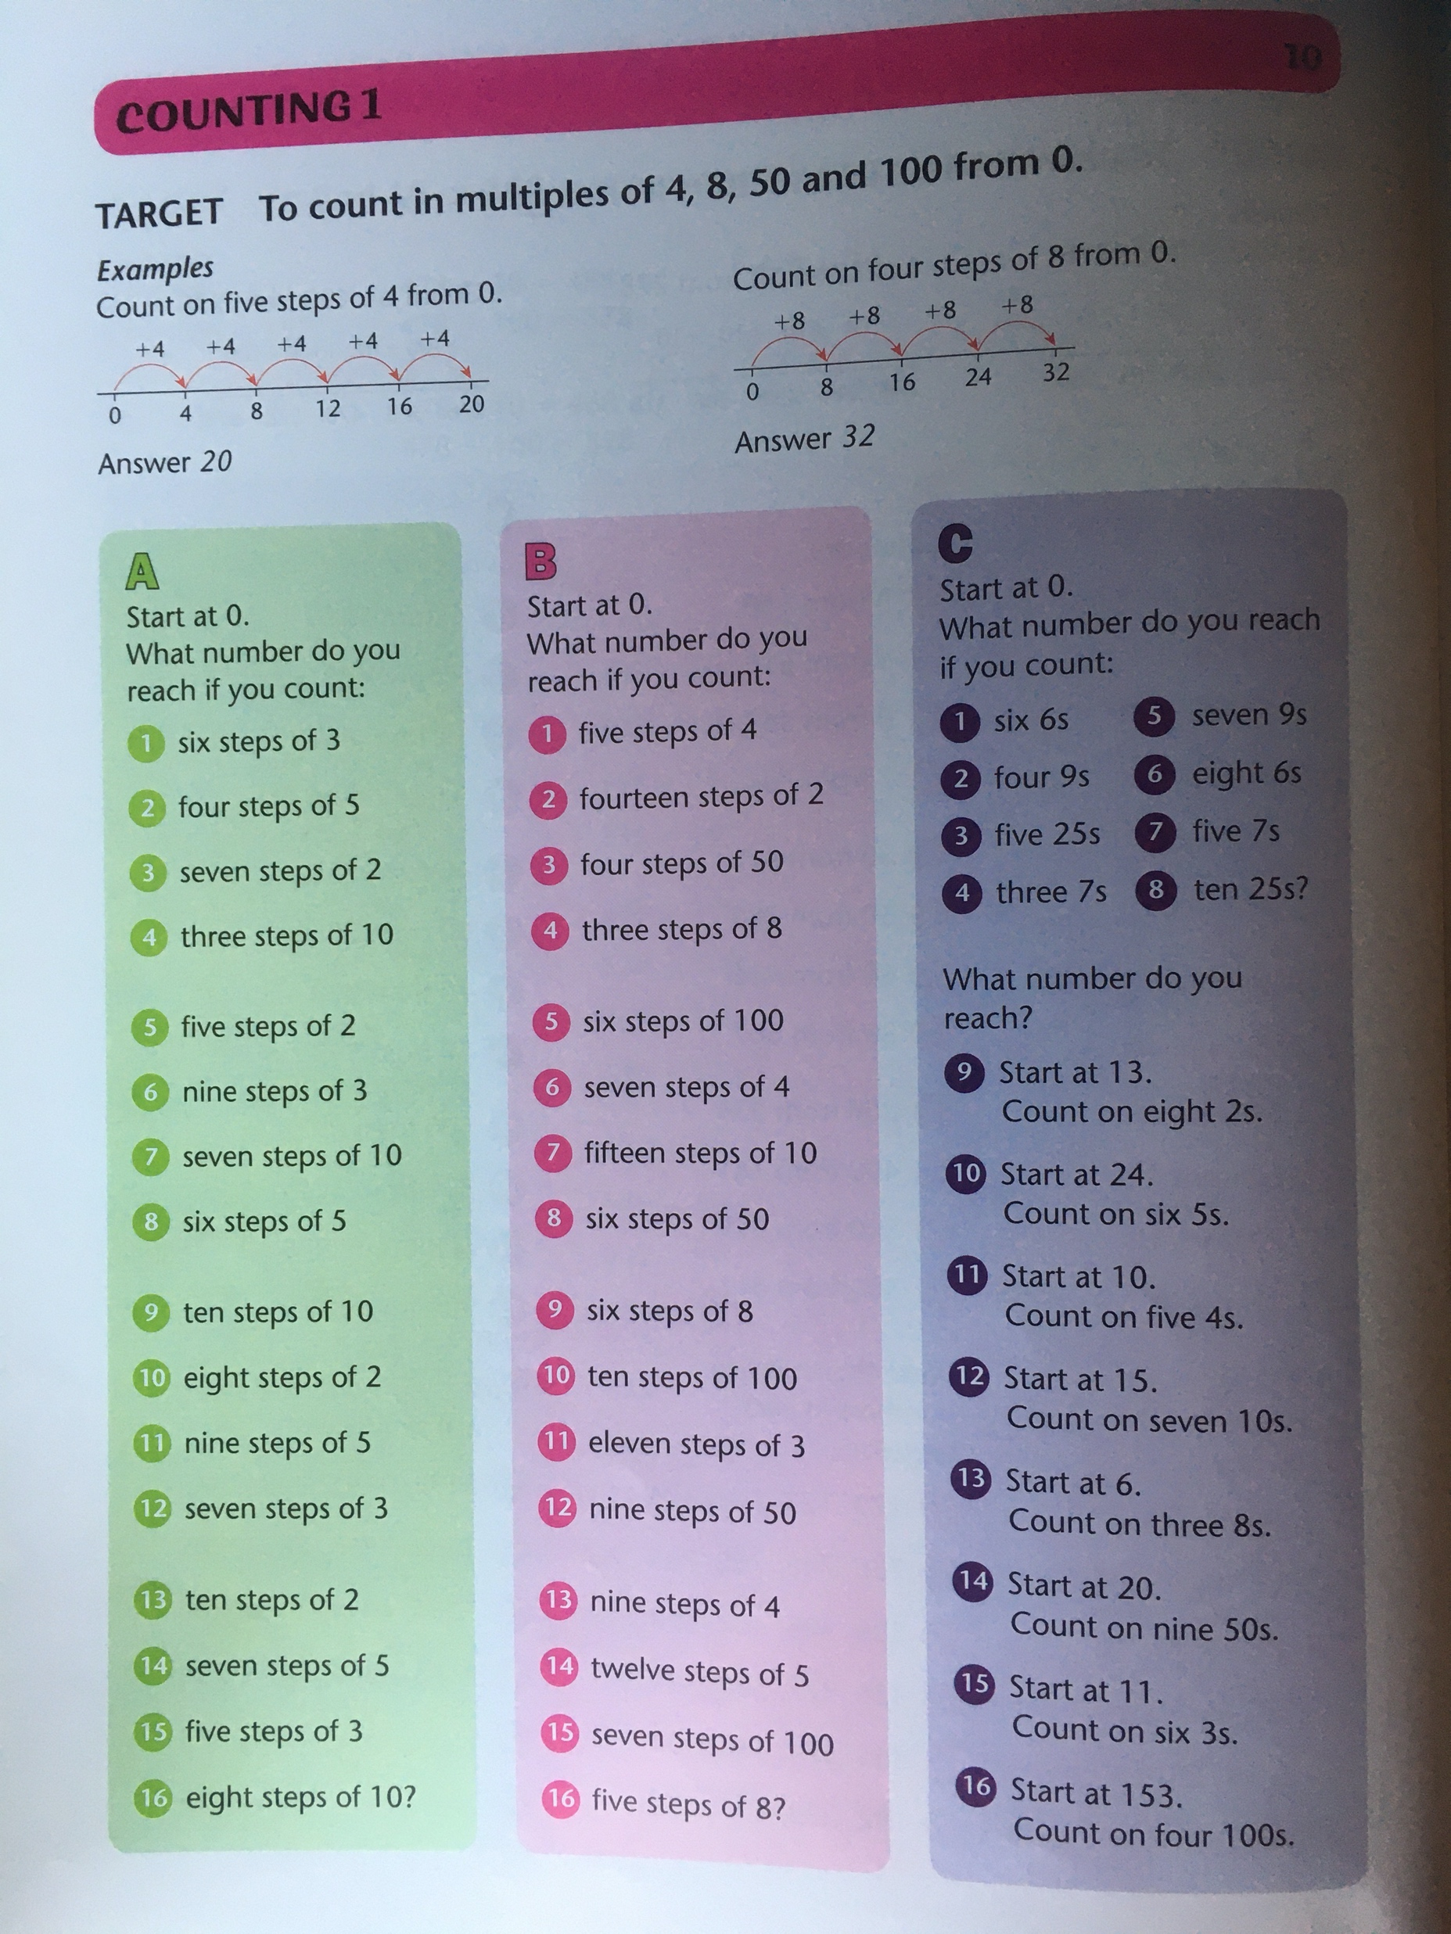
Complete section A and B.
Section C is a challenge!

Slide 10
Now try these!

Slide 11
If you have time...
Try a times tables game on this website.
https://www.topmarks.co.uk/maths-games/7-11-years/times-tables

Slide 12
Maths lesson 2

Slide 13
Warm up
1. 12 ÷ 4 = _____ 2. 20 ÷ 4 = _____ 3. 8 ÷ 4 = _____ 4. 36 ÷ 4 = _____ 5. 24 ÷ 4 = _____ 6. 4 ÷ 4 = _____
7. 16 ÷ 4 = _____ 8. 28 ÷ 4 = _____
9. 40 ÷ 4 = _____ 10. 32 ÷ 4 = _____ 11. 44 ÷ 4 = _____ 12. 48 ÷ 4 = _____

Slide 14
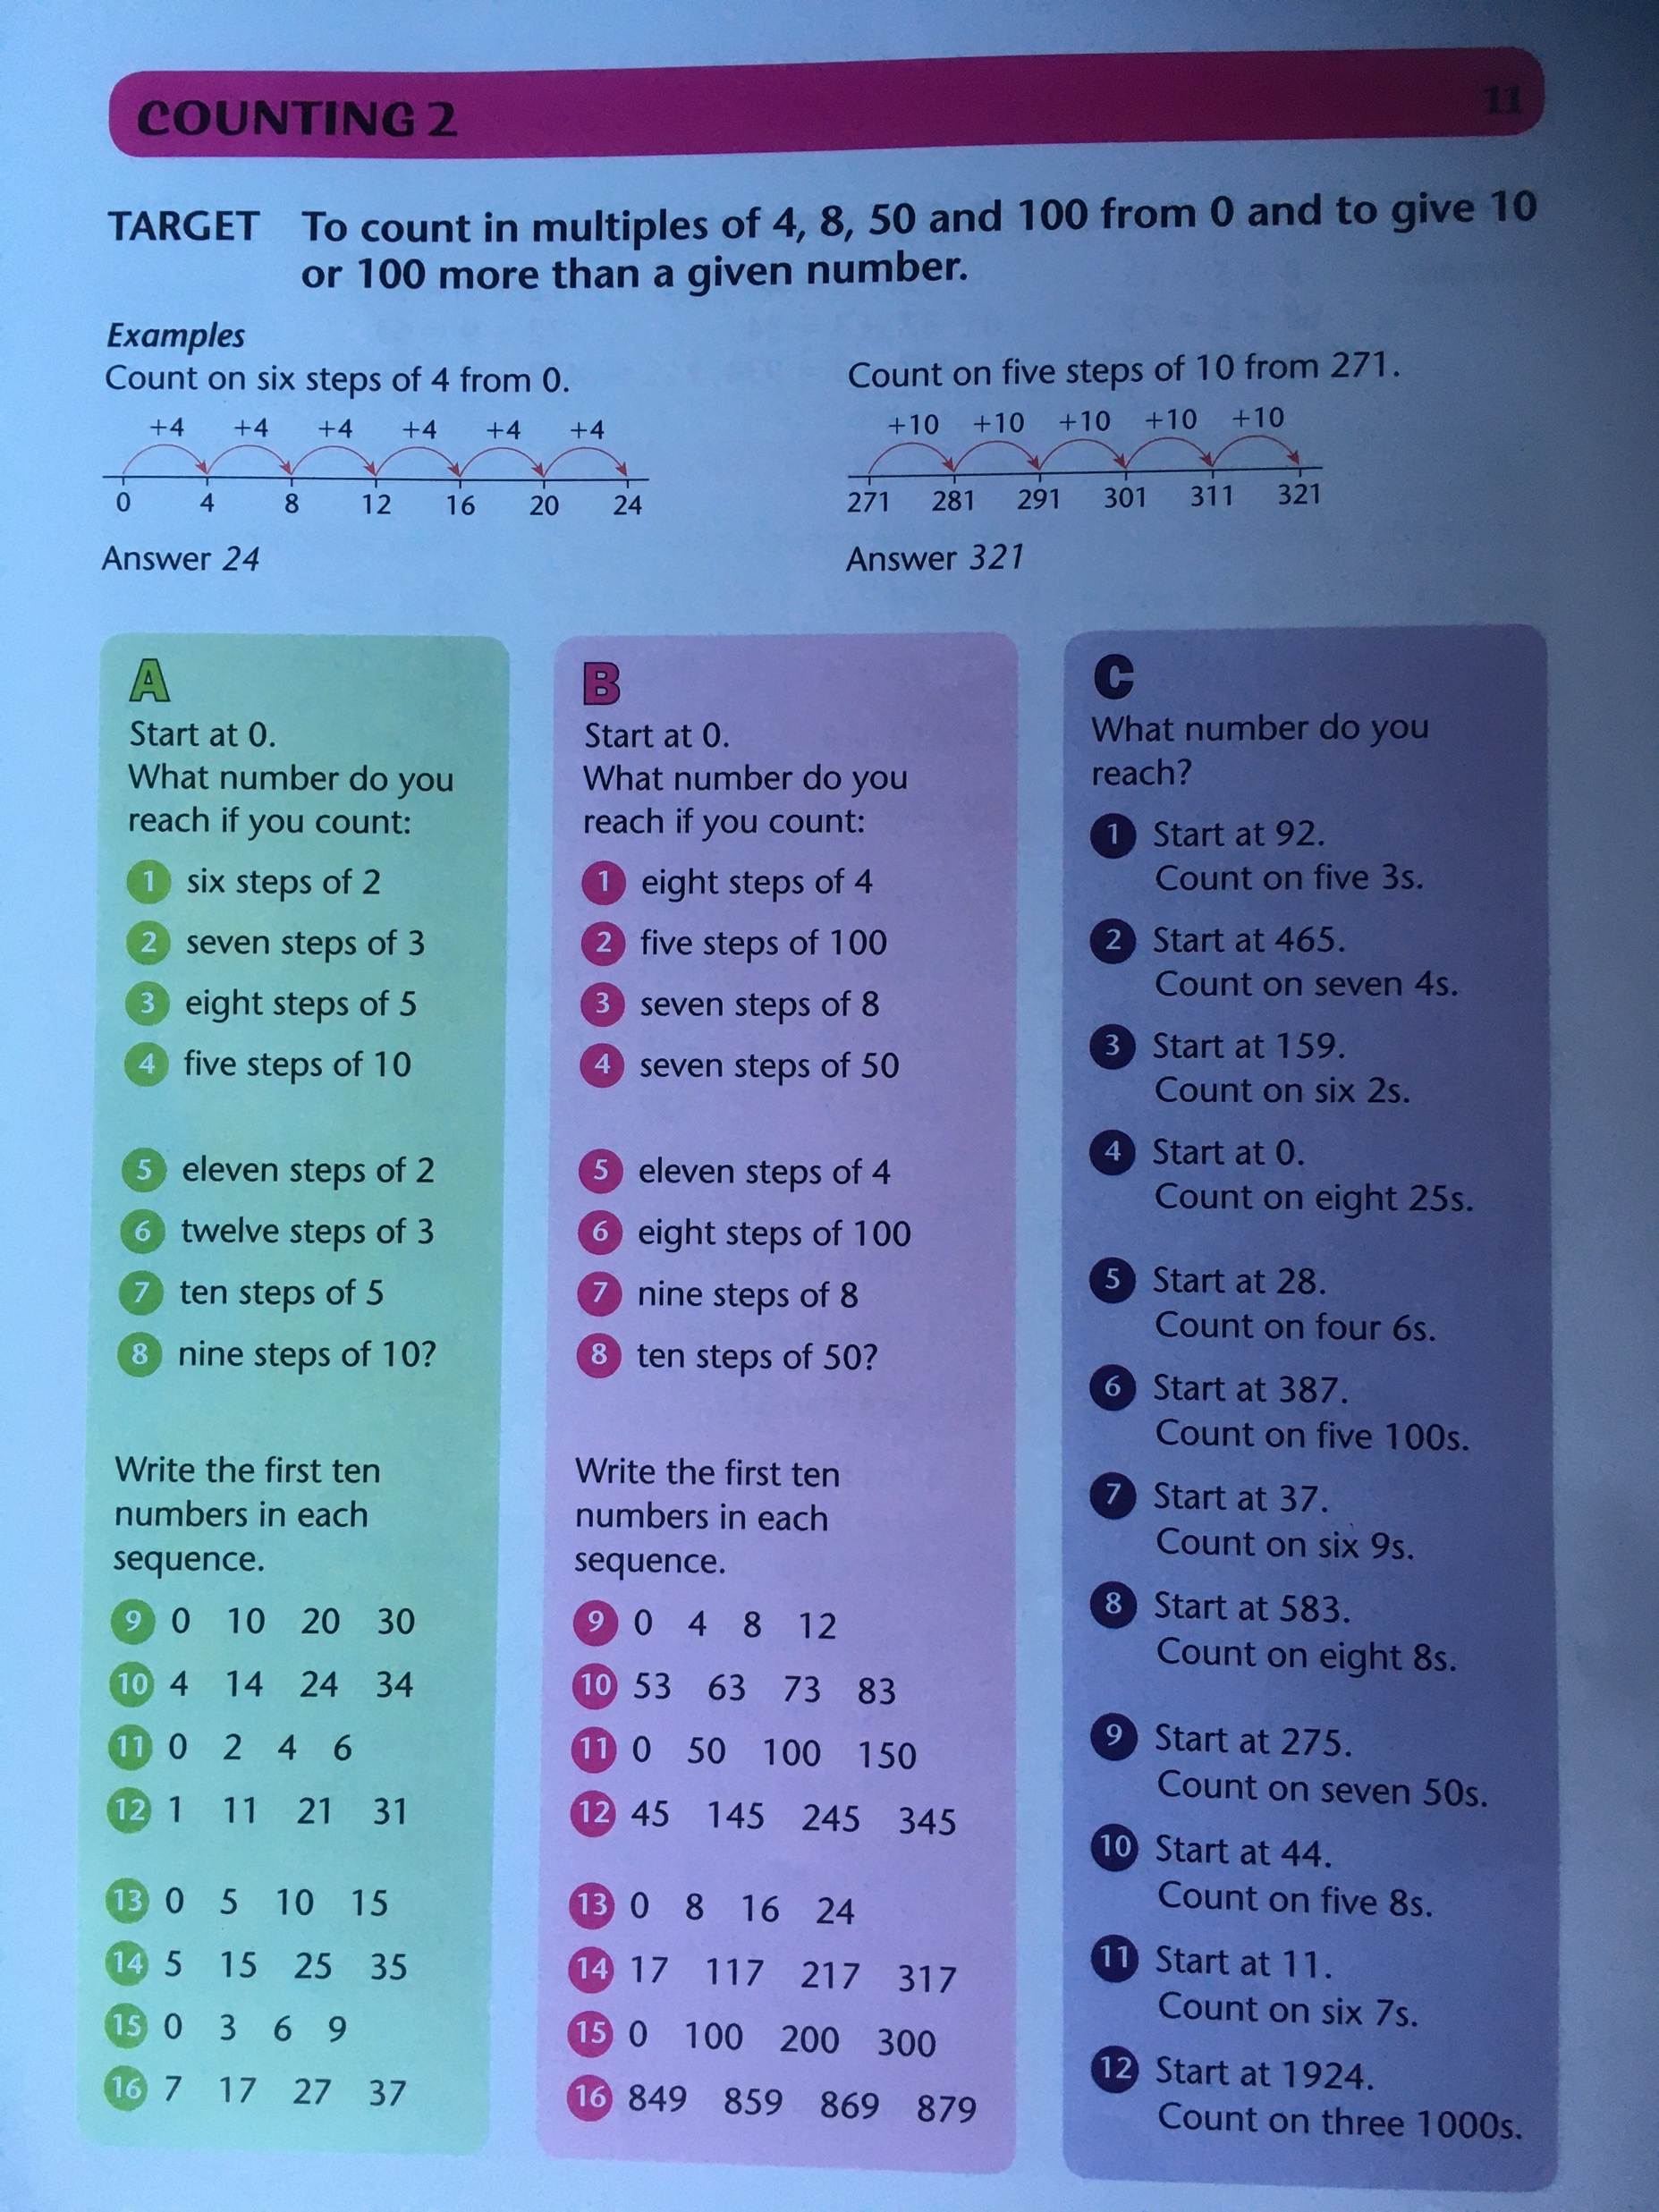
Complete section A and B.
Section C is a challenge!

Slide 15
Now try these!

Slide 16
If you have time...
Try a times tables game on this website.
https://www.topmarks.co.uk/maths-games/7-11-years/times-tables

Slide 17
Maths lesson 3

Slide 18
Warm up
1. 12 x 3 =
2. 4 x 6 =
3. 6 x 3 =
4. 5 x 8 =
5. 2 x 11 =
6. 8 x 3 =
7. 5 x 3 =
8. 0 x 6 =
9. 4 x 3 =
10. 8 x 5 =
11. 11 x 6 =
12. 4 x 4 =

Slide 19
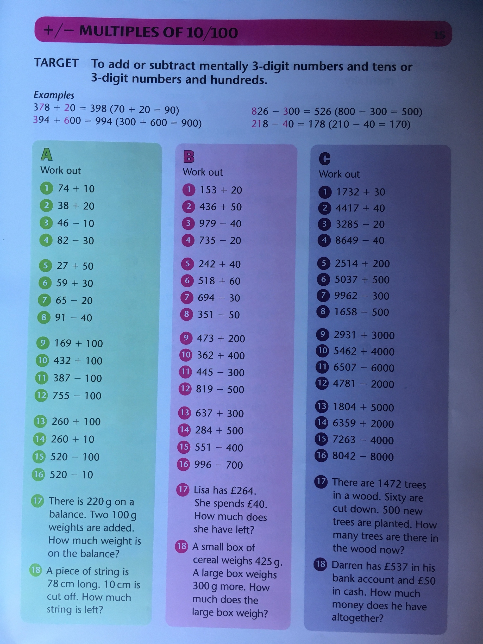
Complete section A and B.
Section C is a challenge!

Slide 20
Now try these!
231 people were at a train station when 80 more arrived. How many are at the station now?
323 newspapers were delivered to the newsagent.
60 were sold within an hour. How many newspapers are left?
184 people were at a concert when 200 more arrived. How many are at the concert now?
529 packets of football stickers were delivered to the shop.
400 packets were sold that same day. How many packets are left?
442 cars were driven onto the ferry while 30 coaches were driven on. How many vehicles are on the ferry?
There were 355 cupcakes baked for a conference.
40 were eaten before the conference started. How many are left?

Slide 21
If you have time...
Try a times tables game on this website.
https://www.topmarks.co.uk/maths-games/7-11-years/times-tables

