Slide 1
Week beginning 15th June
This is your Maths work for this week. There are:
- 3 pieces of early bird work
3 pieces of Maths work
In addition to this, keep on with your Joe Wicks PE, learning your times tables and spelling work too.

Slide 2
This week, post at least two pieces of your work onto Class Dojo
For great work posted, there will be dojos given out!

Slide 3
Morning Work
Early Bird Time!

Slide 4
Early bird work 15.6.20
1. Double 23 = | 6. Halve 24 =
2. Double 45 = | 7. Halve 48 =
3. Double 25 = | 8. Halve 24 =
4. Double 150 = | 9. Halve 66 =
5. Double 16 = | 10. Halve 28 =

Slide 5
Early Bird Work 16.6.19
Finish these sequences:
12, 15, 18, 21, ___, ___, ___
50, 45, 40, 35, ___, ___, ___
12, 16, 20, 24, ___, ___, ___
12, 18, 24, 30, ___, ___, ___
33, 32, 31, 30, ___, ___, ___

Slide 6
Early Bird Work 17.6.19
Problem Solving Questions
Increase 30 by 20
What is 6 less than 30?
What is the sum of 30 and 12?
Multiply 12 by 2
What is 3 lots of 20?
Share 40 between 2
What is 6 more than 25?
There were 20 cakes shared between 4 friends. How many each?
Write your own question like these ones.

Slide 7
Maths lesson 1

Slide 8
X by 4
Using the 4 x tables
3 x 4 = 12
3 x 40 = 120
3 x 400 = 1200
4 x 3 = 12
4 x 30 = 120
4 x 300 = 1200
What do you notice?

Slide 9
X by 4
Using the 4 x tables
3 x 4 = 12
3 x 40 = 120
3 x 400 = 1200
4 x 3 = 12
4 x 30 = 120
4 x 300 = 1200
What do you notice?
When you know your 4 times tables, you can use them to work out related calculations.

Slide 10
X by 4
X by 4 by doubling and doubling again.
Working out:
Calculation:
4 x 8
Answer:
32
8
Double it
16
Double it again
32
When you x by 4, you can double the number and then double it again.
You can do this with small and large numbers.

Slide 11
X by 4
X by 4 by doubling and doubling again.
Working out:
Calculation:
4 x 30
Answer:
120
30
Double it
60
Double it again
120
When you x by 4, you can double the number and then double it again.
You can do this with small and large numbers.

Slide 12
X by 4
Using the inverse calculation to solve questions with spaces
The inverse of x by 4 is ÷ by 4
x 4 = 24
To work out what this number is, do the inverse calculation:
24 ÷ 4 =

Slide 13
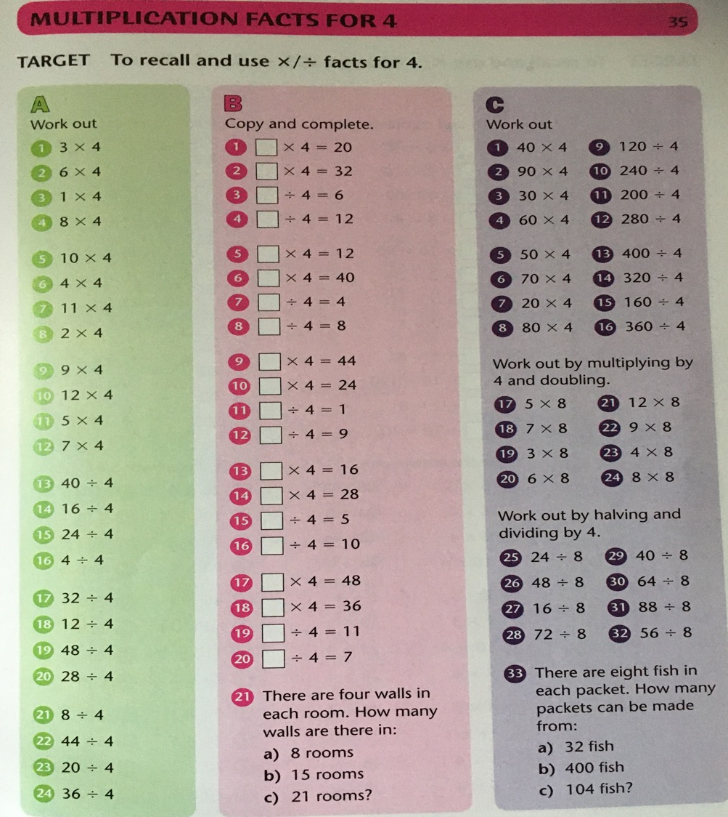
Now have a go at these

Slide 14
If you have time...
Try a multiplication and division game.
https://www.topmarks.co.uk/maths-games/7-11-years/multiplication-and-division

Slide 15
Maths lesson 2

Slide 16
X by 8
Using the 8 x tables
3 x 8 = 24
3 x 80 = 240
3 x 800 = 2400
8 x 3 = 24
8 x 30 = 240
8 x 300 = 2400
What do you notice?

Slide 17
X by 8
X by 8 by doubling, doubling and doubling again.
Working out:
Calculation:
8 x 30
30
Answer:
240
Double it
60
Double it again
120
Double it again
240
When you x by 8, you can double the number and then double it again and then double it again!
You can do this with small and large numbers.

Slide 18
X by 8
Using the inverse calculation to solve questions with spaces
The inverse of x by 8 is ÷ by 8
x 8 = 40
To work out what this number is, do the inverse calculation:
40 ÷ 8 =

Slide 19
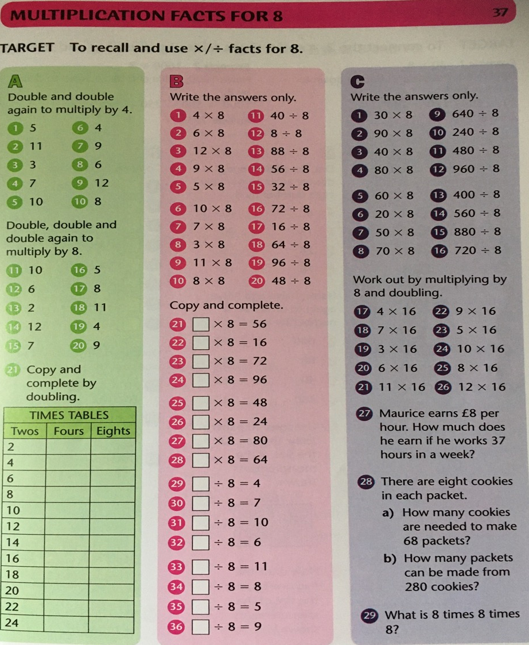
Now have a go at these

Slide 20
If you have time...
Try a multiplication and division game.
https://www.topmarks.co.uk/maths-games/7-11-years/multiplication-and-division

Slide 21
Maths lesson 3

Slide 22
Solving x by 2, 4 and 8 by doubling
2 x 5 = ___
4 x 5 = ___
8 x 5 = ___
Try these
Double the 5.
Double the 5 then double it again.
Double the 5, double it again, then double it again.
Now try these
2 x 30 = ___
4 x 30 = ___
8 x 30 = ___
Double the 30.
Double the 30 then double it again.
Double the 30, double it again, then double it again.

Slide 23
Solving x by 2, 4 and 8 by doubling
Answers
2 x 5 = ___
4 x 5 = ___
8 x 5 = ___
Try these
10
Double the 5.
20
Double the 5 then double it again.
40
Double the 5, double it again, then double it again.
Now try these
2 x 30 = ___
4 x 30 = ___
8 x 30 = ___
60
Double the 30.
120
Double the 30 then double it again.
240
Double the 30, double it again, then double it again.

Slide 24
Solving ÷ by 2, 4 and 8 by halving
40 ÷ 2 = ___
40 ÷ 4 = ___
40 ÷ 8 = ___
Try these
Halve the 40.
Halve the 40 then halve it again.
Halve the 5, halve it again, then halve it again.
Now try these
80 ÷ 2 = ___
80 ÷ 4 = ___
80 ÷ 8 = ___
Halve the 40.
Halve the 40 then halve it again.
Halve the 5, halve it again, then halve it again.

Slide 25
Solving ÷ by 2, 4 and 8 by halving
Answers
40 ÷ 2 = ___
40 ÷ 4 = ___
40 ÷ 8 = ___
Try these
20
Halve the 40.
10
Halve the 40 then halve it again.
5
Halve the 40, halve it again, then halve it again.
Now try these
80 ÷ 2 = ___
80 ÷ 4 = ___
80 ÷ 8 = ___
40
Halve the 40.
20
Halve the 40 then halve it again.
10
Halve the 40, halve it again, then halve it again.

Slide 26
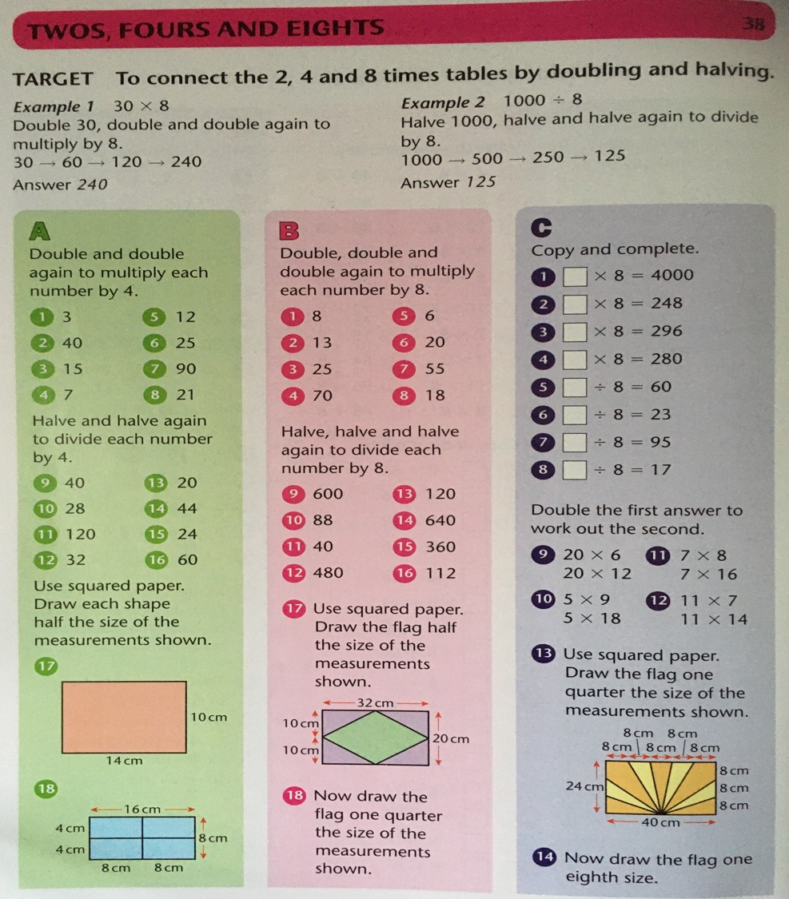
Now have a go at these

Slide 27
If you have time...
Try a multiplication and division game.
https://www.topmarks.co.uk/maths-games/7-11-years/multiplication-and-division

Slide 28

Complete the Sum dog challenges for this week.
Don’t forget to put your work on Class Dojo!

