Slide 1
16.03.21
Can I measure and draw lengths using cm and mm?

Slide 2

Warm Up Activity
Change these into mm
Mild
Hot
2 cm = ______ mm
5cm = _______mm
8cm = _______mm
9cm = _______mm
3 cm 6mm = ______mm
7 cm 9mm = ______mm
6cm 7mm = ______mm
5 cm 3 mm = _____mm
8cm 0mm = _____mm
10 cm = _____mm
3cm = _____mm
3cm 7 mm = _____mm
4 cm 8 mm = ____mm
5cm 9mm = ____mm
9 cm 8 mm = _____mm
10 cm 1 mm = _____mm
12 cm 5 mm =_____mm
15 cm 7 mm = _____mm
17 cm 6 mm = ____mm
15 cm 9 mm = _____mm

Slide 3
Warm Up Activity
How did you get on?
Mild
Hot
2 cm = 20 mm
5cm = 50mm
8cm = 80mm
9cm = 90mm
3 cm 6mm = 36mm
7 cm 9mm = 79mm
6cm 7mm = 67mm
5 cm 3 mm = 53mm
8cm 0mm = 80mm
10 cm = 100mm
3cm = 30mm
3cm 7 mm = 37mm
4 cm 8 mm = 48mm
5cm 9mm = 59mm
9 cm 8 mm = 98mm
10 cm 1 mm = 101mm
12 cm 5 mm =125mm
15 cm 7 mm = 157mm
17 cm 6 mm = 176mm
15 cm 9 mm = 159mm

Slide 4
True or false the length of this line is 6cm.

Slide 5
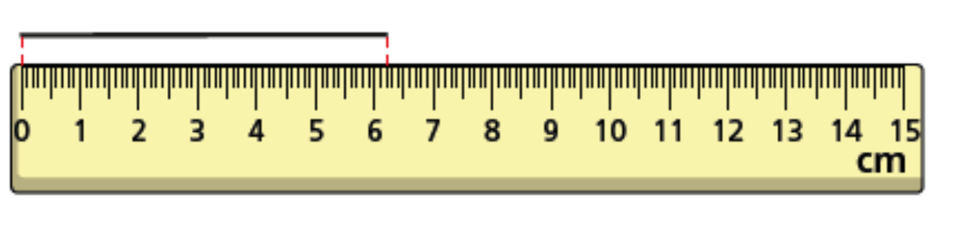
The answer is false.
The line is 6m and 2mm long

Slide 6
Last week when we began measuring lines we struggled with the mm. Remember there are 10mm in a cm.
3cm 5mm =
3 ½ cm
8cm 5mm = 8 ½ cm
12cm 5mm = 12 ½ cm
So halfway between each cm is 5 mm. We can also write that as ½

Slide 7
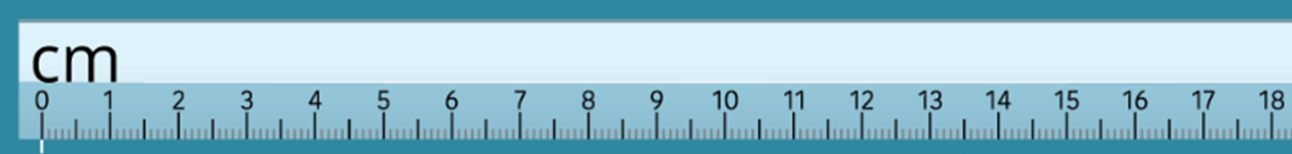
_____________________________
7cm = 70mm
_________________
4cm = 40mm
____________
3cm = 30mm

Slide 8
________________________________
7cm 7mm = 77mm
___________________________________________________________________
16cm 1mm = 161mm
________________________________________________________________________
17cm 3mm = 173mm

Slide 9
______________________________________________________________-
14 cm 9mm
149mm
________________
3cm 8mm
38mm

Slide 10
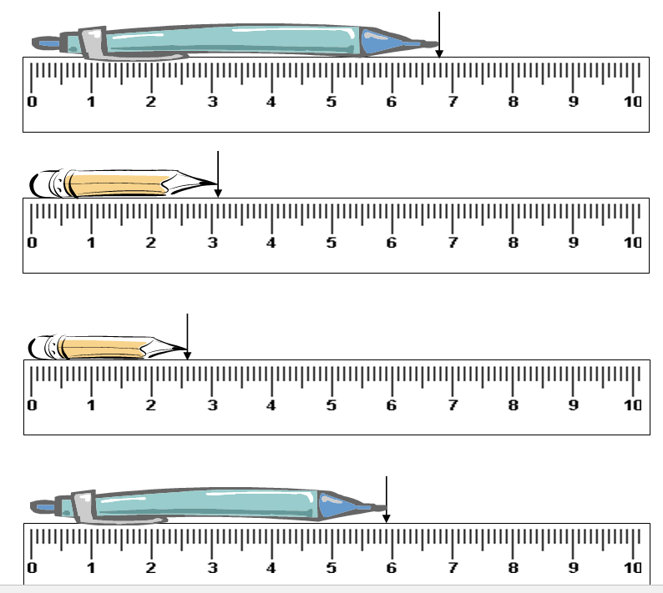
How long are the pens and pencils in cm and mm?
6cm 8mm
68mm
3cm 1mm
31mm
2cm 6cm
26mm
5 cm 9mm
59mm

Slide 11
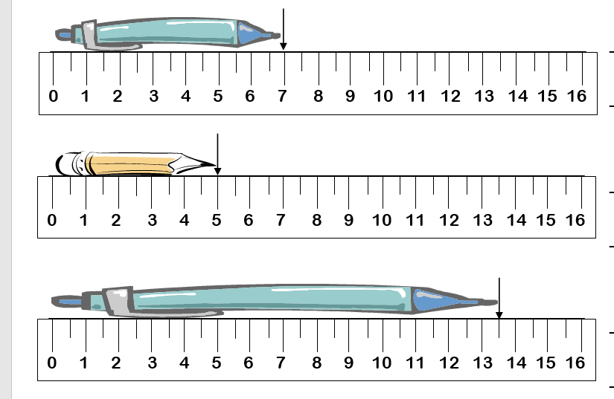
What do you notice about these rulers?
7cm
5cm
13 ½ cm

Slide 12
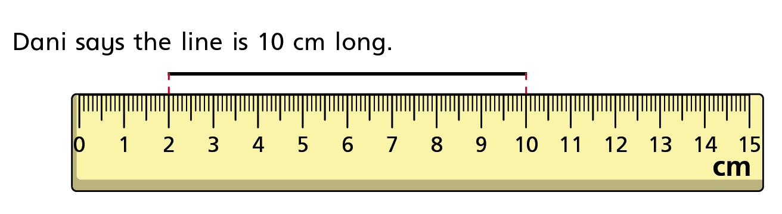
What mistake has Dani made?
What is the actual length of the line?

Slide 15
Draw lines the following lengths in your book and write their measurements next to it.
3 cm 5 mm
10 cm 5mm
5 cm 6mm
9 cm 4 mm
18 cm 7mm
11 cm 1mm

Slide 16
