Slide 1
4.03.21
Year 3
Maths Lesson
Home Learning Powerpoint – If you have any problems, just send us a Dojo message.

Slide 2

On this maths powerpoint:
1 warm up activity
Answers from yesterday’s work
1 maths lesson
Remember – you can get Dojos for posting pictures of your work on Class Dojo!

Slide 3

Warm Up Activity 4
Answers on the next slide. No peeking!
Convert these unit of length
Easier
Harder
3 cm = ____mm
5 cm = ____mm
9cm = ____mm
4cm 6mm = ____mm
8 cm 9mm = ____mm
7 cm 6mm= ____mm
1m = ____ cm
4 m = ____ cm
7 m 50 cm = ____ cm
5 m 60 cm = _____cm
6 cm 7mm = _____mm
8 cm 9mm = _____mm
9cm 5mm = ____mm
10 cm 3mm = ____mm
2m 40 cm = _____cm
8m 55cm = _____cm
9m 88cm = _____cm
7m 33cm = _____ cm
10 m 70cm = ____cm
12m 67cm = ____cm

Slide 4
Warm Up Activity 4 Answers
Answers on te next slide. No peeking!
Easier
Harder
3 cm = 30 mm
5 cm = 50 mm
9cm = 90 mm
4cm 6mm = 46 mm
8 cm 9mm = 89 mm
7 cm 6mm= 76 mm
1m = 100 cm
4 m = 400 cm
7 m 50 cm = 750 cm
5 m 60 cm = 560cm
6 cm 7mm = 67 mm
8 cm 9mm = 89 mm
9cm 5mm = 95 mm
10 cm 3mm = 103mm
2m 40 cm = 240 cm
8m 55cm = 855 cm
9m 88cm = 988 cm
7m 33cm = 733 cm
10 m 70cm = 1070_cm
12m 67cm = 1267 cm

Slide 5
Write today’s date and objective in your home learning book.
4.03.21
Can I add units of length
Remember to be proud of your work and use your best presentation

Slide 6
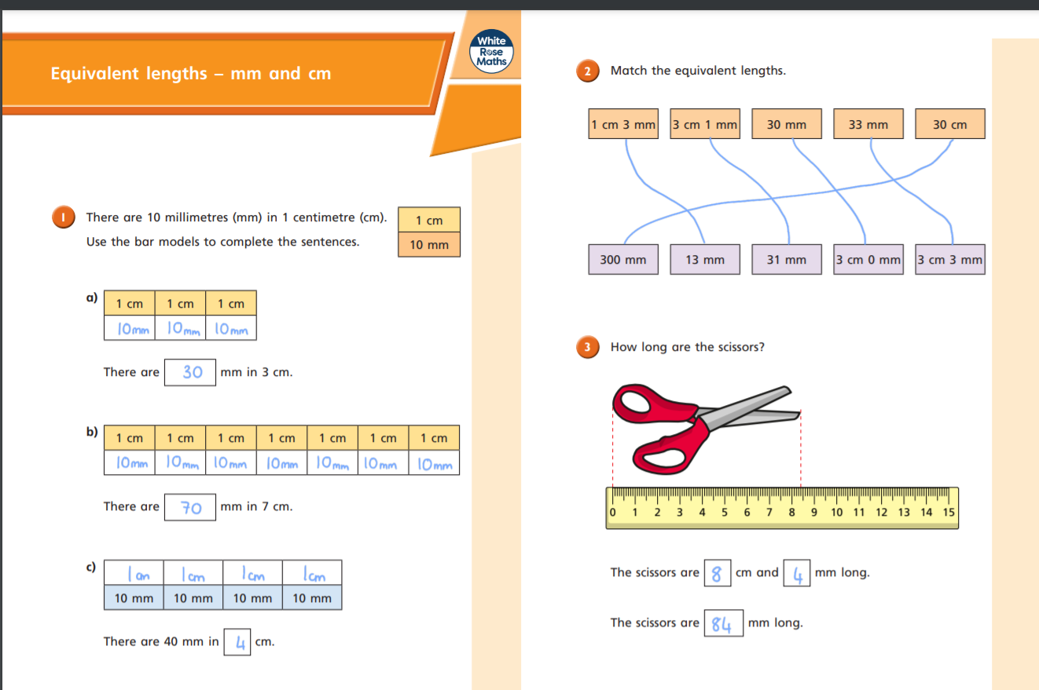

Slide 7
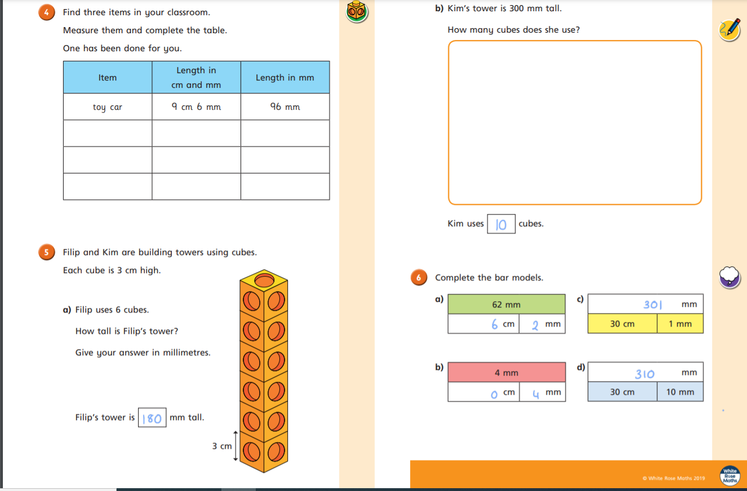

Slide 8
For today’s Maths lesson, I would like you to use this video from White Rose Maths. In today’s lesson we are learning about using our knowledge of length to add units of length together.
https://vimeo.com/506146810
Pencil
Ruler
Exercise book
You will need to get the equipment shown here
I have also copied a few of the slides to help you on your way.

Slide 9

Convert the measurements.
1 cm $=$ ______ mm
1 m $=$ ______ cm
2) 47 $+$ 25 $+$ 13 $=$
3) 128 cm $=$ 1 m $+$ ____ cm

Slide 10
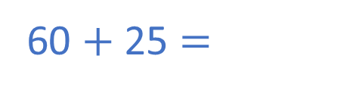
Convert the measurements.
1 cm $=$ ______ mm
1 m $=$ ______ cm
2) 47 $+$ 25 $+$ 13 $=$
3) 128 cm $=$ 1 m $+$ ____ cm
10
100
60 $+$ 25 $=$
85
28

Slide 11
Tommy uses toy bricks to make a tower.
What is the height of the tower?
53 cm
18 cm
23 cm
12 cm
12 cm
17 cm

Slide 12
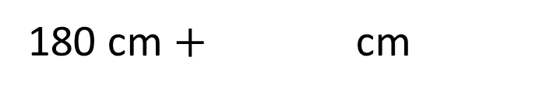

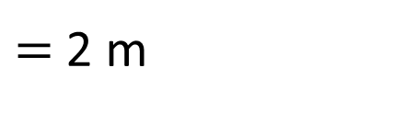
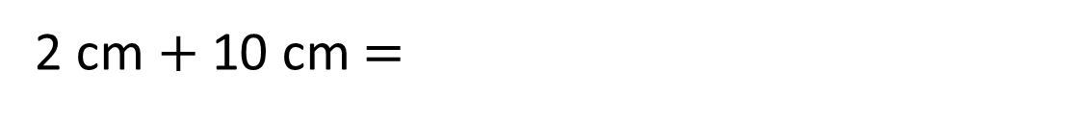
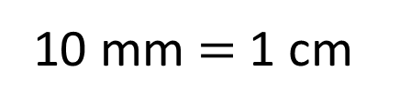
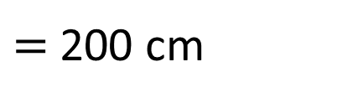
cm
20 mm $+$ 10 cm $=$
12
30
10 mm $=$ 1 cm
12 cm
2 cm $+$ 10 cm $=$
180 cm
1 m 80 cm $+$ cm
20
$=$ 2 m
180 cm $+$ cm
$=$ 200 cm
20
1 m
100 cm
80 cm

Slide 13

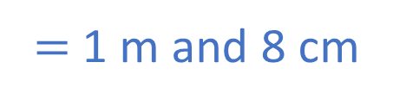
H | T | O
 | 6 | 3
 | 4 | 5
A mat is 45 cm long.
A rug is 63 cm long.
How long are they altogether?
108 cm
$$+$$
1
0
8
108 cm
$=$ 1 m and 8 cm
1 m
8 cm
1
108 cm
?
Mat
Rug
45 cm
63 cm

Slide 14



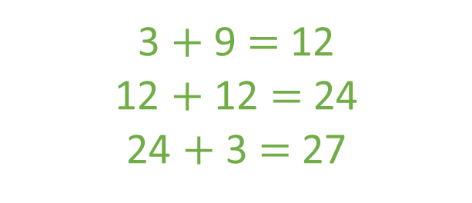
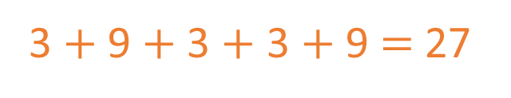
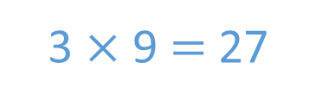
A paperclip is 30 mm long.
A crayon is 9 cm long.
Dexter arranges some paperclips
and crayons like this:
Does his pattern fit onto a 30 cm long piece of paper?
Have a think
Yes
3 cm
30 mm
3 cm
9 cm
30 mm
3 cm
30 mm
9 cm
3 $+$ 9 $+$ 3 $+$ 3 $+$9 $=$ 27
3 $+$ 9 $=$ 12
12 $+$ 12 $=$ 24
24 $+$ 3 $=$ 27
3 $×$ 9 $=$ 27

Slide 15
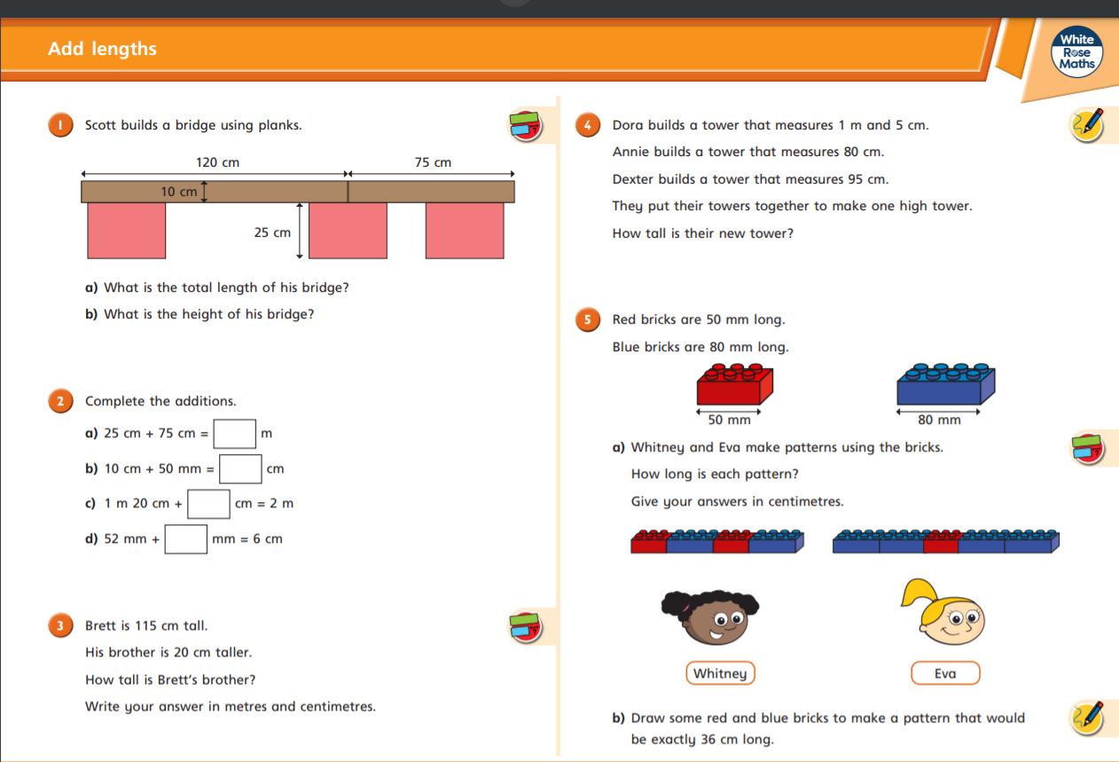

Slide 16
