Slide 1
5.03.21
Year 3
Maths Lesson
Home Learning Powerpoint – If you have any problems, just send us a Dojo message.

Slide 2

On this maths powerpoint:
1 warm up activity
Answers from yesterday’s work
1 maths lesson
Remember – you can get Dojos for posting pictures of your work on Class Dojo!

Slide 3

Warm Up Activity 5
Answers on the next slide. No peeking!
Add together these units of length. You may need to convert between cm and mm
Easier
Harder
3 cm + 8 cm =
9cm +12cm=
17cm +4 cm =
30mm +20mm=
40mm+ 50mm=
3cm + 10mm =
5cm +60mm
7cm +30mm=
8cm + 10mm=
100mm+10cm =
7cm + 16cm =
14cm + 23cm =
8cm + 23mm =
25mm+2cm 40mm=
16mm + 5cm 30mm
12mm + 44mm =
22mm+ 77mm=
15mm + 6cm 40mm =
10cm + 10 cm 20mm=
20cm + 33mm =

Slide 4
Warm Up Activity 5
Answers
Answers onthe next slide. No peeking!
Add together these units of length. You may need to convert between cm and mm
Easier
Harder
3 cm + 8 cm = 11cm
9cm +12cm= 21cm
17cm +4 cm =21cm
30mm +20mm= 50mm
40mm+ 50mm= 90mm
3cm + 10mm = 4cm
5cm +60mm = 11cm
7cm +30mm= 10cm
8cm + 10mm= 9cm
100mm+10cm = 20cm
7cm + 16cm = 23cm
14cm + 23cm = 37cm
8cm + 23mm = 103mm
25mm+2cm 40mm= 49mm
16mm + 5cm 30mm = 69mm
12mm + 44mm = 56mm
22mm+ 77mm= 99mm
15mm + 6cm 40mm =79mm
10cm + 10 cm 20mm= 20cm20mm
20cm + 33mm = 233mm

Slide 5
Write today’s date and objective in your home learning book.
5.03.21
Can I subtract units of length
Remember to be proud of your work and use your best presentation

Slide 6
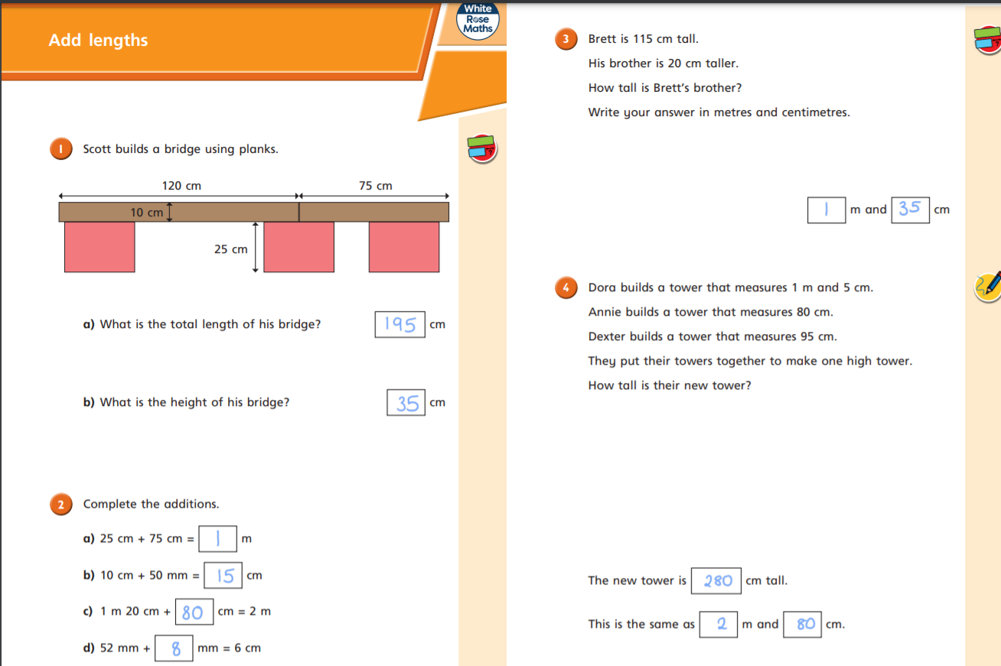

Slide 7
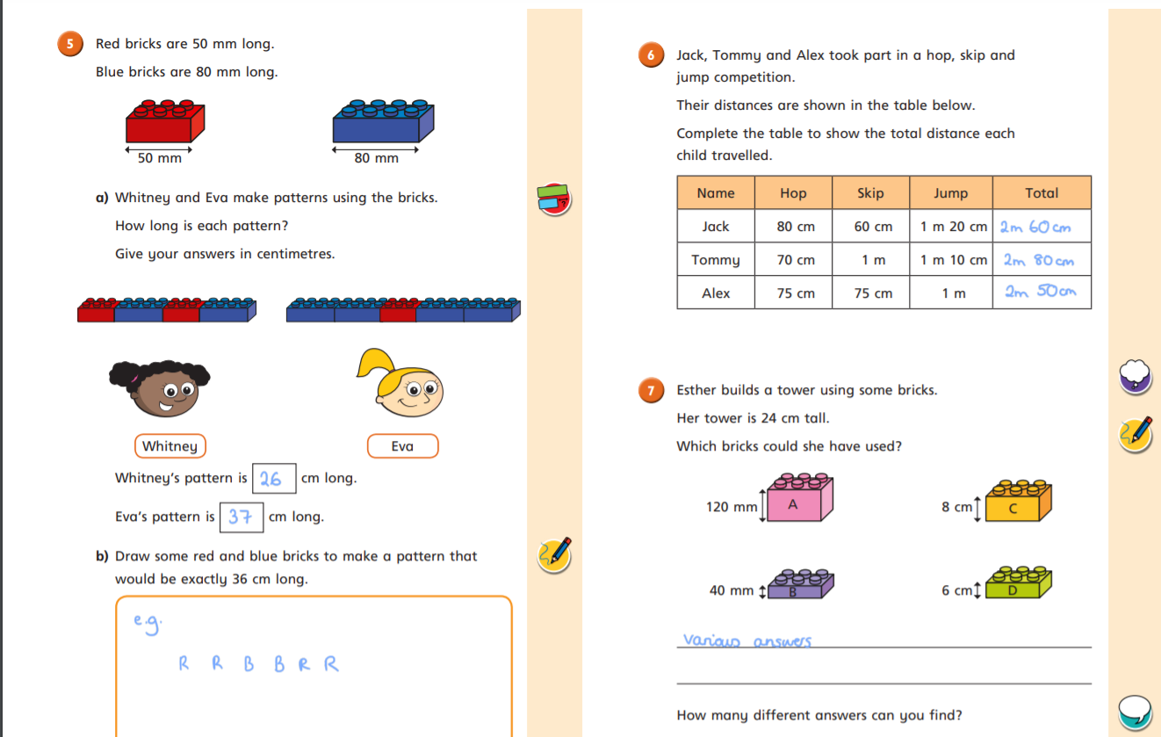

Slide 8
For today’s Maths lesson, I would like you to use this video from White Rose Maths. In today’s lesson we are learning about using our knowledge of length to subtract units of length together.
https://vimeo.com/506146876
Pencil
Ruler
Exercise book
You will need to get the equipment shown here
I have also copied a few of the slides to help you on your way.

Slide 9

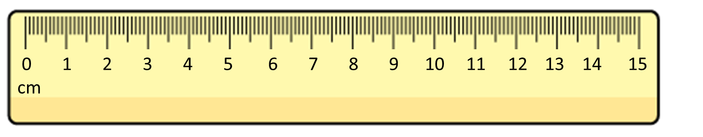
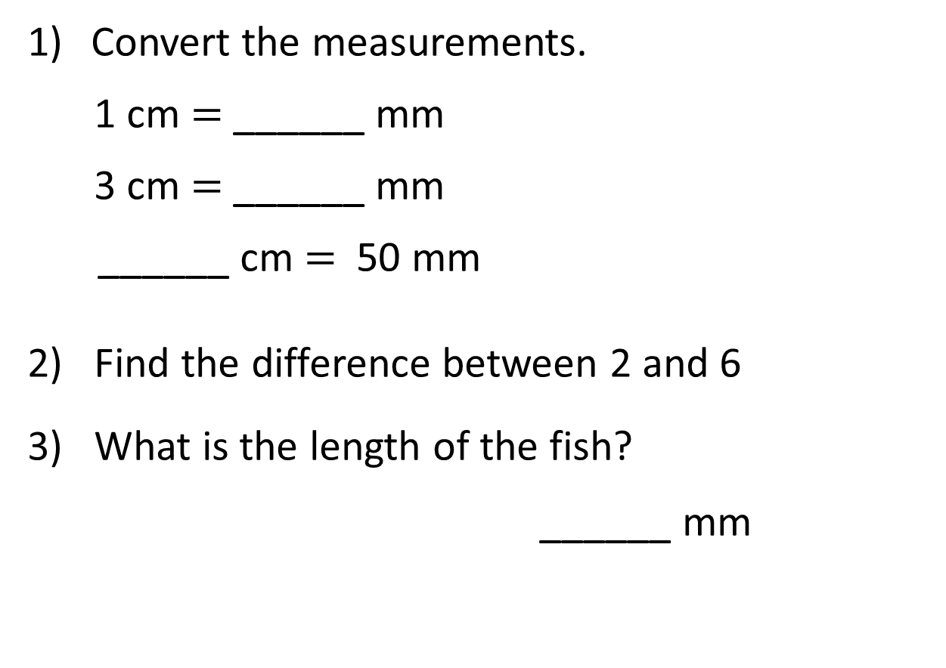
Convert the measurements.
1 cm $=$ ______ mm
3 cm $=$ ______ mm
______ cm $=$ 50 mm
2) Find the difference between 2 and 6
3) What is the length of the fish?
______ mm

Slide 10
Convert the measurements.
1 cm $=$ ______ mm
3 cm $=$ ______ mm
______ cm $=$ 50 mm
2) Find the difference between 2 and 6
3) What is the length of the fish?
______ mm
10
30
5
4
40

Slide 12
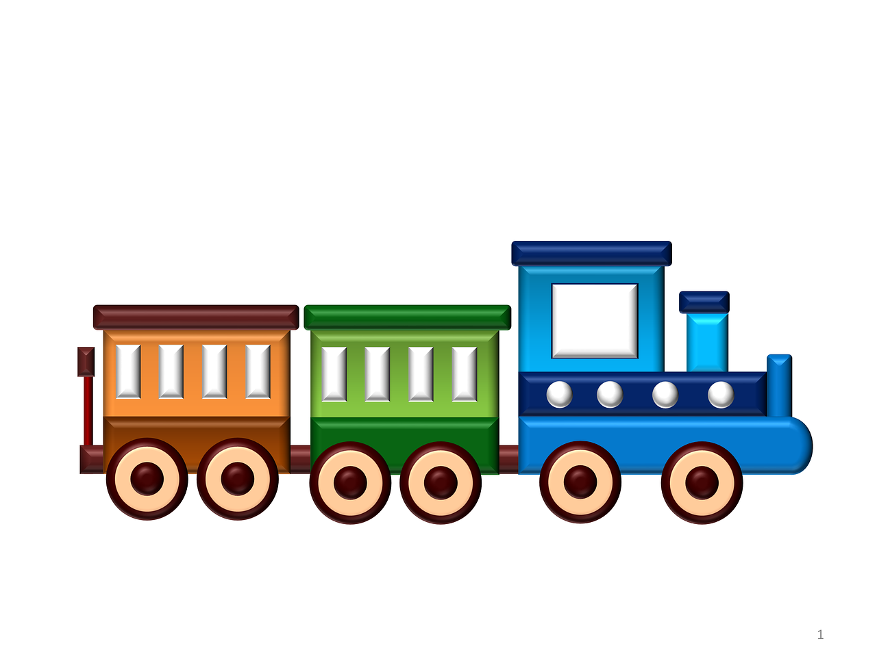
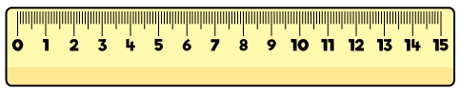

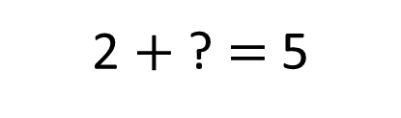
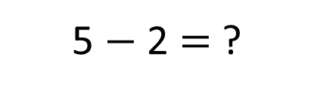
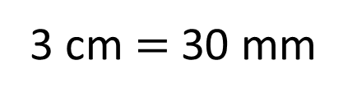
6
The train is ____ cm long.
30
The van is ____ mm long.
2 $+$ ? $=$ 5
3 cm $=$ 30 mm
How much longer is the train than the van?
The train is 3 cm/30 mm longer than the van.
5 $−$ 2 $=$ ?

Slide 13


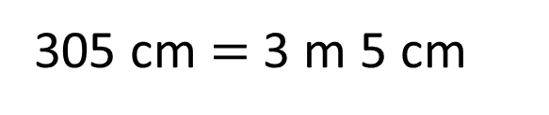

The large car is 145 cm longer than the small car.
The large car is 4 m 50 cm long.
How long is the small car?
____ m ___ cm
3
5
H | T | O
4 | 5 | 0
1 | 4 | 5
4 m 50 cm
Large
450 cm
4
1
145 cm
$$−$$
?
Small
305 cm $=$ 3 m 5 cm
3
0
5

Slide 14

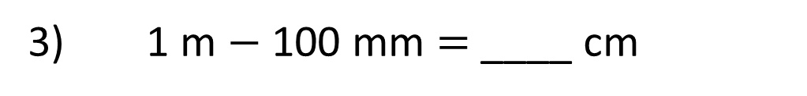
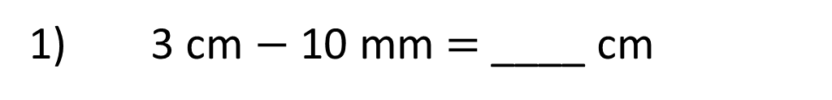


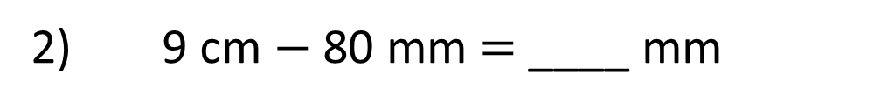

Have a think
2
1) 3 cm $−$ 10 mm $=$ ____ cm
3 cm $−$ 1 cm $=$ 2 cm
10
2) 9 cm $−$ 80 mm $=$ ____ mm
90 mm $−$ 80 mm $=$ 10 mm
90
3) 1 m $−$ 100 mm $=$ ____ cm
100 cm $−$ 10 cm $=$ 90 cm

Slide 15
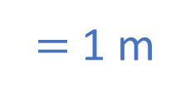
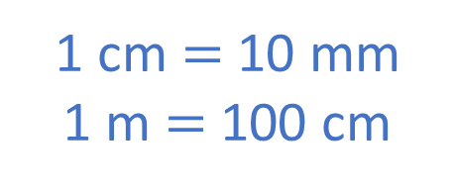


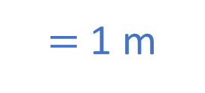

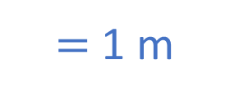
Complete the table so that each
row and column adds up to 1 m.
Have a think
100 mm | 50 cm | ____ cm
___ cm | 200 mm | 50 mm
15 cm | ____ mm | 55 cm
$=$ 1 m
$=$ 1 m
$=$ 1 m
$=$ 1 m
$=$ 1 m
$=$ 1 m
1 cm $=$ 10 mm
1 m $=$ 100 cm

Slide 16
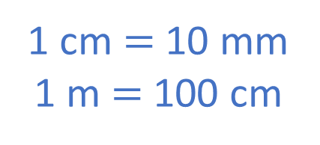
Complete the table so that each
row and column adds up to 1 m.
100 mm | 50 cm | ___ cm
___ cm | 200 mm | 50 mm
15 cm | ____ mm | 55 cm
40
1 cm $=$ 10 mm
1 m = 100 cm
75
300
15 cm + _____cm + 55 cm = 100 cm
10 cm + 50 cm + ____ cm = 100 cm
75
____ cm + 20 cm + 5 cm = 100 cm
30
40
70 cm + ____ cm = 100 cm
60 cm + ____ cm = 100 cm

Slide 17
Have a go at the worksheets on the next slides.
Notes:
Can we simplify?
Discuss reduction structure – take away

Slide 18
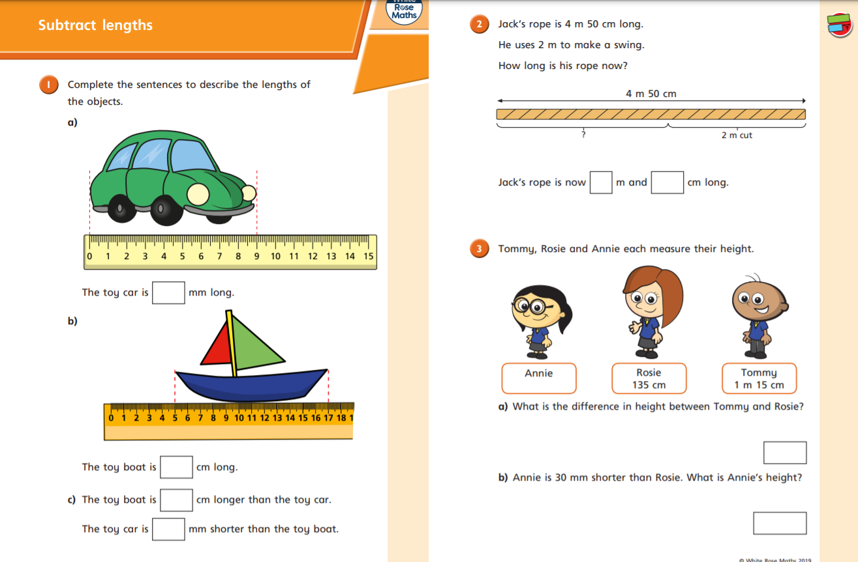

Slide 19
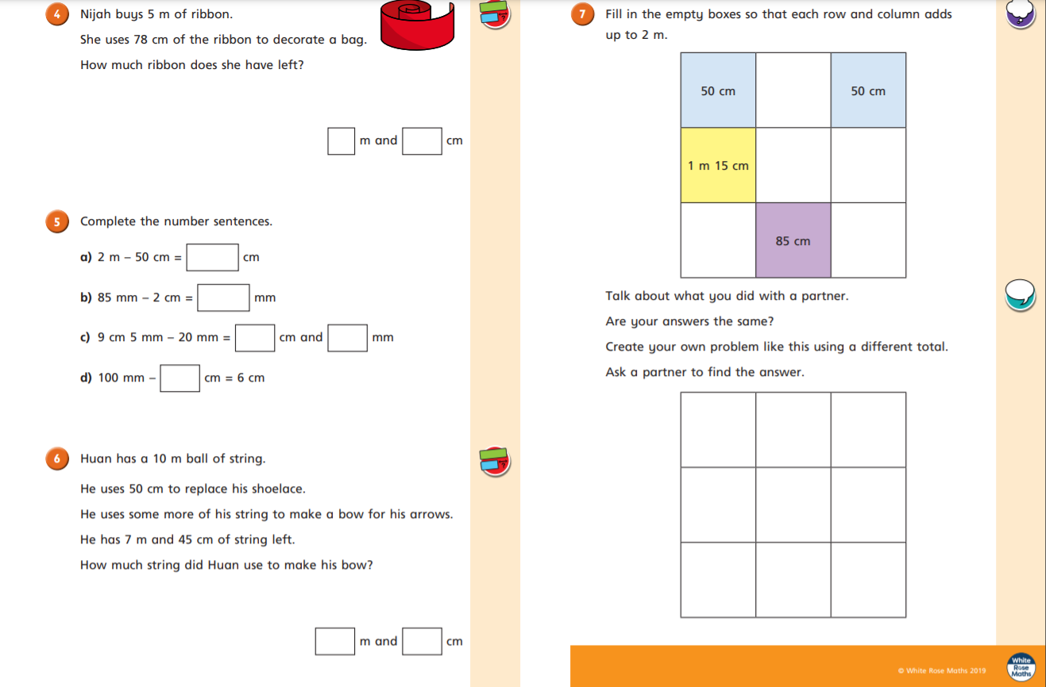

Slide 20
Challenges

Slide 22
How did you do?
I can’t wait to look at your work.
Don’t forget to put your finished work on Class Dojo!

