Slide 1
W.B. 7.1.21
Year 3
Maths Lesson
Home Learning Powerpoint – If you have any problems, just send us a Dojo message.

Slide 2

On this maths powerpoint:
1 warm up activity
1 maths lesson
Remember – you can get Dojos for posting pictures of your work on Class Dojo!

Slide 3

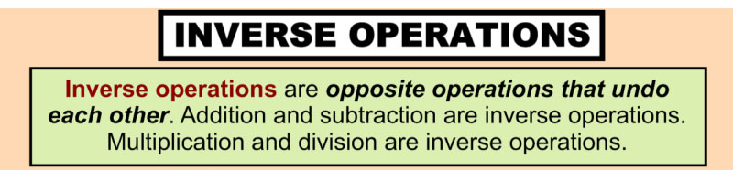
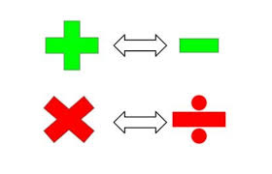
Warm Up Activity
Inverse Operations Reminder:

Slide 4

Warm Up Activity
Inverse Operations
What is the inverse of …
3 x 10 = 30
Answers
30 ÷ 10 = 3
What do you notice?
The answer is the opposite!
(Inverse)
5 x 10 = 50
50 ÷ 10 = 5
4 x 2 = 8
8 ÷ 2 = 4
5 x 3 = 15
15 ÷ 3 = 5

Slide 5
Warm Up Activity
Inverse Operations
What is the inverse of …
8 x 10 = 80
Answers
___________
Now you try!
Write down the inverse calculation
9 x 10 = 90
___________
6 x 2 = 12
____________
9 x 3 = 27
____________
____________
4 x 5 = 20

Slide 6
Maths Lesson 7.1.21
Objective: To solve Missing Number Division calculations
Example:
30 ÷ = 3
Work out what goes in the gap!

Slide 7
Maths Lesson
Objective: To solve Missing Number Division calculations
How do you work it out?
Work out the inverse calculation.
Use your times tables.
30 ÷ = 3
What is the inverse of this calculation?
x 3 = 30
What number can go here?
How many lots of 3 make 30?

Slide 8
Maths Lesson
Objective: To solve Missing Number Division calculations
How do you work it out?
Work out the inverse calculation.
Use your times tables.
30 ÷ = 3
What is the inverse of this calculation?
x 3 = 30
What number can go here?
How many lots of 3 make 30?
So…
30 ÷ = 3
10

Slide 9
Maths Lesson
Objective: To solve Missing Number Division calculations
Now you try!
Remember: Work out the inverse calculation.
Use your times tables.
Easy
Medium
Hard
50 ÷ = 10
80 ÷ = 10
60 ÷ = 10
30 ÷ = 10
90 ÷ = 10
20 ÷ = 10
15 ÷ = 3
33 ÷ = 3
12 ÷ = 3
27 ÷ = 3
36 ÷ = 3
18 ÷ = 3
20 ÷ = 4
÷ 4 = 4
24 ÷ = 4
÷ 9 = 4
40 ÷ = 4
÷ 2 = 4
Answers on the next slide – no peeking!

Slide 10
Maths Lesson
Objective: To solve Missing Number Division calculations
Answers:
Easy
Medium
Hard
50 ÷ 5 = 10
80 ÷ 8 = 10
60 ÷ 6 = 10
30 ÷ 3 = 10
90 ÷ 9 = 10
20 ÷ 2 = 10
15 ÷ = 3
33 ÷ = 3
12 ÷ = 3
27 ÷ = 3
36 ÷ = 3
18 ÷ = 3
20 ÷ 5 = 4
16 ÷ 4 = 4
24 ÷ 6 = 4
36 ÷ 9 = 4
40 ÷ 10 = 4
8 ÷ 2 = 4
5
11
4
9
12
6

