Slide 1
Week beginning 18th May
This is your Maths work for this week. There are:
- 3 pieces of early bird work
3 pieces of Maths work
In addition to this, keep on with your Joe Wicks PE, learning your times tables and spelling work too.

Slide 2
This week, post at least two pieces of your work onto Class Dojo
For great work posted, there will be dojos given out!

Slide 3
Morning Work
Early Bird Time!

Slide 5
Learn to spell these words and use your best handwriting. Can you use these words in your own exciting sentences?

Slide 8
Maths lesson 1

Slide 9

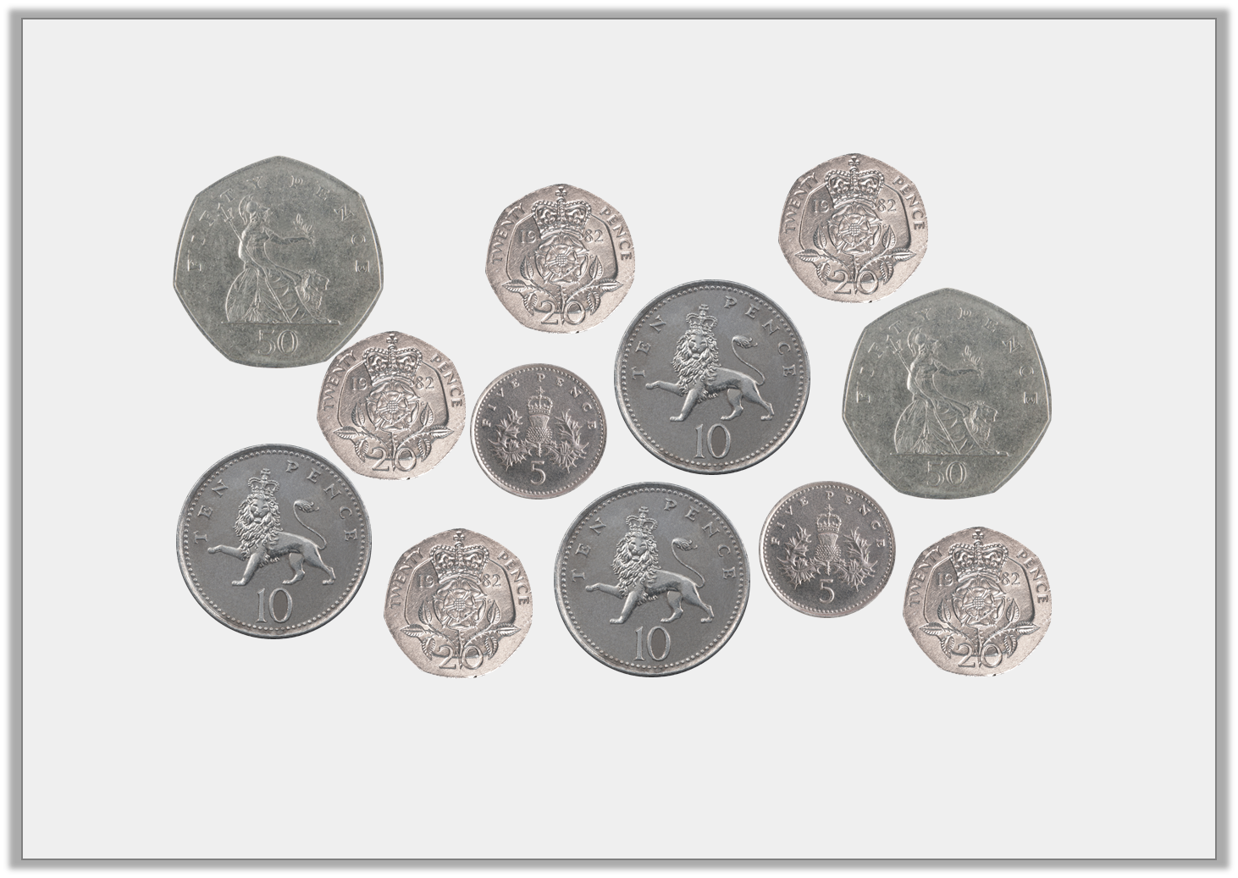

Introduction
Find 4 different ways to make £1
Warm up
© Classroom Secrets Limited 2019

Slide 10
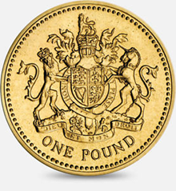
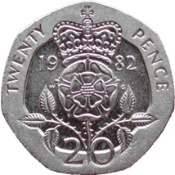



How else could we write £1.64?
£1
60p
4p
4p
100p
164p
60p

Slide 11
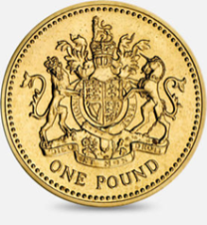


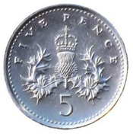

How else could we write £3.09?
£3
9p
300p
309p
9p

Slide 12

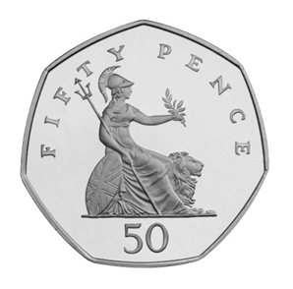



How else could we write 467p?
7p
400p
60p
£4
60p
7p
£4.67

Slide 13
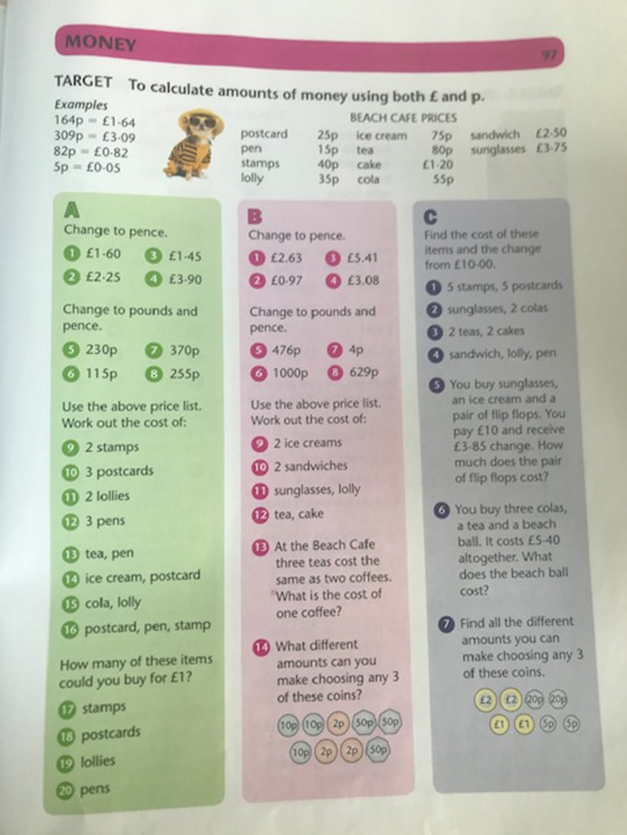
Complete section A and B.
Section C is a challenge!
Now try the questions on the next slides.

Slide 16
If you have time...
Try a times tables game on this website.
https://www.topmarks.co.uk/maths-games/7-11-years/times-tables

Slide 17
Maths lesson 2

Slide 18
Change these amounts in £ and p
Warm up
450p
780p
310p
987p
56p
16p
11p
321p
1056p
665p

Slide 19
Change these amounts in pence.
£7.89
£3.45
£2.34
£0.23
£0.32
£3.90
£6.70
£0.99
£13.76
£14.55

Slide 20
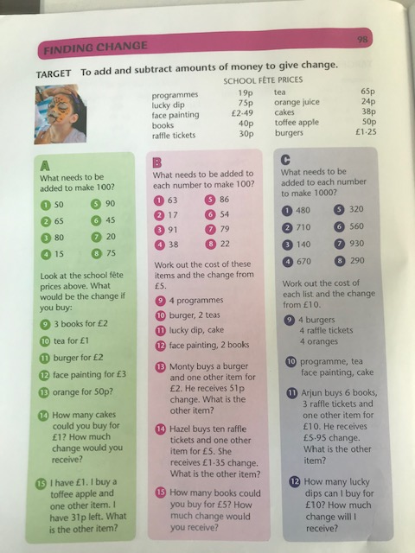
Complete section A and B.
Section C is a challenge!

Slide 25
Maths lesson 3

Slide 26
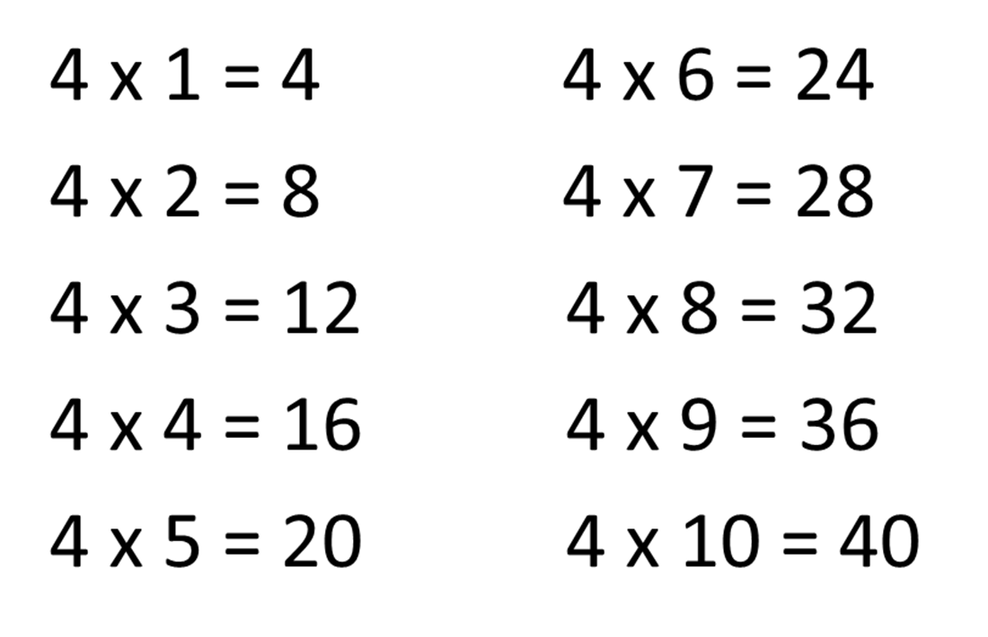
Warm up – Learn your x4 tables

Slide 29
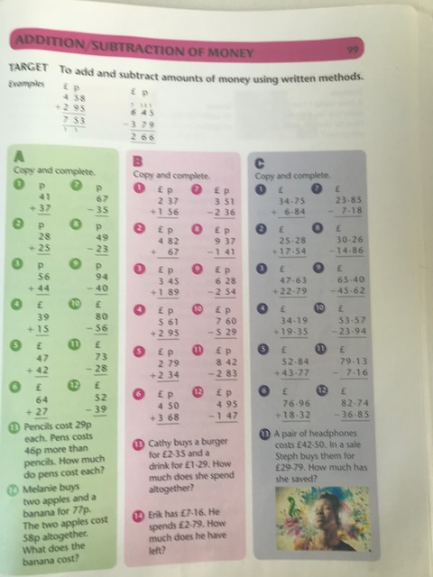
Complete section A and B.
Section C is a challenge!

Slide 32

Complete the Sum dog challenges for this week.

