Slide 1
Week beginning 19th October
This is your Maths work for this week. There are:
- 3 pieces of early bird work
3 pieces of Maths work

Slide 2
This week, post at least two pieces of your work onto Class Dojo
For great work posted, there will be dojos given out!

Slide 3
Morning Work
Early Bird Time!

Slide 5
Learn to spell these words and use your best handwriting. Can you use these words in your own exciting sentences?

Slide 6
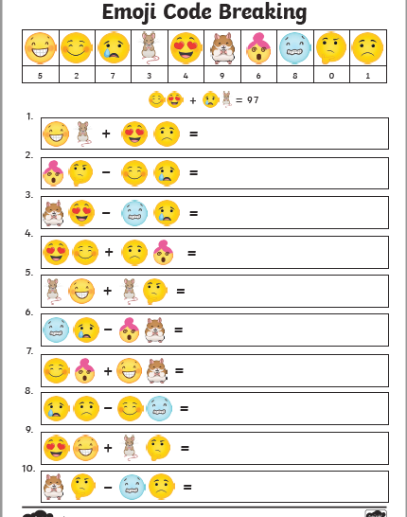
See if you can work out the emoji calculations. There are some trickier ones on the next slide too.

Slide 7
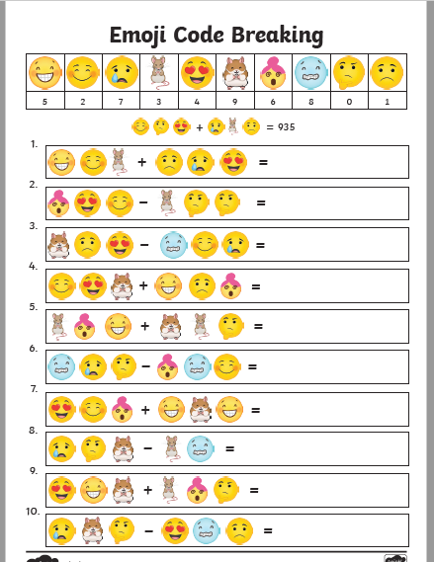

Slide 8
Maths lesson 1

Slide 9
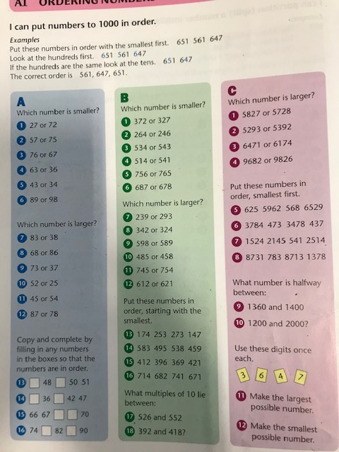

Slide 10
Maths lesson 2

Slide 11
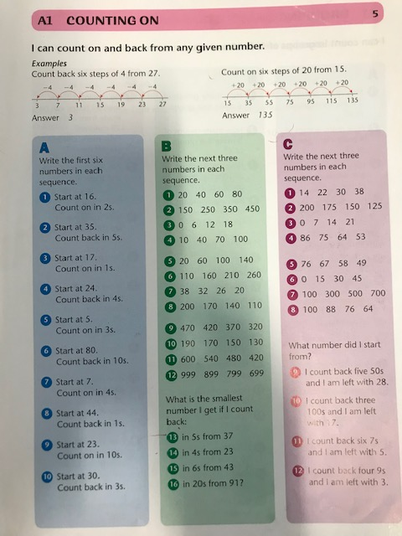

Slide 12
Maths lesson 3

Slide 13
