Slide 1
Week beginning 22nd June
This is your Maths work for this week. There are:
- 3 pieces of early bird work
3 pieces of Maths work
In addition to this, keep on with your Joe Wicks PE, learning your times tables and spelling work too.

Slide 2
This week, post at least two pieces of your work onto Class Dojo
For great work posted, there will be dojos given out!

Slide 3
Morning Work
Early Bird Time!

Slide 5
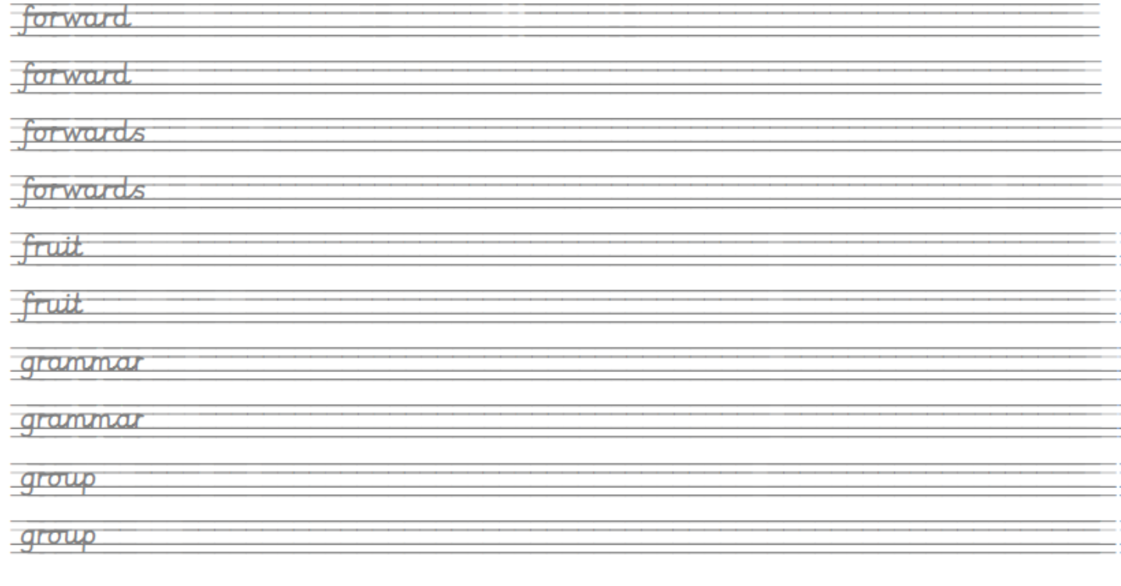
Learn to spell these words and use your best handwriting. Can you use these words in your own exciting sentences?

Slide 6
Spot the spelling mistake! Spell it correctly.
1) The man assidently bumped his car into the wall. _______________________
2) It was actuly James’ go in the game next. _____________________________
3) The letter had the wrong adres on it. ______________________________
4) ‘Make sure you anser correctly’ said the instructor. _________________________
5) The lady was due to arive at 3pm. ___________________________________
6) ‘Why do you not beleve me?’ asked the girl._________________________
7) Josh got a brand new biscicle for his birthday.____________________________

Slide 7
Maths lesson 1

Slide 8
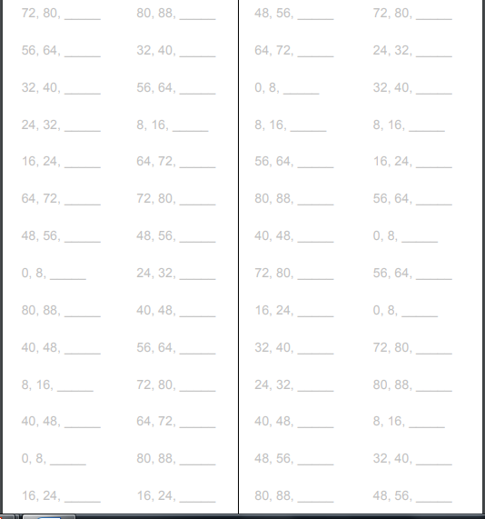
Warm up
Counting in steps of 8 to practice your x8 tables

Slide 9
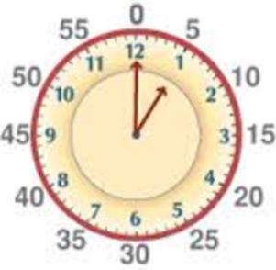
What can you remember about how we write digital time?
When we write digital time we always write minutes past the hour. Remember to count in 5’s.
Quarter past seven – it is fifteen minutes past seven
Think about what the time is in words first as this may help.
7:15

Slide 10
What time does this clock show?
Twenty five minutes to seven
6:35
Remember to count in 5’s!

Slide 11
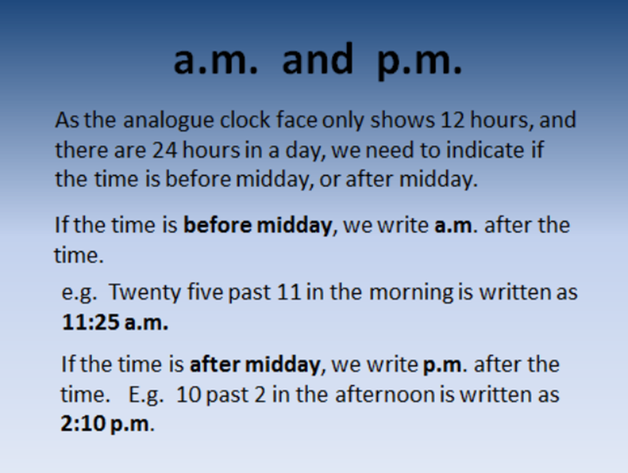

Slide 12
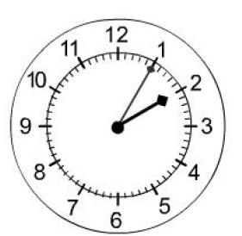
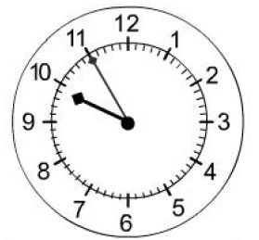
Try writing these times in digital time
AM
PM
PM
Five past two
Five to ten
Twenty to eleven

Slide 13
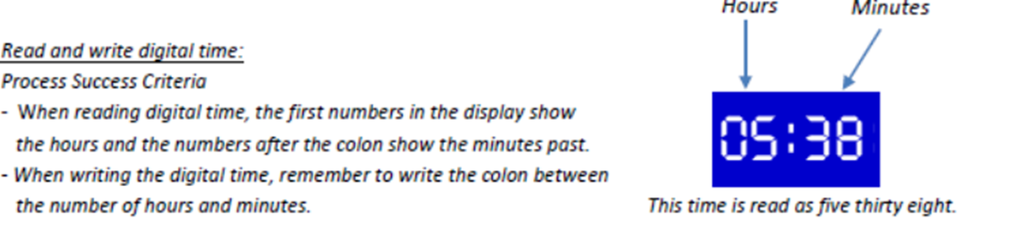

Slide 14
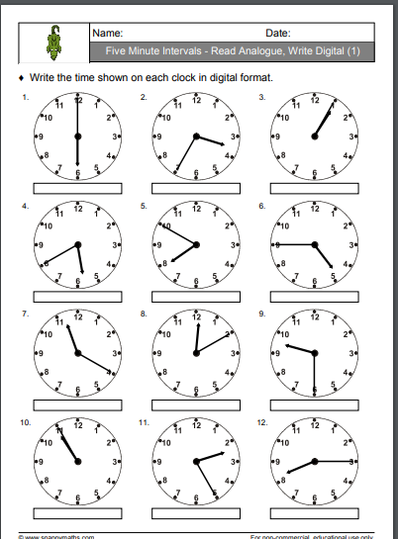
Write the time shown on each of these clocks in digital format

Slide 15
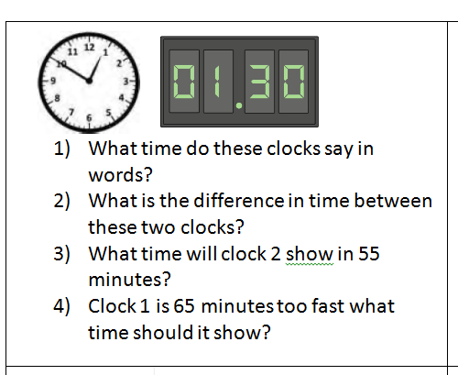
Now try this challenge question!

Slide 16
If you have time...
Try a game of time match up.
http://www.wldps.com/gordons/Matching_pairs_-_Time.swf

Slide 17
Maths lesson 2

Slide 18
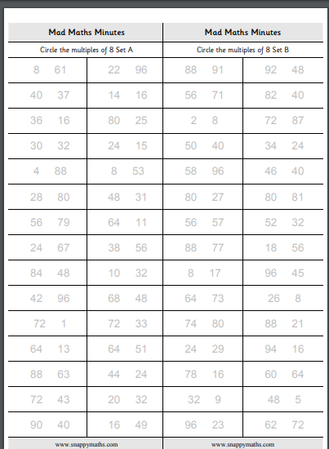
Warm up
Circle the multiple of 8 in each pair of numbers

Slide 19
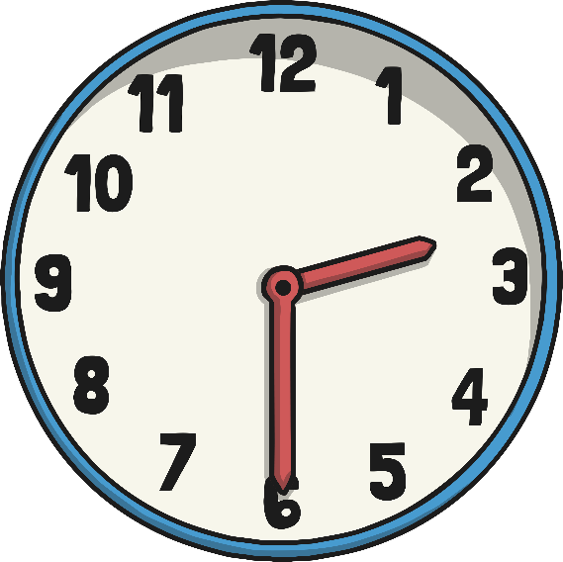
The 24 Hour Day
A day has 24 hours. A clock has 12 hours.
This means each time will happen twice every day.
half past 2 in the morning
half past 2 in the afternoon

Slide 20
a.m. and p.m.
We have to use a way to write these times differently. One way is to use a.m. and p.m.
a.m. (ante meridiem – before noon)
p.m. (post meridiem – after noon)
2:30 a.m.
2:30 p.m.

Slide 21
The 24 Hour Clock
Another way is to use a 24 hour clock.
This means the hours after 12 noon are converted to 13:00 to 23:00.
2:30
14:30
A 4 digit format is used. 2 digits for the hour, a colon (:) and 2 for the minutes.

Slide 22
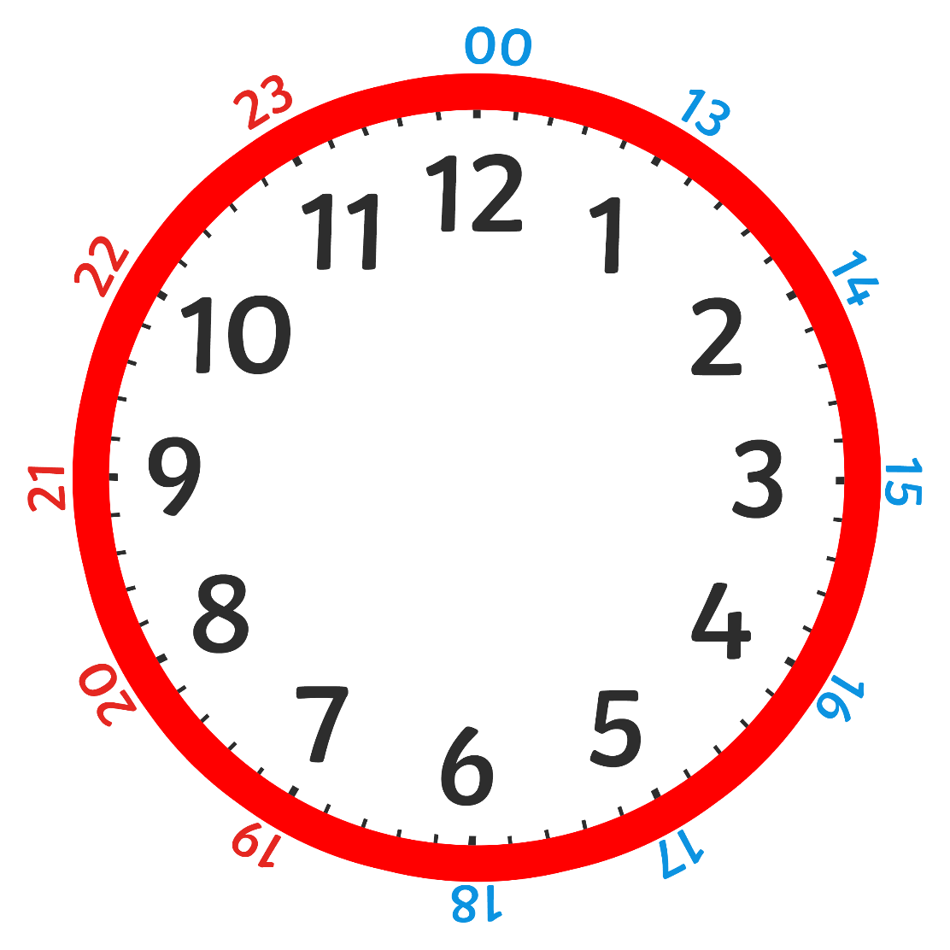
On a 24 hour clock, once we get past 1pm we add 12 hours on to the time shown on the clock face.

Slide 23
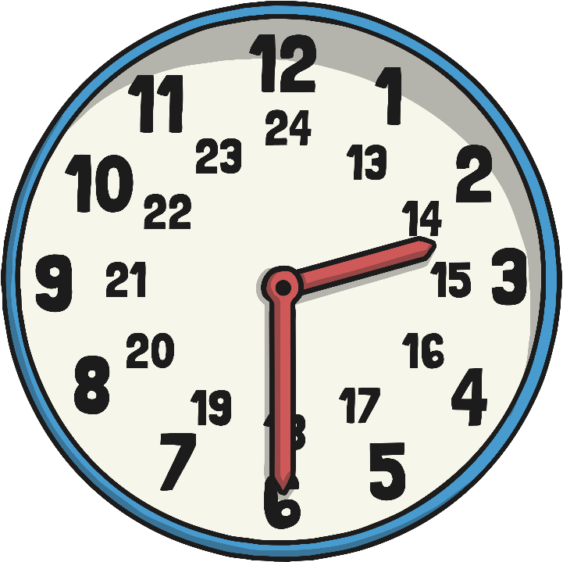
24 Hour Hours
This clock and table show the corresponding hours on a 24 hour clock.
0:00 = 12:00 AM | 12:00 = 12:00 PM
1:00 = 1:00 AM | 13:00 = 1:00 PM
2:00 = 2:00 AM | 14:00 = 2:00 PM
3:00 = 3:00 AM | 15:00 = 3:00 PM
4:00 = 4:00 AM | 16:00 = 4:00 PM
5:00 = 5:00 AM | 17:00 = 5:00 PM
6:00 = 6:00 AM | 18:00 = 6:00 PM
7:00 = 7:00 AM | 19:00 = 7:00 PM
8:00 = 8:00 AM | 20:00 = 8:00 PM
9:00 = 9:00 AM | 21:00 = 9:00 PM
10:00 = 10:00 AM | 22:00 = 10:00 PM
11:00 = 11:00 AM | 23:00 = 11:00 PM
Midnight is referred to as 00:00

Slide 24
24 Hour Time in the Morning
To convert between 12 and 24 hour time in the morning change the format.
6:00 a.m.
06:00
becomes
10:30
10:30 a.m.
becomes
The hours stay the same.

Slide 25

24 Hour Time in the Afternoon
To convert between 12 and 24 hour time in the afternoon add or subtract 12 hours and change the format.
6:00 p.m. becomes 18:00
22:30 becomes 10:30 p.m.

Slide 26

24 Hour Digital Clocks
2
1
1
5
24 hour digital clocks also have an hour and minute display, separated by a colon.
The hours will always be before the colon. The hours go from 0 to 23.
The minutes will always be after the colon.

Slide 27
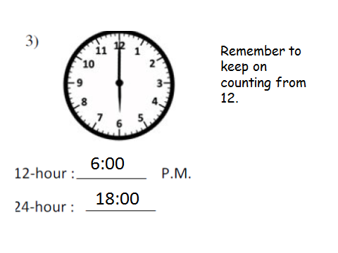
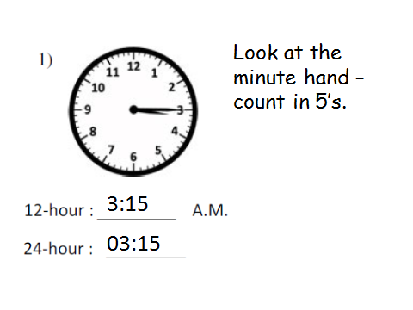
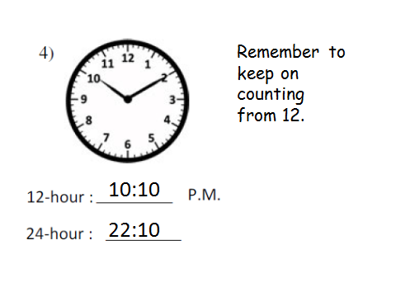
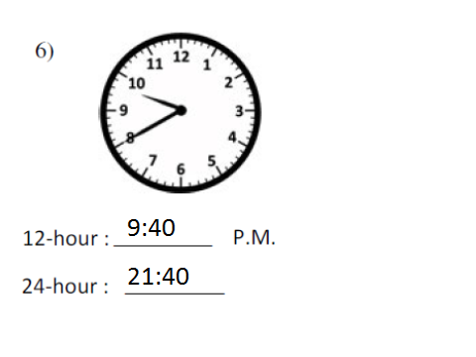

Slide 28
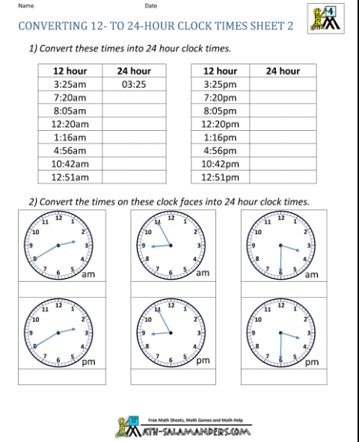

Slide 29
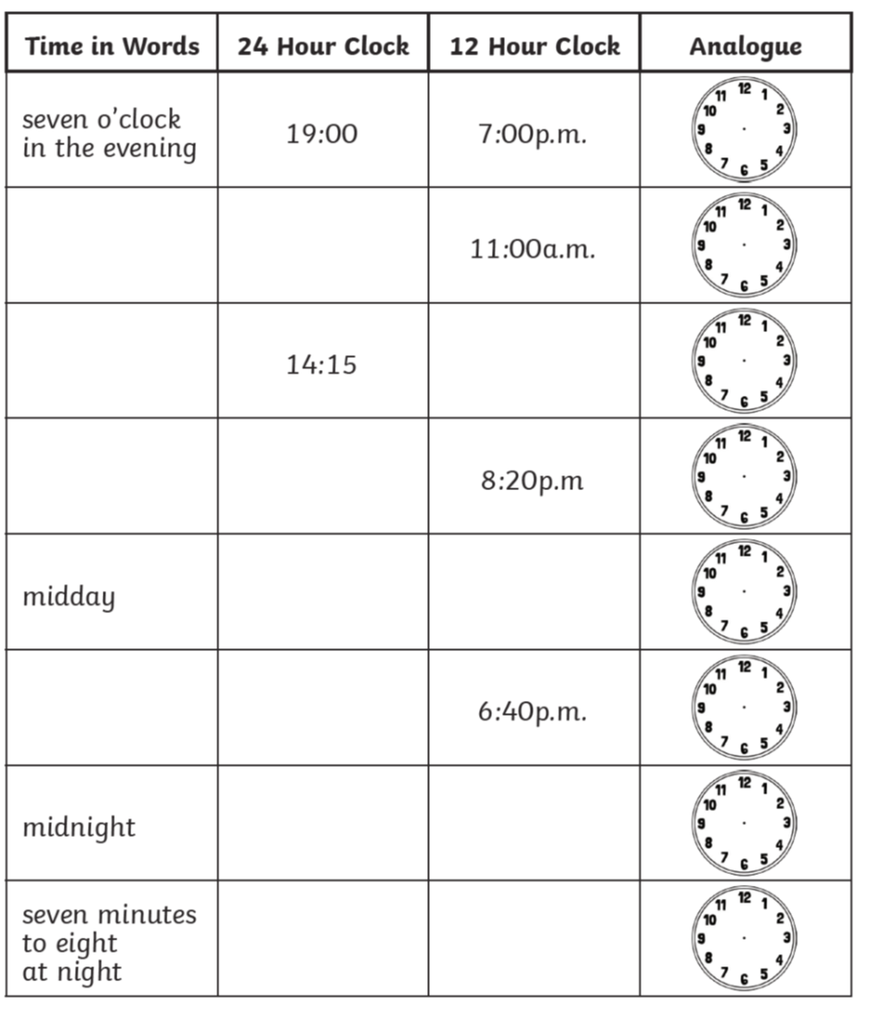
Complete this time conversion table

Slide 30
If you have time...
Try a game of time match up.
http://www.wldps.com/gordons/Matching_pairs_-_Time.swf

Slide 31
Maths lesson 3

Slide 32
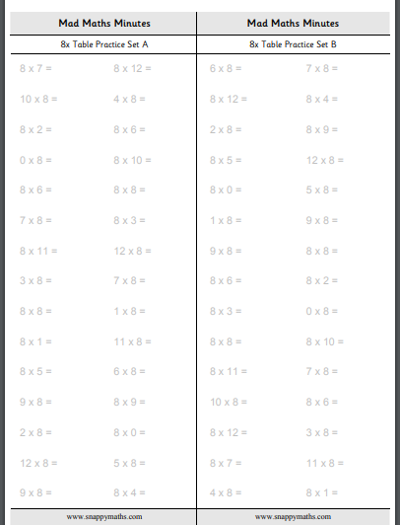
Warm up
Complete the x8 questions

Slide 33
Timetables
Transport timetables often use 24 hour times. Here is an example of a bus timetable:
Service Number | 83 | 83a | 83 | 83a
Ecclesfield, Mill Rd | 17:10 | 17:21 | 17:35 | 17:41
Ecclesfield, High St | - | 17:24 | - | 17:44
Southey Green, Moonshine Ln | 17:22 | 17:33 | 17:47 | 17:53
Pitsmoor, Pinfold Ln | 17:34 | 17:45 | 17:59 | 18:05
Sheffield, Snig Hill | 17:42 | 17:55 | 18:07 | 18:15
Hunters Bar, Ecclesall Rd | 18:04 | 18:13 | 18:27 | 18:33
Fulwood, Crimicar Ln | - | 18:27 | - | 18:47
Bents Green, Ringinglow Rd | 18:15 | - | 18:38 | -

Slide 34
Timetables
Sometimes, 24 hour clock times appear without the separating colon (:). Here’s what the bus timetable would look like without the colon:
Service Number | 83 | 83a | 83 | 83a
Ecclesfield, Mill Rd | 1710 | 1721 | 1735 | 1741
Ecclesfield, High St | - | 1724 | - | 1744
Southey Green, Moonshine Ln | 1722 | 1733 | 1747 | 1753
Pitsmoor, Pinfold Ln | 1734 | 1745 | 1759 | 1805
Sheffield, Snig Hill | 1742 | 1755 | 1807 | 1815
Hunters Bar, Ecclesall Rd | 1804 | 1813 | 1827 | 1833
Fulwood, Crimicar Ln | - | 1827 | - | 1847
Bents Green, Ringinglow Rd | 1815 | - | 1838 | -

Slide 35
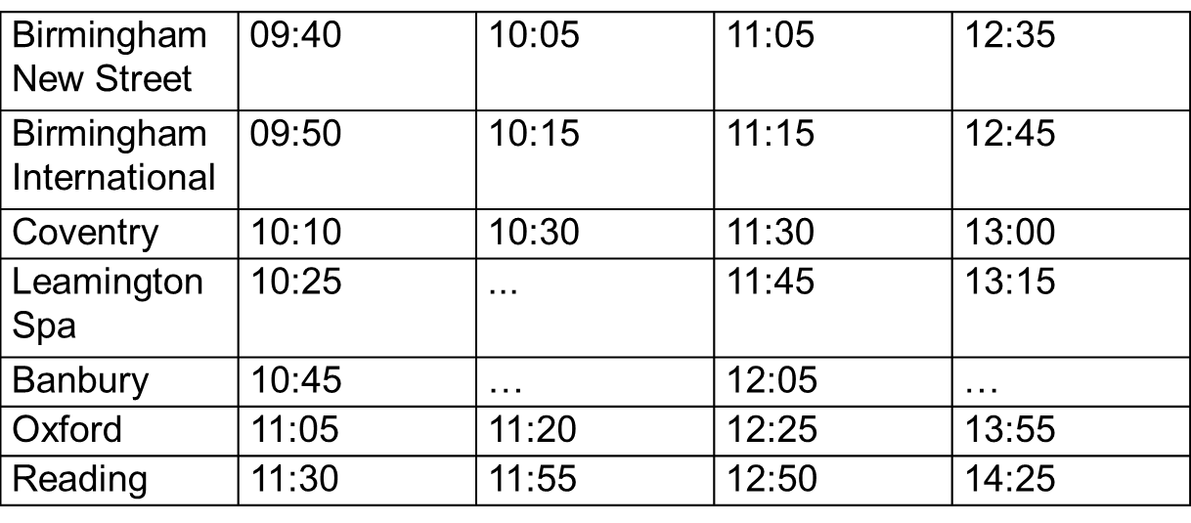
This is a train timetable.
At what time does the first train leave Birmingham New Street?
How long does the train take from Birmingham New Street to Reading?
I arrive at Banbury at 10:25. How long do I need to wait until the next train?

Slide 36
I catch the 13:00 train from Coventry. How long does is take to get to Oxford?
How long does the 12:35 from Birmingham New Street take to et to Leamington Spa?

Slide 37
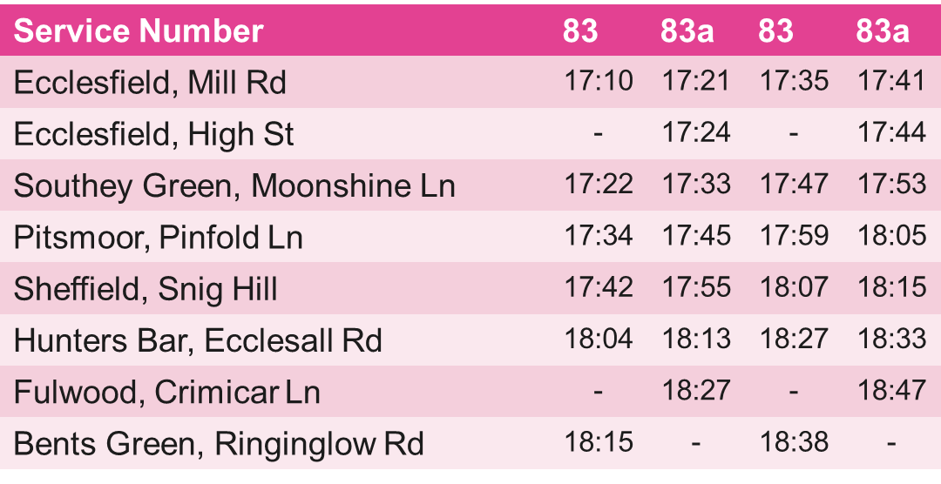
1) What time does the 83 bus arrive at Pinfold lane, Pitsmoor?
2) How long does it take the 83a to get from High street, Ecclesfield to Snig Hill, Sheffield?
3) I am at Mill road, Ecclesfield. If I wanted to be at Ringinglow road, Bents Green by 18:45 which bus and time should I get?
4) How long does it take Bus 83 to get from Mill road, Ecclesfield to Ringinglow road, Bents Green?

Slide 38
Waterloo (London) | 07:10 | 08:35 | 11:35 | 13:50
Woking | 07:35 | - | 12:00 | 14:15
Basingstoke | 07:55 | 09:21 | 12:21 | -
Andover | 08:16 | - | 12:42 | -
Salisbury | 08:36 | 09:54 | 13:17 | 15:08
Yeovil | 09:24 | 10:42 | 14:07 | 15:48
Honiton | 10:01 | - | 14:53 | 16:34
Exeter | 10:27 | 11:42 | 15:18 | 16:59
1. What time is the first train from Waterloo, London?
2. How long does the train take from Waterloo to Basingstoke?
3. How long does the 08:35 from Waterloo take to travel to Exeter?
4. I want to be in Honiton by 14:00. Which train from Waterloo do I need to get?

Slide 39
Waterloo (London) | 07:10 | 08:35 | 11:35 | 13:50
Woking | 07:35 | - | 12:00 | 14:15
Basingstoke | 07:55 | 09:21 | 12:21 | -
Andover | 08:16 | - | 12:42 | -
Salisbury | 08:36 | 09:54 | 13:17 | 15:08
Yeovil | 09:24 | 10:42 | 14:07 | 15:48
Honiton | 10:01 | - | 14:53 | 16:34
Exeter | 10:27 | 11:42 | 15:18 | 16:59
5. At how many stations does the 08:35 train from Waterloo stop before it arrives at Exeter?
6. How long is the journey from Salisbury at 15:08 to Exeter?

