Slide 1
Week beginning 4th May
This is your Maths work for this week. There are:
- 3 pieces of early bird work
3 pieces of Maths work
In addition to this, keep on with your Joe Wicks PE, learning your times tables and spelling work too.

Slide 2
This week, post at least two pieces of your work onto Class Dojo
For great work posted, there will be dojos given out!

Slide 3
Morning Work
Early Bird Time!

Slide 5
Learn to spell these words and use your best handwriting. Can you use these words in your own exciting sentences?

Slide 6
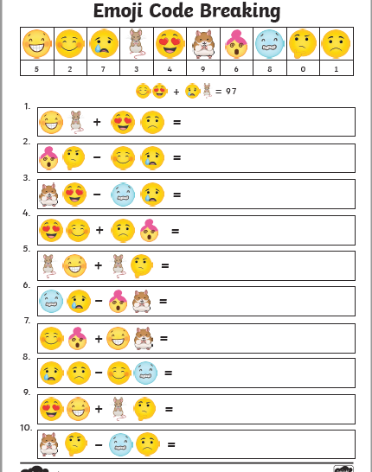
See if you can work out the emoji calculations. There are some trickier ones on the next slide too.

Slide 7
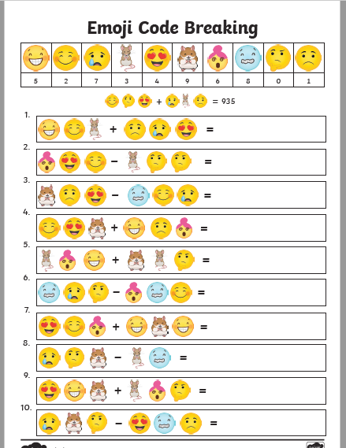

Slide 8
Maths lesson 1

Slide 9
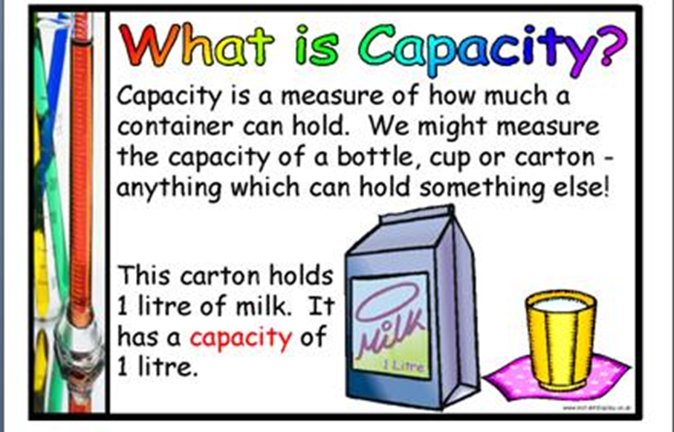
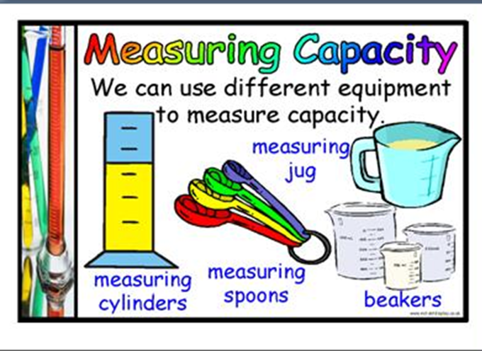
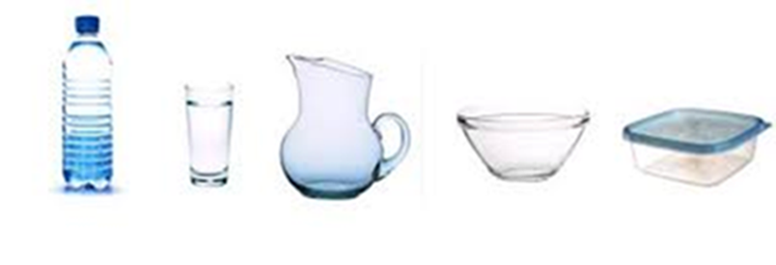
A few weeks ago you learned about capacity.

Slide 10
Warm up
9 litre = ____ ml
4 litres = ____ml
7 litres = ___ml
3.4 litres = ___ml
2.1 litres = ____ ml
8.7 litres = ____ml
7000ml = ___l
5000ml =___l
3000ml = ___l
2200ml = ___l
8600ml= ____l
5400ml = ___l
Remember 1 litre is 1000ml.

Slide 11
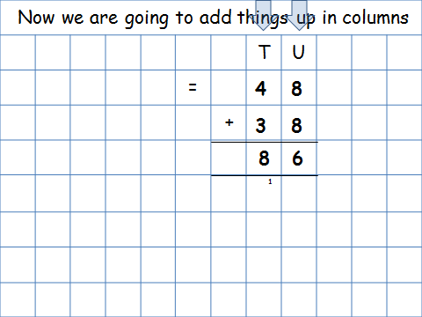
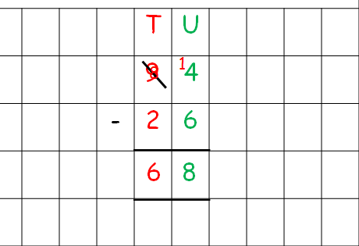
Today you are going to add and subtract capacities using a written method. Remember the methods you have learned in class.
Subtraction
Addition

Slide 12
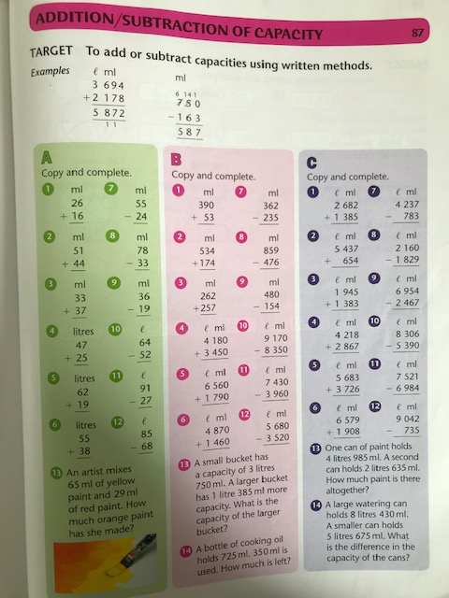
Complete section A and B.
Section C is a challenge!
Now try the questions on the next slide.

Slide 13
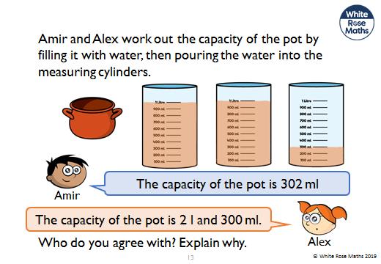
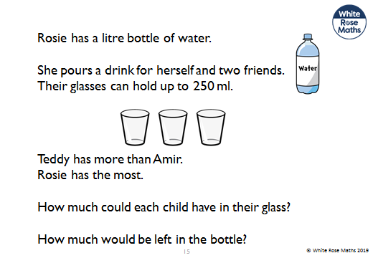
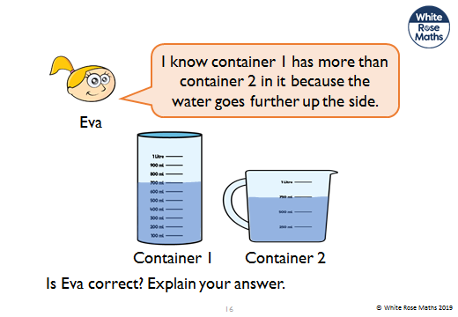
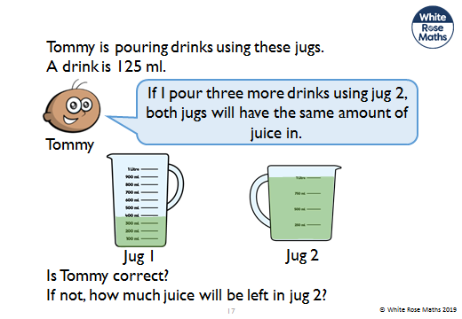

Slide 14
If you have time...
Try a times tables game on this website.
https://www.topmarks.co.uk/maths-games/7-11-years/times-tables

Slide 15
Maths lesson 2

Slide 16
Todays lesson looks at weight. Measuring weights accurately is important in activities such as cooking.
We measure weight in Kilograms and grams. Like capacity we can convert between units of measure for weight.
1 kg = 1000g
1000g = 1Kg

Slide 17
Warm up
1 Kg = ______g
2Kg = ______g
5Kg =______g
8Kg= ____g
4Kg = ____g
4.5Kg = ___g
6.7Kg = ___g
2000g = ___Kg
7000g = ___Kg
6500g = ____Kg
8900g = ____Kg
3600g= ___Kg
2300g = ___Kg
4700g= ___Kg
Remember 1 Kilogram is 1000 grams.

Slide 18
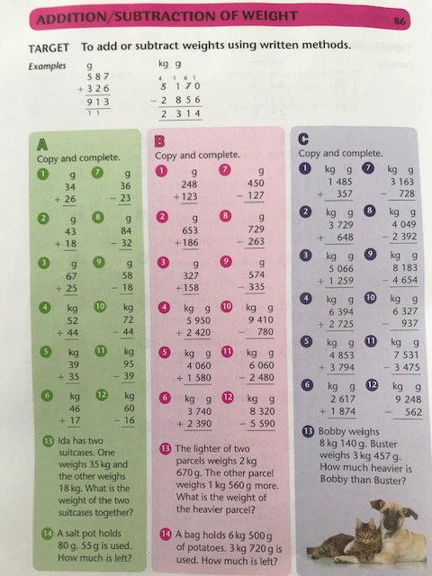
Complete section A and B.
Section C is a challenge!

Slide 19
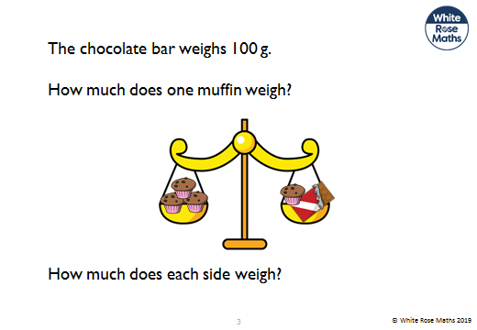
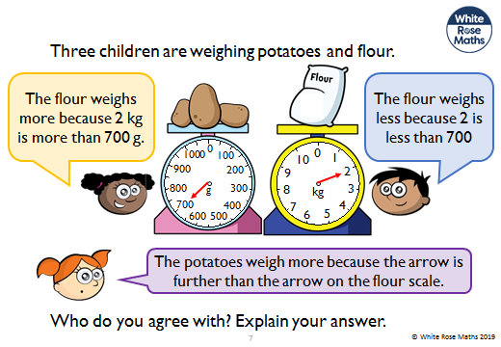
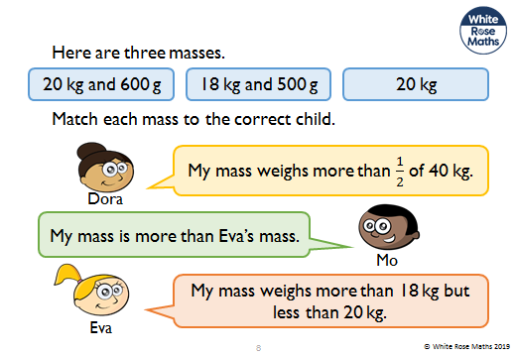
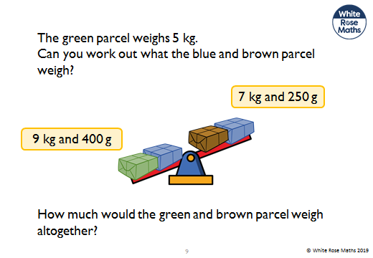

Slide 20
If you have time...
Try making something that requires you to weigh out ingredients e.g making bread. Look at the weights you are using.
Make sure you ask a parents permission first!
Have a go at this - https://mathsframe.co.uk/en/resources/resource/87/itp-measuring-scales

Slide 21
Maths lesson 3

Slide 22

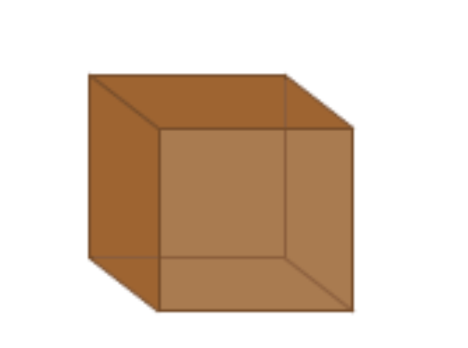
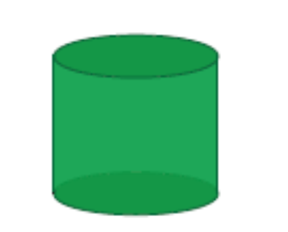
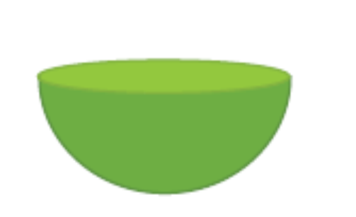
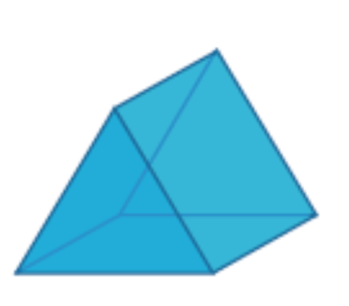


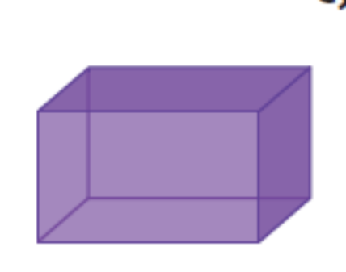

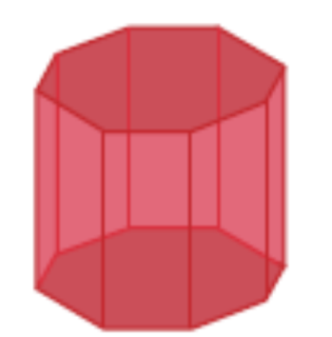

Warm up
Can you name these 3D shapes?

Slide 23
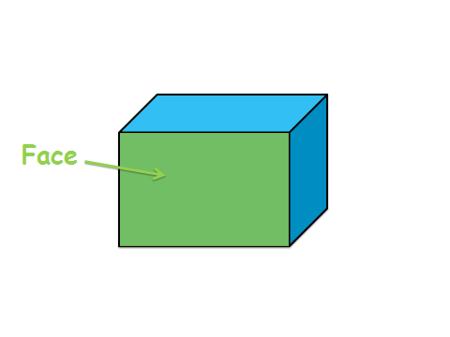
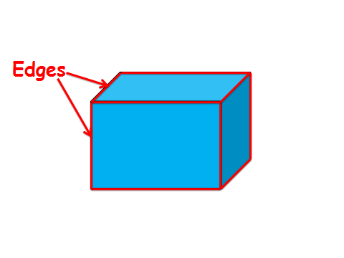
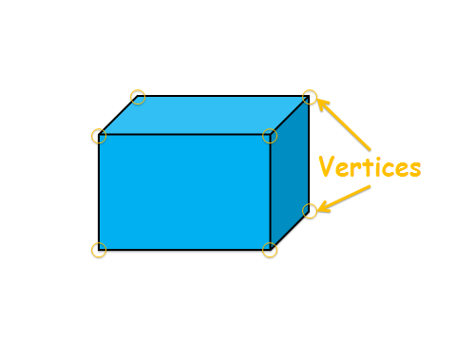
Use these words when describing the properties of 3D shapes

Slide 24
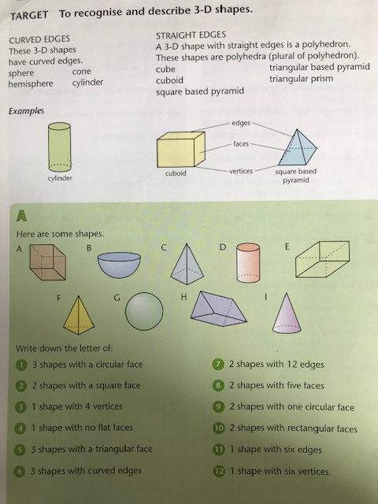
Complete Section A.
Have a go at the challenges on the next slides.

Slide 26
If you have time...
https://mathsframe.co.uk/en/resources/resource/115/sorting-3d-shapes-on-a-venn-diagram

Slide 27
There also some excellent lessons that can be accessed on the link below.
https://whiterosemaths.com/homelearning/year-3/

