Slide 1
Week beginning 8th June
This is your Maths work for this week. There are:
- 3 pieces of early bird work
3 pieces of Maths work
In addition to this, keep on with your Joe Wicks PE, learning your times tables and spelling work too.

Slide 2
This week, post at least two pieces of your work onto Class Dojo
For great work posted, there will be dojos given out!

Slide 3
Morning Work
Early Bird Time!

Slide 5
Learn to spell these words and use your best handwriting. Can you use these words in your own exciting sentences?

Slide 6
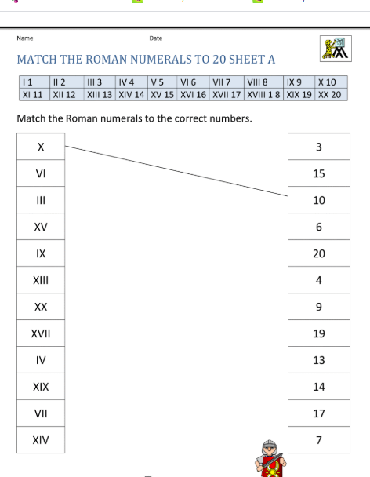

Slide 7
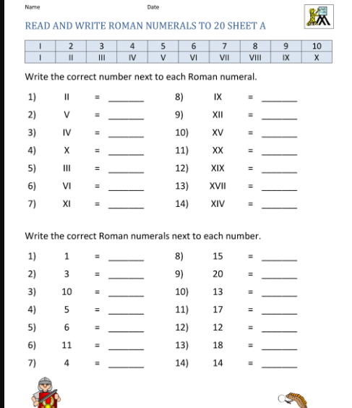

Slide 8
Maths lesson 1

Slide 9
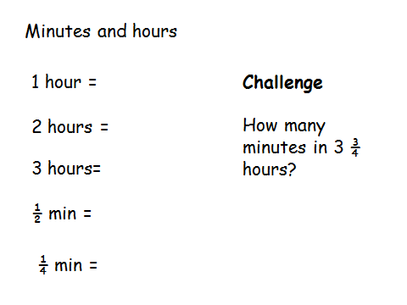
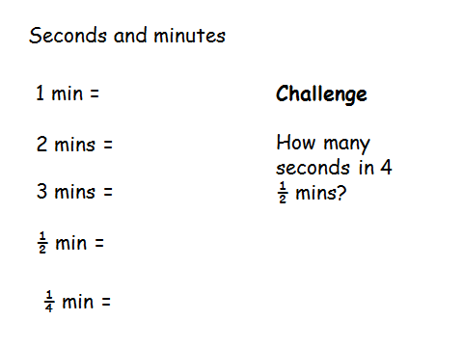
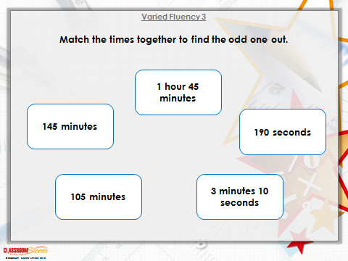
Warm up

Slide 10
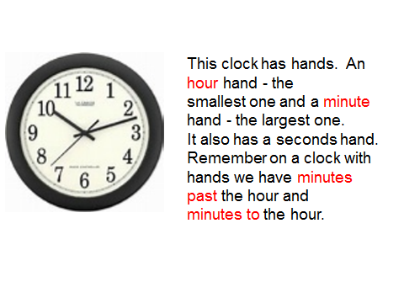
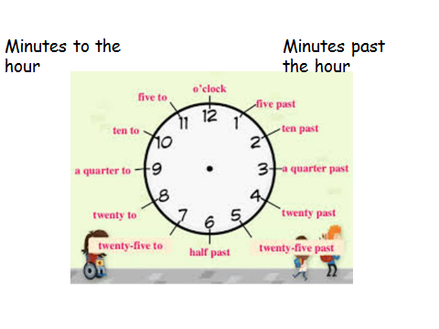

Slide 11
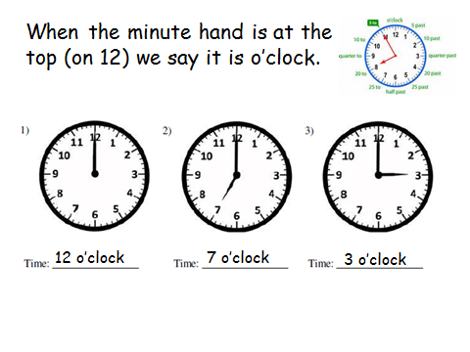
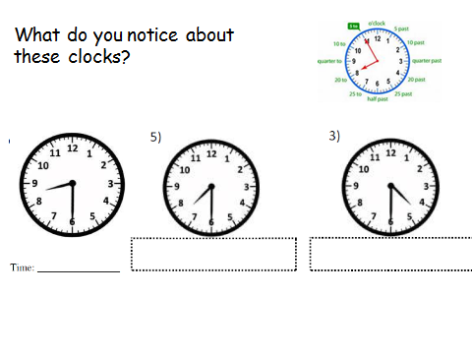

Slide 12
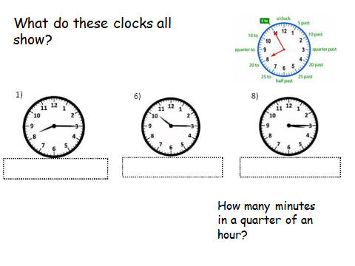
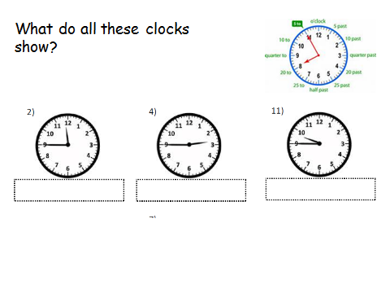

Slide 13
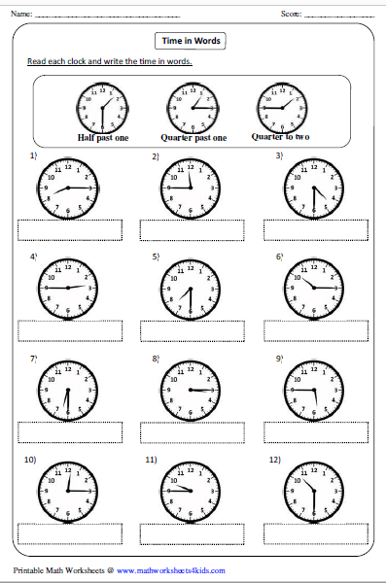
Write the times shown on these clocks in words.
Challenge
All of the clocks are five minutes fast! Write the new times in words.
Example – 1) Ten past eight

Slide 14
If you have time...
Try a game of time match up.
http://www.wldps.com/gordons/Matching_pairs_-_Time.swf

Slide 15
Maths lesson 2

Slide 16
14
52
24
30
7
60
60
48
120
1 ½ mins
12
30
31
What units of time are these numbers showing? E.g. 24 – 24 hours in a day

Slide 17
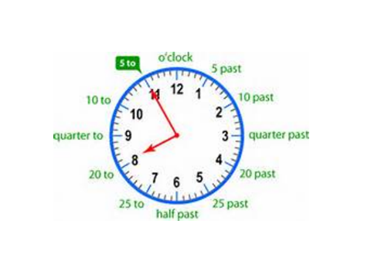
Remember on a clock with hands we have minutes to and past the hour.

Slide 18
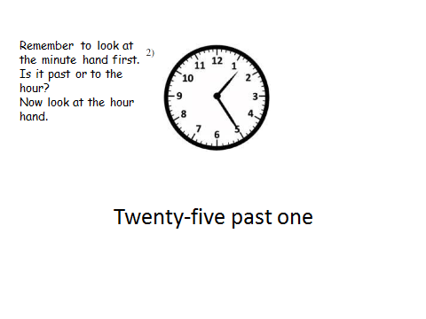
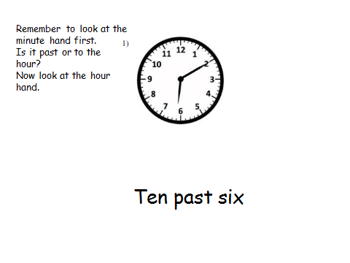
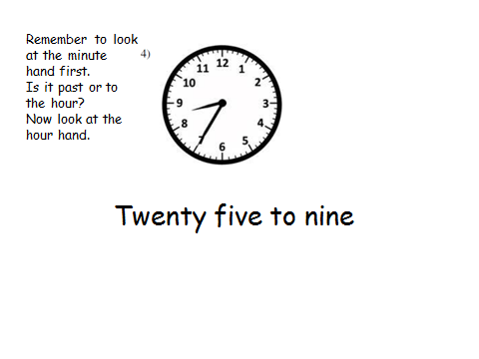
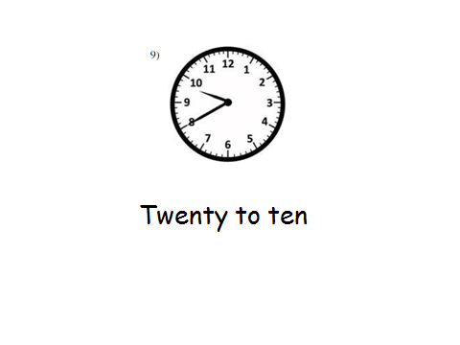

Slide 19
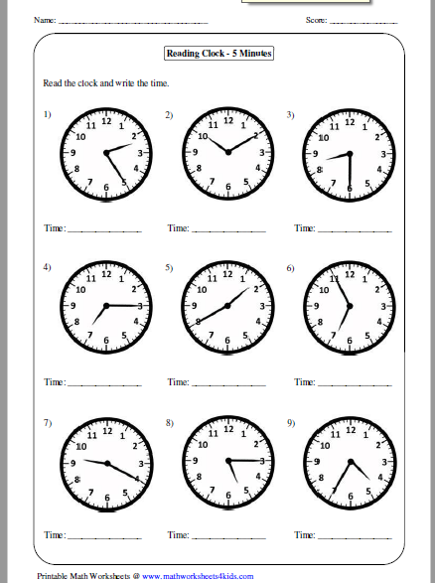
Write the time shown on these clocks in words.

Slide 20
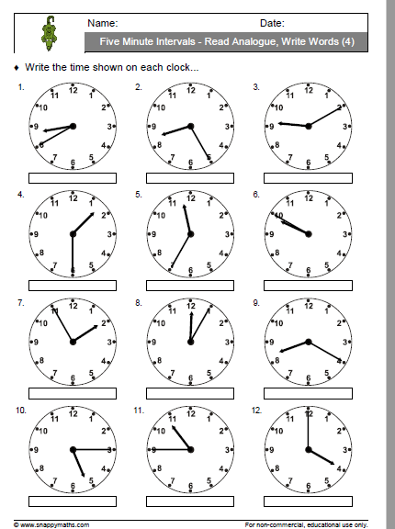

Slide 21
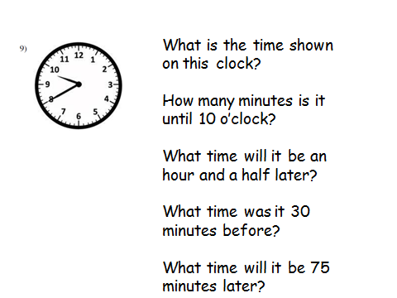
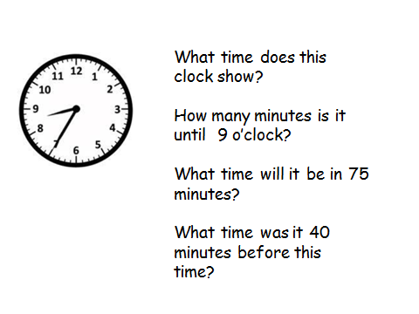
Challenge – Now try these!

Slide 22
If you have time...
Try a game of time match up.
http://www.wldps.com/gordons/Matching_pairs_-_Time.swf

Slide 23
Maths lesson 3

Slide 24
Warm up – Try this game
http://www.snappymaths.com/other/measuring/time/interactive/unitsoftimeftc.htm

Slide 25
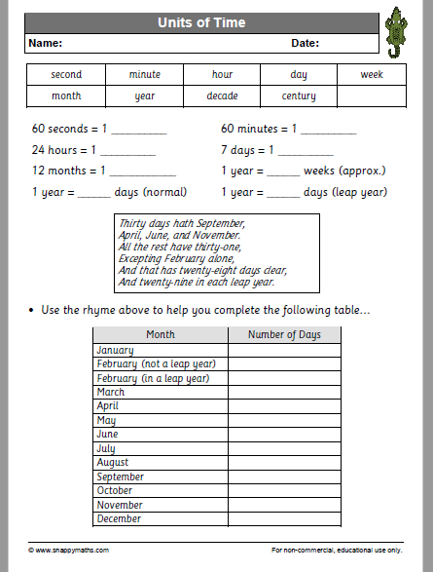

Slide 26
Challenge – Using what you know about units of time, try these

Slide 27

Complete the Sum dog challenges for this week.

