Slide 1

Welcome to Sycamore Class meet the teacher evening.

Slide 2

Our School Mission Statement
We all work together
to do our best to shine with God's love, and success
in a happy, peaceful and prayerful place where everyone tries to be kind, helpful and caring.
Vision
By reflecting principles of the Catholic Faith we at St. Maria Goretti aim to celebrate the uniqueness of each child and through high expectations enable all our children to reach their full potential and become happy, confident and successful individuals.

Slide 3
Miss Seefus – Class Teacher
Year 5 – Our Sycamore Class team…
Mrs Hamilton (Teaching Assistant)- Every morning
Wednesday/Thursday afternoon.

Slide 4
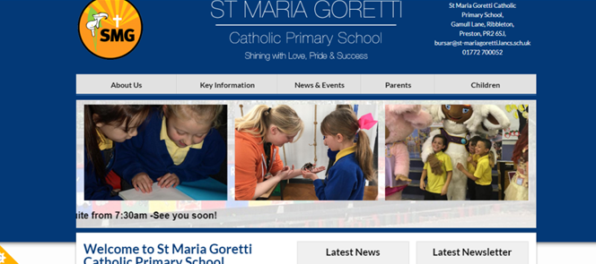
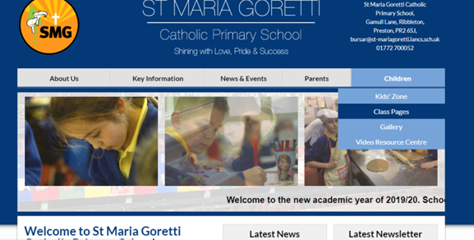
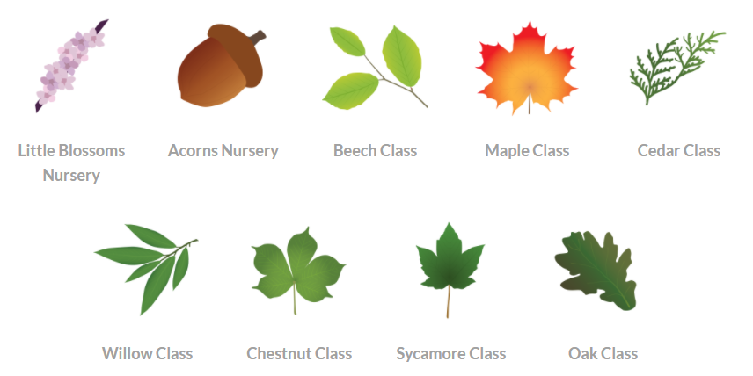
Our learning in Sycamore class.
Our class page on the school website contains our curriculum overview for the year. It also contains up to date photos.

Slide 5
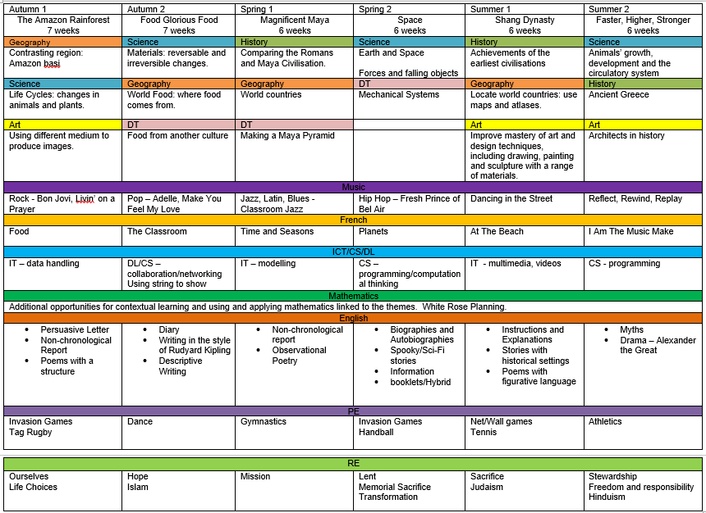
Our Curriculum Overview

Slide 6
RE in Sycamore Class
Autumn Term
Ourselves
Life Choices
Hope
Islam
Spring Term
Mission
Lent
Memorial Sacrifice
Transformation
Summer Term
Sacrifice
Judaism
Stewardship
Freedom and Responsibility
Hinduism

Slide 7
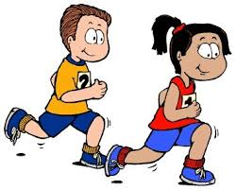

Key Information
PE kits should be in school on a Monday ready for PE on Thursday. Hair should be tied back for PE.
Water bottles should be sent in to school every day. These need to be filled up in the morning BEFORE school has started.

Slide 8
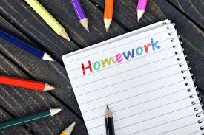
Homework in Sycamore Class
Maths and SPaG homework will be sent home every Tuesday to be returned the following Tuesday. Homework will link to our learning in class, though, if your child is struggling, please contact me .
Spellings will also be given out for your child to learn. Spelling tests will be every Tuesday.
Mrs Hamilton will listen to the children read every Wednesday or Thursday. However, please read at home with your child for at least 15 minutes EVERY DAY.

Slide 9
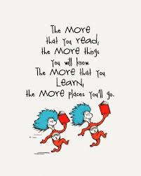
Reading in Sycamore Class
Reading is taught in many different ways in school. We have whole class shared reading, guided reading and class novels. Reading is also taught through other curriculum subjects.

Slide 10

SMG Golden Behaviour Rules
Is it caring?
Is it Safe?
Is it my best?

Slide 11


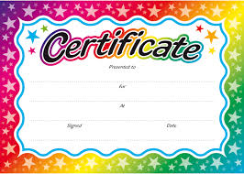


Rewards
We love to reward children in this school for putting effort into their work, being polite and helpful, having lovely manners and for being exceptionally behaved.

Slide 12

Attendance and punctuality
School starts at 8:45 but children can arrive from 8:30. It is so important that children are in school and on time every day. If they miss days or are late for school you will miss vital learning. Obviously, if your child is ill please ring the office to inform them of why they are absent. Otherwise the absence will be unauthorised.

Slide 13

Class Communication
Our main means of communicating with parents will be on Class dojo. Please check your dojo regularly. If you need to contact me, please send me a message and I will try to reply as soon as possible. I will not reply to dojo messages after 6pm. Please try and keep dojo a positive means of communication.

