Slide 1


Welcome to Chestnut Class (Year 4)
Meet the Teachers Evening 2025/2026

Slide 2


We all work together
to do our best to shine with God's love, pride and success
in a happy, peaceful and prayerful place where everyone tries to be kind, helpful and caring.
Vision
By reflecting the principles of the Catholic Faith we at St. Maria Goretti aim to celebrate the uniqueness of each child and through high expectations enable all our children to reach their full potential and become happy, confident and successful individuals.
Our School Mission Statement

Slide 3
In Chestnut class, we want our children to be happy, creative, imaginative and develop into independent learners, who have a love and passion for all their learning.
Our Class Vision
n

Slide 4
Year 4 – Our Chestnut Class team……
Mrs. Nuttall – Everyday
Miss Kaur (Teaching Assistant)- Everyday
(Class cover teacher) – Tuesday afternoon

Slide 5
Mrs Nuttall
As your child’s class teacher, I aim to make them feel happy, safe and secure whilst in school. I am firm but fair in my management of the children and set clear goals and boundaries for them. This helps them understand the expectation I have of them and encourages independence, which becomes more and more important as the year progresses. I will fully support your child’s needs and am happy to discuss these with you.

Slide 7

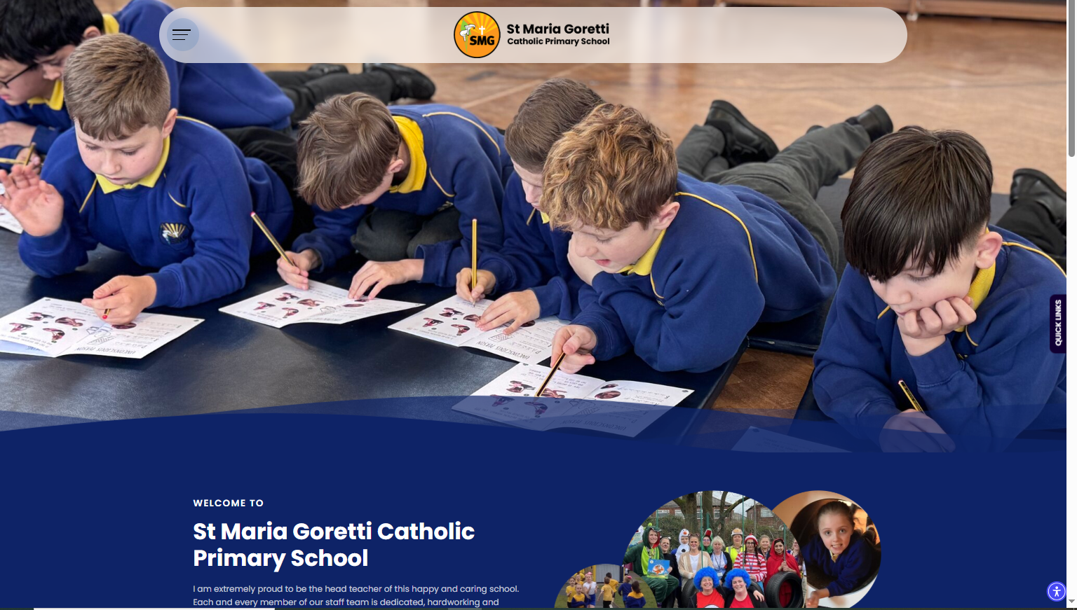
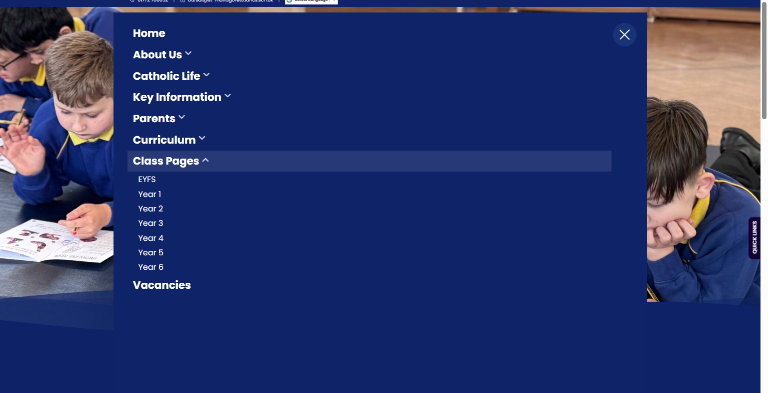
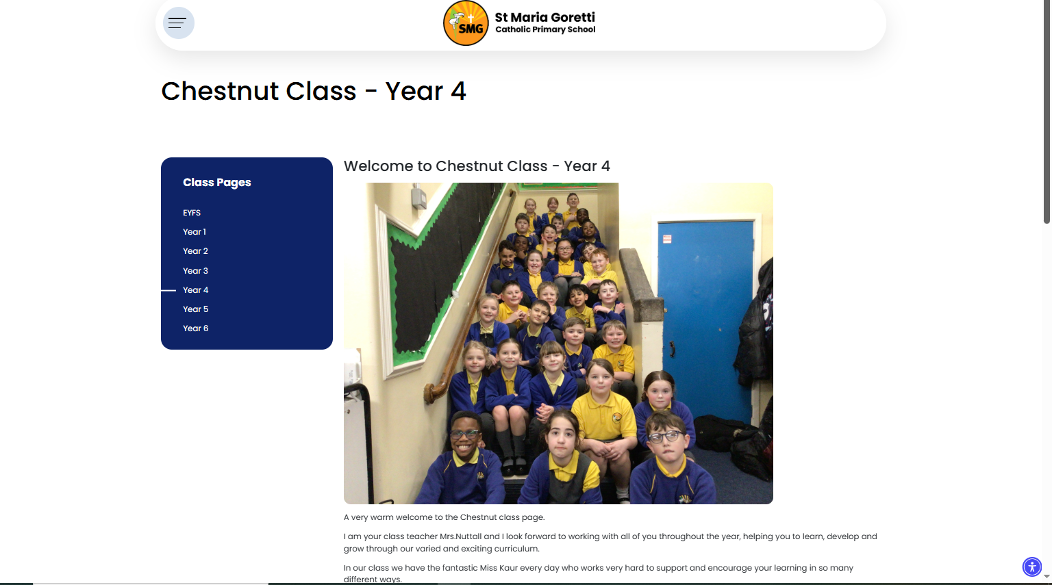
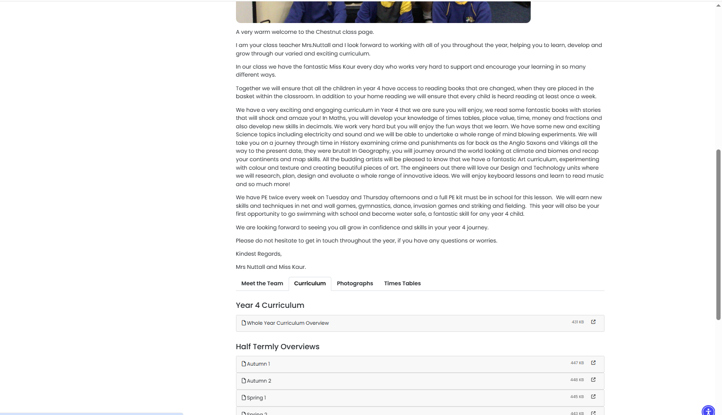
Scroll down to the staff photos and choose the curriculum tab

Slide 8
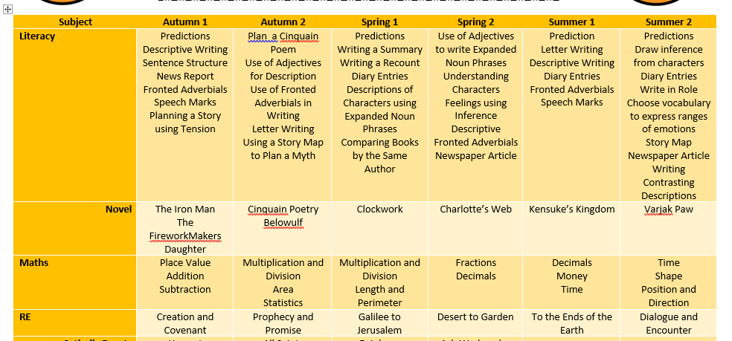
Our Curriculum Overview
Our class page on the school website contains our curriculum overview for the year. It also contains photos.

Slide 9








Slide 10
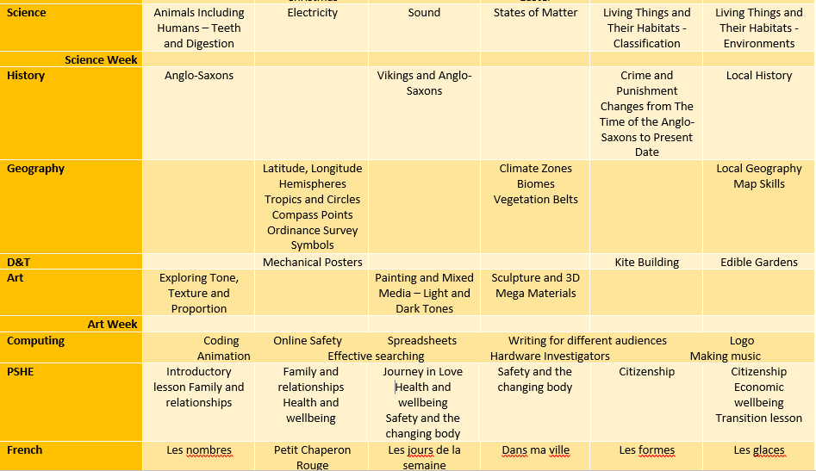

Slide 11
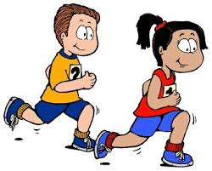

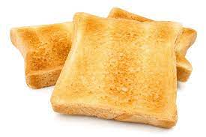
Key Information
PE day is twice a week on a Tuesday and Friday. This is subject to change with cover teacher but you will be informed.
Water bottles should be sent in to school every day. These need to be filled up in the morning BEFORE school has started.
Toast can be bought for 30p a day. This will be collected in class. It is easier to bring £1.50 for the week. If the children want to bring in a snack form home they may but this must be fruit and any fruit such as grapes or cherry tomatoes that could be a choking hazard must be cut into quarters longways.

Slide 12


Multiplication Check
In Year 4 we have a statutory multiplication test.
The children will access this on an iPad and will have to answer multiplication questions e.g. 8 X 6 = and they will have 5 seconds to answer before the next questions appears.
We will have lots of practice through games, songs and activities.
You can support this at home by encouraging use of TT Rockstars as part of their screen time, doing pop quizzes, asking them times tables perhaps on the way to school or whilst chatting and just get them used to answering times table questions quickly.
I have printed off times tables grids for you to take home and display for your child. Please take one on the way out.
There is parental information on the school website on our class page.

Slide 13
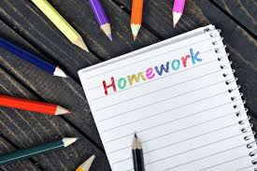


Homework in Chestnut Class
The children will be sent home each week with a homework task. This should be returned before the following Monday. This is to show you what they are learning in school.
The children will be expected to access TT rockstars to improve their times tables knowledge and homework may be sent home at times..
Please read with your child for at least 15 minutes EVERY DAY.
Children can also log on to Reading plus at home to further their reading skills.

Slide 14
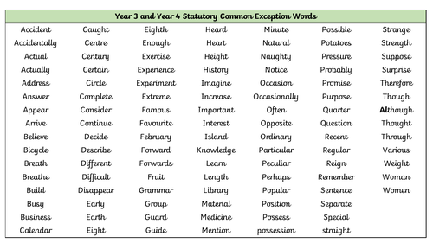
Please take a copy of the Common Exception words before you leave.

Slide 15

Reading in Chestnut Class
Reading is taught in many different ways in school. We have whole class shared reading, guided reading and class novels. Reading is also taught through other curriculum subjects.
Please read with your child for at least 15 minutes EVERY DAY. Complete at least two sessions of Reading Plus a week.

Slide 16
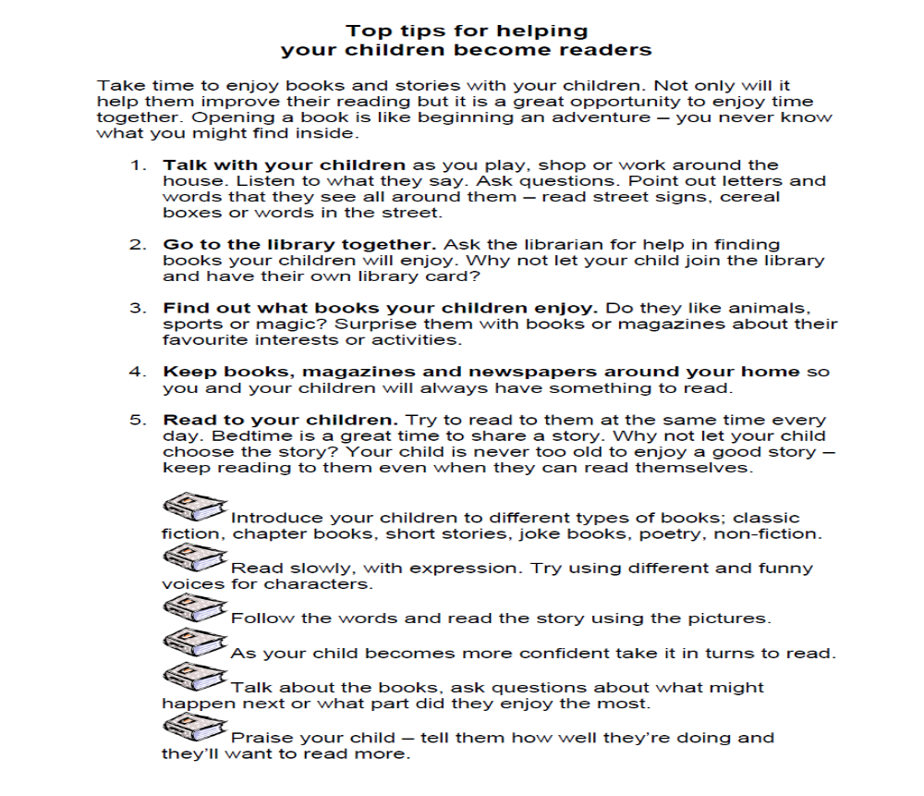

Slide 17
RE in Chestnut Class
Autumn Term
Creation and Covenant
Prophecy and Promise
Spring Term
Galilee to Jerusalem
Desert to Garden
Summer Term
To the Ends of the Earth
Dialogue and Encounter

Slide 18
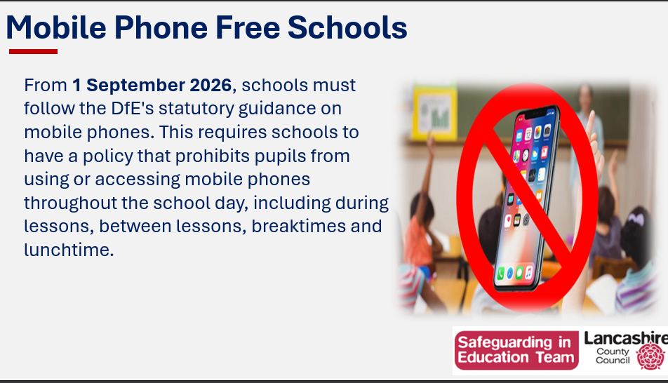

Slide 19
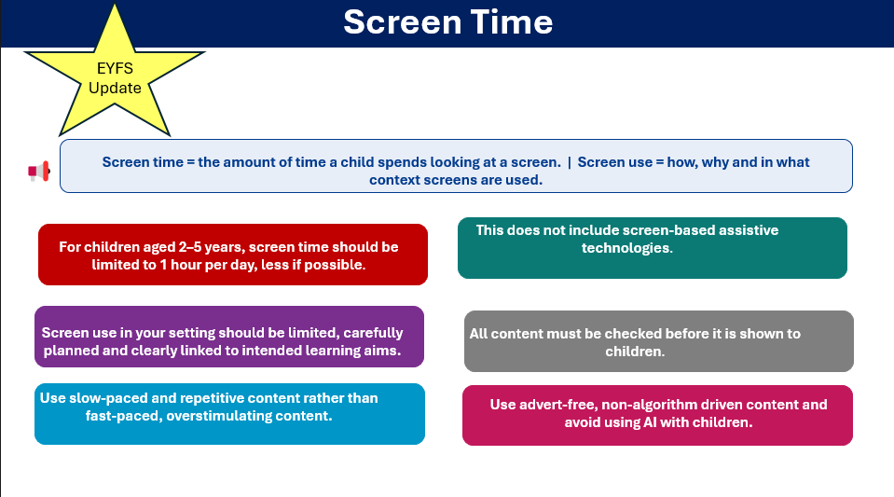
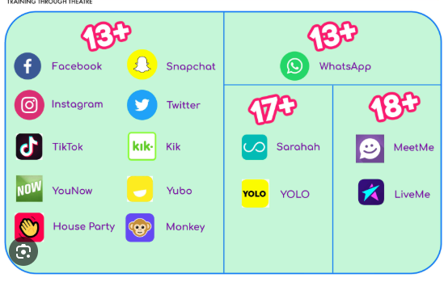

Slide 20

SMG Golden Behaviour Rules
Is it caring?
Is it Safe?
Is it my best?

Slide 21


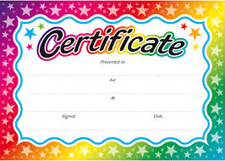

Rewards
We love to reward children in this school for putting effort into their work, being polite and helpful, having lovely manners and for being exceptionally behaved.
In year 4 we have stickers for our bookmarks and raffle tickets in addition to the weekly awards and golden tickets.

Slide 22

Attendance and punctuality
School starts at 8:40am
Children can arrive and the gates/doors open from 8:30am.
It is so important that children are in school and on time every day. If they miss days or are late for school you will miss vital learning. If your child is ill please ring the office to inform them of why they are absent. Otherwise the absence will be unauthorised.

Slide 23

Class Communication
Our main means of communicating with parents will be on Class Dojo. Please check your Dojo regularly. If you need to speak to me, please send a message and I will try to reply as soon as possible. I will not reply to Dojo messages after 5.30pm or at the weekend. Please try and keep Dojo a positive means of communication.
I love when the children use their learning at home. If your child does any home learning please send me photos, if your child asks you to, so this can be celebrated back in class.

