Slide 1

Year 5
Welcome to Sycamore Class 'Meet the Teacher'

Slide 2

Our School Mission Statement
We all work together
to do our best to shine with God's love, pride and success
in a happy, peaceful and prayerful place where everyone tries to be kind, helpful and caring.
Vision
By reflecting principles of the Catholic Faith we at St. Maria Goretti aim to celebrate the uniqueness of each child and through high expectations enable all our children to reach their full potential and become happy, confident and successful individuals.

Slide 3
Year 5 – Our Sycamore Class team…
Miss Seefus and Mrs Walker

Slide 4
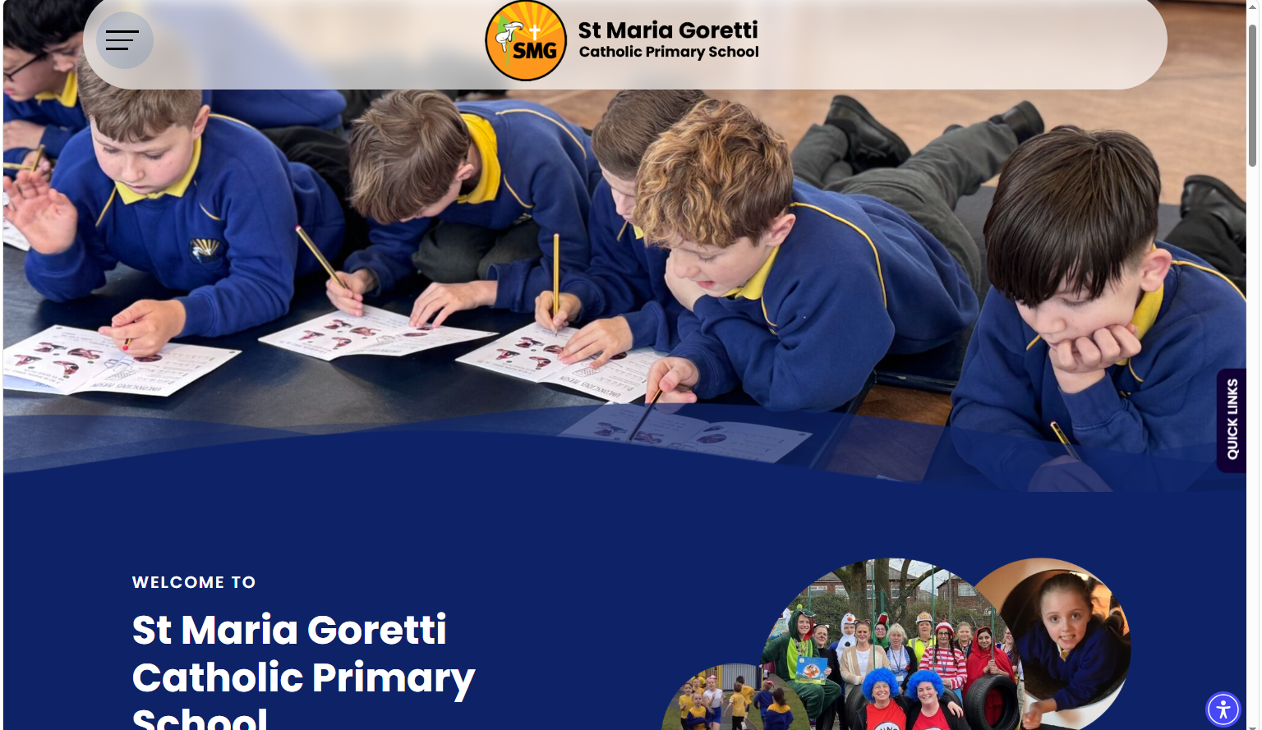
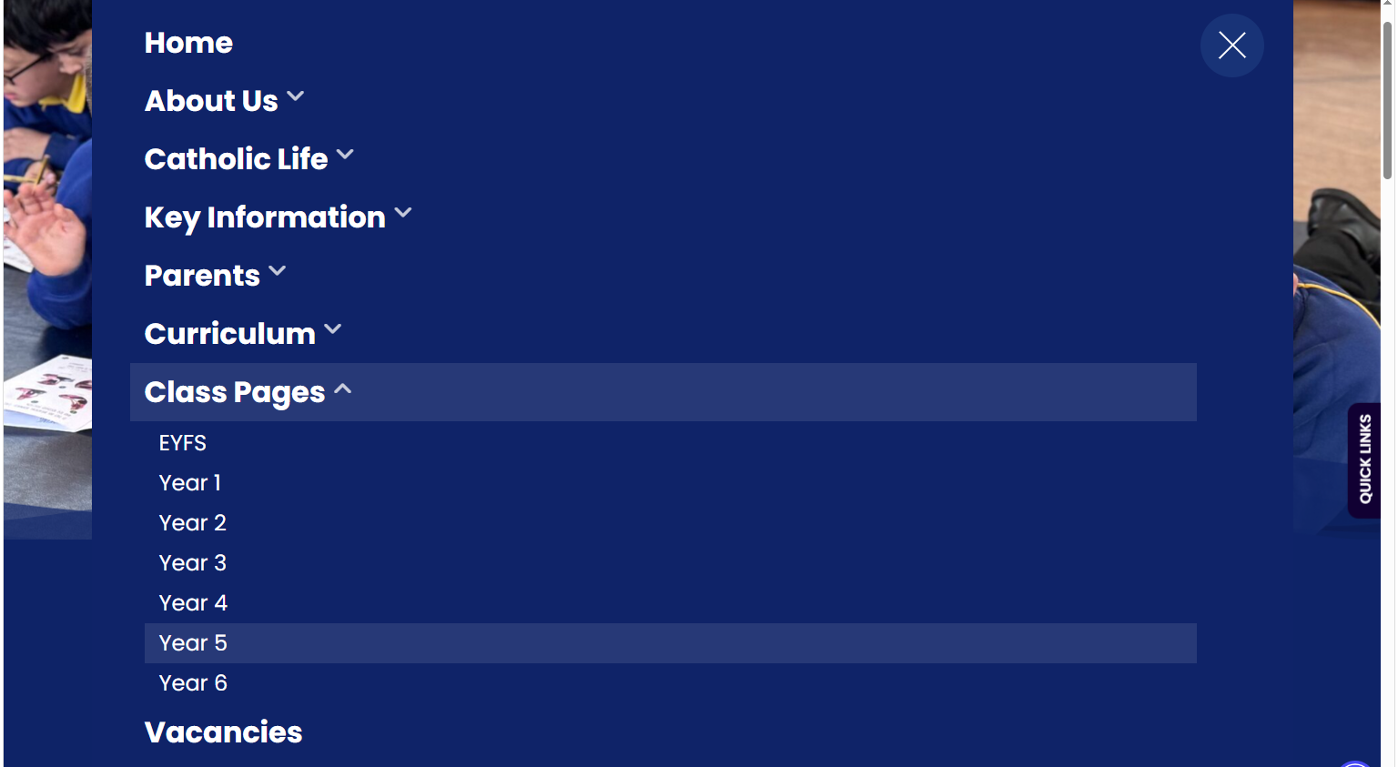
Our learning in Sycamore class.
Our class page on the school website contains our curriculum overview for the year. It also contains up to date photos.

Slide 5
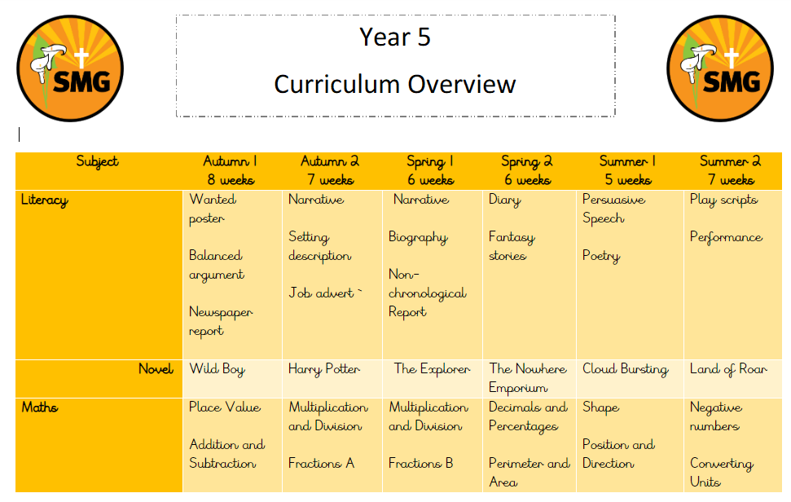
Our Yearly Curriculum Overview

Slide 6
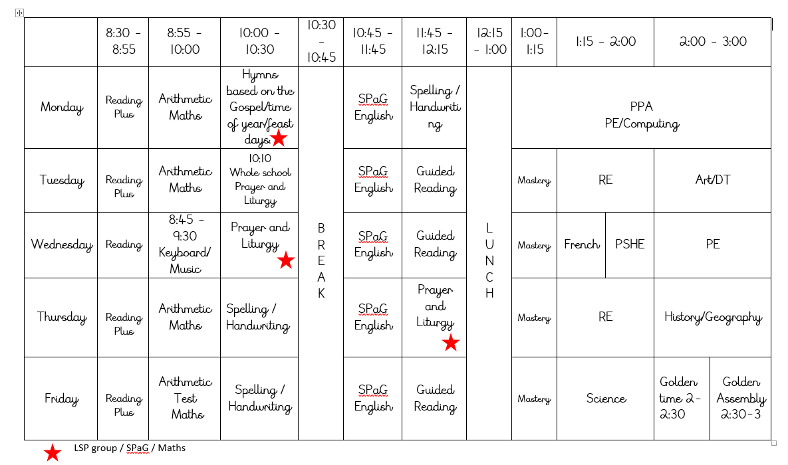
Our Weekly Timetable

Slide 7


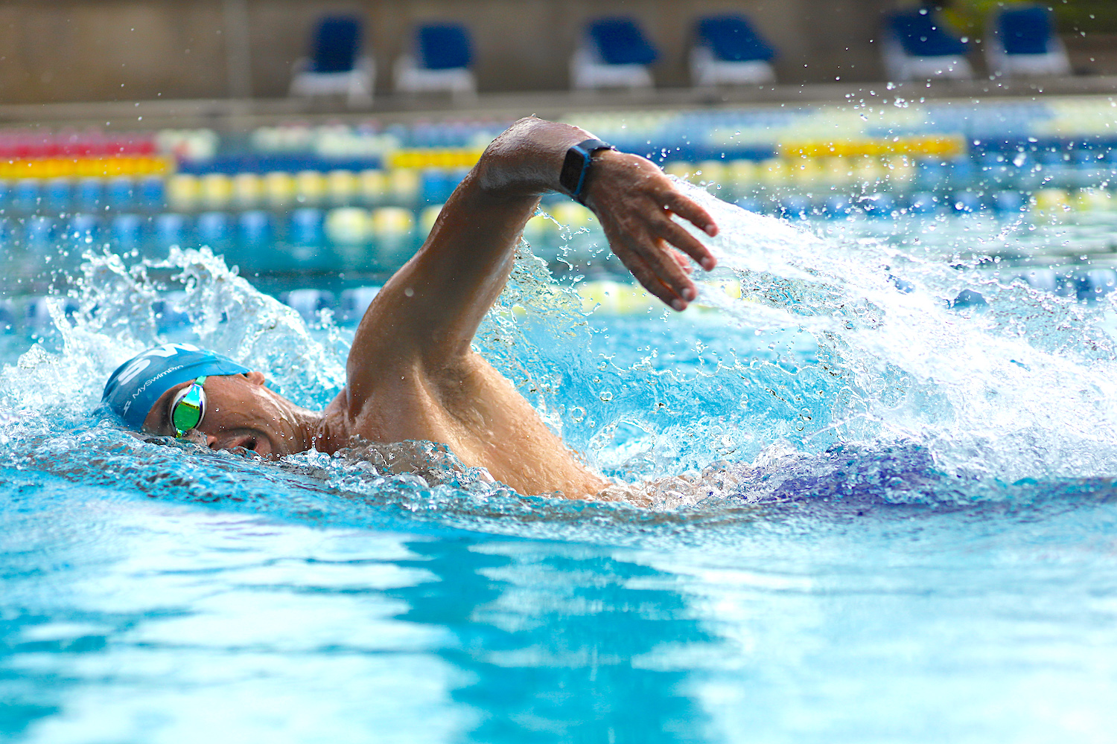
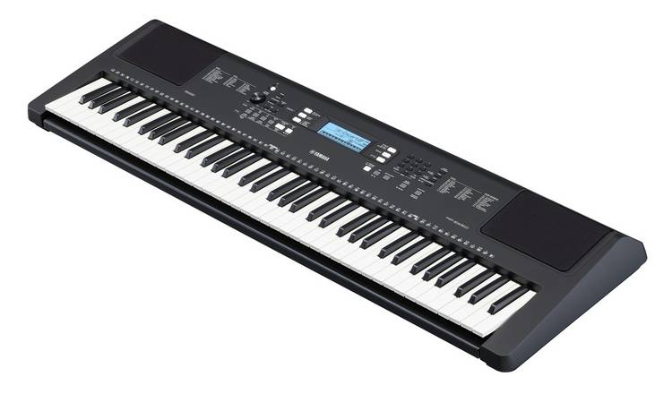
Trips and other learning opportunities
Passport

Slide 8
RE in Sycamore Class
Creation and Covenant
Prophecy and Promise
Galilee to Jerusalem
Desert to Garden
To the Ends of the Earth
Dialogue & Encounter

Slide 9
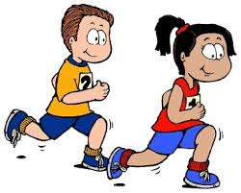
Key Information
PE kits should be in school on a Monday. These should remain in school until Friday.
Our PE days are Monday and Wednesdays.
Hair should be tied back for PE.
No jewellery is allowed, including earrings.

Slide 10

Key Information
Water bottles should be sent into school every day. These need to be filled up in the morning before school has started.
With permission, children can walk home alone, although I do require written permission via a letter to the office.

Slide 11
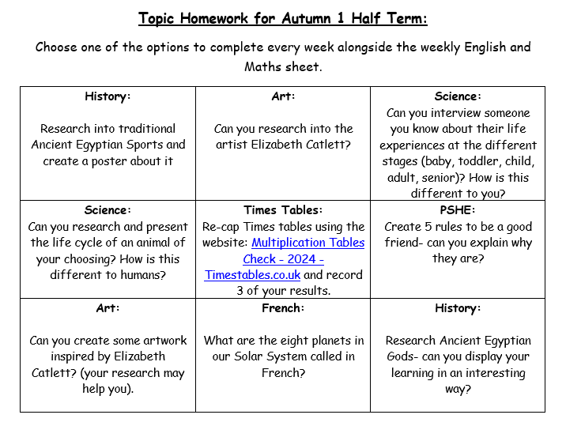
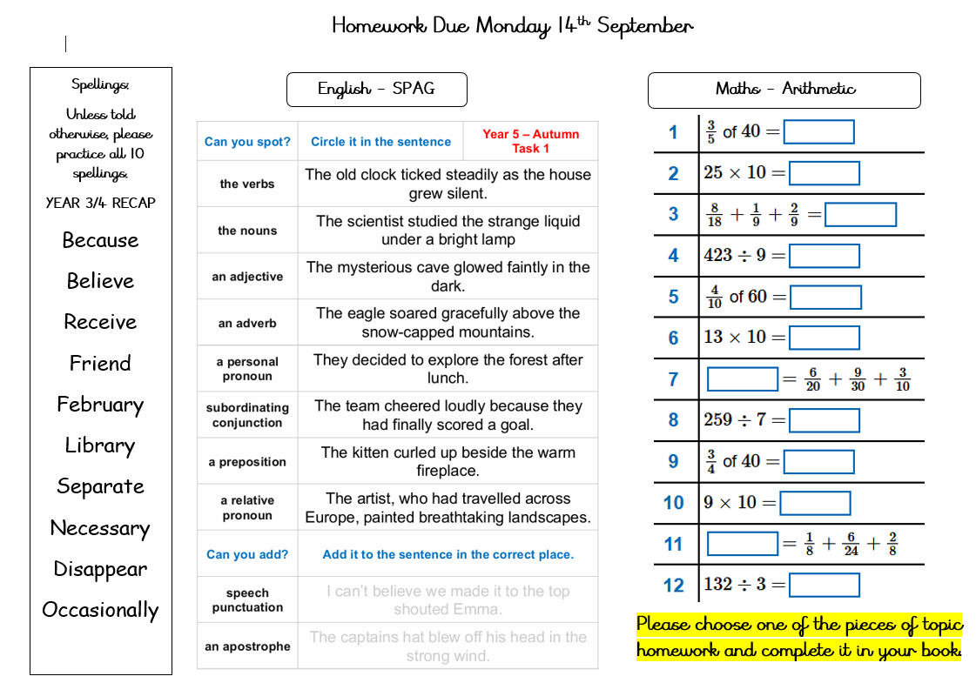
Homework in Sycamore Class
Maths and English homework will be sent home every Monday to be returned by the following Monday.
Topic homework will be given out on a choice bases every half term. One piece must also be completed alongside English and maths.
Homework will link to our learning in class, though, if your child is struggling, please contact me.
Spellings will also be given out for your child to learn.

Slide 12
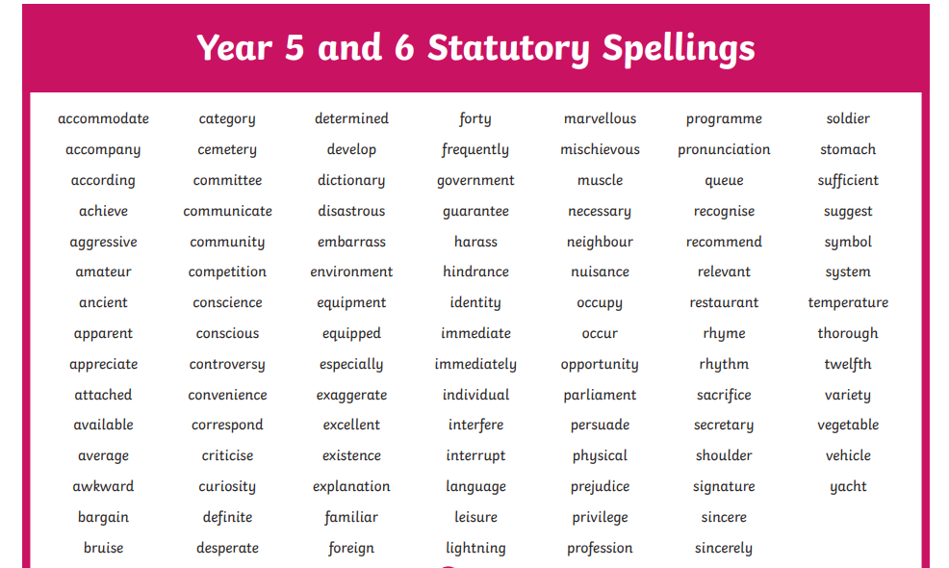

Slide 13




Home Learning

Slide 14
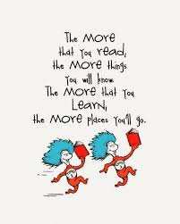
Reading in Sycamore Class
Reading is taught in many different ways in school. We have whole class shared reading, guided reading, Reading Plus and class focus novels. Reading is also taught through other curriculum subjects.
Mrs Walker will listen to the children read every week. Books can be placed in the box at the back if they need changing. Also, please read at home with your child for at least 15 minutes EVERY DAY.

Slide 15
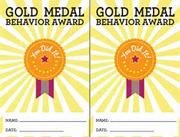
SMG Golden Behaviour Rules
Is it caring?
Is it Safe?
Is it my best?

Slide 16

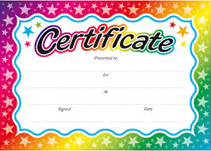

Rewards
We love to reward children in this school for putting effort into their work, being polite and helpful, having lovely manners and for being exceptionally behaved. Children are expected to follow our behaviour mantras.

Slide 17

Attendance and punctuality
School starts at 8:40 but children can arrive from 8:30 after being dropped off at the gates. It is so important that children are in school and on time every day. If they miss days or are late for school, you will miss vital learning. Obviously, if your child is ill, please ring the office to inform them of why they are absent. Otherwise, the absence will be unauthorised.

Slide 18

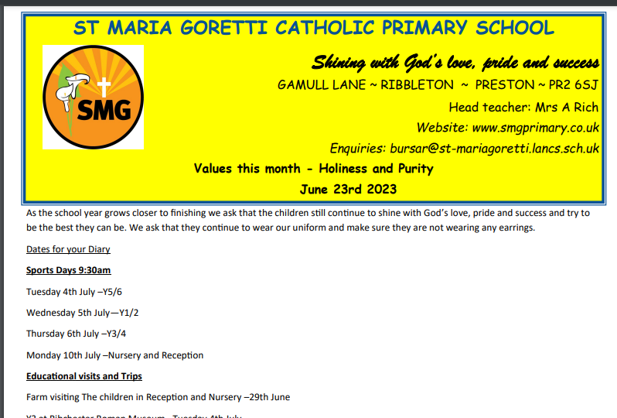
Class Communication
Our main means of communicating with parents will be on Class dojo. Please check your dojo regularly. If you need to contact me, please send me a message and I will try to reply as soon as possible. I will not reply to dojo messages after 5pm. Please try and keep dojo a positive means of communication.
https://www.smgprimary.co.uk/stream/newsletters/full/1/-//

Slide 19
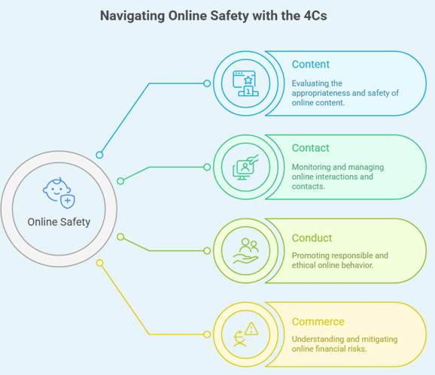
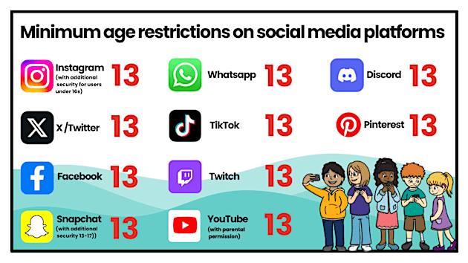
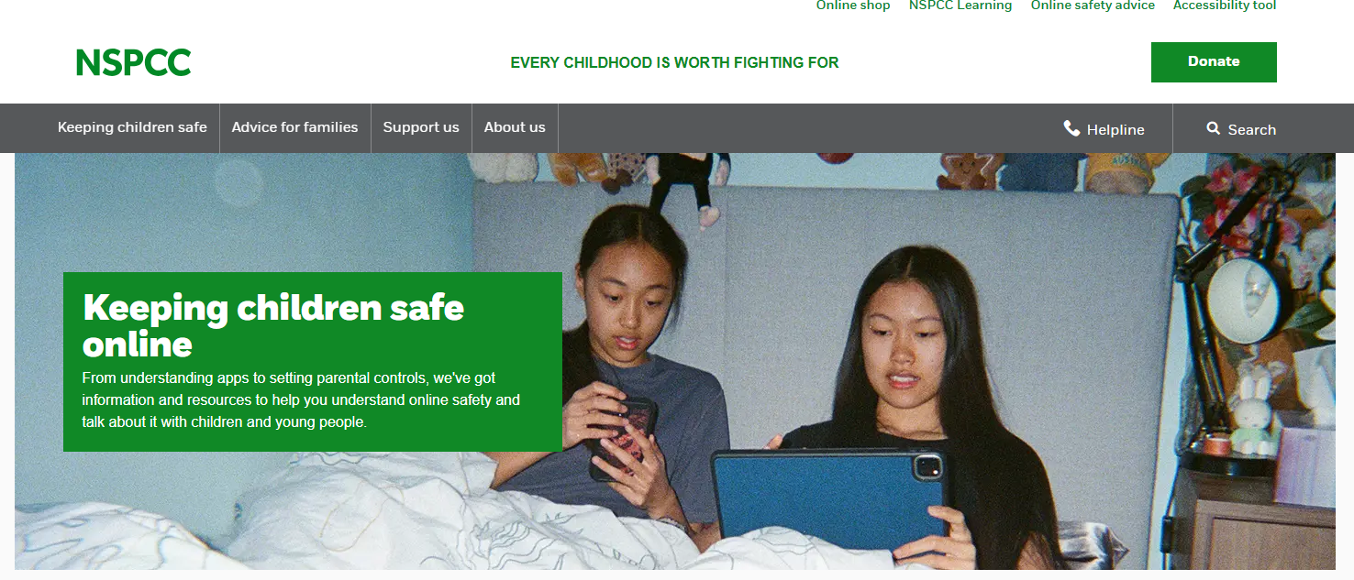
Online Safety
The "4Cs" framework provides a simple and effective way to think about online safety: Content, Contact, Conduct, and Commerce. By understanding these four areas, as parents / carers you are better equipped to support your children in navigating the online world safely and responsibly.

