Slide 1
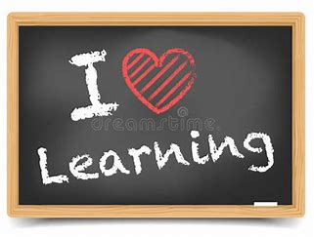
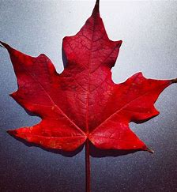
Welcome to Maple Class
Meet the Teacher
2025/2026

Slide 2

We all work together
to do our best to shine with God's love, and success
in a happy, peaceful and prayerful place where everyone tries to be kind, helpful and caring.
Vision
By reflecting the principles of the Catholic Faith, we at St. Maria Goretti aim to celebrate the uniqueness of each child and through high expectations enable all our children to reach their full potential and become happy, confident and successful individuals.
Our School Mission Statement

Slide 3
In Maple class, we want our children to be happy, creative, imaginative and develop into independent learners, who have a love and passion for all their learning.
Our Class Vision
n

Slide 4
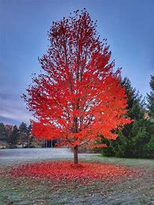
Miss Martin – Every day
Year 1 – Our Maple Class team…
Mrs Towers (Teaching Assistant)- Every day

Slide 5

Our class page on the school website contains our curriculum overview for the year.
Each half term a more detailed plan will be added.
Photographs will also be added, I will send a dojo when I add photos.
Our learning in Maple Class.

Slide 6
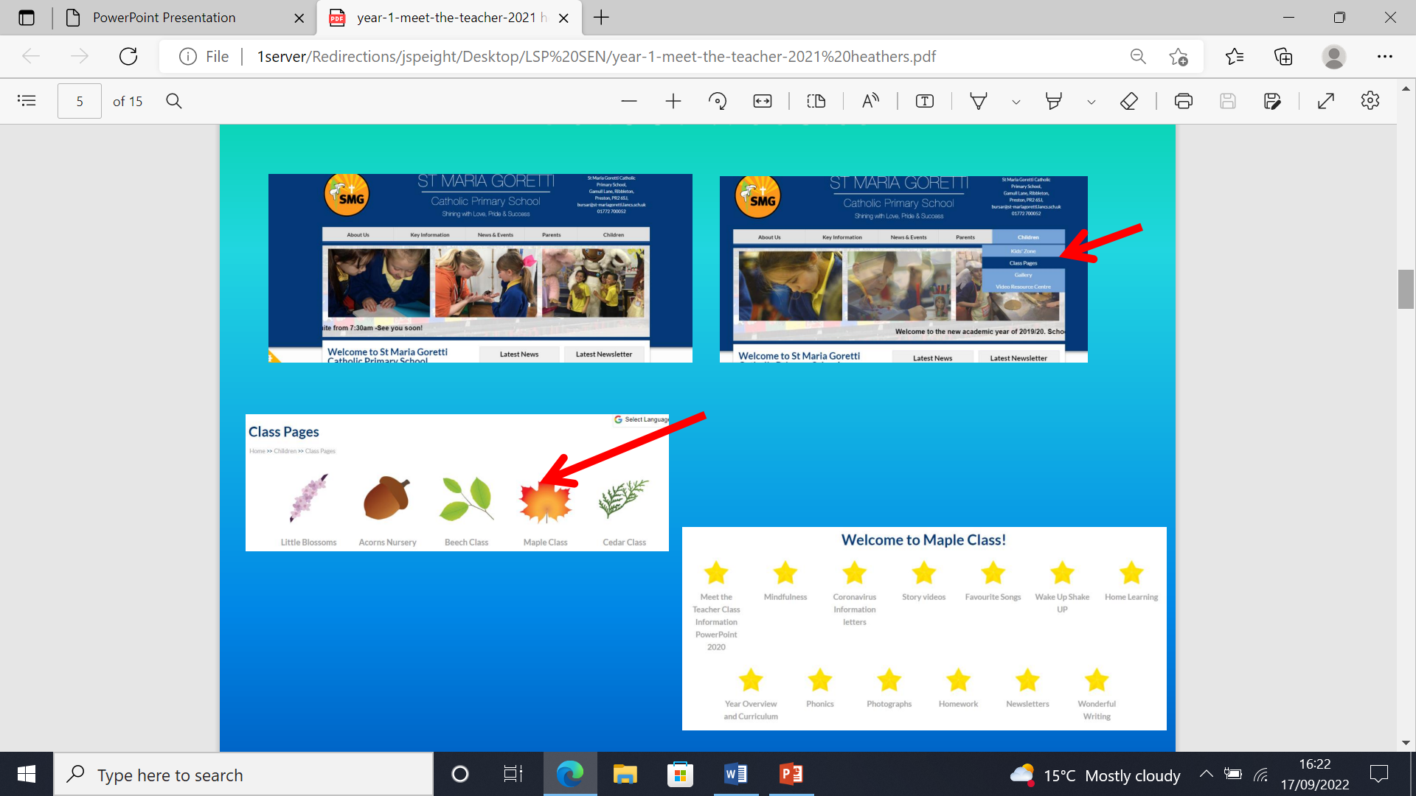

Slide 7
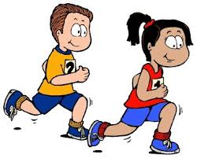

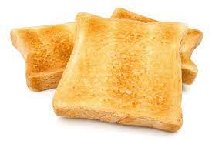
Key Information
PE day is a Tuesday and Friday afternoon. Please make sure all clothing is named.
Water bottles should be sent into school every day. These need to be filled up in the morning BEFORE school has started.
Toast can be bought for 30p a day. Please send this into school in a labelled envelope. It is easier to bring £1.50 for the week or you may pay for the whole term.

Slide 8
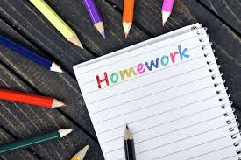
Supporting your child at home
We don’t send formal homework each week in Maple class.
Your child will be learning new phonics each week and these will be reflected in the reading books they are sent home. Please ensure you read with your child EVERYDAY. If your child is reluctant, start with just one page a day and slowly up this.
Tricky words or common exception words - will be sent home for your child to learn. Every week have a look at these words with your child and see if they can read and write them. This should be achieved by the summer.

Slide 9
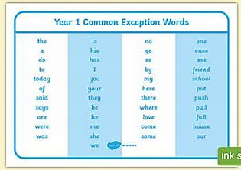
Please take a copy of the Common Exception words before you leave.

Slide 10
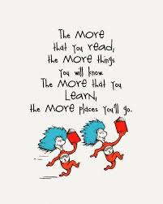
Reading in Maple Class
Reading is taught in many different ways in school. We have whole class shared reading, guided reading and class stories. Reading is also taught through other curriculum subjects.
Please read with your child EVERY DAY. This 1:1 time each day is so important.

Slide 12
RE in Maple Class
Autumn Term
Creation and Covenant
Prophecy and Promise
Spring Term
Jerusalem to Galilee
From Desert to Garden
Summer Term
To the Ends of The Earth
Dialogue and Encounter

Slide 13

SMG Golden Behaviour Rules
Is it caring?
Is it Safe?
Is it my best?

Slide 14


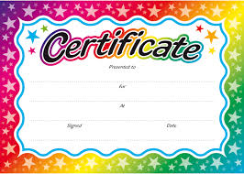

Rewards
We love to reward children in this school for putting effort into their work, being polite and helpful, having lovely manners and for being exceptionally behaved.

Slide 15

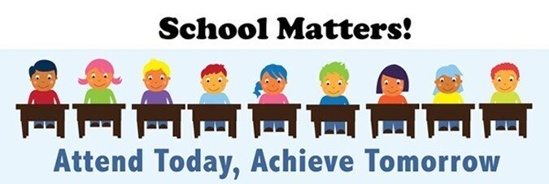
Attendance and punctuality
School starts at 8:40 but children can arrive from 8:30. It is so important that children are in school and on time every day. If they miss days or are late for school, they will miss vital learning. If your child is ill, please ring the office to inform them of why they are absent. Otherwise, the absence will be unauthorised. Do not just send a dojo this is not reporting an absence.

Slide 16

Class Communication
Our main means of communicating with parents will be on Class Dojo. Please check your Dojo regularly. If you need to speak to me, please send a message and I will try to reply as soon as possible. I will not reply to Dojo messages after 5.30pm or at the weekend. Please try and keep Dojo a positive means of communication.
I love when the children use their learning at home. If your child does any home learning please send me photos, if your child asks you to, so this can be celebrated back in class.

