Slide 1
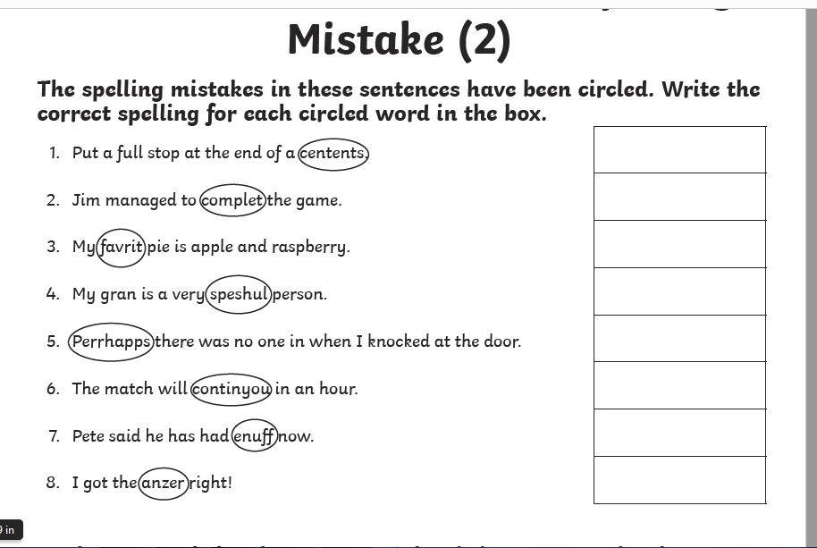
Correct the spelling mistakes! Spell it correctly.

