Slide 1

Willow Class
Wonderful Home learning!

Slide 2
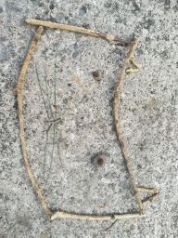
Oliver’s invincible cat art work. Ask him about the cat when we get back to school.

Slide 3
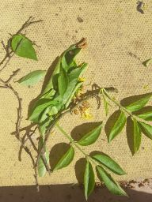
Amelia’s Parrot made out of leaves

Slide 4
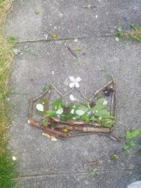
Filip’s crown using natural materials.

Slide 5
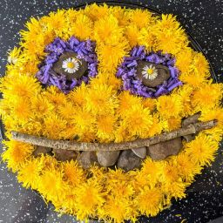
Ellie’s wonderful face using lots of different types of flowers.

Slide 6
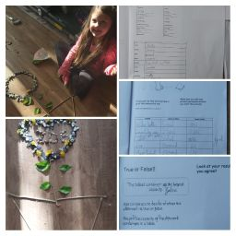
Zoe has been busy creating al love heart out of different materials.

Slide 7
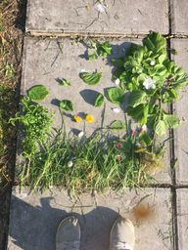
Sophia’s nature art

