Slide 1
23.11.20
Can I interpret data in a pictogram?

Slide 2
What is data?
Data is just information and we can organise data in different ways.
Can anyone think of any ways in which present data?

Slide 3
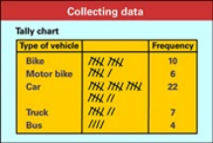
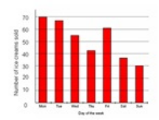
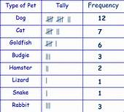
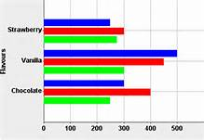
There are lots of different ways data can be presented.

Slide 4
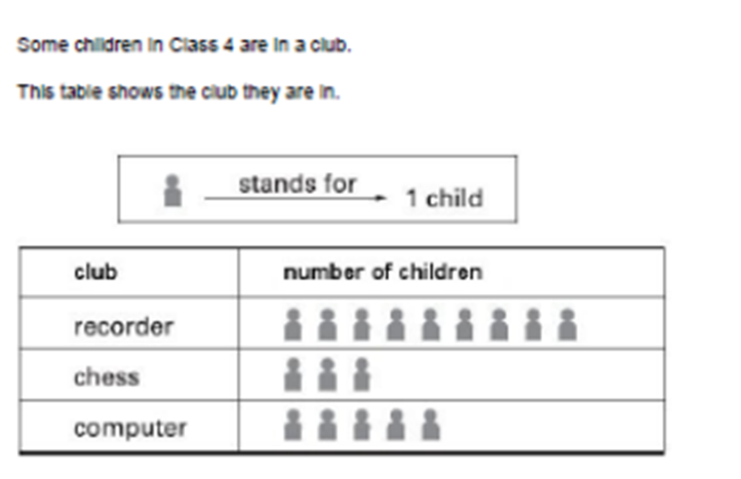
Today we are going to look at pictograms. This is an example of a pictogram. Why do you think it is called a pictogram?

Slide 5
We can interpret the data in a pictogram.
Always put the totals in as this will help you with the answers to any questions
9
3
5
What can you tell me about the data in this pictogram?

Slide 6
We can answer questions about the pictogram.
How many children are in Class 4?
How many children go to recorder club?
How many more children go to recorder club than chess?
If 4 more people join computer club how many children will there be?
17 children
9 children
9
3
9 – 3 = 6 children
5
5 + 4 = 9 children

Slide 7
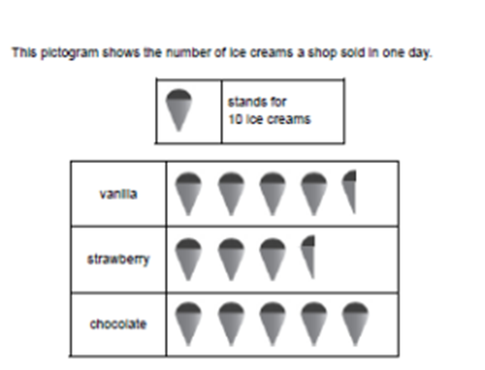
What can you tell me about the data in this pictogram?
1 ice cream stands for 10 ice creams sold
Half an ice cream will stand for 5 ice creams sold

Slide 8
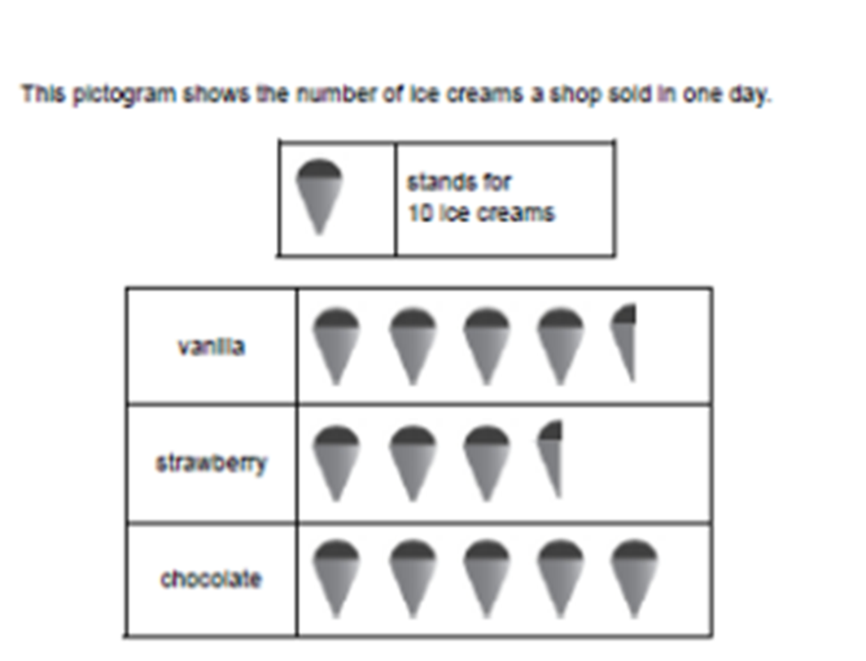
Which is the most popular flavour?
Which is the least popular flavour?
How many ice creams did the shop sell altogether?
How many more chocolate ice creams were sold than strawberry?
How many fewer vanilla ice creams
were sold than chocolate?
Chocolate
Strawberry
45
45 + 35 + 50 = 130
35
50 – 35 = 15
50
50 – 45 = 5

Slide 9
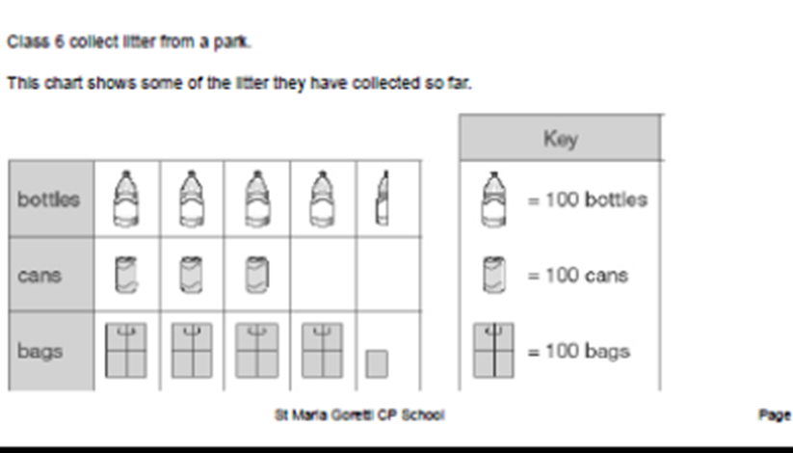
How is the data in this pictogram different to the others we have looked at?

Slide 10

What will half a bottle represent?
What will a quarter of a bag represent? How do you know?

Slide 11
How many bottles were collected?
How many cans were collected?
How many bags were collected?
How many more bags were collected than cans?
450
300
450
300
425
425
125

Slide 12
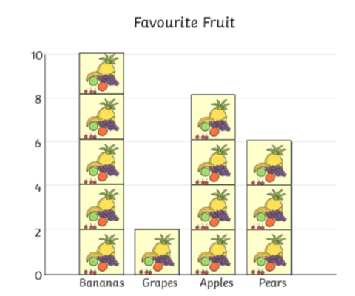

Slide 13
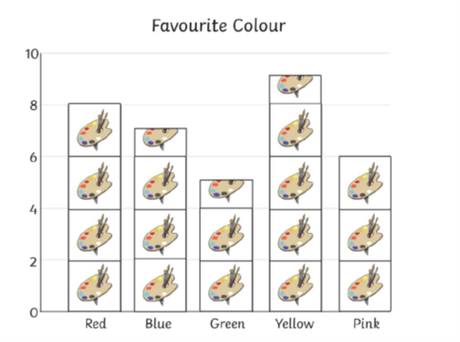

Slide 14
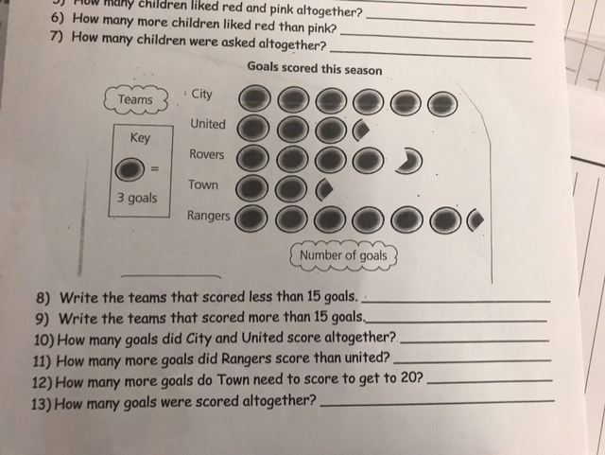

Slide 25
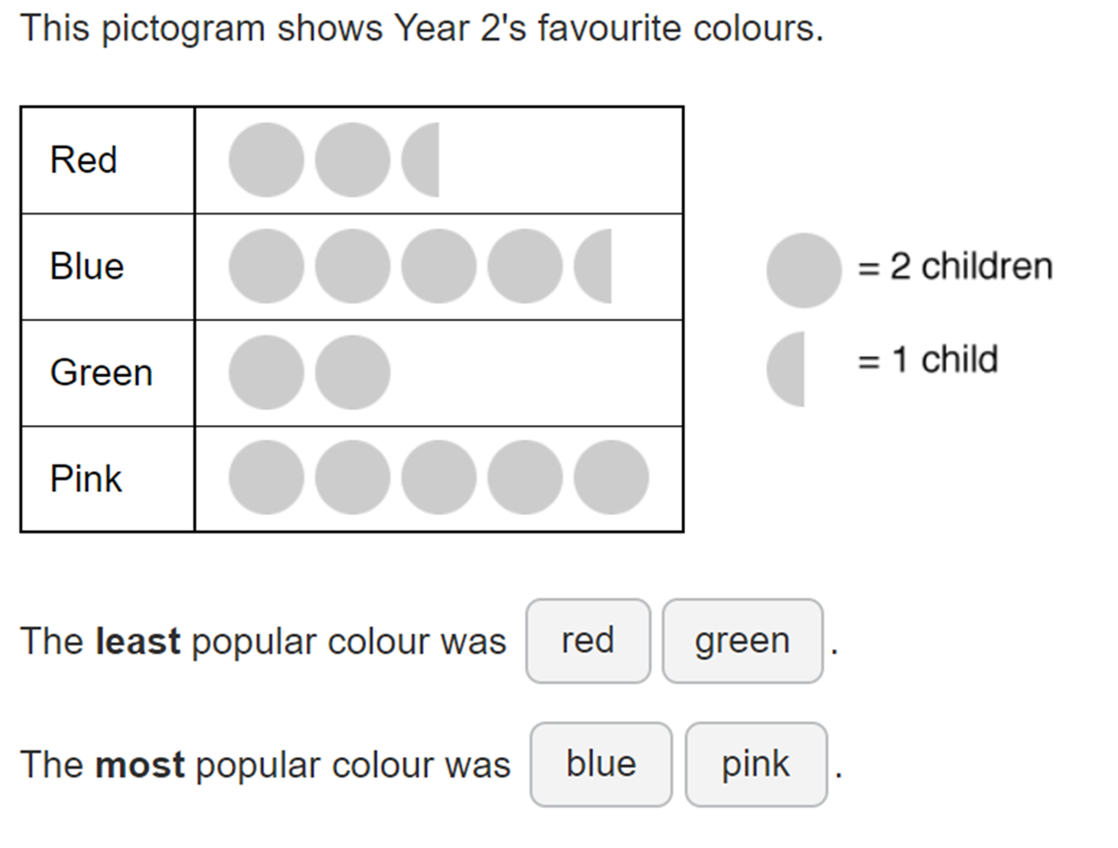

Slide 26






Ron, Amir and Alex record the scores of six football matches. Unfortunately,
Ron spilt paint on them.
Record the results based on
what the children remember.
Match | Number of goals = 2 goals
1
2
3
4
5
6
Match 1 had 3 more goals than match 3
Match 6 had 1 less goal than match 2
Match 4 had twice as many goals as match 3

Slide 27





Whitney and Teddy are making pictograms to show how many chocolate eggs each class won at the fair.
What’s the same and what’s different about them?
Whose pictogram do you prefer and why?
KEY: $=$ 5 eggs
KEY: $=$ 10 eggs
Class | Number of eggs
1
2
3
4
5
6
Class | Number of eggs
1
2
3
4
5
6

Slide 28
24.11.20
Can I present data in a pictogram?

Slide 29
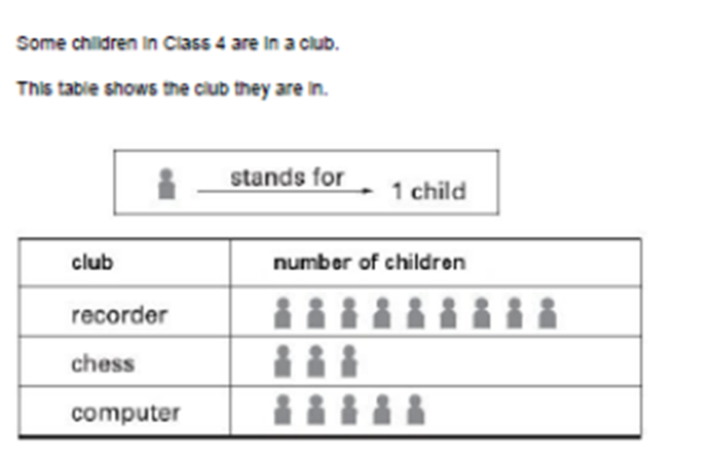
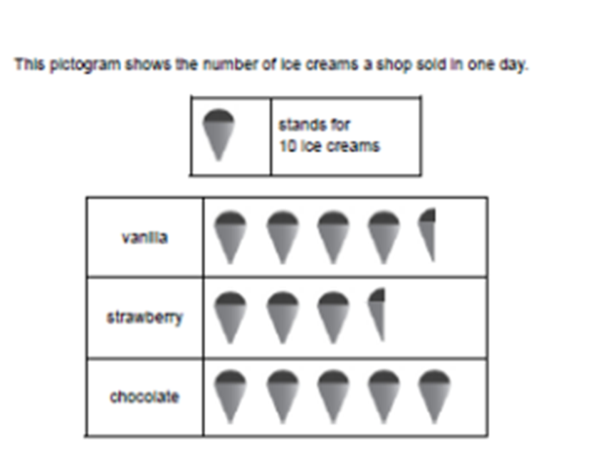
Yesterday we looked at data presented in a pictogram. What was a pictogram?
A pictogram uses pictures to present data that had been collected.
It is important to look at the value of the picture in the key.

Slide 30
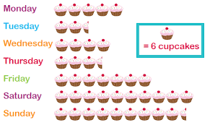
This is another pictogram. What data is being presented?
What does 1 cake represent? What does half a cake represent?

Slide 31

How many cupcakes were sold on Monday?
6 x 5 = 30
How many more cakes were sold on Friday than Wednesday?
42 – 24 = 18
How many fewer cakes were sold on Tuesday than Saturday?
60 – 15= 45

Slide 32
Today we are going to make our own pictograms using some data already collected?
Our pictograms will be about favourite ice cream flavours.

Slide 33





Ice Cream flavour | Number of ice creams bought
Vanilla | 6
Strawberry | 4
Chocolate | 5
Mint choc chip | 1
Stands for every 2 bought
Vanilla
Strawberry
Chocolate
Mint choc chip

Slide 34
What was the most popular flavour bought?
What was the least popular flavour bought?
How many more vanilla ice creams were sold than mint choc chip?
Stands for every 2 bought
Vanilla
Strawberry
Chocolate
Mint choc chip

