Slide 1
Monday 11th January 2021
Can I identify the different seasons in the Liturgical year?
Write the date and objective neatly in your home learning book.

Slide 2
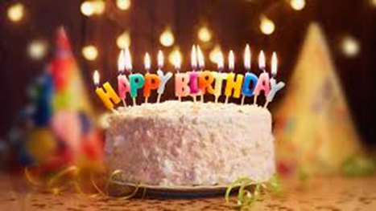


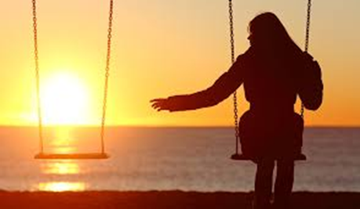
Last week we looked at our journey through the new year identifying the good times and difficult times.

Slide 3



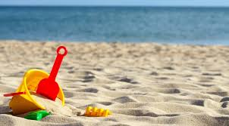
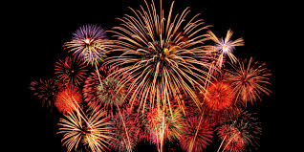


Slide 4
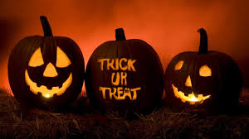

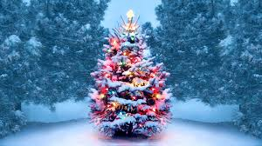

Slide 5
We talked about the following questions.
What will the highlights of your year be?
Who is with you on your journey?
What makes it a good journey?
What difficult times might there be?

Slide 6
We planned our journey through 2021 and wrote down the things we were looking forward to. Can you remember what you wrote?
January
February
March
April
May
June
July
August
September
October
November
December

Slide 7
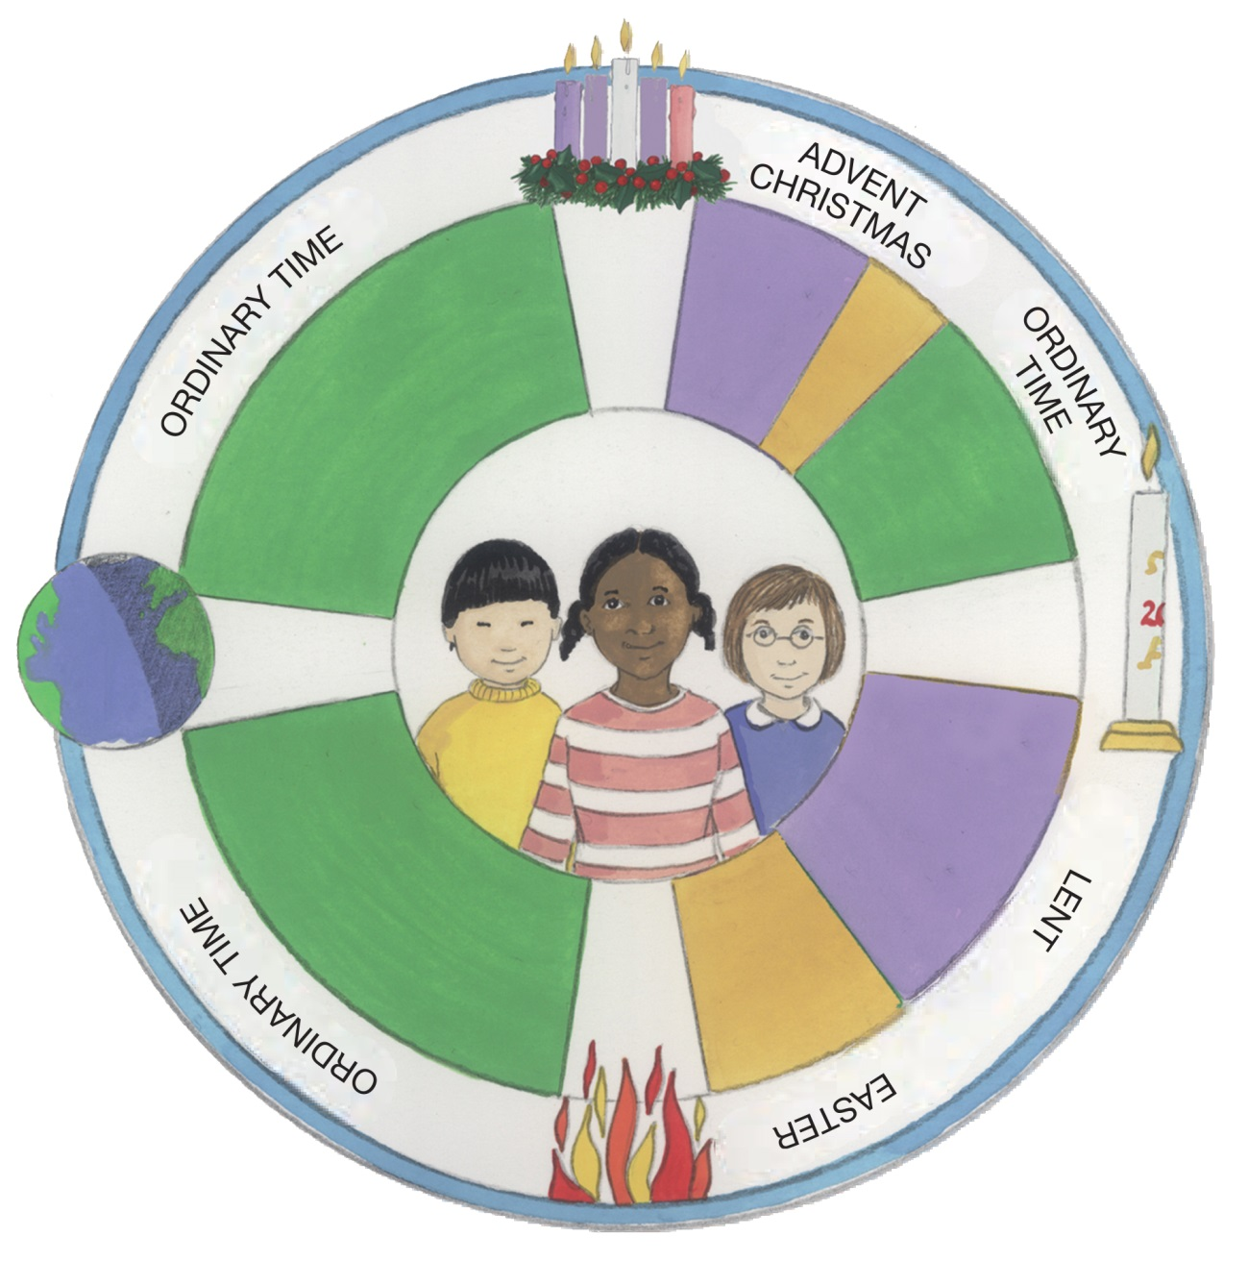
What do you think this is? Do you recognise anything?

Slide 8
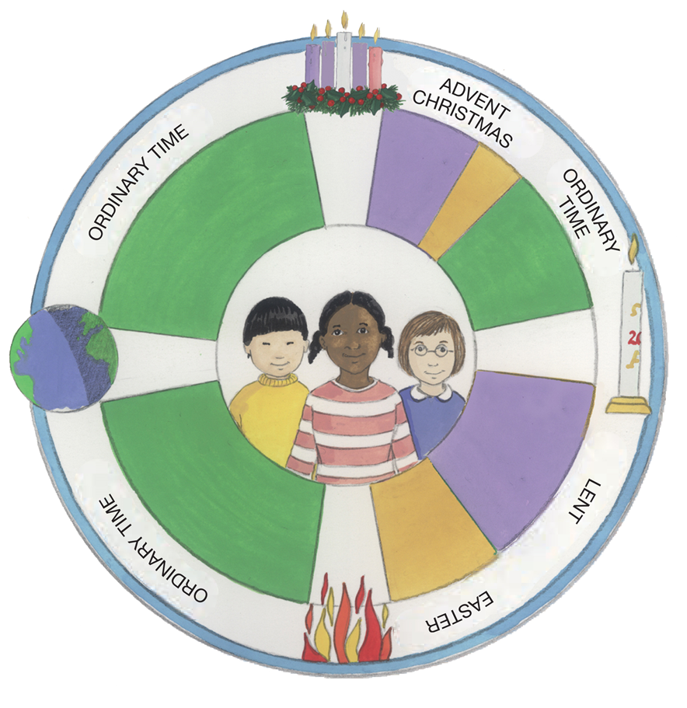
This is called a Liturgical calendar. This calendar marks out the special events and seasons in the Church year. What symbols can your see?
Advent wreath
Easter candle
Earth
This is the church’s journey through the year.
Flames

Slide 9

The year of the Church family is marked by special events and seasons. It is called the Liturgical Year. It begins with the first Sunday of Advent and ends with the feast of Christ the King. The word liturgical means the Church family’s celebration and remembrance of the journey of Jesus when he lived on earth, his death and Resurrection.

Slide 10
It is a calendar of Sundays, feast days and special seasons which are celebrated during one year. A feast day is a day set aside by the Church family to celebrate an event in the life of Jesus, Mary his mother or a saint.
Liturgy is the actions and words of the prayer and worship the Church family offers to God.

Slide 11
The Liturgical Year helps Christians to be close to the work of the Trinity, God the Father, Son and Holy Spirit, throughout the seasons of the year. It brings the Church family together as everyone shares in the celebrations. Following the celebrations Christians are sent out to love and serve God in the world.

Slide 12
Colours help us follow the journey through the Liturgical year.

Slide 13

White
White is displayed at Christmas, Trinity Sunday and All Saints’ Day. It is used at happy events, such as weddings and baptisms. White symbolises purity and holiness (being close to God). It also shows respect and honour.

Slide 14

Red
Red is used during most of Holy Week and Pentecost. Red is a symbol of the fire that appeared on the disciples’ heads at Pentecost and also reminds Christians of Jesus’ blood when he died.

Slide 15
Purple
Purple is used during Advent and from Ash Wednesday until the day before Holy Week. Purple symbolises Jesus’ title of the King of kings.

Slide 16
Green
Green is displayed from the day after Candlemas until Shrove Tuesday, and also from the day after Pentecost until the day before All Saints’ Day. Green is a symbol of life and reminds Christians that Jesus rose from the dead.

Slide 17
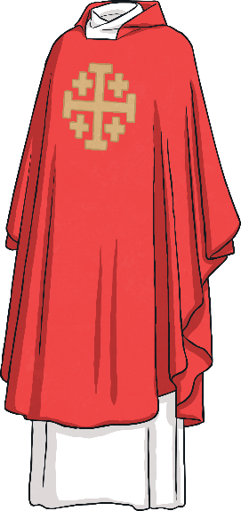


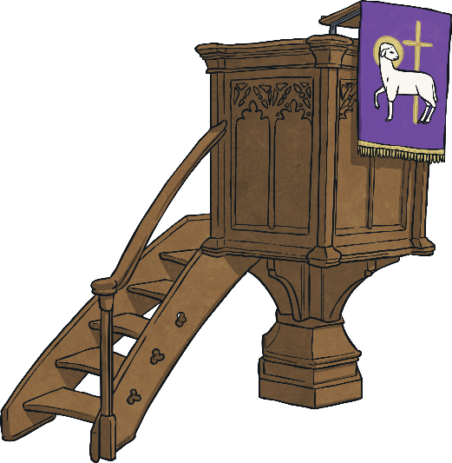
Colours in Church
Colours are displayed in different areas in a church.
Click on the picture to find out more.
Cross
(with a piece of
material draped around it) –
A symbol of Jesus’ death on the cross.
.
Vestments –
Robes worn by a priest.
Pulpit –
Where the priest stands
to read the Bible.

Slide 18
Task
If you can, print off the liturgical wheel on the next slide (or the one attached to this lesson) and colour in each section the correct colours of the liturgical year.
If you have no printer, draw around something circular (a bowl or dish) and in your home learning book make your own liturgical wheel.

Slide 19
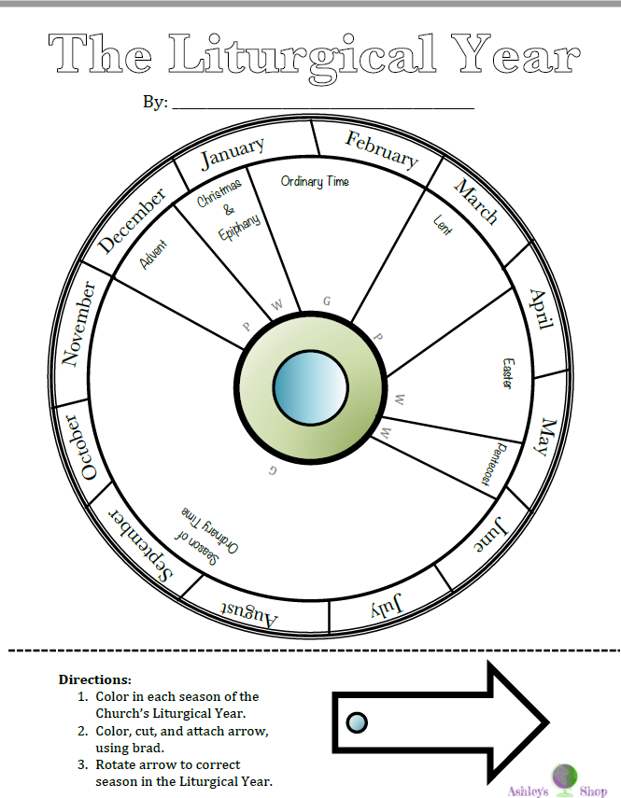

Slide 20
Can you find out what we celebrate in each season of the Liturgical Year?
Advent
Christmas
Ordinary time
Lent
Easter Triduum
Use the internet to help you and write your answers neatly in your home learning book (you will need these for the next RE lesson) You can use the information on the next slide too.

