Slide 1
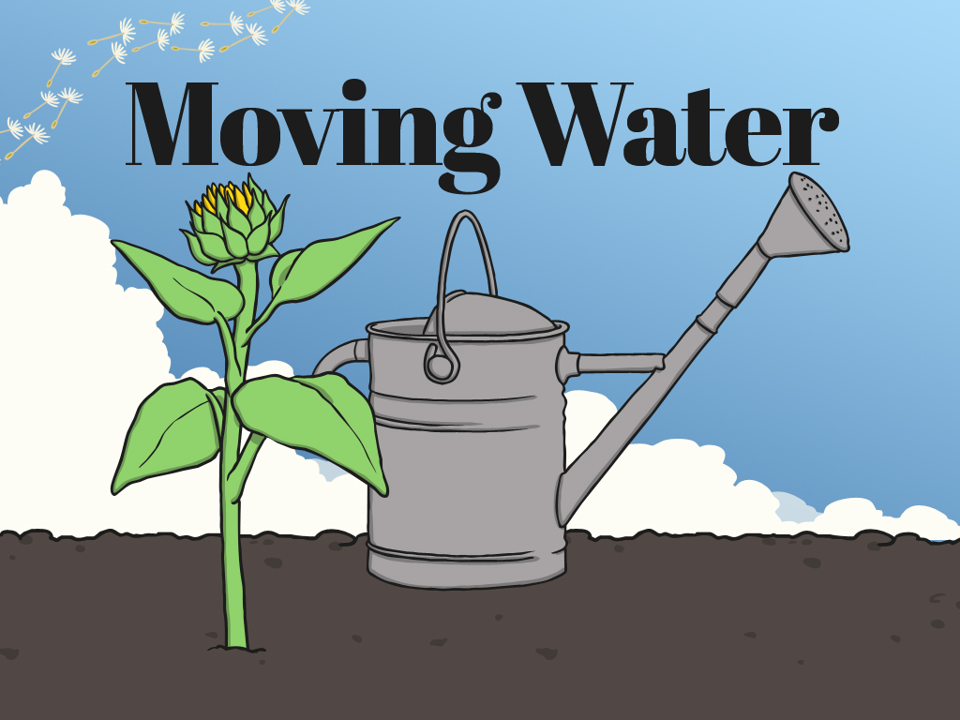


Slide 12
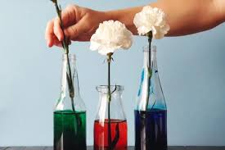
Or you could try and set up an experiment using carnations.
Observe what happens to the white carnations if you put them in different coloured food dyes.
Write up your observations.

