Slide 1

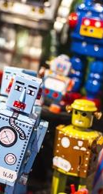
The Psychology of Robots
Science Lesson
Year 3 & 4
With Robopsychologist – Dr Sarita Robinson
This talk was funded by UCLan Engage
Join Robopsychologist, Dr Sarita Robinson, as she explores what makes a robot friendly like BB-8, and not scary like the Daleks.
In this session you will also learn about the history of Robotics, the ways in which robots are used in today’s world, and what the robots of the future might look like.

Slide 2
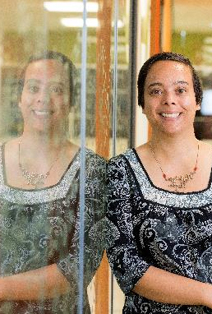
Special Robots Science Lesson.
Run by Dr Sarita Robinson from UCLAN
This lesson will be live on zoom. Just click on this link at 10.50am. Don't be late! Join Zoom Meeting: https://zoom.us/j/93149647077?pwd=RUwzOWxMcUcwOFppV1RsNTRiNmd1UT09 Meeting ID: 931 4964 7077 Passcode: 543481 How exciting everyone!

