Slide 1
Spelling – Using were, where, we’re and wear correctly

Slide 2
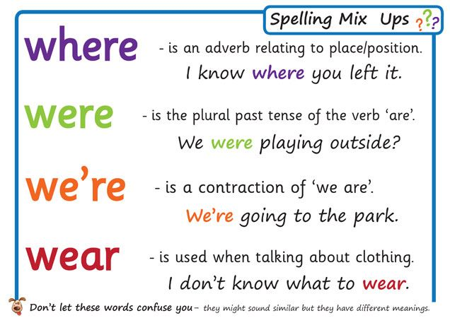

Slide 4
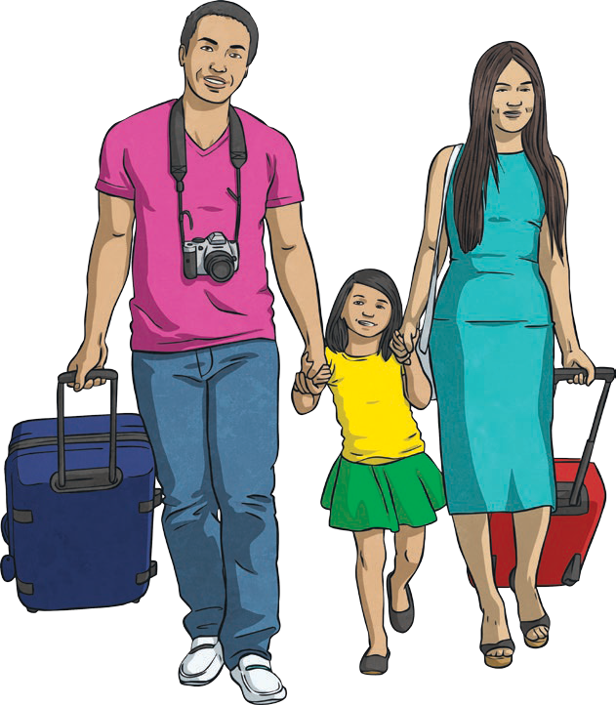
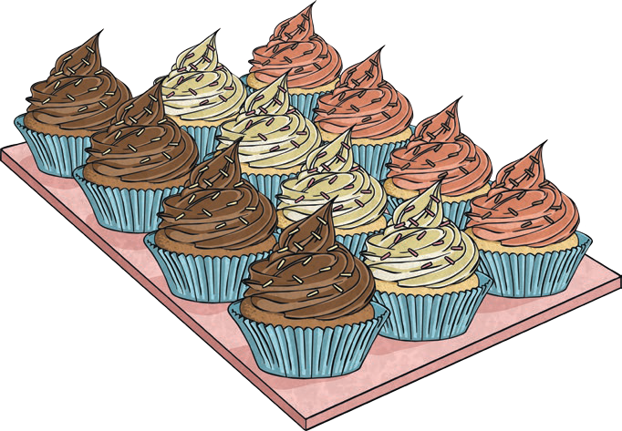
Were
There were lots of cakes at the party.
They were going on their holiday.

Slide 5
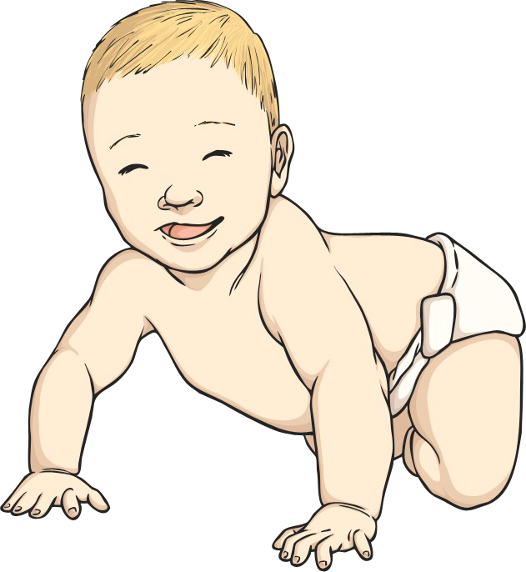

Where
Where are dad’s books?
This is where I was born.

Slide 6
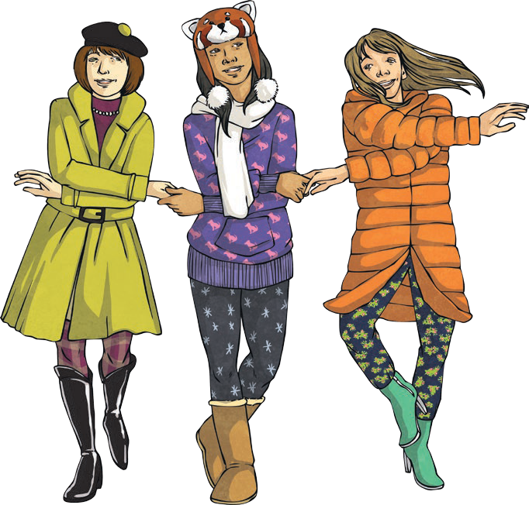
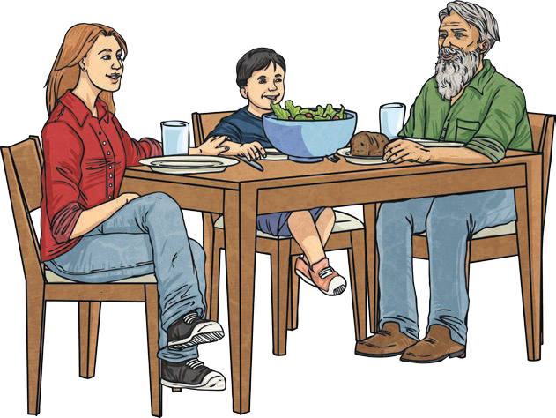
We’re
We’re all friends.
We’re eating our dinner.

Slide 7
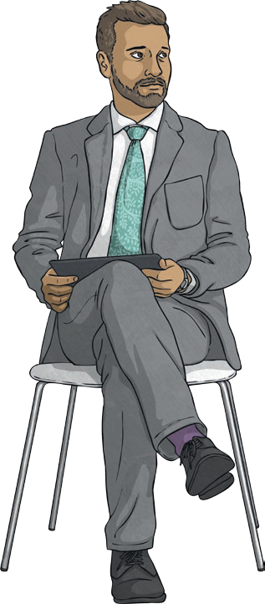
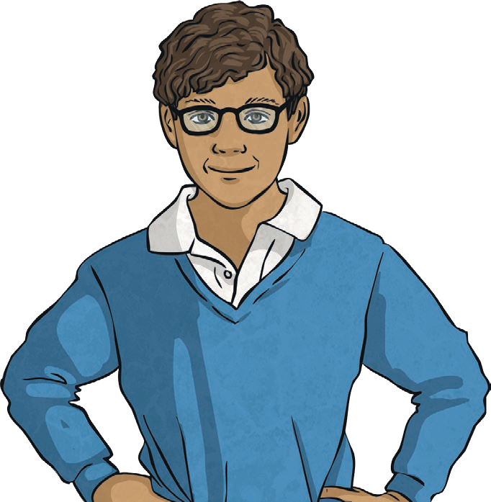
Wear
I wear a uniform for school.
My dad wears a suit.

Slide 8
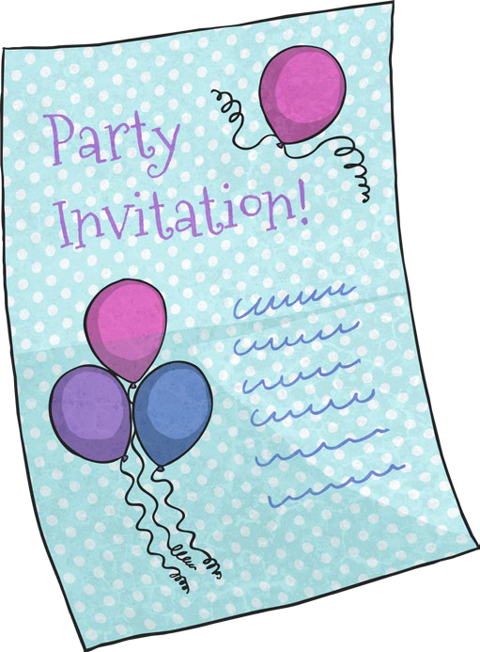
Were, Where, We’re and Wear
My friends were just telling me that we’re going to a party where we have to wear pink wigs!

