Slide 1
Spelling – Adding ly to words ending in ic and al

Slide 3
Learn to spell these words.

Slide 4
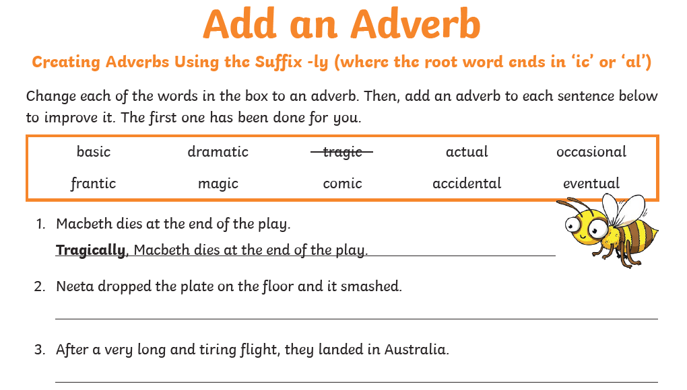

Slide 5
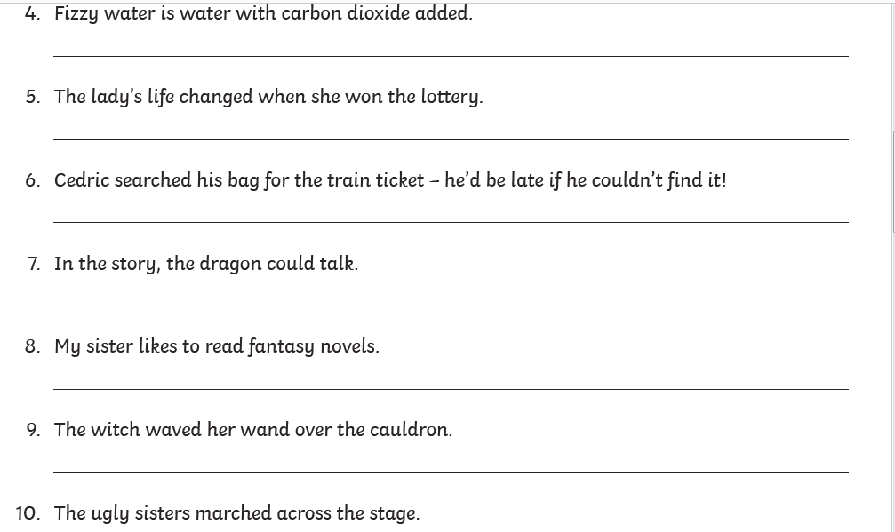

Slide 6
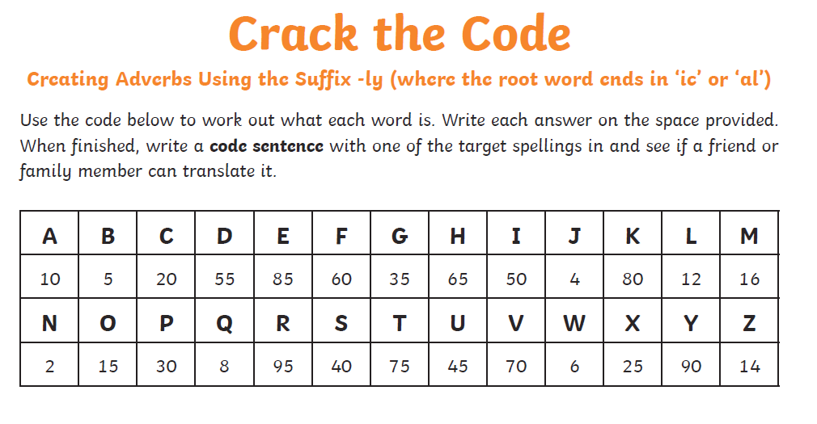

Slide 7
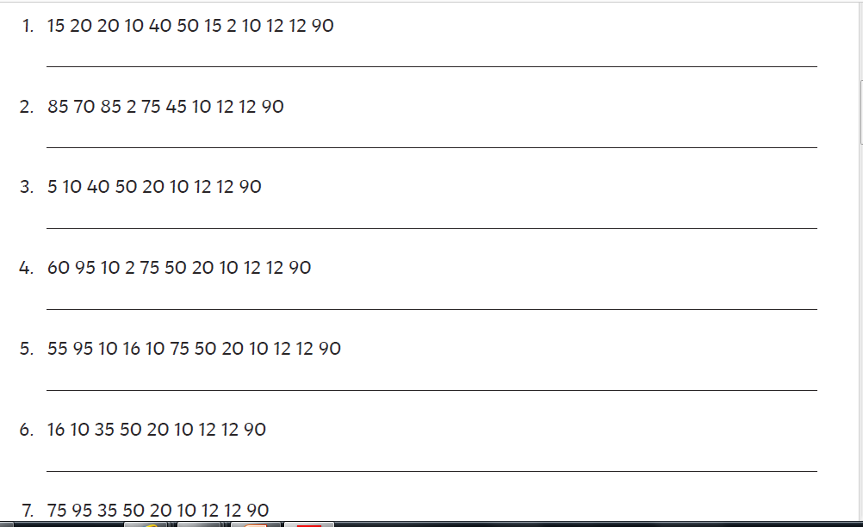

Slide 8
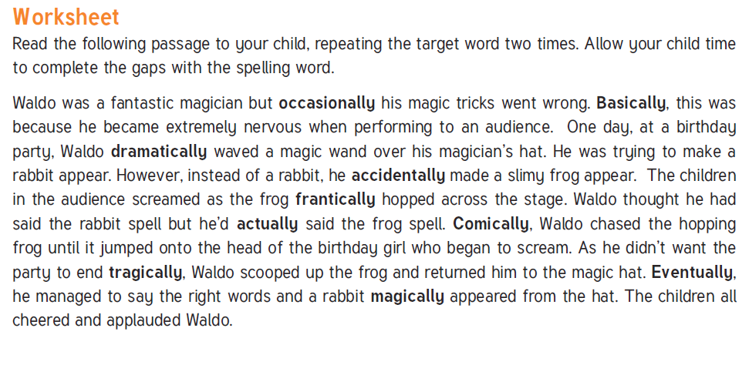

Slide 9
